Slide 1
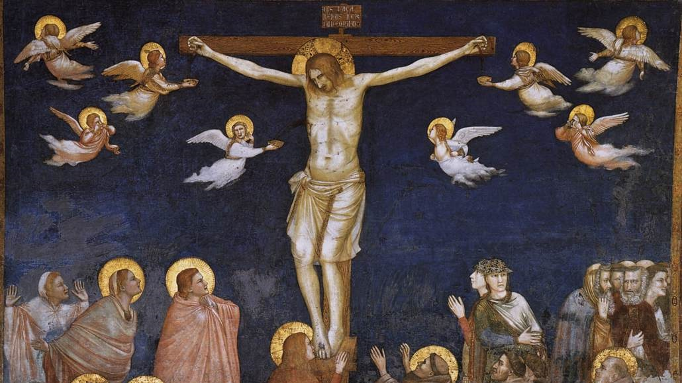
Stations of the Cross
Turnbull High School
BGE
Notes:
Background- According to St Alphonsus (Who's Stations of the Cross Meditations this PowerPoint is based on) in His 'Glories of Mary', before her Assumption body and soul into heaven, Our Lady spent her remaining years in prayer, longing to be reunited with Her son and Lord. In addition to receiving Him into Herself in Holy Communion (Think of what it must have been like for Our Lady, full of grace, to receive the Lord into Her body again, in a way a repetition of the Annunciation- maybe we could think about this when receiving the Lord ourselves, always seeking to receive Him more worthily.) She would visit the places in which the events of His life had taken place- not least the journey of the Passion. Christians from the beginning, have visited the stable in Bethlehem and the sites of the passion, and over centuries, many have made the pilgrimage to the Holy Land to stand where the Saviour's feet stood and where His blood watered the soil. Over time, as that part of the world became more dangerous, a group of Franciscans followed the example of their founder, St Francis who created the nativity scene, by creating little outdoor shrines, each one focusing on a 'station' of Jesus' journey to Calvary (the hill where Jesus was crucified.) Since that time, it has become standard for Catholic churches to have stations of the cross around the walls so that the faithful can travel to those places in their hearts, and live the passion as if they were there. Today, we will use art depicting the stations of the cross to help us to travel in our imagination and in our hearts all the way to the holy land. We will step outside of time and into the permenant present of God's presence. Let us meditate on the great price of our sins and the immense love that God has for us. Rather than punishing us, first he has loved us, gave up his throne in heaven, became one of us so that through his suffering, death and resurrection he might lift us up to heaven.
Preparatory Prayer
Lord Jesus, You made this journey to die for me because of your great love, even though I don’t always love you as I should. But now I love you with my whole heart and I’m sorry for all my sins. Forgive me, Jesus, and let me take this journey of the cross with you. As you died for love of me, I would die for love of you. In life and death I want to always be with you.

Slide 3
Notes:
Station 1: Jesus is condemned to death V: We adore you, O Christ, and we praise you. R: Because by your holy cross you redeemed the world.
Reﬂection: After Jesus was whipped and crowned with thorns, the judge Pilate said he had to die on the cross, although he had done nothing wrong.
Prayer: It was not just Pilate who made you die, Lord, it was my own sins. You died so that I could be with you in heaven. I love you Jesus, more than I love myself. I am sorry for my sins with all my heart. Please help me never be separated from You. Help me love you always and then do with me what you will. Glory Be

Slide 5
Notes:
Station 2: Jesus is made to carry His cross V: We adore you, O Christ, and we praise you. R: Because by your holy cross you redeemed the world.
Reﬂection: As Jesus started His journey with the cross on His shoulders, He thought of us, knowing He was going to save us.
Prayer: Lord Jesus, I will have hard things to do in this life. Please make me strong so that I can do all things with patience and do them well. I am sorry for my sins with all my heart. Please help me never be separated from You. Help me love you always and then do with me what you will. Glory Be.

Slide 7
Notes:
Station 3: Jesus Falls the First Time V: We adore you, O Christ, and we praise you. R: Because by your holy cross you redeemed the world.
Reﬂection: Jesus’ body was weak. He had been beaten and crowned with thorns. He almost couldn’t walk with the heavy cross on His back. The soldiers continued to hit Him and He fell several times on His journey.
Prayer: Dear Jesus, the cross must have been so heavy but it was my sins which hurt you most. By your love during the first fall,
please help me not to fall in sin. I love you, Jesus, with all my heart. I’m sorry for all of my sins. Help me love you always and then do with me what you will. Glory Be

Slide 9
Notes:
Station 4: Jesus meets His Sorrowful Mother V: We adore you, O Christ, and we praise you. R: Because by your holy cross you redeemed the world.
Reﬂection: Jesus met His mother on His way to the cross. He looked at Mary and Mary looked at Him. Their hearts were hurt, as with arrows, because of the great love between them.
Prayer: Most loving Jesus, by your sadness when you met your mother, give me the grace to love your mother too. Mary, my queen, by your sorrow when you met your Son, pray for me that I will always remember Jesus’ love poured out on the cross. I love you, Jesus, and I’m sorry for my sins. Help me never to sin again. Help me love you always and then do with me what you will. Glory Be

Slide 11
Notes:
Station 5: Simon of Cyrene Helps Jesus to Carry His Cross
V: We adore you, O Christ, and we praise you. R: Because by your holy cross you redeemed the world.
Reﬂection: The Jews noticed that Jesus was weak and would die soon. But they didn’t want him to die on the way, they wanted him to die on the cross. So they made a man named Simon help him carry the cross.
Prayer: Sweet Jesus, Simon did not want to carry the cross with you, but I would. I will accept whatever hard things you have for me, even to my death, so that I can be with you. You died because you loved me, and I would die for you. I love you, Jesus, and I’m sorry for my sins. Help me never to sin again.Help me love you always and then do with me what you will. Glory Be.

Slide 13
Notes:
Station 6: Veronica Wipes the Face of Jesus V: We adore you, O Christ, and we praise you. R: Because by your holy cross you redeemed the world.
Reﬂection: The holy woman, Veronica, saw that Jesus was covered with sweat and blood. She gave him a cloth to wipe his face. When she got the cloth back, the dirt, blood and sweat had made a picture of his face.
Prayer: Beloved Jesus, your face was beautiful before, but then it was made dirty and ugly. My soul was also beautiful when I was baptized, but I have it made it ugly with my sins. You alone can make it beautiful again. By your sacrifce, O Jesus, make my soul beautiful again. I am sorry for all of my sins. Help me never to sin again. Help me love you always and then do with me what you will. Glory Be.

Slide 15
Notes:
Station 7: Jesus Falls the Second Time
V: We adore you, O Christ, and we praise you. R: Because by your holy cross you redeemed the world.
Reﬂection: Jesus fell under the cross a second time. When he fell, our Lord felt all of his cuts and pains again.
Prayer: Gentle Jesus, how many times have you forgiven me? And how many times have I fallen into sin again? By your fall, help me keep living in your grace until I die. When I’m tempted to sin, may I ask for your help. I love you, Jesus, with all of my heart. I’m sorry for all of my sins. Help me never to sin again. Help me love you always and then do with me what you will. Glory Be.

Slide 17
Notes:
Station 8: The Women of Jerusalem Weep over Jesus
V: We adore you, O Christ, and we praise you. R: Because by your holy cross you redeemed the world.
Reﬂection: The women saw Jesus, hurt and bloody, and they felt great sadness for him as he walked along. But Jesus said to them, “Weep not for me, but for your children.”
Prayer: My Jesus, I am very sad for my own sins against you, you who loves me so much. Because I love you, I am sad that my sins have hurt you. My Jesus, I love you more than myself. I am sorry for all of my sins. Help me never to sin again. Help me love you always and then do with me what you will. Glory Be

Slide 19
Notes:
Station 9: Jesus Falls for the Third Time
V: We adore you, O Christ, and we praise you.
R: Because by your holy cross you redeemed the world.
Reﬂection: Jesus fell for the third time. He was weak and the
soldiers were mean. They tried to hurry him when he was barely
strong enough to move.
Prayer: Jesus, by your weakness on the way to the cross, give me
strength so that I will never care what other people think about me
if it takes me away from you. I love you, Jesus, with all my heart.
I’m sorry for all of my sins. Help me love you always and then do
with me what you will.
Glory Be.

Slide 21
Notes:
Station 10: Jesus is Stripped of His Clothes
V: We adore you, O Christ, and we praise you. R: Because by your holy cross you redeemed the world.
Reﬂection: The soldiers tore off Jesus’ clothes. They did not care that they hurt him again. And yet the Saviour loved them.
Prayer: Innocent Jesus, by your pain, help me get rid of all the things that I might care about more than you, so that I can love you above all. You are the only one who deserves all of my love. I love you, Jesus, with all my heart. I’m sorry for all of my sins. Help me never to sin again. Help me love you always and then do with me what you will. Glory Be.

Slide 23
Notes:
Station 11: Jesus is Nailed to the Cross
V: We adore you, O Christ, and we praise you. R: Because by your holy cross you redeemed the world.
Reﬂection: When they threw Jesus down on the cross, Jesus stretched out his arms and offered His life to God to save us. They nailed him on the cross and then lifted up the cross to let him die.
Prayer: Dear Jesus, take my heart, full of love, to the cross with you, so that it will be with you always. I love you more than myself.
I’m sorry for all of my sins. Help me never to sin again.
Help me love you always and then do with me what you will. Glory Be

Slide 25
Notes:
Station 12: Jesus is Raised upon the Cross and Dies
V: We adore you, O Christ, and we praise you. R: Because by your holy cross you redeemed the world.
Reﬂection: Jesus hung on the cross for three hours. Finally, he let go of his body, bowed his head, and died.
Prayer: O Jesus, I kiss the cross on which you died for love of me. Because of my sins, I am the one who should have died. But your death is my hope. By your death, Jesus, give me the grace that, when I die, I will be full of love for you. My soul is in your hands. I love you, Jesus, with all my heart. I’m sorry for all of my sins. Help me never to sin again. Help me love you always and then do with me what you will. Glory Be

Slide 27
Notes:
Station 13: Jesus is Taken Down from the Cross and Placed in the Arms of His Mother
V: We adore you, O Christ, and we praise you. R: Because by your holy cross you have redeemed the world.
Reﬂection: After Jesus died, two of his friends, Joseph and Nicodemus,
took his body off of the cross.
They placed him in the arms of his mother, who held him with great love.
Prayer: Mother of Sorrows, for the love of your son, accept me as your servant, and pray to Him for me. Jesus, you died for me. Let me love you because you are all that I want. I’m sorry for all of my sins. Help me never to sin again. Help me love you always and then do with me what you will. Glory Be.

Slide 29
Notes:
Station 14: Jesus is Laid in the Tomb
V: We adore you, O Christ, and we praise you. R: Because by your holy cross you have redeemed the world.
Reﬂection: The discipled carried Jesus’ body to bury it. His holy mother arranged his body gently as it lay. Then they closed the tomb and went away.
Prayer: Jesus, I kiss the stone that lays over your tomb. But you rose on the third day. By your resurrection, make me rise with you on the last day and be with you forever in heaven, to praise you and love you always. I love you and I’m sorry for all of my sins. Help me never to sin again. Help me love you always and then do with me what you will. Glory Be

Slide 30
Notes:
Final Prayer
Kind, sweet Jesus, I kneel before you. With all my soul, I pray that you help me have faith, hope and charity, as well as true sorrow for my sins, and the plan to do better. I think with love about your five wound on your hands, feet and side and remember the words of the prophet David, “They have pierced my hands and my feet, they have numbered all my bones.” Our Father and Hail Mary.

