Slide 1
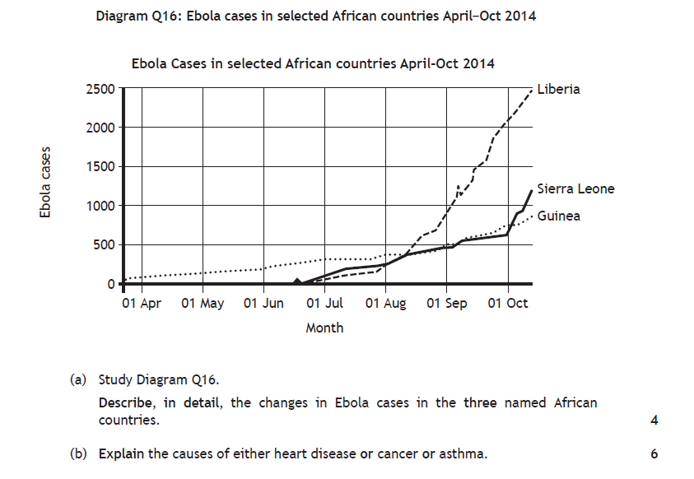
Specimen 17/18

Slide 2
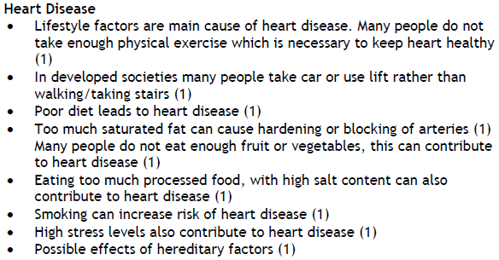

Slide 3
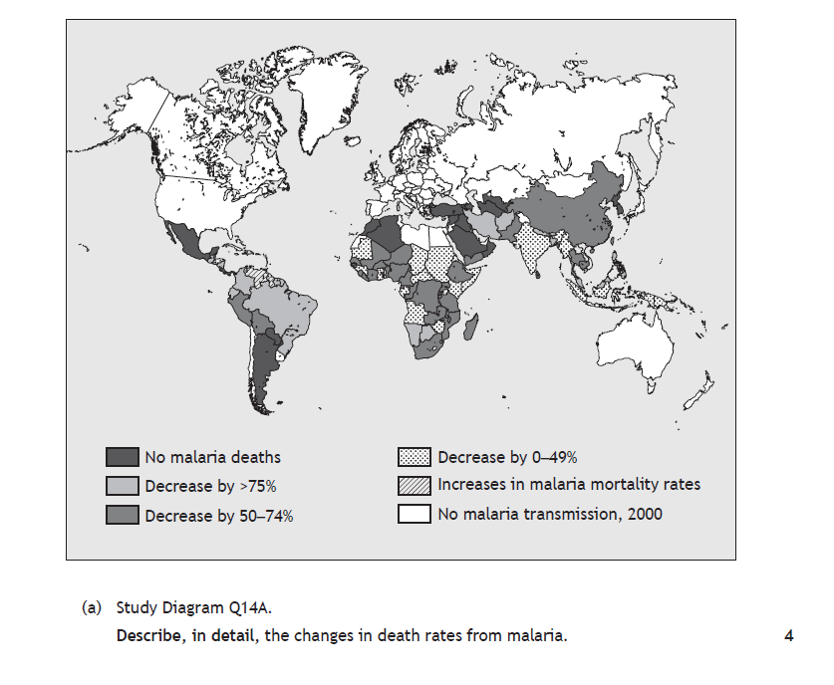
N5 2017

Slide 4
Mostly there has been a global reduction in worldwide mortality rates from malaria (1),
although in South America countries such as Surinam and Venezuela have experienced an increase since 2000 (1).
In Brazil and Peru, the mortality rates have decreased by 75% since 2000 (1) and in Argentina the disease appears to have been eliminated since 2000 (1);
in Africa most countries have experienced a reduction of between 0% and 74% (1); Nigeria and Kenya are both in this category (1);
In SW Africa, countries such as Namibia and Botswana have had a reduction of over 75% in malaria mortality (1). Or any other valid point.

Slide 6
Malaria happens when the parasites injected into the bloodstream by mosquitoes migrate to the liver, multiply and break out in a new form to attack the red blood cells (1); this causes the victim to become seriously ill and if not treated can result quickly in death (1)
Symptoms usually start after about a week to 10 days and can include fever, shaking, chills, sickness, vomiting and muscle pains (1).
Children under 5 are often worst affected because they have built up less resistance than adults (1); malaria can recur and so people may often experience several bouts of illness (1); this has a very serious economic effect on their families as if they cannot work they may lose income (1);
as a result, families may not be able to afford to send their children to school, so they lose out on education (1); their income may be so low that they cannot afford sufficient food and so malnutrition and hunger can also be a problem (1);
crops may be left unharvested in the fields because farm workers are too ill to gather them in (1);
The whole economy of a malaria affected country can suffer because of low productivity, as much of the workforce is frequently off sick (1);
few tourists want to visit the country because of the threat from malaria, further hitting the country economically (1).

Slide 7
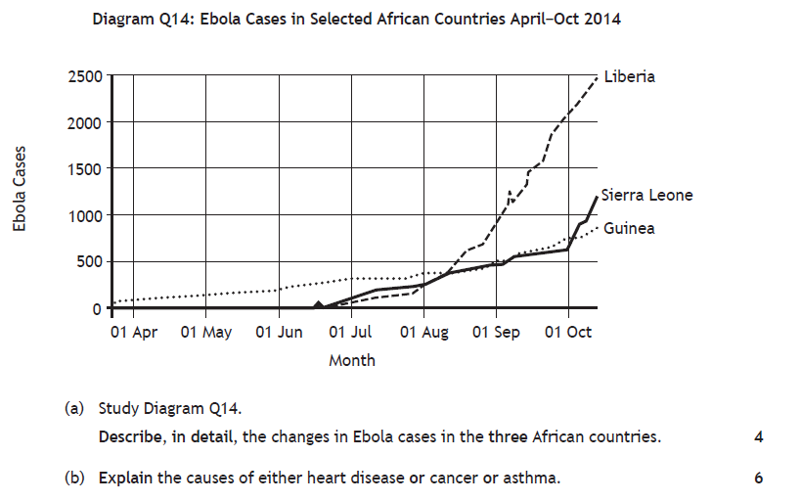
N5 2016

Slide 8
In April 2014 there were few cases of Ebola in Africa. By October 2014 there were almost 2500 cases in Liberia (1).
In Sierra Leone there were almost 1,200 cases by October 2014 (1).
In Guinea there were around 800 cases by October 2014 (1).
In Liberia cases rose rapidly from around 250 in August 2014 to around 2500 by October 2014 (1).
Sierra Leone witnessed a rapid increase in cases from around 500 cases on October 1st 2014 to almost 1200 by mid October 2014 (1).
Lifestyle factors are the main cause of heart disease. Many people do not take enough physical exercise which is necessary to keep the heart healthy (1).
In developed societies many people take the car or use the lift rather than walking/taking the stairs (1).
Poor diet also leads to heart disease (1). Too much saturated fat can cause hardening or blocking of the arteries (1).
Many people do not eat enough fruit or vegetables, this can contribute to heart disease (1).
Eating too much processed food, with a high salt content can also contribute to heart disease (1).
Smoking can increase the risk of heart disease (1).
High stress levels also contribute to heart disease (1).
Possible effects of hereditary factors (1).

Slide 9
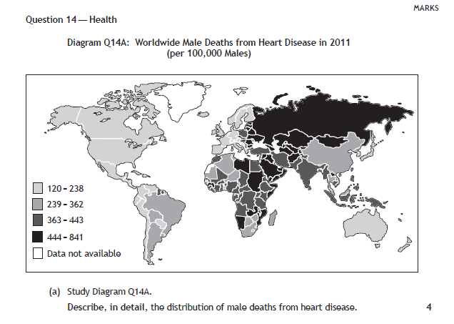
N5 2015
Male deaths from heart disease are most common in Eastern Europe (1).
Russia for example, has a rate of 444-841 per 100,000 (1). This compares
to only 120-238 in the UK (1). Canada, the USA and Mexico have some of
the lowest rates (1), with under 120-238 per 100,000 (1). Many central
African countries have rates of 363-443. (1)
Or any other valid point.

Slide 10
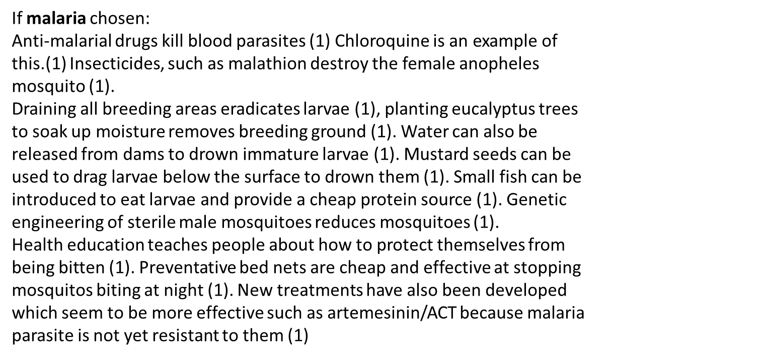

Slide 11
N5 2014
Notes:
2014

Slide 12
One mark for a valid point and 2 for a developed point.
For full marks reference must be made to developed and developing countries. (Otherwise maximum of 5 marks)
Health Education programmes have been introduced to limit the spread of AIDS in Developing and Developed countries (1).
ARV drugs are also more freely available (1).
Condoms are available for free (1) and TV and Radio advertising has been used to get the message across (1).
Agencies such as the World Bank have made funding available to Developing Countries to tackle the disease (1).
In Developed Countries, needle exchanges (1) and drug therapy programmes (1) have been introduced.

Slide 13
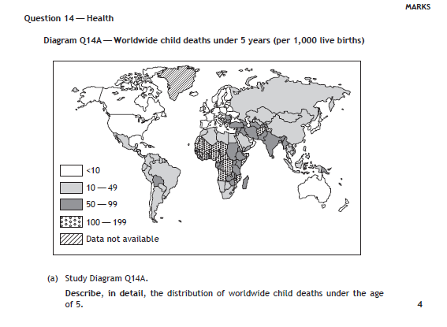
N5 2014
Notes:
2014

Slide 14
One mark for each valid point. Two marks for a developed point.
Maximum of 2 marks if no reference to figures.
More children under the age of 5 die in developing countries (1).
African countries have the most number of child deaths under the age of 5 (1). Many African countries have between 100-199 child deaths under the age of 5 (1) eg Sudan (1).
There are mostly between 10-49 child deaths per 1,000 in Asia (1) eg Russia and China (1).
There are typically between 10-49 child deaths under the age of 5 in South America (1) except Bolivia (1) which has between 50-99 (1).
The continents of North America and Europe have the least number of child deaths (1).
There are less than 10 child deaths under the age of 5 in many developed countries (1) eg UK (1).
Or any other valid point

Slide 15
(b) Describe ways that HIV and Aids can be transmitted in developing and developed countries
4
c) Explain the consequences HIV and Aids can have on the people and economy of a country 6

Slide 16
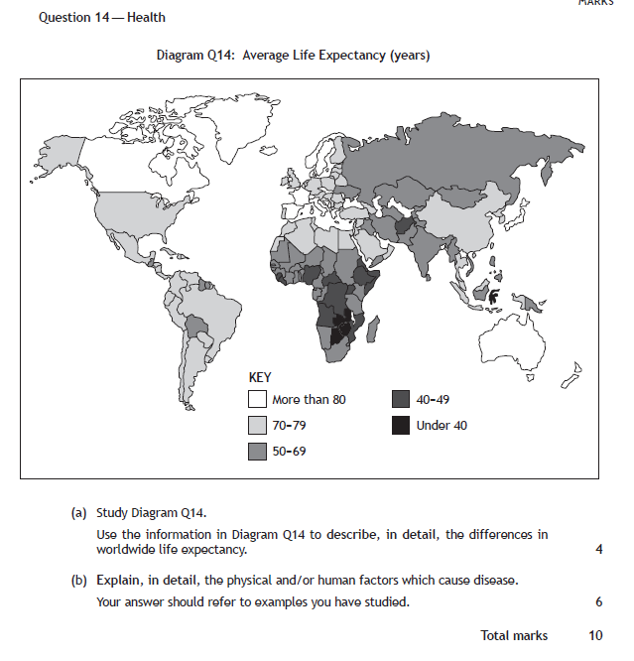
Notes:
Specimen

Slide 17
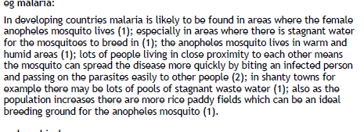

Slide 20
(b) (i) Heart disease – inability to work (1) and lower life expectancy (1).
Increased health costs (1), more hospital beds needed (1). Children can
inherit heart disease from parents (1).
Malaria – large numbers of children die at an early age (1), adults unable
to work (1), lower productivity (1), limited resources used up on health
care (1) hindering development (1).
Or any other valid point. 4 marks
(ii) Heart disease – people are now eating a better diet (1), the amount of milk,
butter and other fatty products has dropped (1) while the sale of fruit and
vegetables has increased (1). The smoking ban has reduced smoking
levels (1) and cut down on passive smoking (1). There are more regular
check ups (1) and more advanced treatment (1) such as by-pass surgery (1)
etc.
Malaria – Drugs are too expensive (1) and the parasite has become
resistant to them (1). Insecticides are also expensive (1) and pollute the
environment (1). Draining all breeding areas is impractical (1). Bed nets
are cheap and quite effective (1). New treatments have been developed
which seem to be more effective (1) such as artemesinin/ACT (1). The
rate of malaria infection worldwide is still increasing (1).

Slide 22
b) Aids – sharing dirty needles (1), unprotected sex with infected person (1), babies drinking breast milk of infected mother (1), sharing body fluids (1) infected blood transfusions (1).
Heart disease – lack of exercise (1), overeating/drinking (1), lifestyle/stress (1), hereditary (1), eating foods high in fat (1). 4 marks
(c) Loss of workforce (1). Hinders development leading to fewer jobs (1). Costs of hospital treatment increase (1). Less wealth in country (1). Death rate increases (1). Emotional impact on relatives and friends (1). Loss of tourist revenue (1).

Slide 23
Int 2 – 2014
(b) Heart disease, malaria and AIDS are common diseases.
Choose one of these diseases. Describe:
(i) the main causes of the disease;
(ii) the consequences of the disease for the population in an affected area. 6
Answer will depend on disease chosen. Mark 2:4, 3:3 or 4:2.
Some candidates will combine answers into one. 6
Eg Heart Disease
This can be caused by high blood pressure (1). Eating fatty foods (1) which leads to high cholesterol (1) and narrowing of arteries (1) which puts a strain on the heart (1). Lack of exercise (1) and smoking (1) also increase chance of heart attack.
Or any other relevant point.
Consequences
Money has to be spent on health services for ill people (1). Many work days are lost (1). People cannot support themselves (1) and rely on outside help (1). Many premature deaths/lower life expectancy (1).
Or any other relevant point.

Slide 24
Int 2 - 2013
For either AIDS or Malaria describe:
(i) the methods which have been used to control the disease;
(ii) the effectiveness of these methods. 6
Mark 3/3 or 4/2 or 2/4
AIDS – Methods – introduction of health education programmes (1). Compulsory testing of people (1). Increased availability of ARV drugs (1). Distribution of free condoms (1). Use of radio/TV to get message over (1).
Effectiveness – Drugs available, but not enough trained staff in some developing areas (1). Isolated areas can be difficult to reach (1). Many people not aware they have the disease (1). Poor testing facilities (1). Some people avoid being tested (1). Some drugs too expensive (1). Education campaigns difficult due to illiteracy (1) and different dialects and languages (1).
Malaria – Methods – Use of insecticides (1) eg malathion (1). Use of anti-malarial drugs (1) eg chloroquine (1). Water released from dams to drown immature larvae (1). Genetic engineering of sterile male mosquitoes (1). Draining breeding sites (1). Planting eucalyptus trees to soak up moisture (1). Use small fish to eat larvae (1). Mustard seeds to drag larvae below surface to drown them (1). Health education (1) Bed nets (1).
Effectiveness – rate of malaria infection worldwide still increasing (1). Drugs are too expensive (1) and the parasite has become resistant to them (1). Insecticides also expensive (1) and pollute the environment (1). Draining all breeding ground impractical (1). Bed nets cheap and quite effective (1). New treatments developed which seem to be more effective (1) eg artemesinin (1).
Any other relevant answer. 6

Slide 25
Int 2 – 2012
Diagram Q6B: Worldwide Causes of Death 2011
(b) Study Diagram Q6B.
(i) Choose one of the diseases shown in Diagram Q6B and describe its causes. ( Heart Disease, AIDS, Malaria) 5
(ii) Describe the methods used to control the spread of either Malaria or
Heart Disease. 4
eg AIDS
AIDS can be spread by sharing needles with an infected person (1) and also by having unprotected sex with an infected person (1). It can be spread to babies who are breast fed if their mother has AIDS. The spread of AIDS is prevalent in countries where civil war has broken out (1) due to rape and sexual assault (1), for example, African countries such as Rwanda and the Democratic Republic of Congo (1). The spread of AIDS is also hastened by lack of education which means many people are unaware of the causes of the disease (1). Lack of primary health care is also a contributory factor as many people are unaware of prevention methods (1).
Or any other relevant point
5 marks
(ii) eg Malaria
Drugs are used to kill the parasite (1) eg artemesinin based drugs or larium or malarone (1). Insecticides are used to kill the mosquito (1) eg DDT (1). Swampy areas and stagnant water can be drained as this kills the immature larvae (1). Bed nets with insecticide (1) prevent the mosquito biting whilst people are sleeping (1). Education via primary health care (1) can help people to identify the risks associated with malaria and thus prevent catching it in the first place (1). Coconut shells can be placed in areas of water, the bacteria (bti) inside (1) kills the mosquito larvae (1). Fish such as Nile Tapia can be put into paddy fields to eat mosquito larvae (1). New vaccine RTS,S (1).
4 marks

Slide 26
Int 2 - 2011
b) Describe the main causes of either AIDS or heart disease. 4
(c) For malaria or AIDS, what are the consequences of the disease for the population in an affected area? 5
(b) Aids – sharing dirty needles (1), unprotected sex with infected person (1), babies drinking breast milk of infected mother (1), sharing body fluids (1) infected blood transfusions (1).
Heart disease – lack of exercise (1), overeating/drinking (1), lifestyle/stress (1), hereditary (1), eating foods high in fat (1). 4 marks
(c) Loss of workforce (1). Hinders development leading to fewer jobs (1). Costs of hospital treatment increase (1). Less wealth in country (1). Death rate increases (1). Emotional impact on relatives and friends (1). Loss of tourist revenue (1).
Or any other relevant point. 5 marks

