Slide 1
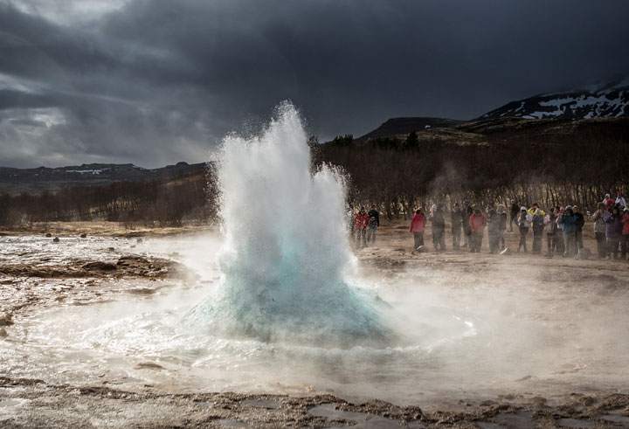
Turnbull High School VISIT ICELAND 2018

Slide 2
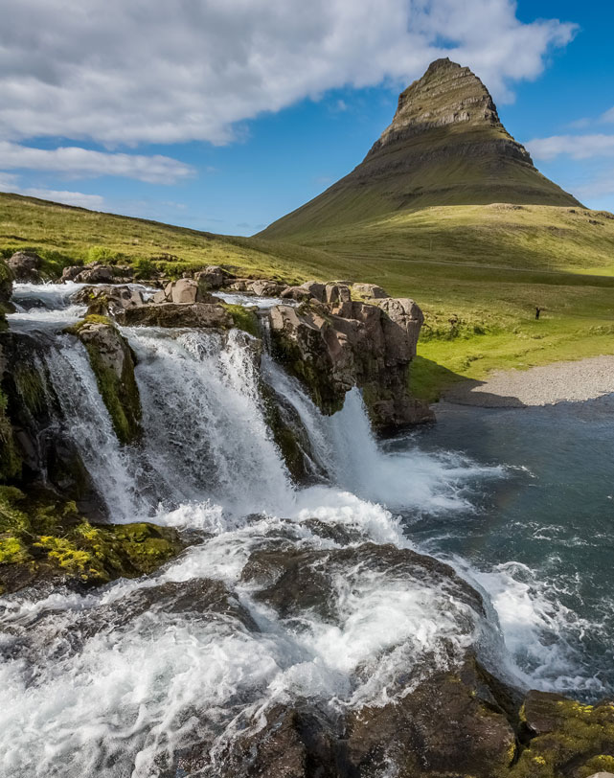
INTRODUCTION ICELAND
Your destination – Iceland
Your itinerary
Travel tips
Your tour operator – Discover the World Education

Slide 3
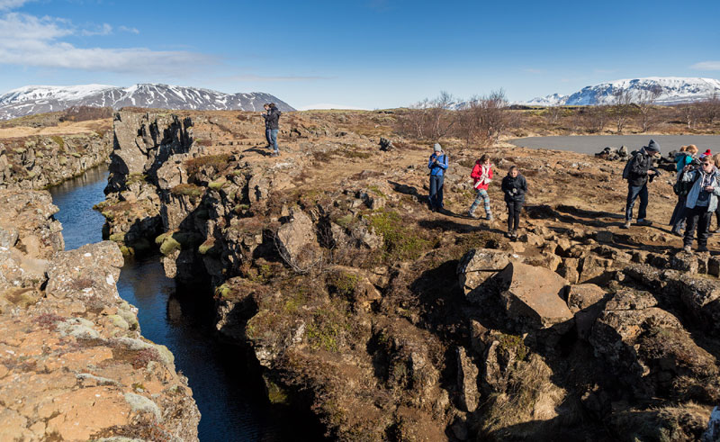
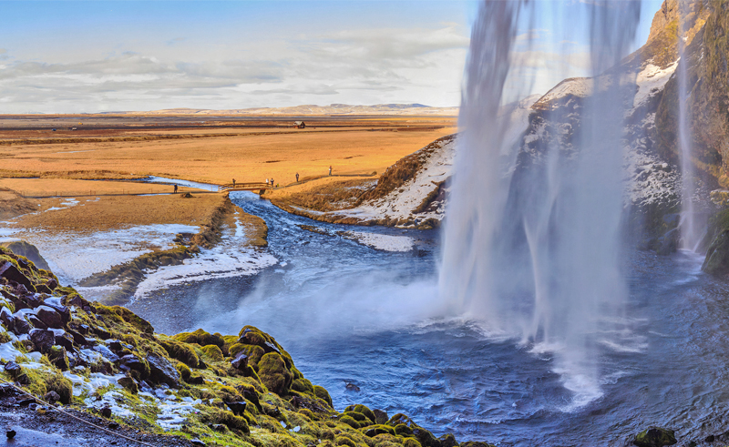
ICELAND FACTFILE
Iceland is an island which is located where the North Atlantic and Arctic Oceans meet. The land has been created at the divergence at Mid Atlantic Ridge. It is a land full of volcanoes, glaciers, waterfalls, jagged coastlines and other incredible geographical features, unmatched by any other place.
Currency: Icelandic króna
Flight duration: 2.5hr
Time zone: GMT

Slide 4
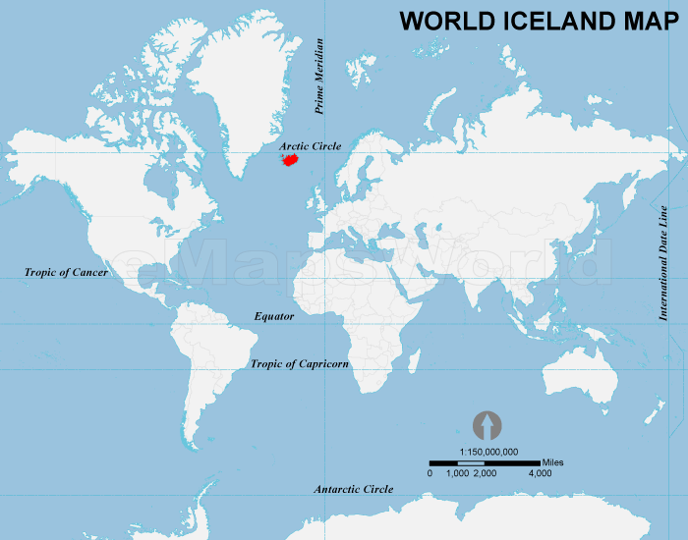
YOUR DESTINATION

Slide 5
CURRICULUM LINKS
TECTONIC PROCESSES, LANDFORMS AND HAZARDS
WATER, RIVER AND COASTAL PROCESSES, LANDFORMS AND MANAGEMENT
GLACIAL PROCESSES, LANDFORMS AND MANAGEMENT
WEATHER PROCESSES AND HAZARDS
POPULATION, ECONOMIC AND URBAN CHANGE
GEOLOGICAL PROCESSES AND LANDFORMS
FOOD, WATER AND ENERGY
RESOURCES
CLIMATE CHANGE
ECOSYSTEMS
FIELDWORK
Notes:
https://www.discover-the-world.co.uk/study-trips/azores/curriculum-links-2

Slide 6
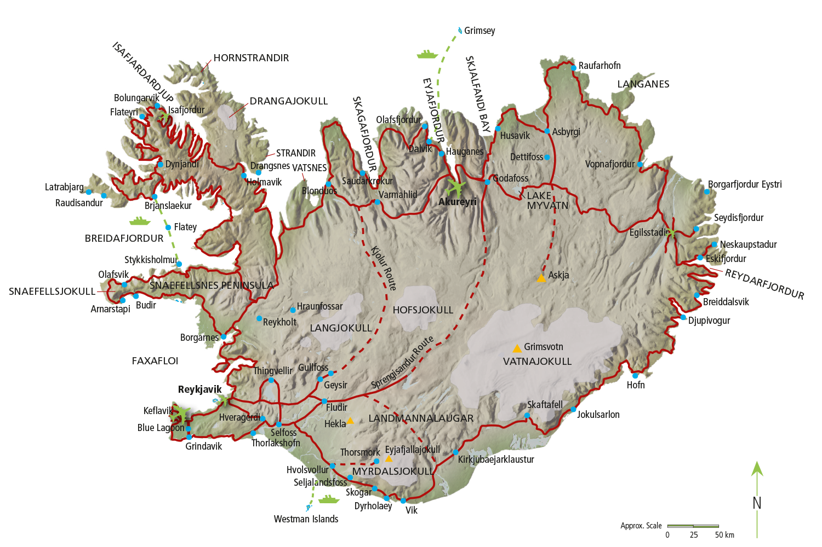

Slide 7
YOUR ITINERARY – DAY 1

Slide 8
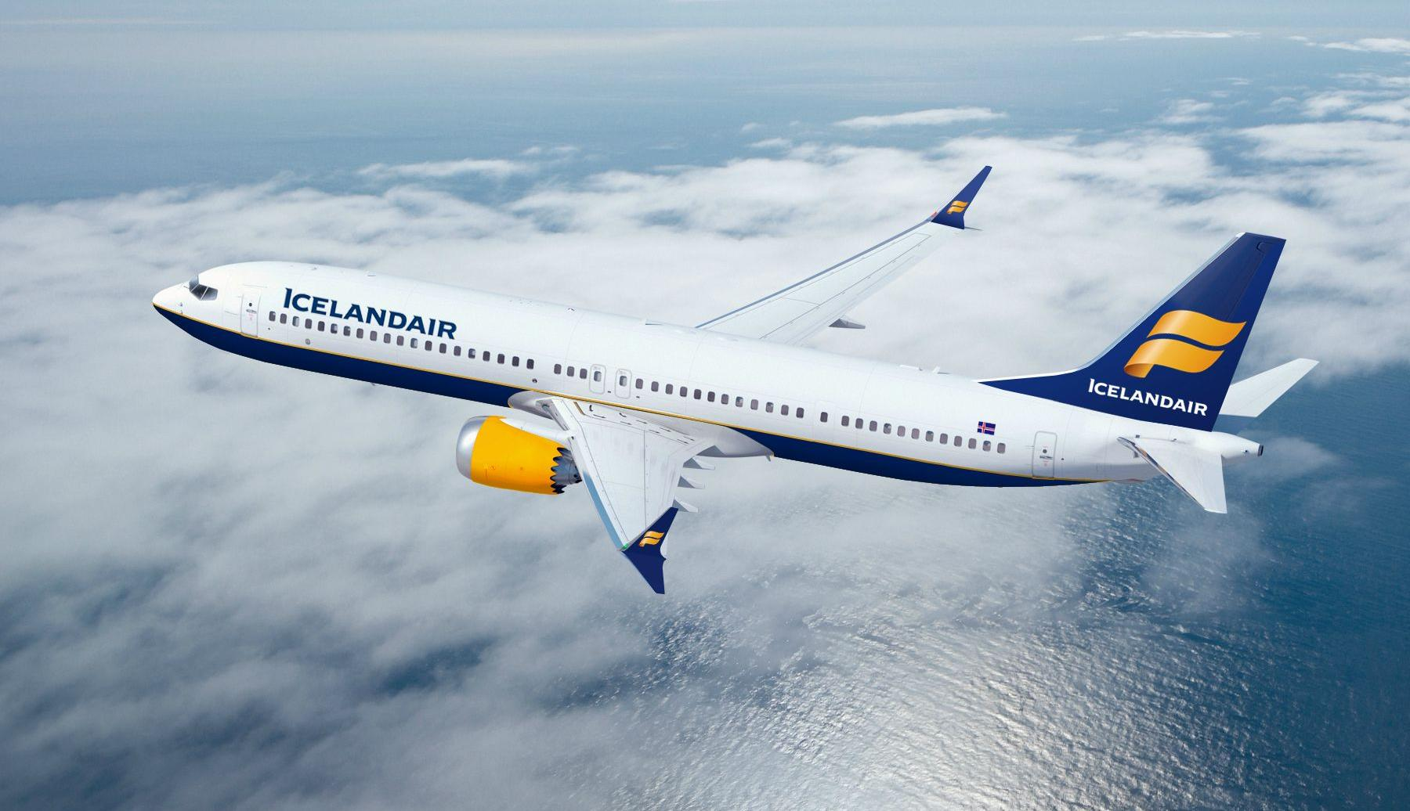
Fly from Glasgow to Keflavik with Icelandair

Slide 9
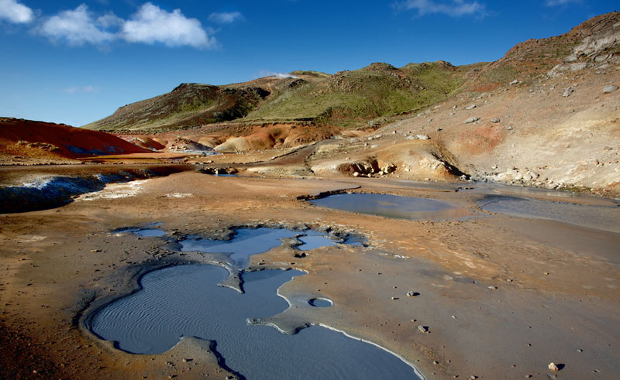
Drive across the Reykjanes Peninsula

Slide 10
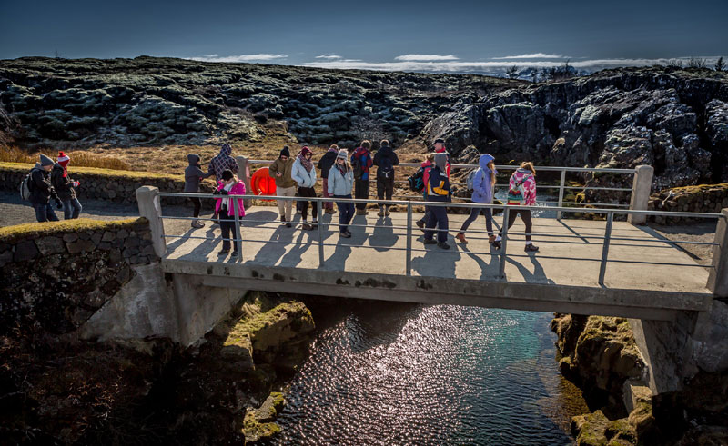
Cross the ‘Bridge between Continents’

Slide 11
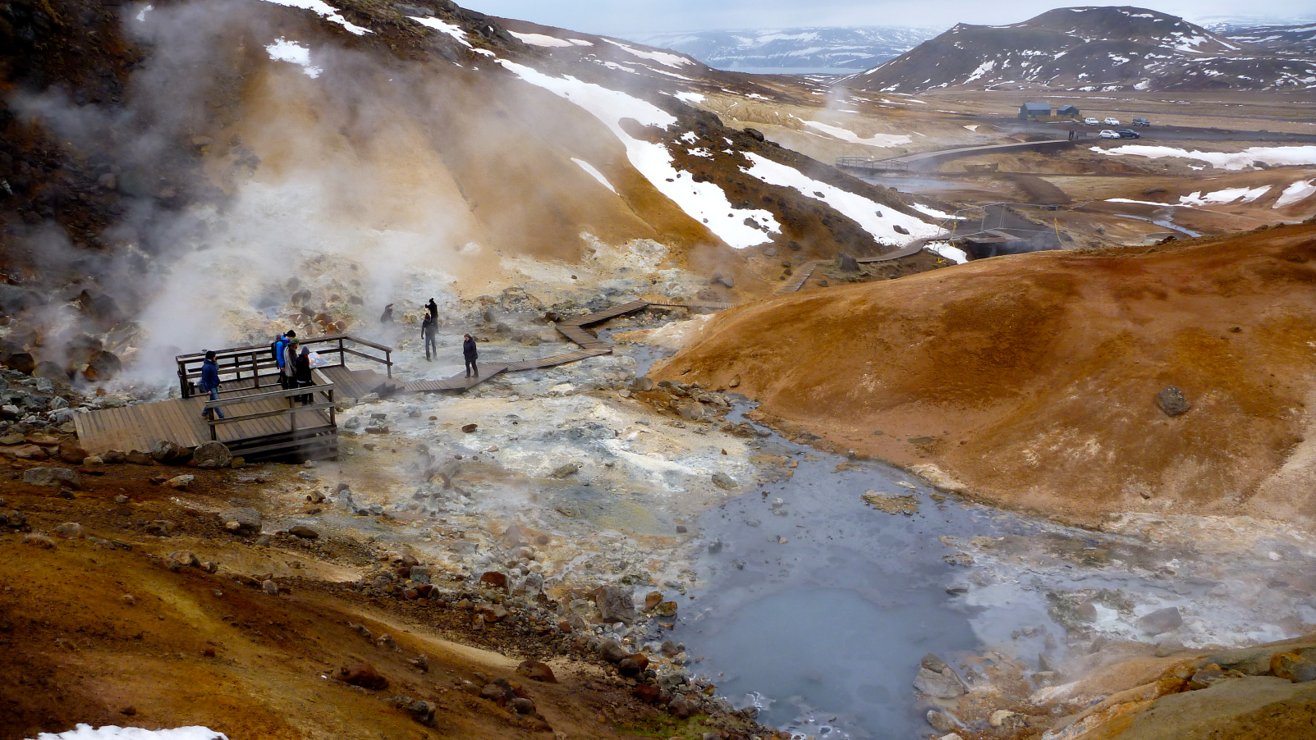
Walk through the sulphurous fumes at Gunnuhver hot springs

Slide 12
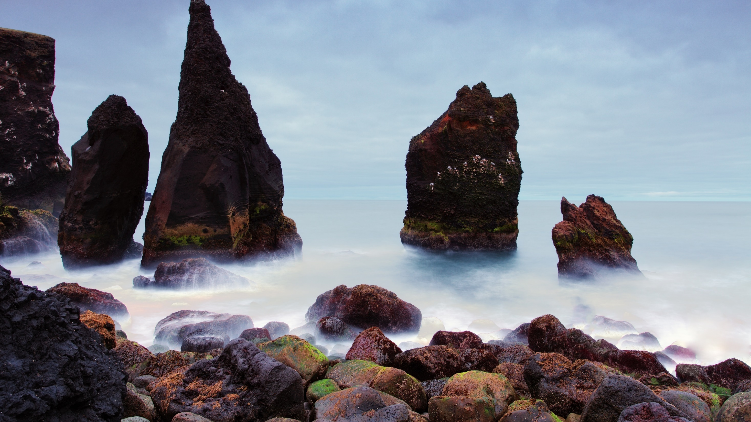
Head to Iceland’s oldest lighthouse and the Reykjanes coastline

Slide 13
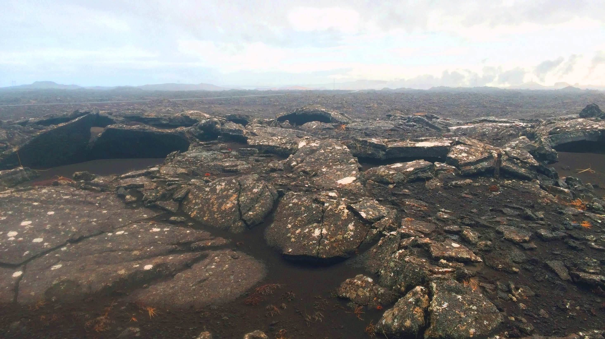
Explore the Stampar Craters

Slide 14
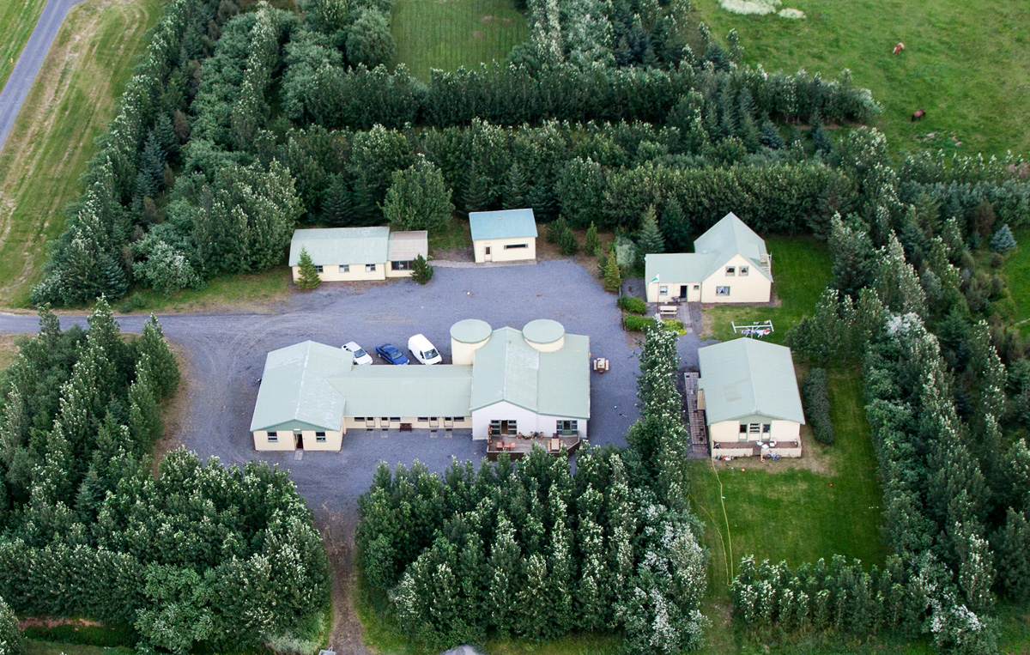
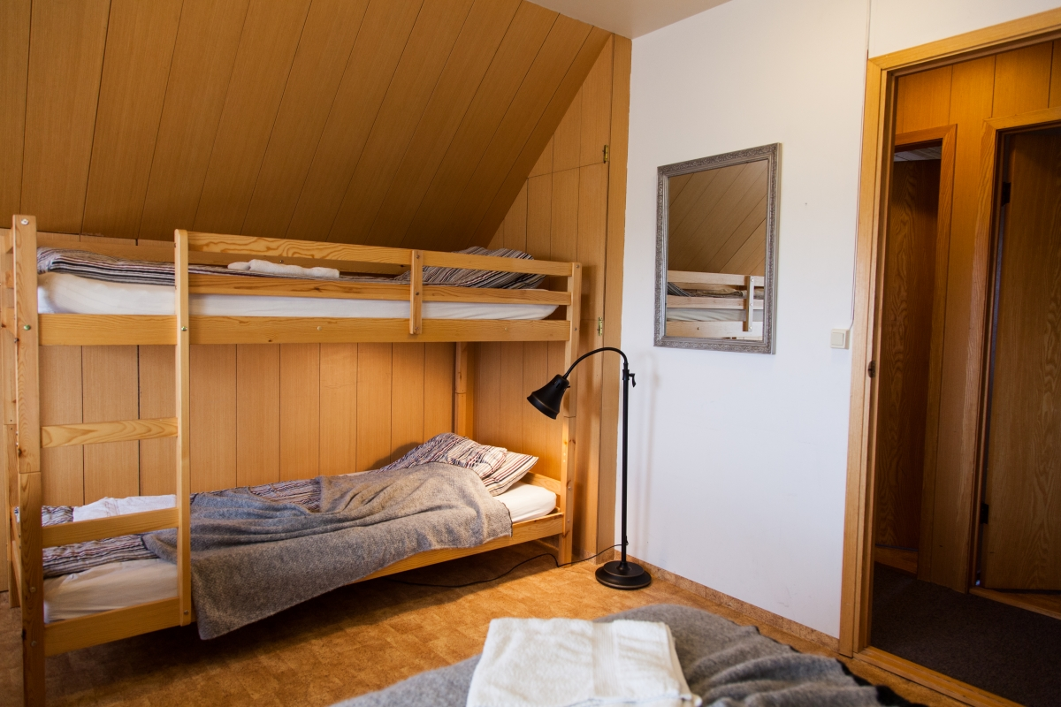
YOUR ACCOMMODATION
Dinner and overnight at Guesthouse Hjardarbol

Slide 15
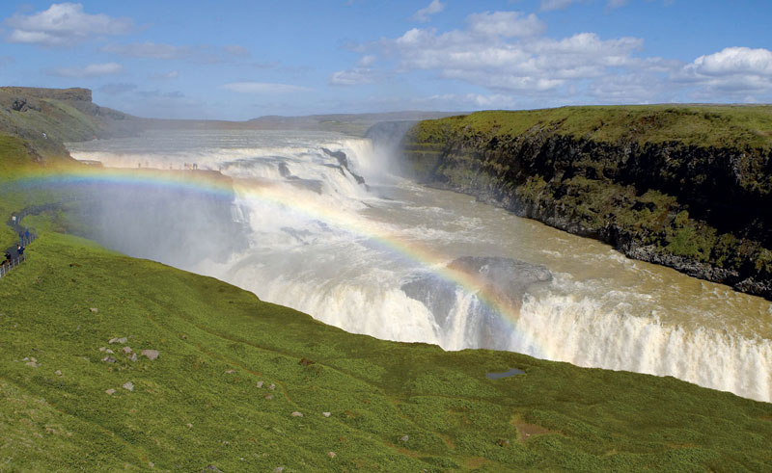
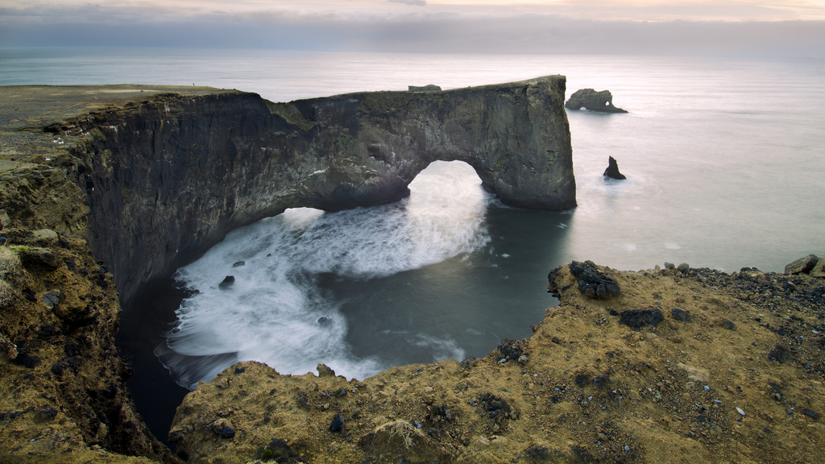
YOUR ITINERARY – DAY 2

Slide 16
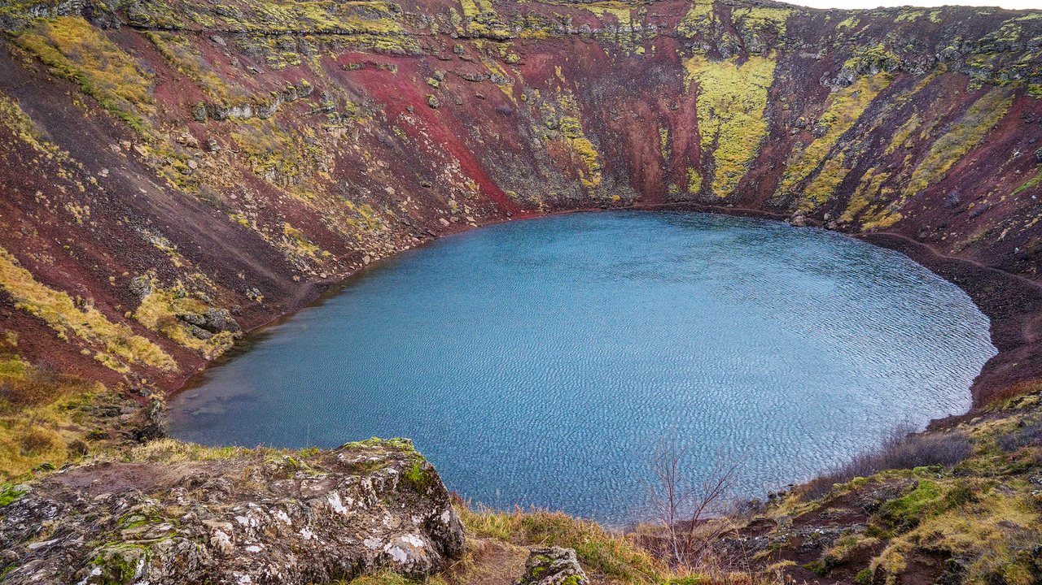
Walk around Kerið crater, formed by the eruption of a cone volcano

Slide 17
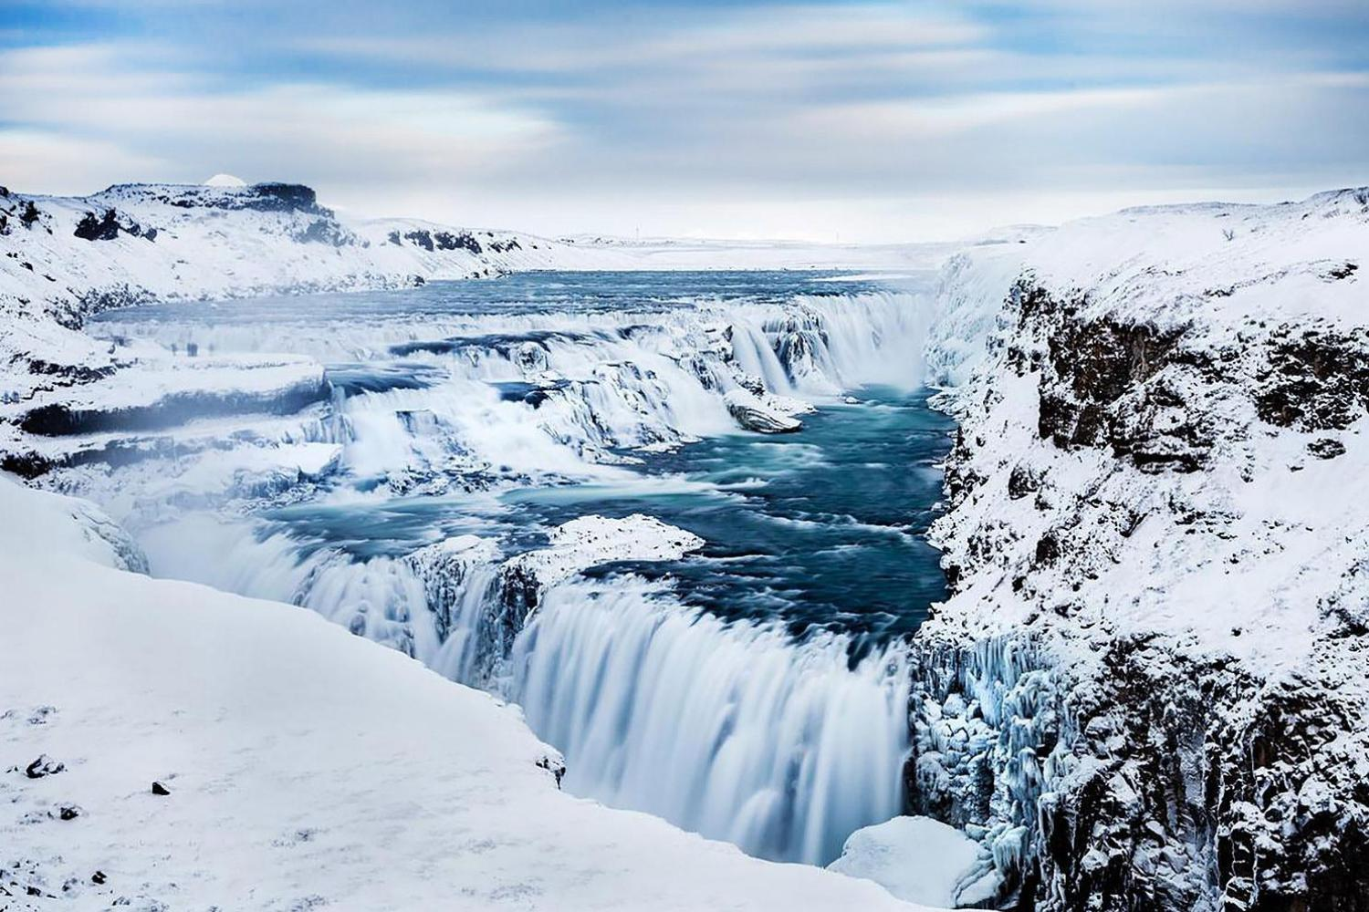
Marvel at Iceland's most photographed waterfall, Gullfoss “Golden Falls”

Slide 18
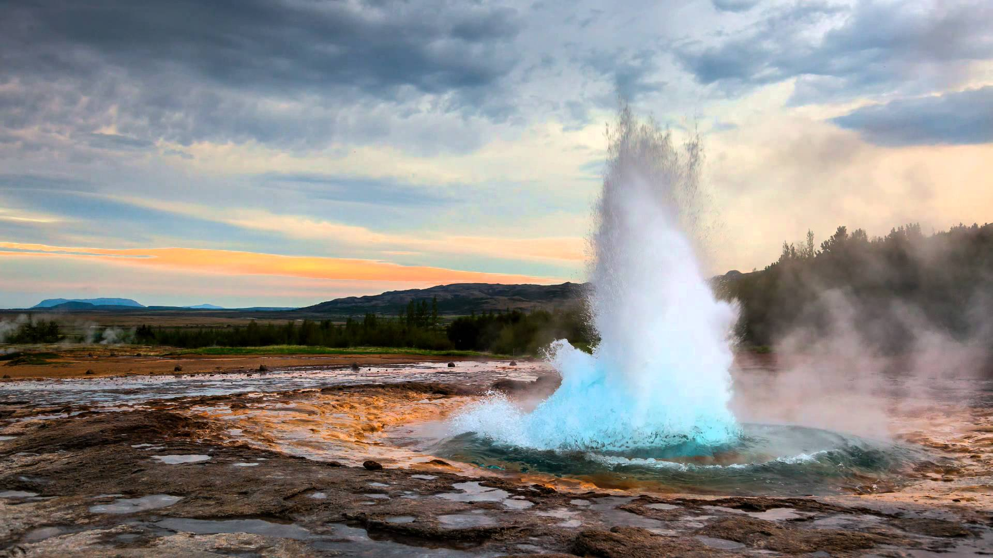
Watch in awe as Strokkur, erupts in front of you

Slide 19
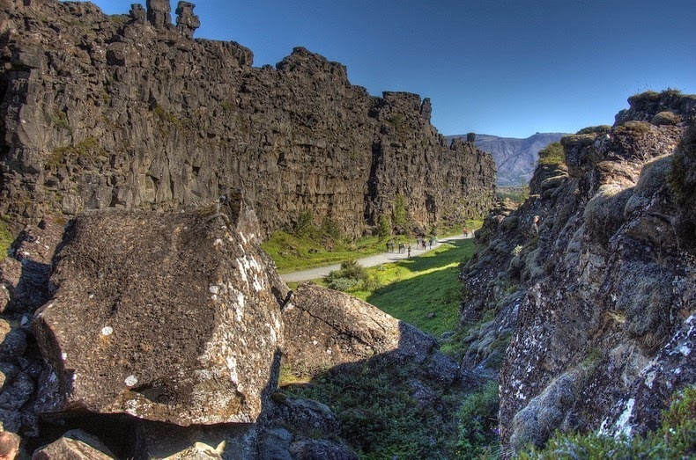
Visit Þingvellir National Park, on the Mid-Atlantic Ridge

Slide 20
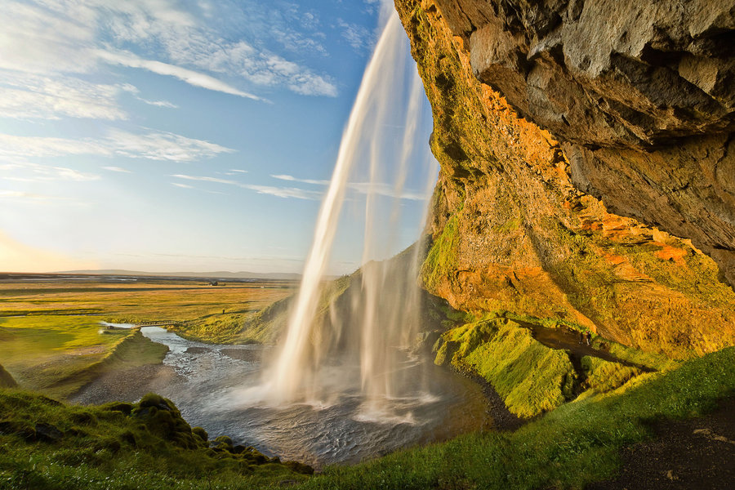
YOUR ITINERARY – DAY 3

Slide 21
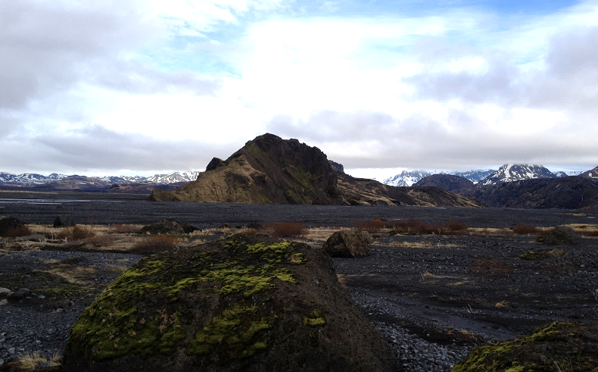
Drive through the valley flooded in 2010 by the Eyjafjallajökull glacier burst

Slide 22
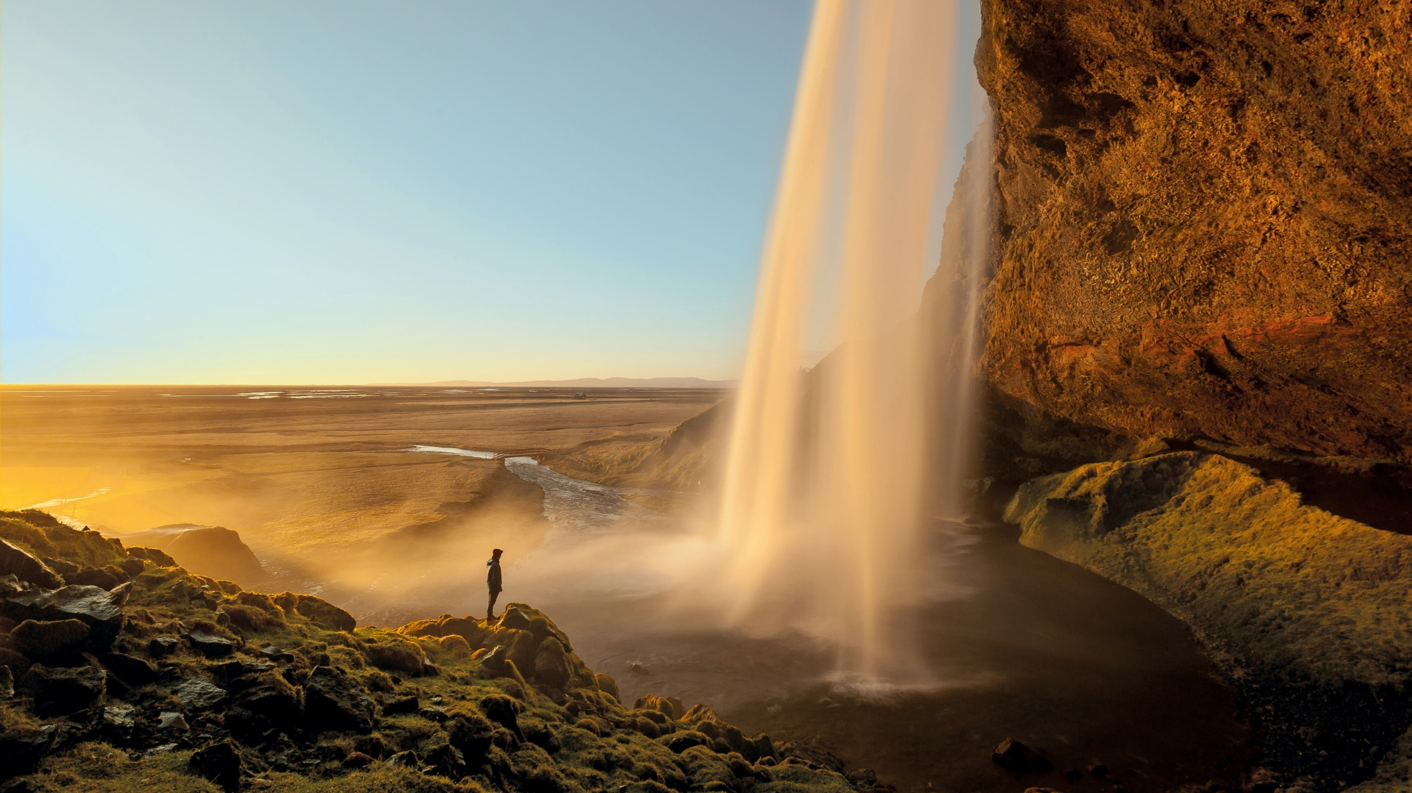
Get soaked by Seljalandsfoss waterfall

Slide 23
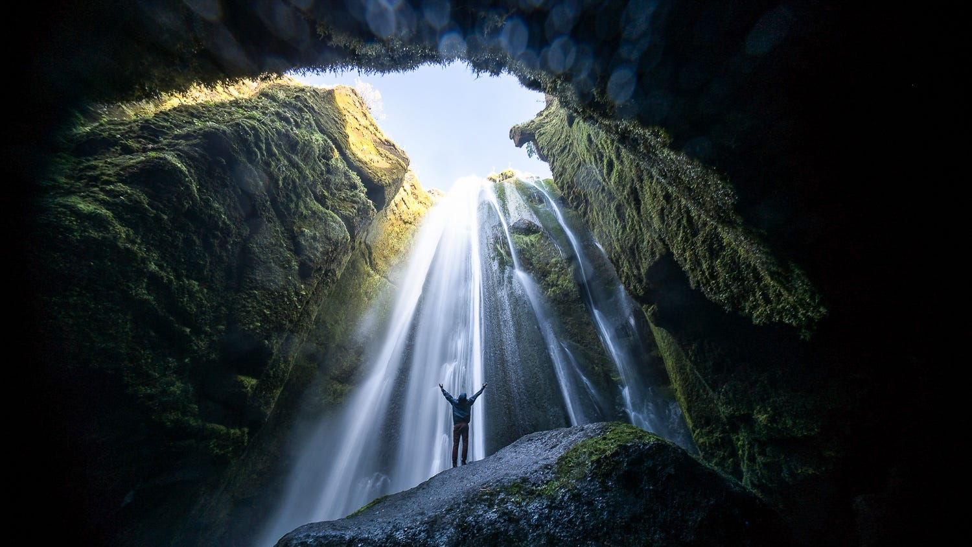
Discover the hidden Gljufrabui waterfall (“The Canyon Dweller”)

Slide 24
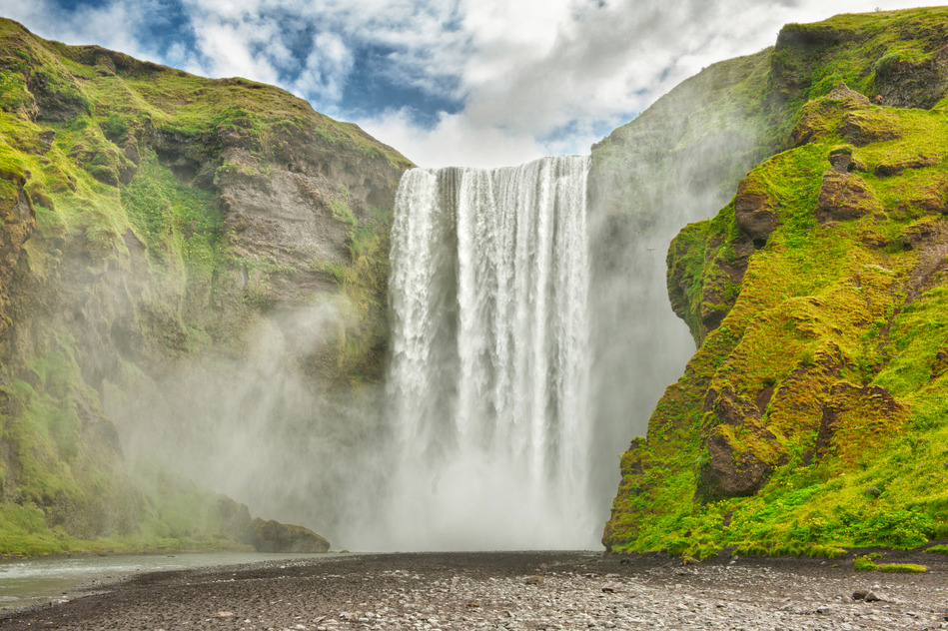
Climb to the top of beautiful Skógafoss

Slide 25
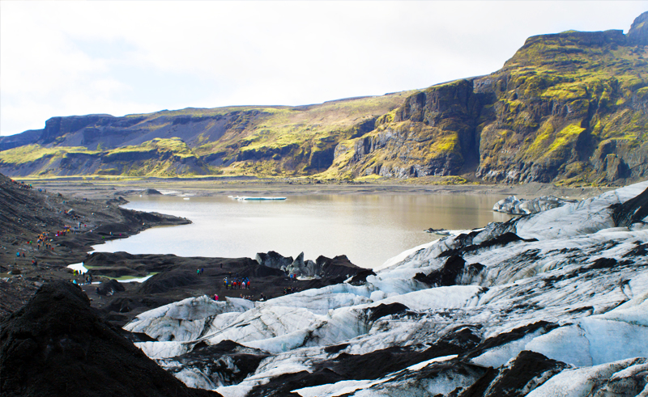
Visit Sólheimajökull glacier tongue

Slide 26
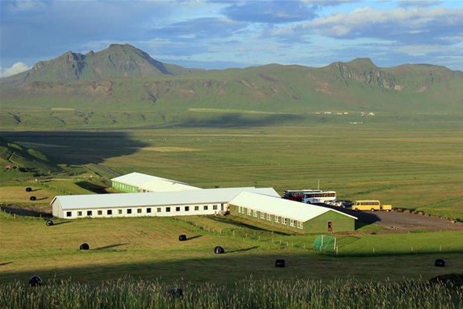
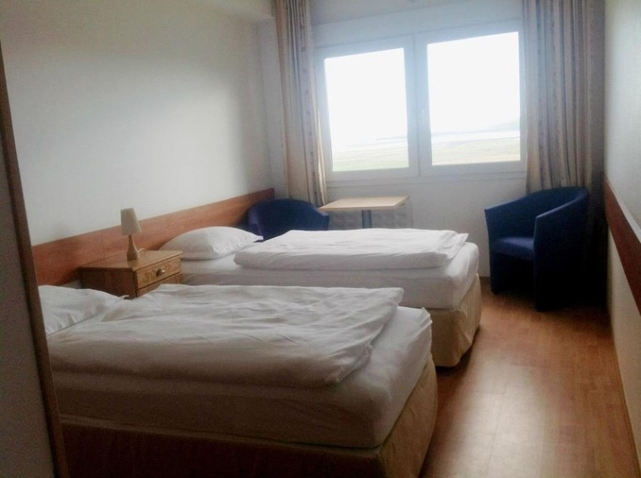
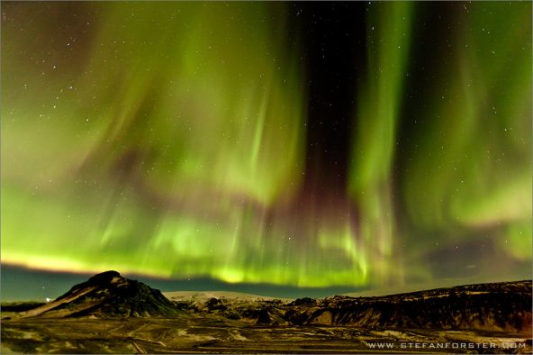
YOUR ACCOMMODATION
Dinner and overnight at Hotel Dyrholaey

Slide 27
YOUR ITINERARY – DAY 4

Slide 28
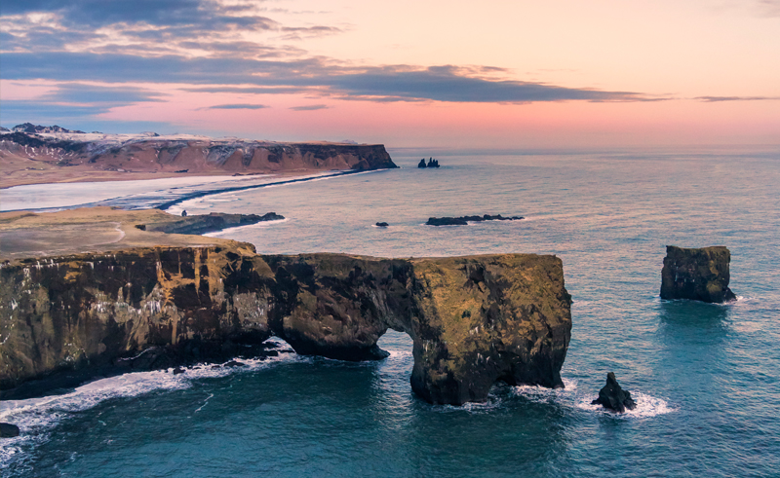
See the stunning coastal landscape at Dyrhólaey

Slide 29
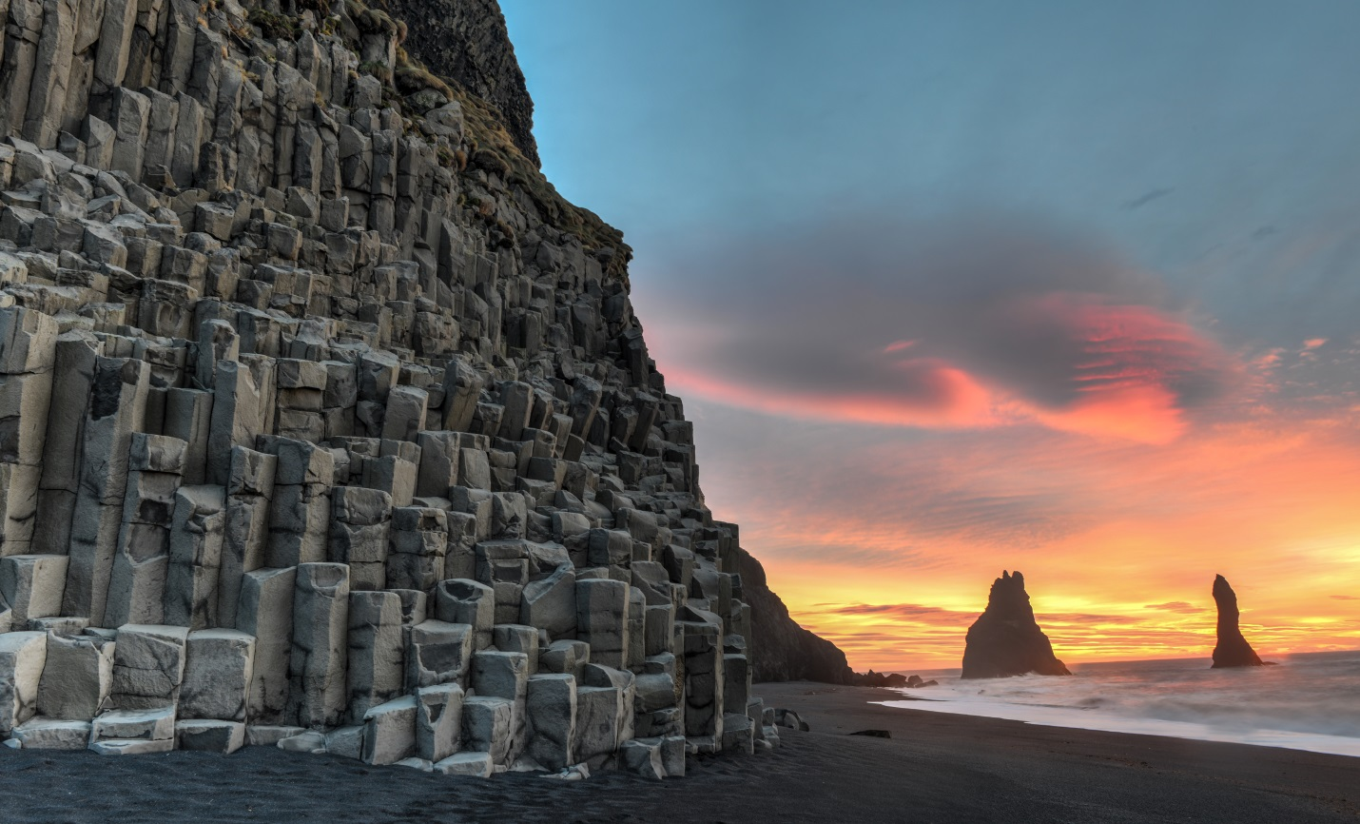
Take a walk on the black sand beach at Reynishverfi
Climb to the top of beautiful Skógafoss

Slide 30
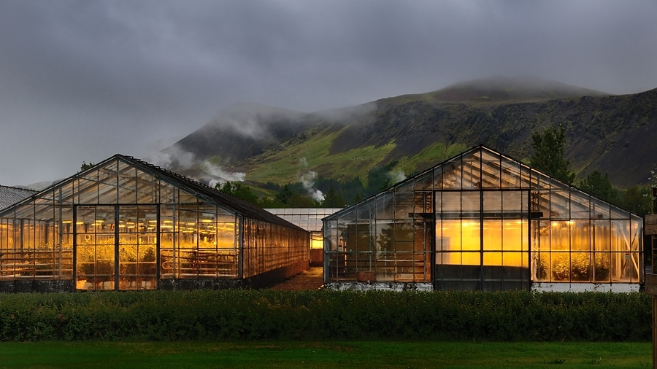
Explore the ‘greenhouse’ town of Hveragerði

Slide 31
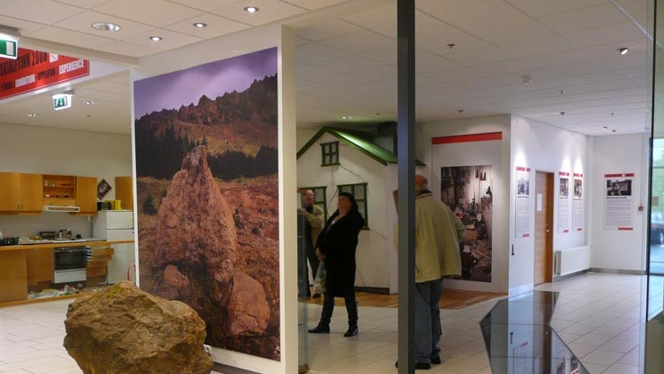
Climb to the top of beautiful Skógafoss
Visit the Earthquake exhibition and learn about a powerful earthquake that struck the town in 2008

Slide 32
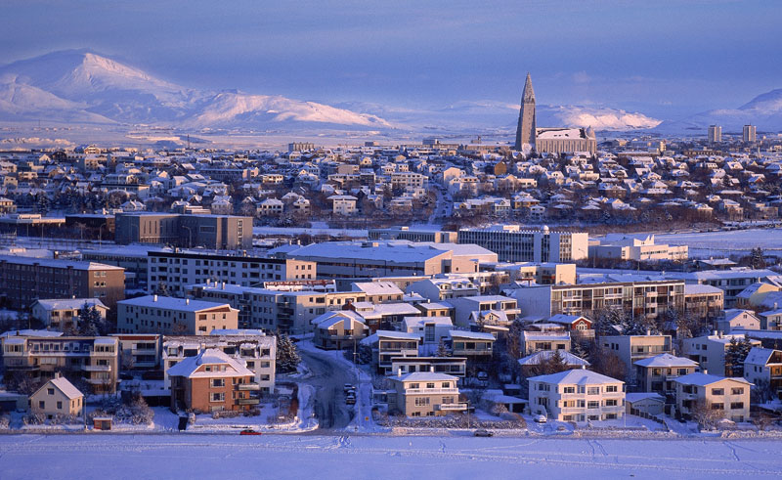
Take a guided tour around Reykjavik city centre

Slide 33
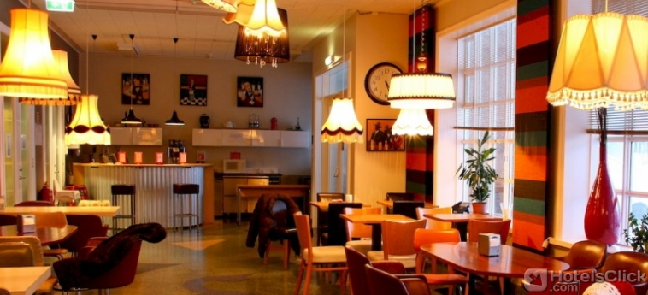
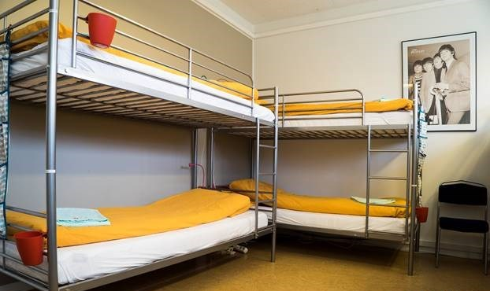
YOUR ACCOMMODATION
Check-in to B47 Hostel in Reykjavik city centre

Slide 34
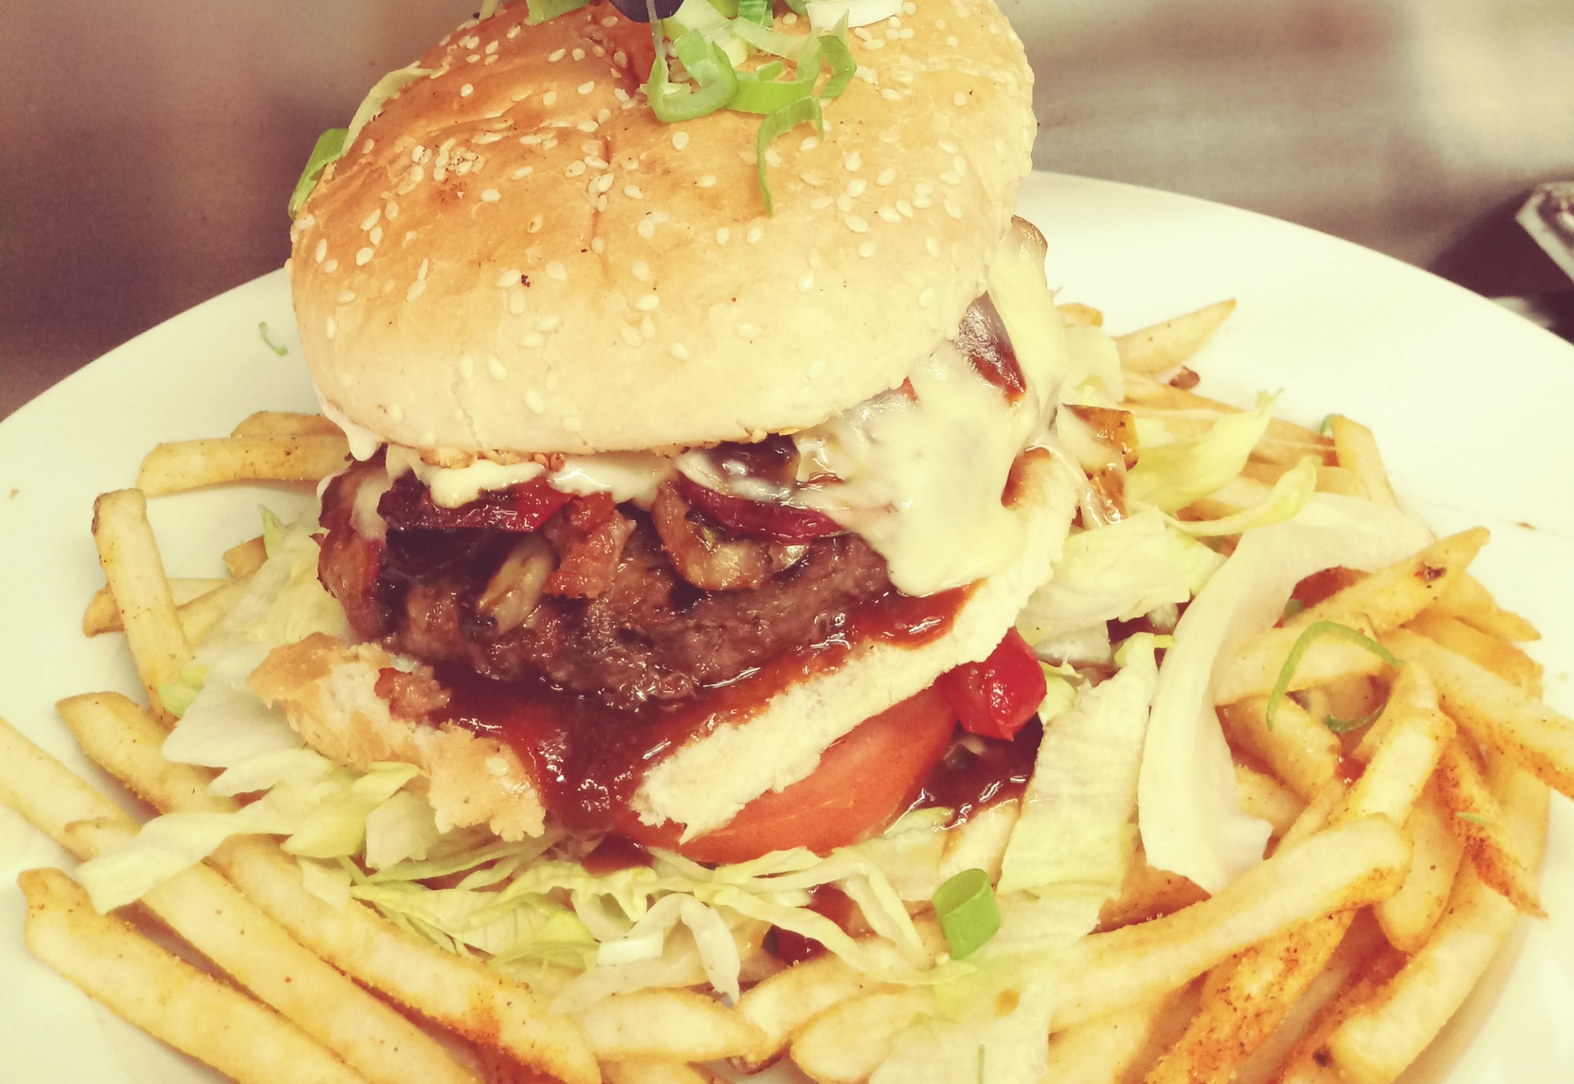
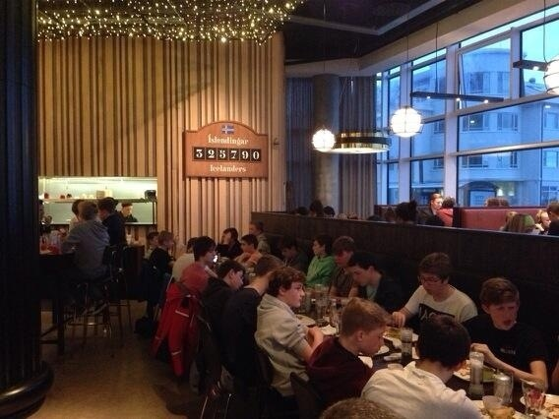
Enjoy dinner at a local restaurant

Slide 35
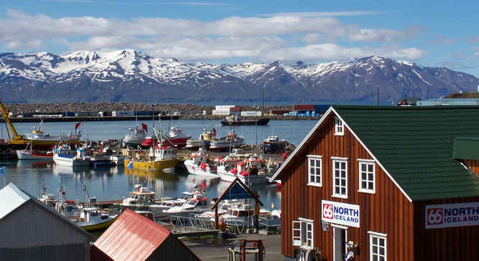
YOUR ITINERARY – DAY 5

Slide 36
Fly back to Glasgow with Icelandair

Slide 37
Travel Tips

Slide 38
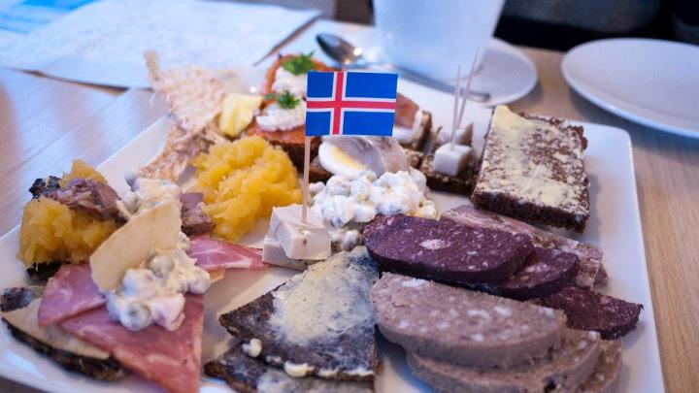
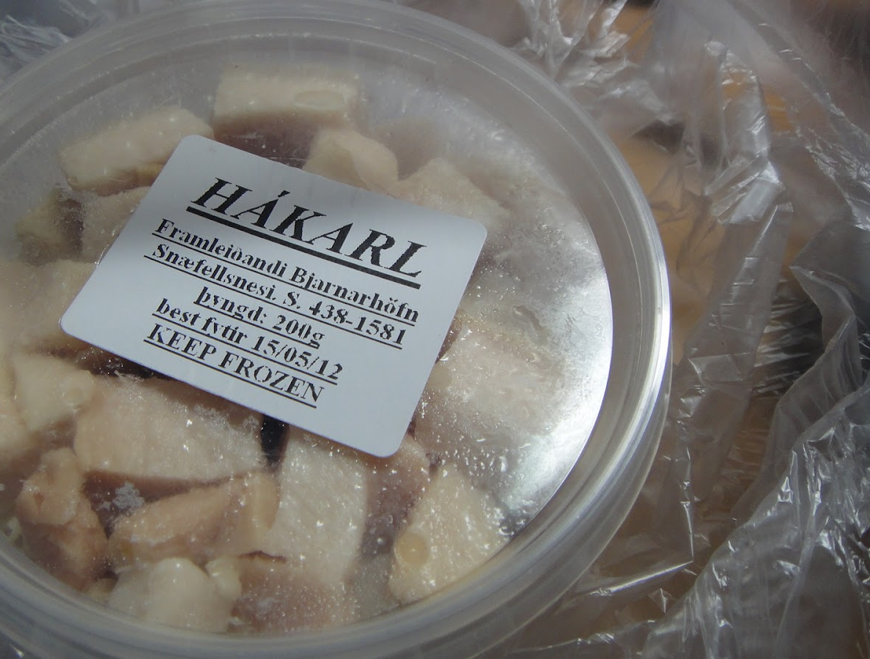
Food

Slide 39
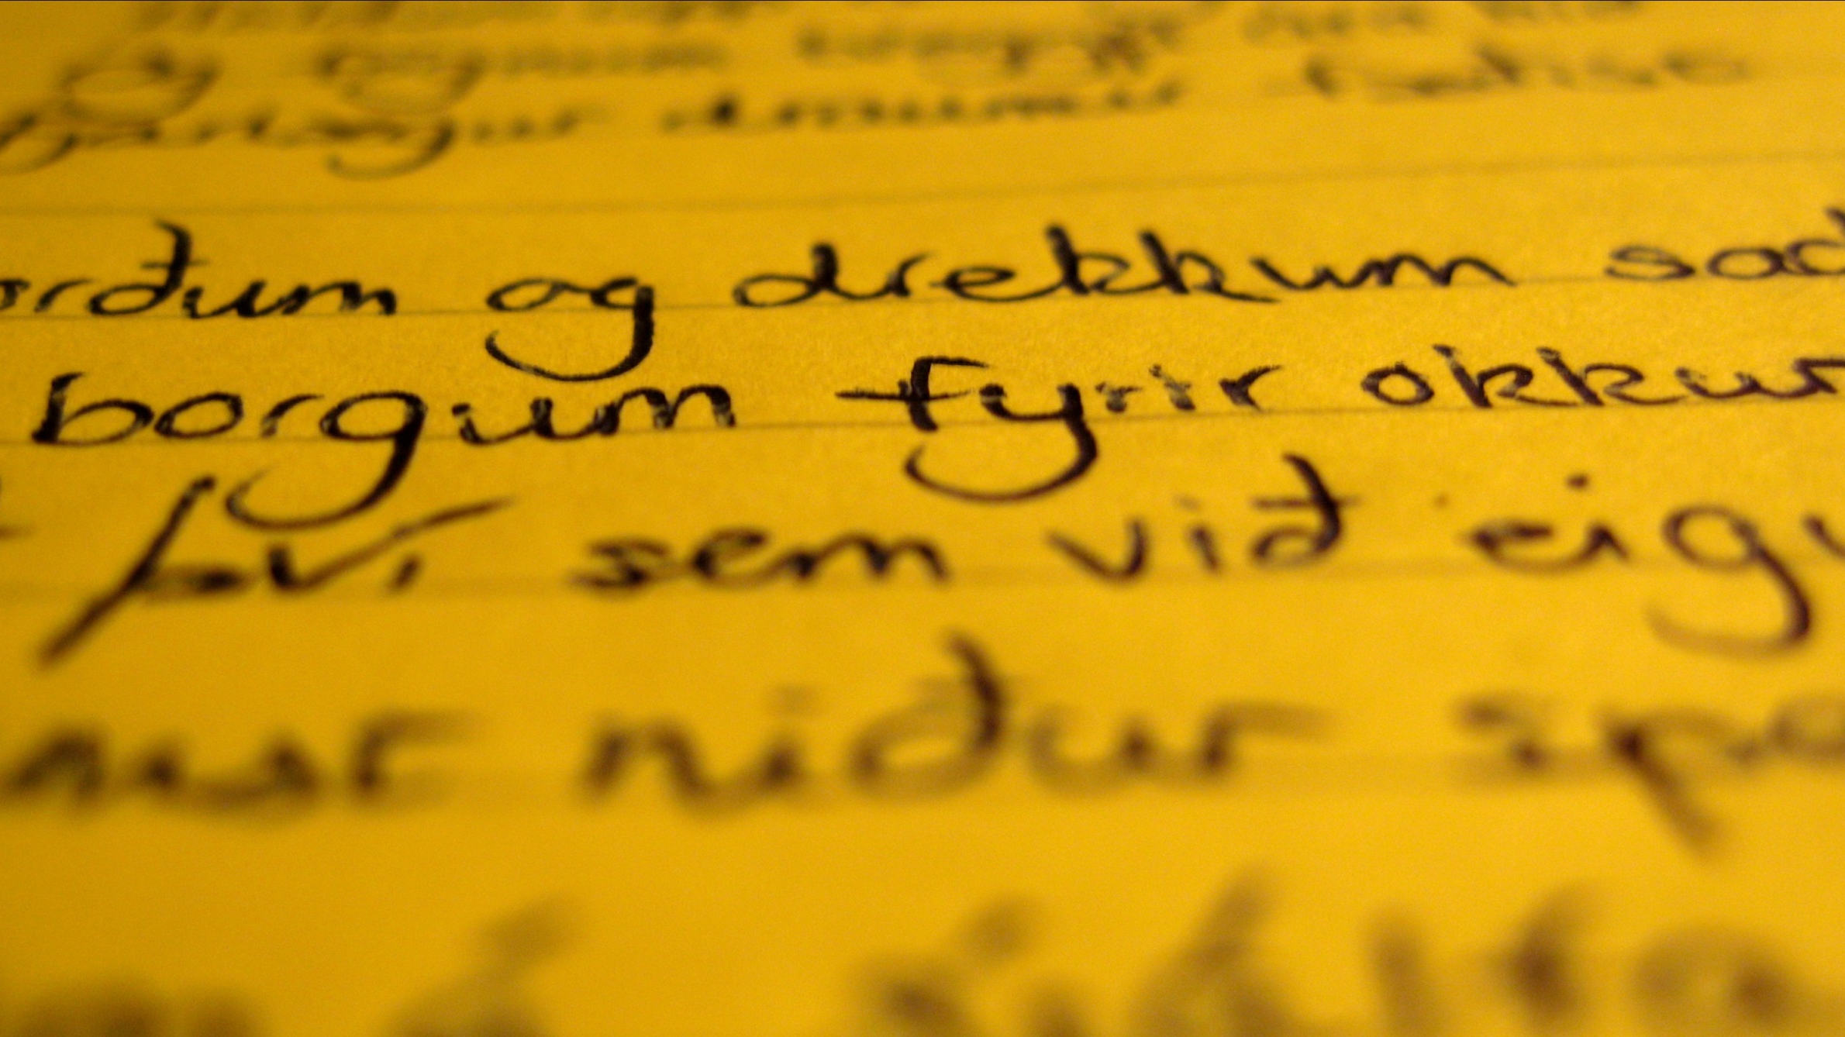
Language
Can you pronounce Eyjafjallajökull?

Slide 40
Currency

Slide 41
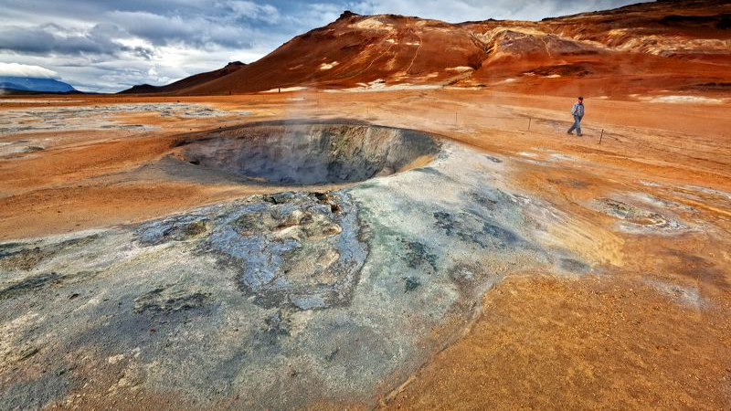
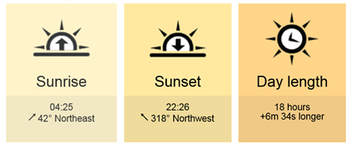
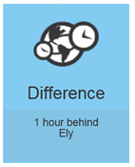
Reykjavik in Mid October
08:25
17:59
9.34hrs
-1hr
 | Min | Max
Average temperature | 2°c | 6°c

Slide 42
What to pack?
Swim wear & towel
Waterproof jacket & trousers
Walking boots
Woolly hat, scarf & gloves
Day bag or small rucksack
Walking trousers, leggings or jogging bottoms
Warm jumpers and socks
Layers!
Camera
Alarm clock
EU adaptor
Sunglasses
Lip balm
Passport & EHIC card

Slide 43
Discover the World Education is the world’s leading tour operator to Iceland
30 years experience of organising tours to Iceland
Exceptional local knowledge and supplier relationships
Great value for money and quality experience
Quality assured members of The School Travel Forum
Travel Disruption Charter
Financial security - fully bonded with ABTA and ATOL

