Slide 1
Lesson Starter
In your groups, write down any jobs or careers you can think of that relate to Geography.

Slide 2
Learning intention Research jobs that have a Geography theme
Success criteria
Find out about 2 geography related jobs
Skills
ICT, Research, Group work, Communication, Problem solving

Slide 5
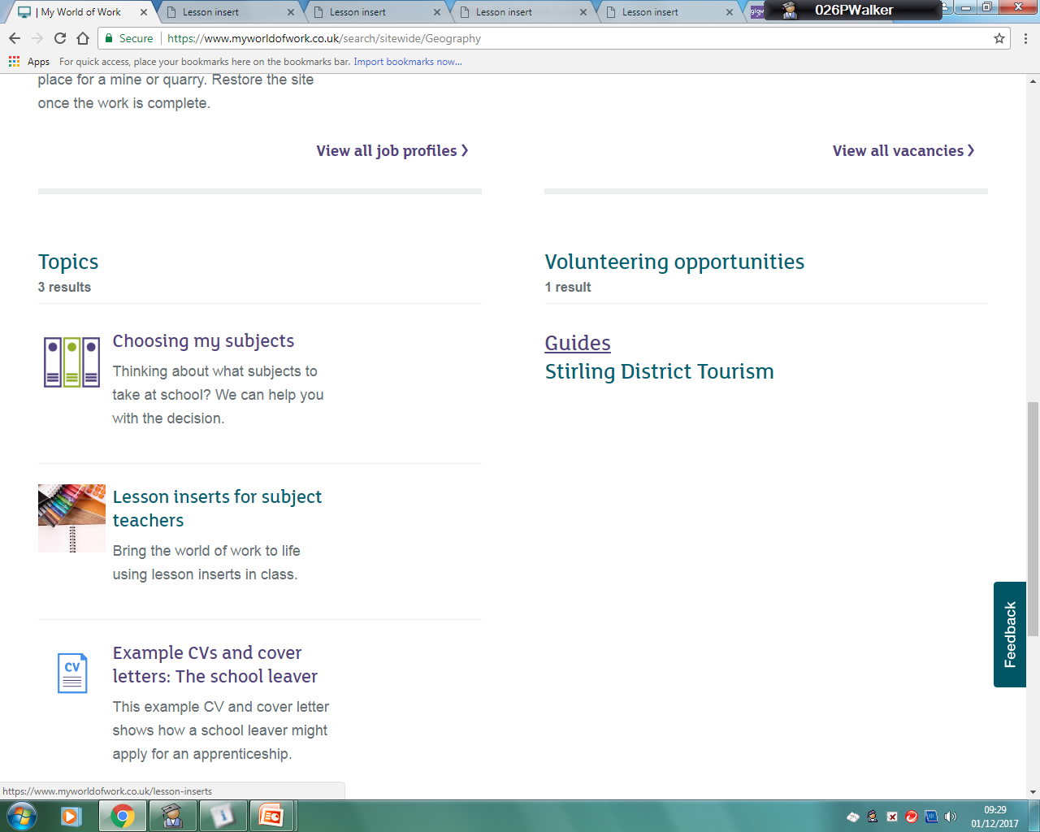

Slide 7
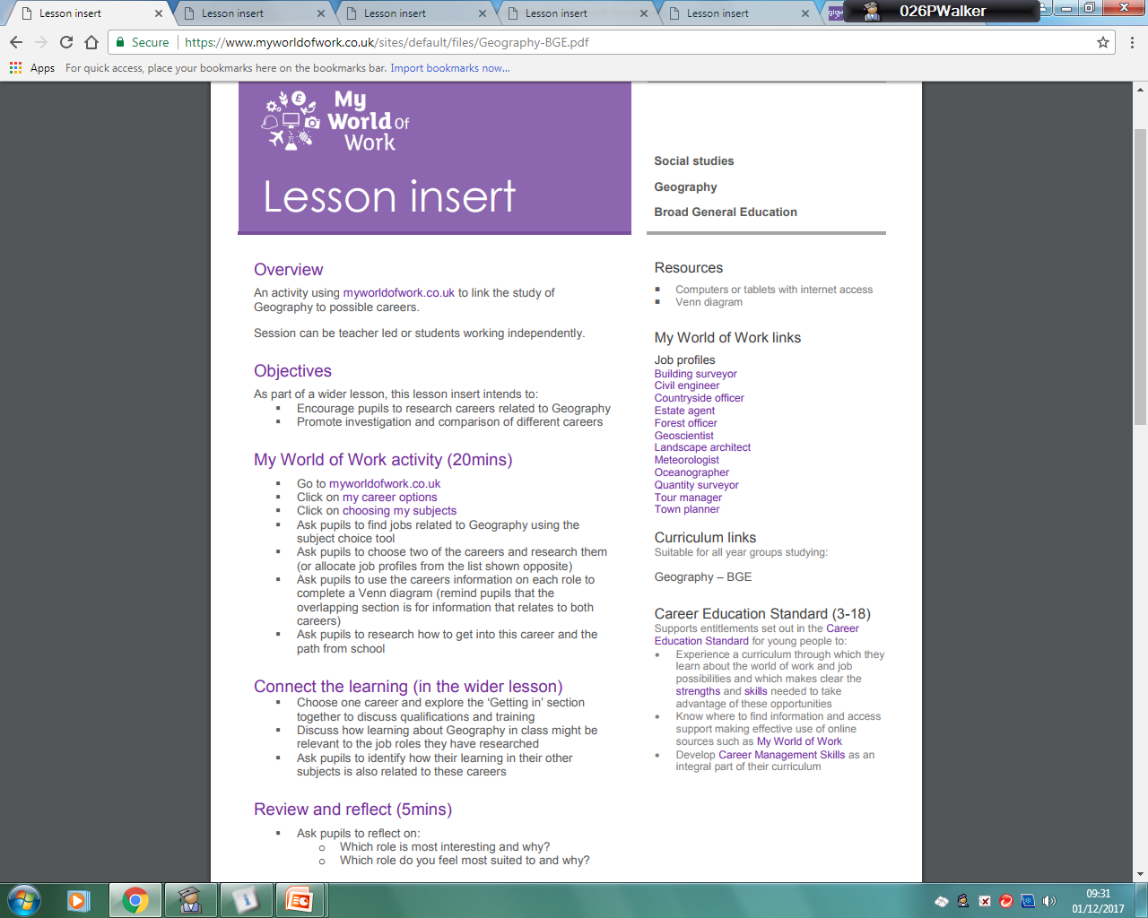

Slide 8
In your jotter draw a Venn diagram similar to the one below - Choose one of the job profiles to complete one of the circles on the Venn diagram about the role. Include 4 points - Choose another job profile to complete the second circle of the Venn diagram. Include 4 points
Job -
Job -

Slide 9
Lesson Starter
In your groups, write down any jobs or careers you can think of that relate to Geography.

Slide 10
Learning intention Research jobs that have a Geography theme
Success criteria
Find out about 2 geography related jobs
Skills
ICT, Research, Group work, Communication, Problem solving

Slide 15
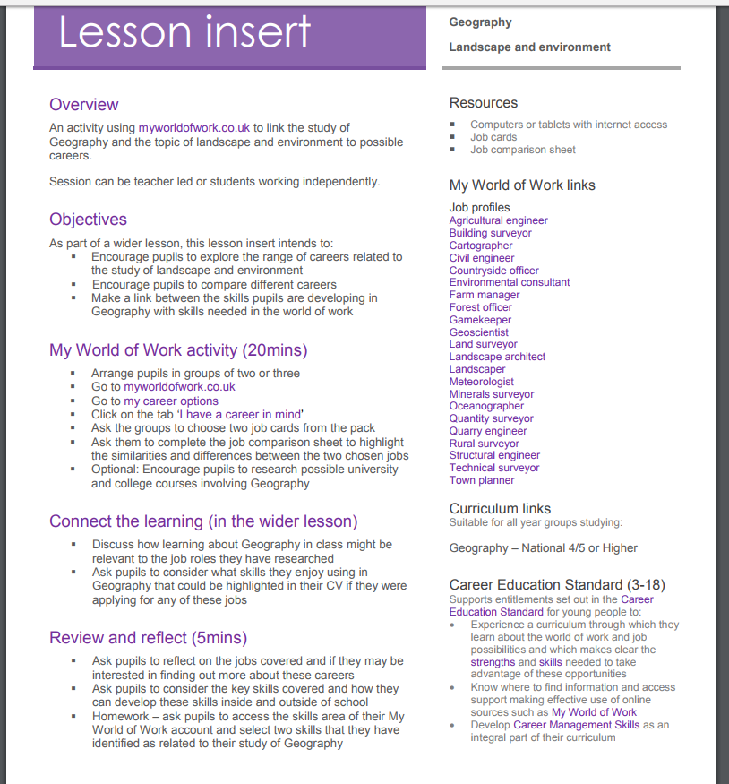

Slide 16
Complete the following table in your jotter about one of the roles you have chosen

