Slide 1
Welcome to English
Turnbull High School
P7 Parent Information Evening

Slide 2
Department
The English department at Turnbull High School is a large and busy department.
We strive to provide pupils with a valuable and enjoyable learning experience, building on existing English and Literacy skills gained in primary school.
Incorporate new and challenging skills, including experiencing modern classic literature and even media skills.

Slide 3
Staff
The department is made up of the following staff members:
TBC (Principal Teacher of English)
Mr M Hendrie (Principal Teacher of Pastoral Care)
Mrs A McBride(Principal Teacher of Pastoral Care)
Ms A Boardman (Acting Principal Teacher of Pastoral Care)
Mrs K Jack
Ms A Young
Mr A Thomson
Miss B Wilson
Mrs L Thompson (Depute Head Teacher)
The English department also benefits from a close relationship with the school librarian.

Slide 4
BGE – Broad General Education
The BGE covers all teaching and learning in S1 to S3
Pupils cover the whole range of Experiences and Outcomes associated with English and Literacy within A Curriculum for Excellence.
Progress within a level is assessed using the English & Literacy Benchmarks

Slide 5
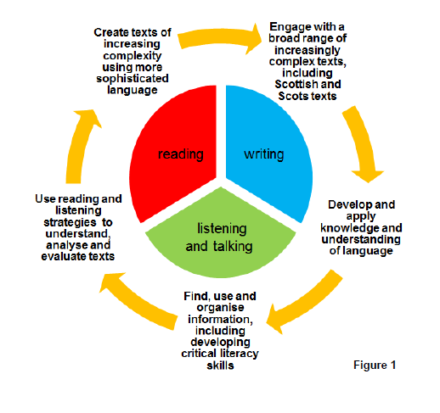
S1 – S3 Course Structure

Slide 6
Reading
Skills
Outcomes
Use reading strategies to understand, analyse and evaluate a variety of texts, including Prose, Drama, Poetry, Media and Non-Fiction
Find, use and organise information, including developing critical literacy skills
Develop close reading skills through study of fiction & non-fiction passages
Produce 2 Critical Essays of Literature (different genres)
Demonstrate understanding of media techniques through the completion of a media related task
Complete a selection of close reading exercises

Slide 7
Writing
Skills
Outcomes
Create a broad range of texts of increasing complexity, using more sophisticated language
Find, use and organise information
Develop and apply knowledge and understanding of language
Write with increasing accuracy, making effective use of spelling, grammar and punctuation
Produce a piece of personal reflective writing
Produce a piece of imaginative writing
Produce a piece of discursive writing

Slide 8
Listening & Talking
Skills
Outcomes
Use listening strategies to understand, discuss, analyse and evaluate a wide range of spoken texts
Develop higher order thinking and questioning skills
Use verbal and non-verbal skills with greater confidence, as well as using language effectively
Complete a selection of listening exercises
Take part in group discussions/ group presentations
Deliver a solo talk presentation

Slide 9
Assessment
Pupils are assessed continually throughout the school year
Assessment is both formative and summative, formal and informal
All pupils have a departmental Personal Learning Plan, recording progress and future targets
Pupils regularly receive feedback from teachers, as well as fellow pupils through self/peer assessment

Slide 10
Homework
Stage appropriate homework booklet
Writing linked to class novel/play/poem
Redrafting
Reading (either personal or class text)
Research
Practising – solo/group presentations

Slide 11
Parent Support
Encourage reading and model reading at home
Help your child to be organised - homework/planner/materials
Get involved – read your child’s work and feel free to comment
Children learn better when families learn together

Slide 12
Extra Curricular
Reading Club
Film Club
Board Games Club
S1 Literacy Committee
World Book Day /Book Week Scotland Activities
Word Mania Competitions
Writing Competitions
Theatre and Cinema trips
Author Visits

Slide 13
Want to know more?
We have our own department blog:
https://blogs.glowscotland.org.uk/ed/turnbullenglish/
(or simply ‘Turnbull English Blog’)
@TurnbullEnglish

