Slide 1
S1 Literacy Programme
Family Learning Event
Notes:
Welcome & thanks. Housekeeping for fire safety.

Slide 2
What is Literacy?
“Literacy is defined as the set of skills, which allow an individual to engage fully in society and in learning, through the different forms of language and the range of texts which society values and finds useful.”
Curriculum for Excellence: literacy across learning – principles and practice
Notes:
Literacy is a key set of skills allowing an individual to communicate. In a world that communicates more frequently and on a larger scale than ever before, literacy really is crucial in allowing our young people to engage with learning and with society in general

Slide 3
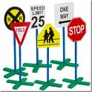
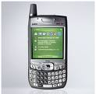
Literacy is all around us...
Notes:
Our pupils are immersed in literacy on a daily basis, using their skills continually. Many of these means of communication that our children are using have changed the scope of literacy – and, as far as kids are concerned, changed the rules. Spelling is no longer an issue when you have spellcheckers or predictive text, punctuation isn’t needed (unless it’s a hash tag on twitter) and Apple even relegate the punctuation marks onto a secondary keyboard. Even vocabulary, at the very heart of our language, can be summed up with a smiley face or emoji.

Slide 4
Why literacy?
“Literacy, alongside numeracy and health and wellbeing, sits at the heart of Curriculum for Excellence, as a key element of the knowledge, skills and attributes which equip children and young people for learning, life and work . . . Literacy and language unlock access to the wider curriculum and lay the foundations for communication, lifelong learning and work, contributing strongly to the development of all four capacities of Curriculum for Excellence”
3-18 English & Literacy Review, Education Scotland
Notes:
Improving the literacy skills of all our children and young people is a national priority, highlighted in the Scottish Government's National Improvement framework, with the aim of raising attainment, reducing inequity, improving life chances and employment prospects. We know that levels of literacy are closely linked to children’s and young people’s overall achievement in school and therefore by striving to raise attainment in literacy, we hope to also raise pupil attainment across the curriculum and improve pupil prospects for the future.

Slide 5
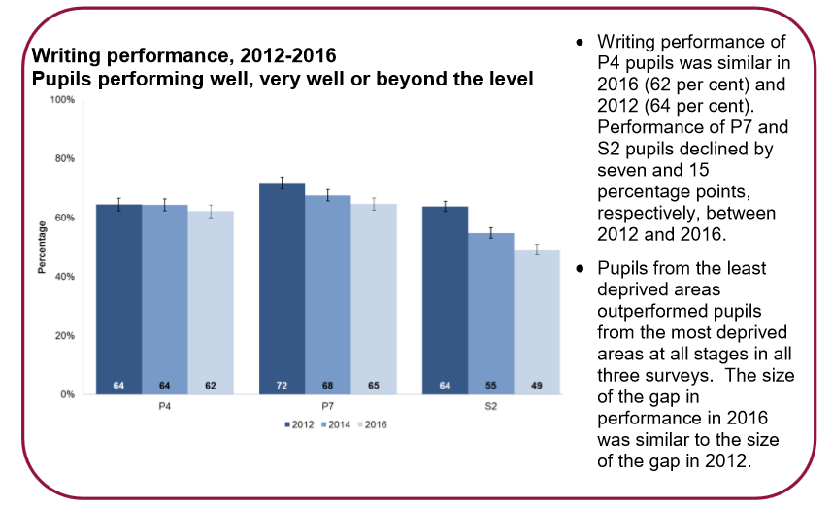
Scottish Survey of Literacy & Numeracy
Notes:
In 2016, the last round of surveys, the focus was on literacy. While pupils were found to be performing well, very well or beyond the level in writing, it was still worrying to note that in the 4 years since 2012, pupil performance had declined as much as 15 percentage points. It is clear that while our young people are doing well, they could be doing better, and this is something that all schools across Scotland are hoping to address and that we, here in Turnbull, are hoping to work on through our latest Literacy Programme.

Slide 6
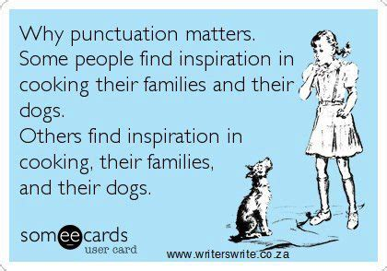
Test yourself
i before e, except after c?
How many ‘c’ and how many ‘s’?
Practise or practice?
Past or passed?
Punctuation saves lives!
Notes:
Lets just take a moment to think about literacy from a pupil’s perspective. From the day they started primary school they have been gathering knowledge about language; the alphabet, phonics and phonemes, spelling, reading, vocabulary; words written with difficulty that soon become sentences and then full pages of writing. It’s only natural that within all this learning taking place, some skills aren’t quite mastered as well as others, perhaps ‘forgotten’ or even just pushed to the side to make way for new learning. Even as adults, are we confident that we remember all we were taught about literacy?
I before e - We all learned the rule in primary school, so you’d think you’d know how to spell the word ‘weird’.......but wait, isn’t that..literally...weird.
And what about those pesky words that seem to have far too many of the same letter, just to make it extra complicated – like ‘necessary’ (or unnecessary, for that matter), occasion or accommodation.
And what’s the deal with practice and practise, or past and passed. In fact, even in this presentation you might be able to spot two different spellings of the word programme...
And lets not forget the importance of punctuation and how it literally saves lives (see meme).

Slide 7
The new S1 Literacy Programme
1 period each week of dedicated, focused teaching
Pupils will attend a specified literacy class, rather than their regular English class
6 literacy classes will allow for reduced pupil numbers and increased teacher support
Classes will cover written literacy skills, including weekly spelling, punctuation and grammar work
Notes:
Currently all S1 pupils come to English 5 times a week. While literacy skills are taught as part of the English course, they are integrated into the activities pupils are already carrying out when reading texts, like novels or poems, or writing essays or creating imaginative stories. Moving forward, the introduction of our new literacy programme will change the structure of the pupils’ week with the introduction of a dedicated literacy period once a week.

Slide 8
Homework Programme
Online homework activities through the use of Studyladder – an internet-based learning program
A free resource that provides interactive activities for pupils to practise their skills in a variety of subjects
Activities set by the teacher, appropriate to the level of the pupil
Notes:
In order to fully support the implementation of our new literacy classes, we will also be launching a new homework programme.

Slide 9
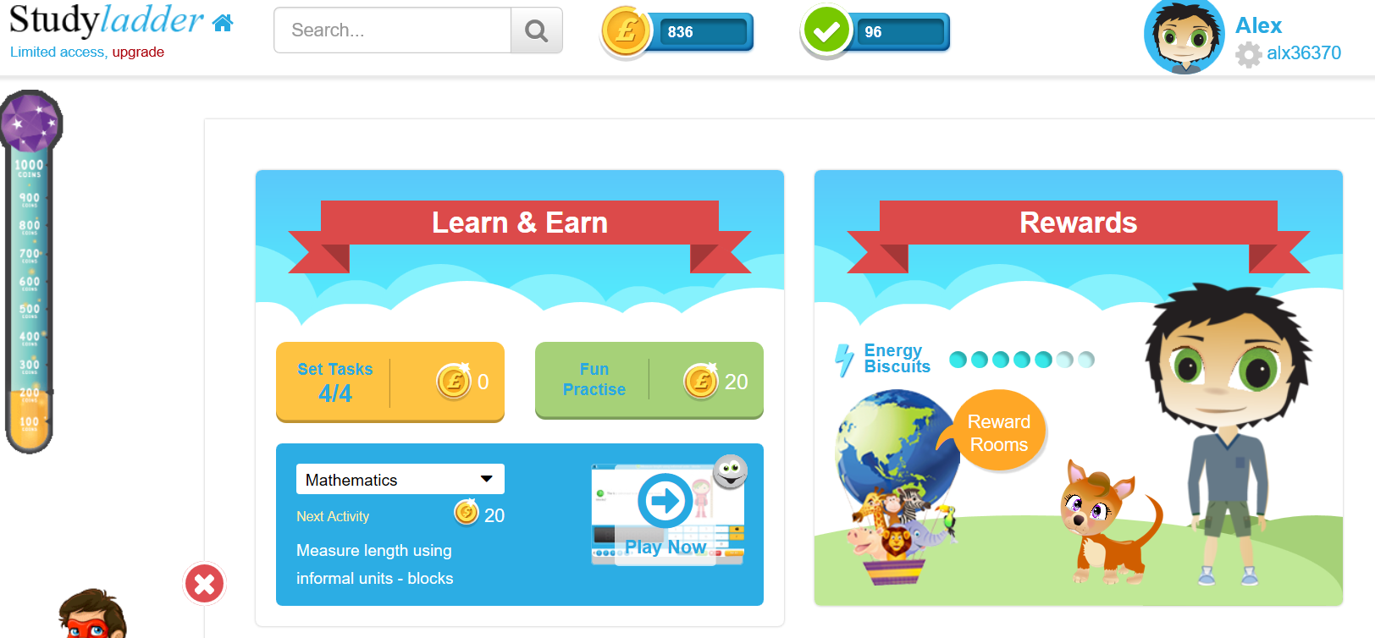
Studyladder
Notes:
When pupils log-in they can see the set tasks that have been set for them by the teacher, and how many they have completed. They can choose to attempt the set tasks in any order they wish and are able to complete up to 3 activities a day out with school. The website will publicise the ability to upgrade to a premium paid account to allow for unlimited access, but this is not required as pupils will never be set more than maximum tasks for a week.

Slide 10
Studyladder
After completing set tasks, pupils can attempt any other activities on the site, up to a maximum of 3 per day.
Parents can sign up too and link their account so as to monitor the progress their child is making
Teachers are able to see all information on pupil progress, with a traffic light system clearly identifying the areas of strength and development.
The site is designed to be supportive to learners, with assistive tools such as electronic reads being build in
Notes:
There are also further bonuses that come with using the site: (as above)

Slide 11
Family Learning Activity
Practice session in ICT rooms on first floor
3 different activities to try
Opportunity for any questions

