Slide 1
Family Learning in English
S1 CfE Parents’ Evening

Slide 2
What is the purpose of this session?
WHAT: To provide useful ideas to help you to support your child with English at home
WHY: So that school and parents can work closely together to develop English skills and get your feedback on the types of support that parents really need and want
HOW: We have two areas for you to look at: the importance of reading fiction and non-fiction and encouraging this at home, and supporting spelling, punctuation and grammar skills in your child’s written work

Slide 3
What is English like in S1?
Reading tasks
reading class texts and responding through a variety of different tasks (including critical essay writing)
reading a passage/extract and responding to specific RUAE style questions
reading for information/researching and taking notes
Writing tasks
writing in a variety of styles and genres at various length (personal, imaginative, informative, discursive, persuasive)
demonstrating an understanding of written literacy skills (spelling, grammar, punctuation)

Slide 4
What is English like in S1?
Talking & Listening tasks
Solo talk, group presentation, group discussion, responding to oral questions, responding to audio text/film/media

Slide 5
Understanding progress
Red class work jotter
Two ticks and a fix / teacher written comments
Blue ‘Writing’ jotter
PLP feedback sheets with specific assessment criteria
Private reading log
Interim reports
S1 report
Parents’ Evenings

Slide 6
How to...help with Reading
Encourage your child!
“Research shows that children who enjoy reading achieve more highly right across the curriculum. Developing a love of reading is one of the most effective ways a school can raise attainment. Success in reading can improve national test results in all areas but, more importantly, it also sets children up as readers for life, with all the accompanying benefits that follow.”
Oxford School Improvement Report

Slide 7
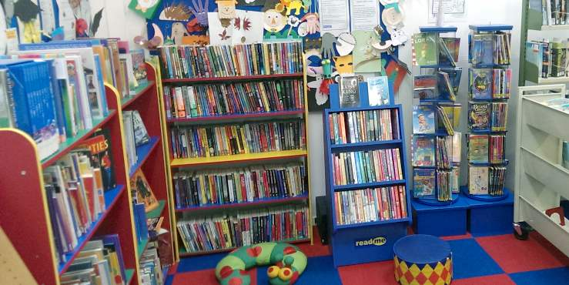
How to...help with Reading
Read with your child
Talk about reading
Read everything and anything!
Join your local library
Make time

Slide 8
Books, Books, Books!
Why not take the book quiz?
Take a look at the Independent's “Top 50 Children’s Books” list
Tick all of the ones that you have read/remember reading
Tick all those your son/daughter has read (that you are aware of)

Slide 9
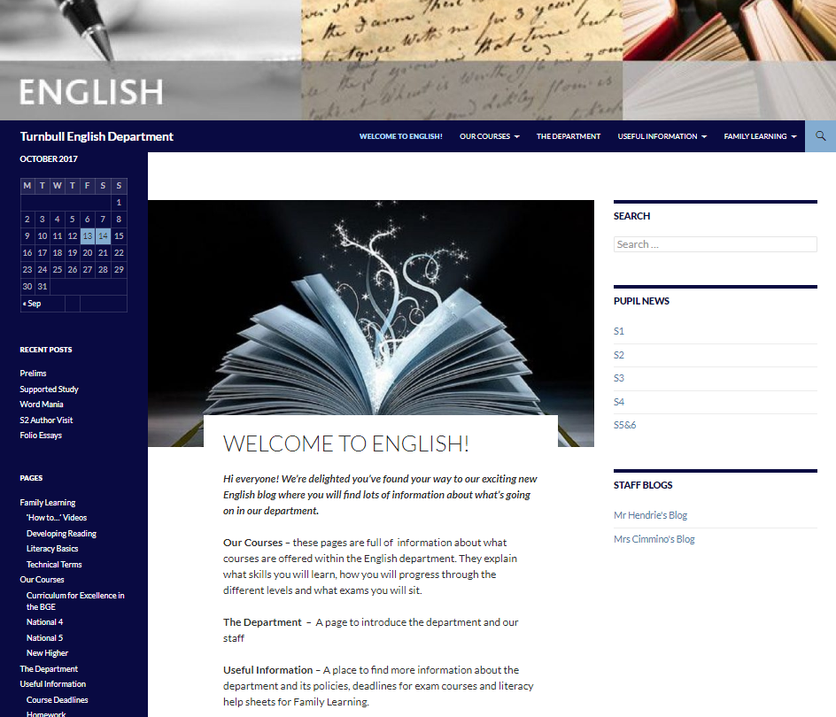
Resources to help
The ‘Developing Reading’ handout sheet
The English blog
The book list
Any library/librarian/book shop
Google

Slide 10
How to...help with Writing!
Encourage them to read
Take an interest in their writing
Read over their work with them
Talk about their writing
Make suggestions – but don’t put words in their mouths!
Help them to proof read

Slide 11
Making it better – technical accuracy
Take a look at the example work
How many errors can you see?
What should it be?
How would you help your child with this?

Slide 12
Example
The door of the house opened the boy went inside. It was dark, the boy looks around for a light. Then he found a lamp on a table near the door. Then the boy turned it on. The room was large like a cave and smeled of damp. The boy stepped forward and heard the floorboard’s creak. It is cold. There was a fireplace at one end of the room, it was empty and full of ashes. The boy walked towards the fireplace. There was a box on the floor infront of it. It was made of wood and looked old with rusty hinges and a broken lach on the front and the lid looked like it was slightly open. the boy reached out to open it.

Slide 13
Making it better - content
We use the mnemonic A CARP PIE
A - Adverbs
C - Connectives
A - Adjectives
R – Relative Pronouns
P - Prepositions
P - Punctuation
I – ‘ing’ words
E – ‘ed’ words

Slide 14
Making it better - content
In weaker writing, sentences mostly begin with a noun, or the definite article (The).
Verbs are also often connected by and, then, or so.
Using A CARP PIE teaches pupils how to vary the way they begin a sentence, or by using punctuation or a relative pronoun to change the middle of the sentence.
Taken altogether, the skills have the effect of creating more interesting, detailed and sophisticated pieces of writing.

Slide 15
Example 2
Slowly, the imposing oak door of the run-down house opened. The young boy tiptoed cautiously inside. Darkness. Searching for a light, his eyes spotted a lamp on a table near the door. Frightened by what might emerge from the darkness, the boy turned it on.
The room was large like a cave and smelled of damp, the odour invading the boy’s nostrils and clinging to his throat. Inching forward, the floorboards creaked under his tiny weight. It was cold; there was a fireplace at one end of the room, but it was empty and full of ashes. The boy walked gingerly towards the fireplace. On the floor lay a box made of wood. It looked old; rusty hinges glowed amber in the pale light and it had a broken latch on the front. The lid looked slightly open. Nervously, the boy reached out a trembling hand to open it...

Slide 16
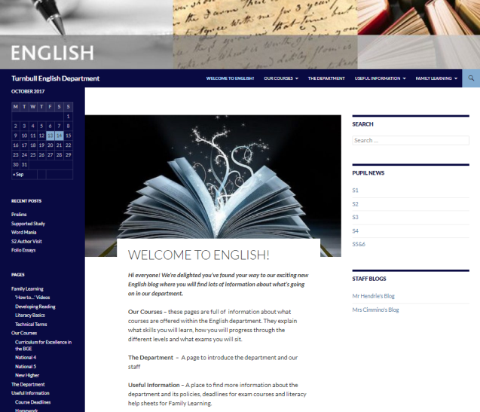
Resources to help
The ‘Core Writing Checklist’
The English blog
Pupil jotter – notes on skills, teacher comments/feedback
Google

