Slide 1
English & Literacy
Turnbull High School
S1 CfE Evening

Slide 2
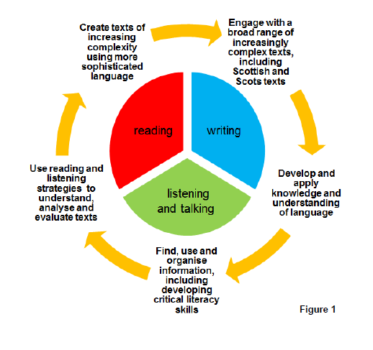
Key Areas for Focus
Notes:
Make up of the S1 –S3 course centred around the significant aspects of learning for English and literacy. Tonight we will focus on writing and how to support pupils in raising attainment in this area.

Slide 3
Raising Attainment in Writing
Majority of pupils are able to write in some detail and with reasonable accuracy on a number of topics and in various genres.
Some struggle to improve the overall quality and sophistication of their writing without support and guidance.
Building upon prior knowledge and skills learned in primary, we aim to further develop pupils’ understanding of language and help them progress in their writing.
Notes:
Writing is, naturally, a skill that crosses the curriculum and, in raising the attainment of pupils’ writing, it can have an impact across a number of subjects.

Slide 4
Task
Read the short extract presented on the worksheet.
With a partner, take 1 minute to discuss your thoughts on the piece.
Was it interesting? Why? Why not?
Was it engaging? Why? Why not?
Did it make you want to read more?
How much do you now know about the character/plot/setting?
Notes:
Photocopy worksheets to be available. Take feedback after brief partner discussion. Tease out the ideas that it is bland, boring, not much detail etc. Too many uses of “the boy”. Long sentence at the end with repeated “and”.

Slide 5
Knowledge from Primary
Many primary schools encourage pupils to consider the structure and impact of their writing by using the acronym VCOP
V – Vocabulary
C – Connectives
O – Openers
P – Punctuation
Notes:
Ask if parents are familiar with this. Vocabulary is the words we use, connectives is how we join ideas together (and, so, but, although, while etc.), openers is how we begin a sentence (order of words/ideas) and punctuation is how we break up ideas within a sentence or end it.

Slide 6
A Carp Pie
We build upon this learning by introducing pupils to additional skills for improving their writing.
We use the mnemonic A CARP PIE
A - Adverbs
C - Connectives
A - Adjectives
R – Relative Pronouns
P - Prepositions
P - Punctuation
I – ‘ing’ words
E – ‘ed’ words
Notes:
Built upon the same principles as VCOP, but looking deeper and more specifically at techniques/skills to develop writing. Broadening pupil understanding.

Slide 7
The Theory
In weaker writing, sentences mostly begin with a noun, or the definite article (The).
Verbs are also often connected by and, then, or so.
Using A CARP PIE teaches pupils how to vary the way they begin a sentence, or by using punctuation or a relative pronoun to change the middle of the sentence.
Taken altogether, the skills have the effect of creating more interesting, detailed and sophisticated pieces of writing.

Slide 8
A is for adverbs
An adverb is a word which describes a verb (e.g. fast, slowly, well) It usually describes how or when the verb is being done.
C is for connectives
Use words/phrases such as While, As, During, Before, After, Although, As if, As long as, As though, Because, If, In case, Once, Since, Though, Until, Unless, When, Whenever, Where, Wherever, to begin sentences.
Notes:
Quick run through of the following slides. Don’ t take too much time. Highlight that there is a help sheet that contains the same information along with specific examples.

Slide 9
A is for adjectives
An adjective is a word that describes a noun
You can pair two adjectives together at the start of a sentence, usually linked by ‘and’ or ‘but’.
R is for relative pronouns
The main relative pronouns are who, which and that.
Who is used for people.
Which and that are used for animals and things.
Notes:
Emphasis that the idea is for pupils to become familiar with these skills and to internalise them. To not only recognise when they are being used by other writers (reading) but to apply then to their own writing.

Slide 10
P is for prepositions
A preposition is a word or group of words linking a noun to the rest of the sentence, often indicating place or position.
Under, over, behind, below, on top of, beside
P is for punctuation
An easy, simple and efficient way to improve the quality of writing is to use a range of punctuation:
Some common examples are given on the next slide
Notes:
To start with, this may be used more frequently when pupils are redrafting and are going back over their work for a second time. However, as time goes on, pupils should become more able to apply these strategies when writing for the first time.

Slide 11
Colon (:) means a list or an example is to follow.
Semi colon (;) means that additional information or explanation is about to be given, which is linked to the previous idea. A semi-colon can often replace the word ‘and’.
Dash (-) emphasises the additional words/idea after the dash.
A pair of dashes (- -) known as parenthesis, emphasises the words between the dashes.
Ellipsis (…) the idea is unfinished/some words are missing. This can create suspense.

Slide 12
I is for ‘ing’ words
The – “ing” word must be a verb; it is called a present participle.
E is for ‘ed’ words
Starting a sentence in this way can add impact and help the reader connect with the character/narrator.
e.g. Flabbergasted, Johnny watched helplessly as Steve rushed out into the busy traffic.

Slide 13
Task
Look back at the extract from earlier.
How many of the skills and techniques have been used?
Try to rewrite and improve the extract by including some of the skills of A CARP PIE
A help sheet with reminders and examples is provided
Notes:
Back to first w/sheet with extract. Try to improve the sentences by applying some of the techniques. Use the help sheet for ideas.

Slide 14
In Practice
Slowly, the imposing oak door of the run-down house opened. The young boy tiptoed cautiously inside. Darkness. Searching for a light, his eyes spotted a lamp on a table near the door. Frightened by what might emerge from the darkness, the boy turned it on.
The room was large like a cave and smelled of damp, the odour invading the boy’s nostrils and clinging to his throat. Inching forward, the floorboards creaked under his tiny weight. It was cold; there was a fireplace at one end of the room, but it was empty and full of ashes. The boy walked gingerly towards the fireplace. On the floor lay a box made of wood. It looked old; rusty hinges glowed amber in the pale light and it had a broken latch on the front. The lid looked slightly open. Nervously, the boy reached out a trembling hand to open it...
Notes:
One I made earlier...

