Slide 1
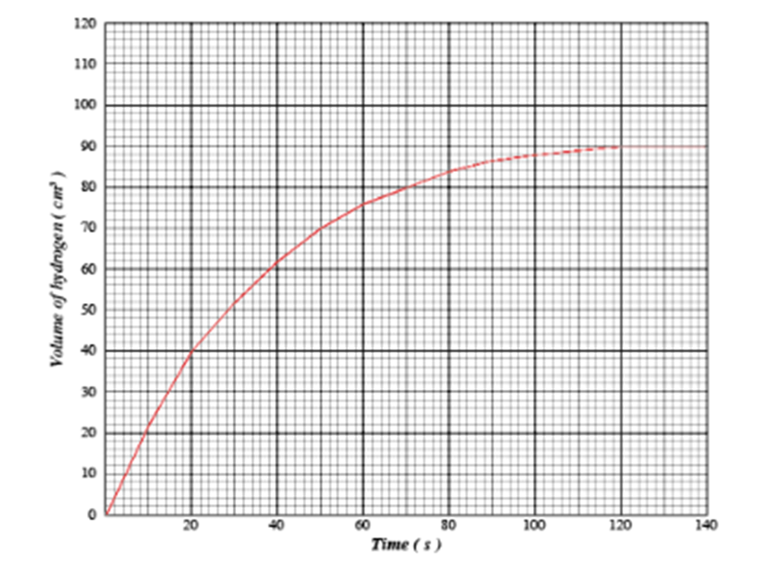
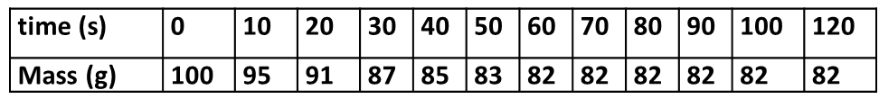
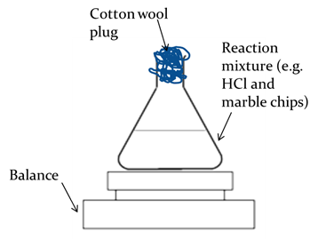
Chemistry Revision Mind Map Unit 1– Reaction Rate 1
List 4 factors which will increase the rate of a chemical reaction.
Draw a label 2 pieces of apparatus which could be used to collect a gas in this reaction:
1.
2.
The graph below shows the volume of hydrogen produced in the reaction of 1g of magnesium ribbon and 1 M hydrochloric acid.
Draw a green line on the graph to show using 1g of magnesium powder and 1 M hydrochloric acid.
Draw a blue line on the graph to show using 1g magnesium ribbon and 0.5M hydrochloric acid(if acid is excess).
Draw a line to show when the reaction finished and state the time.
Reaction stopped:
The average rate of reaction in the first 40 seconds is:
How do you calculate average rate of reaction?
Calculate the average rate of reaction between 10 and 40 seconds, using the appropriate units.
What will happen to the mass of this apparatus over time? Explain why?
In a reaction the volume increased from 20cm³ to 80cm³ in 200 seconds. What was the average rate of reaction in cm³s⁻¹?

Slide 2
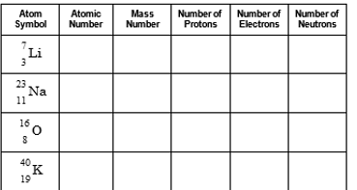
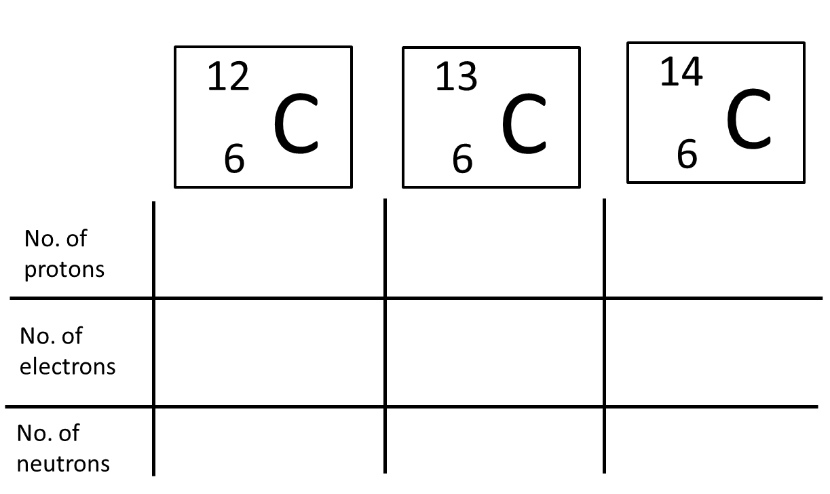
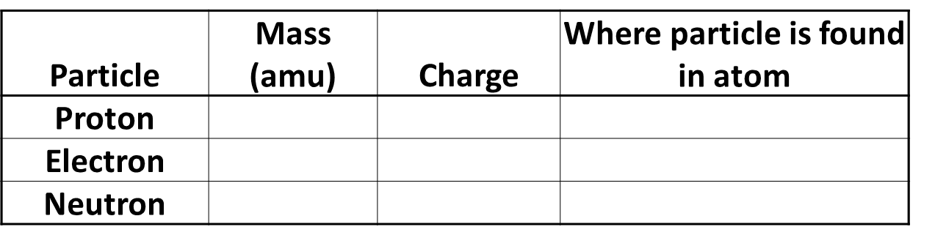
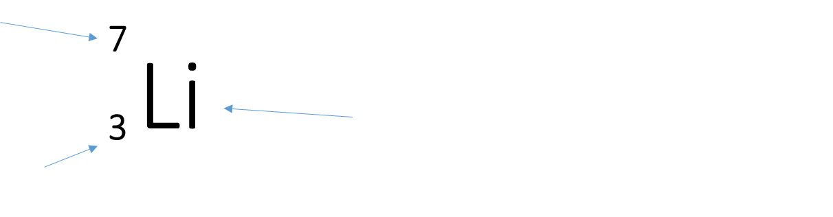
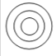
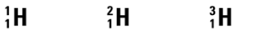
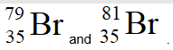
Chemistry Revision Mind Map Unit 1– Atomic structure 2
Draw and label the structure of the atom.
State how you could calculate the mass number of an element.
Complete the following:
What is an isotope:
Complete the following:
State how you could calculate the number of neutrons in an element.
How many electrons are able to go in the 1st, 2nd, 3rd shell.
1st:
2nd:
3rd:
Complete the table:
Below shows you nucleotide notation of an element. Label what each arrow is showing
Draw an electron shell diagram for sodium and for oxygen add write the electron arrangement:
Sodium:
Oxygen:
Hydrogen has 3 isotopes, it has a relative atomic mass of 1.0, which isotope do you think is most abundant ?
State why an atom is neutral.
What does the atomic number tell us
Write the nucleotide notation for Sodium which has a mass number of 23.
Bromine has two isotopes, shown. The relative atomic mass of bromine is 80. What does this suggest about the percentage of each isotope?
What charge is the nucleus of an atom.

Slide 3
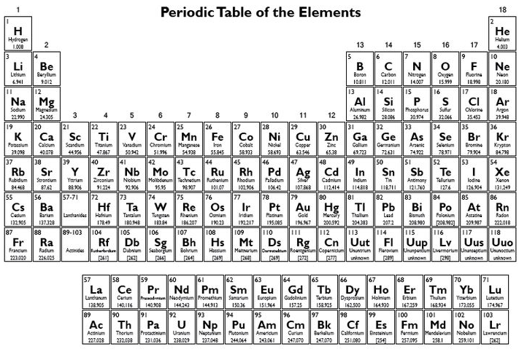
Chemistry Revision Mind Map Unit 1– Periodic Table 3
State the name of group 1 elements.
State the name of Group 7 elements.
Explain why the group 0/8 elements have similar chemical properties?
Labels the groups, high-light the metals and non-metals and identify the atomic number on the below Periodic table.
Are group 1 elements reactive or unreactive? Why?
Explain why group 7 elements have similar chemical properties?
Describe how the reactivity changes as you go down group 1.
Are group 8 elements reactive or unreactive? Why?
Explain why group 7 elements gain an electron?
Explain why group 1 elements have similar chemical properties?
Explain why group 1 metals lose an electron.
State the name of group 8/0 elements.
Define the following:
Element:
Atom:
Ion:

Slide 4
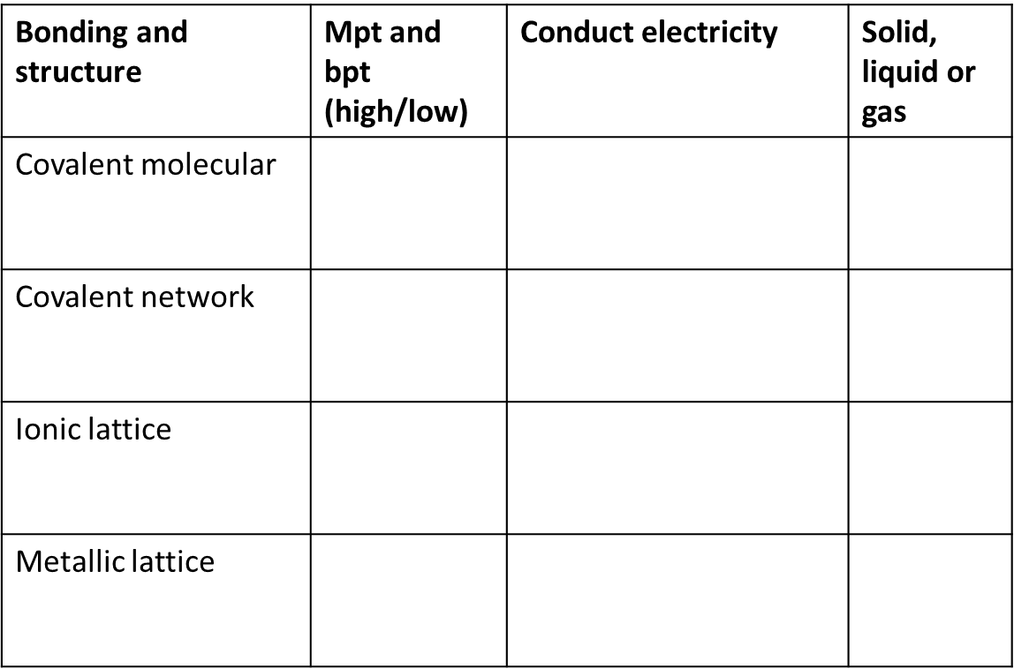
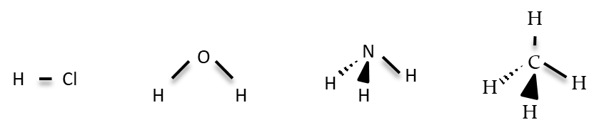
Chemistry Revision Mind Map Unit 1– Bonding 4
What is a covalent bond
What holds the electrons together in a covalent bond
Draw a diagram showing outer electrons to show NH₃
Complete the table below:
Draw a diagram showing outer electrons to show the bonding in HCl
What group in the periodic table are monatomic? What does this mean.
What is an ionic bond
What elements are diatomic? What does this mean.
What is a compound
What name is given to describe the shapes of the following molecules.
Why can ionic solutions conduct electricity when in solution but not when solid?:
What is a metallic bond
Draw a diagram showing outer electrons to show N₂
Why do elements in an ionic bond transfer electrons?
Why can metallic substances conduct electricity.
What is a molecule
.

Slide 5
Chemistry Revision Mind Map Unit 1– Writing formula 5
Write the chemical formula for the following: (SVSDF)
Magnesium hydride
2) Carbon iodide
3) Silicon oxide
4) Beryllium sulphide
Write the chemical formula for the following:
(prefix method)
Carbon dioxide
2) Dinitrogen tetraoxide
3) Nitrogen trihydride
4) Dihydrogen dioxide
Write the chemical formula for the following:
(SVSDF roman numerals method)
Copper(II) oxide
Nickel(II) chloride
Vanadium(V) oxide
Write the chemical formula for the following:
(SVSDF using complex ions, p8 of data book)
Magnesium phosphate
2) Copper(II) nitrate
3) Ammonium carbonate
Write the formula with charges for the following: (remember metals have a positive charge, non-metals have a negative charge)
1) Aluminium Sulfide 2) Copper (II) Nitrate 3) Aluminium hydroxide

Slide 6
Chemistry Revision Mind Map Unit 1– Calculations 6
Draw the two calculations triangles you use in chemistry with the appropriate units
Calculate the mass of:
3 moles of K₂S0₄
0.025 moles of Mg(NO₃)₂
Calculate the concentration of 0.05 moles of 25cm³ HCl
Calculate the volume of 0.04moles of 0.1 molL⁻¹ of H₂SO₄
Calculate the gram formula mass for the following:
1) CO₂
2) K₂SO₄
3) Mg(NO₃)₂
Calculate the number of moles of:
15g of K₂S0₄
2) 0.04g of Mg(NO₃)₂
Calculate the mass of CO₂ produced from 5g of ethene (C₂H₄)
C₂H₄ + 3O₂ → 2CO₂ + 2H₂O

Slide 7
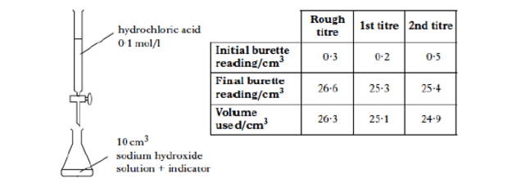
Chemistry Revision Mind Map Unit 1– Acids and Bases 7
Describe the concentration of H⁺ and OH⁻ ions in a neutral solution.
Complete the word equation for the following:
Metal oxide + acid →
Metal hydroxide + acid →
Metal carbonate + acid →
Sodium oxide + hydrochloric acid →
Potassium hydroxide + sulphuric acid →
Calcium carbonate + nitric acid →
The following titration was carried out:
Why is an indicator used?
Calculate the average volume of hydrochloric acid used in the titration.
Why is the rough titre not used?
What does concordant results mean?
What two pieces of equipment are used in titrations to measure accurate volumes?
Describe the concentration of H⁺ and OH⁻ ions in an acidic solution.
What are spectator ions?
Describe the concentration of H⁺ and OH⁻ ions in an alkali solution.
30 cm³ of 1 mol l⁻¹ potassium hydroxide solution was neutralised by 50 cm³ of sulphuric acid. Calculate the concentration of the sulphuric acid.
H₂SO₄ + 2KOH → K₂SO₄ + 2H₂O
Which type of oxides dissolve in water to form an acidic solution?
Which type of oxides dissolve in water to form an alkali solution?
Which type of oxides dissolve in water to form a neutral solution?
Name three metal bases:

Slide 8
Chemistry Revision Mind Map Unit 2– Homologous series 1
What is a homologous series?
What are the prefixes for carbon compounds?
1 Carbon- 2 Carbons-
3 Carbons- 4 Carbons-
5 Carbons- 6 Carbons-
7 Carbons- 8 Carbons-
Describe the steps required to name a carbon compound.
What is the trend in boiling and melting points within a homologous series as molecular size increases?
Describe how to identify an alkane from
their structure
their name
What is the general formula of:
1. alkanes
2. alkenes
3. cycloalkanes
Explain the above trend.
What are hydrocarbons?
Describe how to identify an alkene from
their structure
their name
Draw 2-methylpentane
Draw 2-methylbut-2-ene
What are saturated hydrocarbons?
What are unsaturated hydrocarbons?
Describe the test to distinguish between unsaturated and saturated compounds.
Describe how to identify an cycloalkane from
their structure
their name

Slide 9
Chemistry Revision Mind Map Unit 2–Homologous series 2
What are isomers?
Draw hex-1-ene and one of its isomers
What is meant by hydration?
Draw butane and one of its isomers
Draw the product made when water reacts with propene
What is an addition reaction?
What is meant by halogenation?
Draw propene and one of its isomers
What is meant by hydrogenation?
Draw the product made when bromine reacts with but-1-ene.
Draw the product made when hydrogen reacts with ethene

Slide 10
Chemistry Revision Mind Map Unit 2– Everyday consumer products 3
Describe how to identify an alcohol from
their structure
their name
Describe how to identify an carboxylic acid from
their structure
their name
Draw the full structural formula of butan-2-ol
Draw the shortened structural formula of hexan-3-ol
What is name is given to the functional group of alcohols ?
What is name is given to the functional group of carboxylic acids ?
Draw the molecular formula of propan-1-ol
What is the general formula of alcohols?
Which carboxylic acids is the main component of vinegar?
Draw the full structural formula of heptanoic acid.
What happens to the solubility of alcohols as their size increases?
What happens to the solubility of carboxylic acid as their size increases?
Draw the shortened structural formula of pentanoic acid.
Explain why as alcohols increase in size their melting and boiling points increase
Explain why as carboxylic acid increase in size their melting and boiling points increase
Draw the molecular formula of methanoic acid.

Slide 11
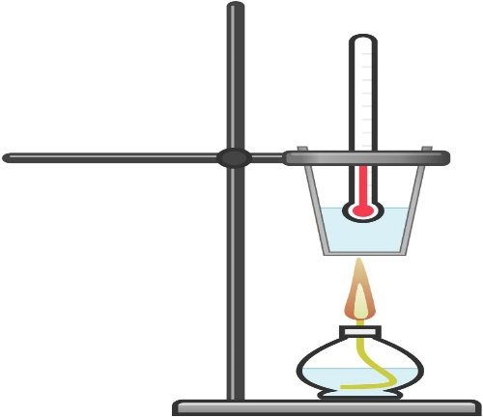
Chemistry Revision Mind Map Unit 2– Energy from fuels 4
What word is used to describe a reaction or process that releases heat energy?
Write a word equation, chemical equation and balanced chemical equation for when propane reacts completely oxygen.
Which formula allows the energy released when a fuel burns to be calculated?
What word is used to describe a reaction or process that takes in heat energy?
What are the units for each term in the above equation?
What is a fuel?
Calculate the energy released when 50cm³ of water is heated from 10.3ºC to 28.4ºC. Include the correct units for your answer.
Using this apparatus which measurements would need to be taken to allow the energy released to be calculated?
What happens during a combustion reaction?
Calculate the temperature rise when 100g of water absorbs 26.7 kJ of energy. Include the correct units for your answer.
What is produced when a hydrocarbon or alcohol burns in a plentiful supply of oxygen (complete combustion)?
Give examples of possible sources of error within this experiment. Include a way of preventing the error.
What is produced when a hydrocarbon or alcohol burns in a limited supply of oxygen (incomplete combustion)?
Calculate the specific heat capacity of the sodium chloride solution which requires 15.6kJ of energy to heat 100g of solution by 24ºC. Include the correct units for your answer

Slide 12
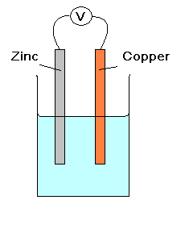
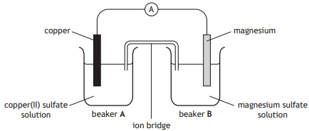
Chemistry Revision Mind Map Unit 3 – Metals 1
What is metallic bonding?
What are the three methods of extracting metals from ores and what metals would be extracted using each method?
1.
2.
3.
This is a simple cell:
What is the purpose of the electrolyte?
Why is the electrolyte an ionic solution?
Write the reduction, oxidation and redox reaction for the cell above:
Reduction:
Oxidation:
Redox:
Show on the diagram the path of electron flow.
Draw the structure of a metallic lattice
Why is a D.C supply used in electrolysis?
Why can metals conduct electricity?
Complete the word equation for the following:
Metal + oxygen →
Metal + water →
Metal + dilute acid →
Zinc + oxygen →
Lithium + water →
Magnesium + hydrochloric acid →
If a metal is found uncombined in the Earths crust, what does this suggest about its reactivity?
This is a half cell:
What is the purpose of the ion bridge?
Show the path of electron flow.
What is the name given to a naturally occurring rocks that contain metal compounds?
What is an oxidation reaction in terms of electrons?
What non-metal can be used as electrodes in half-cells?
What is a reduction reaction in terms of electrons?
Electrons flow from the metal _______________ in the electrochemical series to the metal ________________ in the electrochemical series.
Metals can be extracted from their ore. Metal ions from metal atoms, what is this reaction called?
Write the ion-electron equation for iron (II) ions forming iron (III) ions. What is this reaction called?
The further apart metals are in an electrochemical series, the _______________ the voltage.
When copper is connected to copper in an electrochemical cell the voltage is ___________.

Slide 13
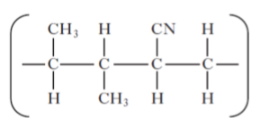
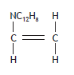
Chemistry Revision Mind Map Unit 3 – Plastics 2
Plastics are materials known as:
Is a monomer saturated or unsaturated? What does this mean?
From the following co-polymer, draw the two monomers used to make it.
Draw a section of a polymer showing three of the following monomers joined together:
Draw the repeating unit for the above polymer you have drawn.
Polymers are long chain molecules formed by joining what together?
What is the name of the reaction called forming a polymer?
Name the monomers used to make the following:
Polystyrene
Polyethene
Polyvinylchlride
Name the polymer made from the following monomers:
Propene
Styrene
Tetraflouroethene

Slide 14
Chemistry Revision Mind Map Unit 3 – Fertilisers 3
The three elements required for plant growth are:
What are the two reactants for the Haber process?
What is the catalyst used in this process?
Write a balanced chemical equation to show the production of ammonia.
Complete the following equations:
Ammonia + Nitric acid →
Potassium hydroxide + Nitric acid →
Circle the salts produced above.
Give two reasons why these salts would be good fertilisers.
What is the name given to the reactions above?
What is the purpose of fertilisers?
Why do fertilisers need to be soluble?
The production of ammonia is a reversible reaction, draw the arrows used to represent this.
What is the formula for ammonia?
What catalyst is used in the Haber process?
What is the purpose of adding a catalyst?
When ammonia dissolves in water, what colour would pH paper turn? Why?
Calculate the percentage of nitrogen in the fertiliser ammonium nitrate (NH₄NO₃)?
What is the name of the process used to make Nitric acid?
What is the name of the process used to make ammonia?
What are the three starting materials in this process?

Slide 15
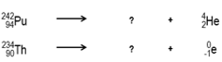
Chemistry Revision Mind Map Unit 3 – Nuclear Chemistry 4
Where does radioactive decay occur in an atom?
An alpha particle can be represented as:
What does the term half-life mean?
A beta particle can be represented as:
Unstable nuclei become more stable by giving out which three forms of radiation?
1.
2.
3.
What affect would increasing the temperature have on the half-life of an isotope?
A proton can be represented as:
Alpha particles are stopped by:
Beta particles are stopped by:
Gamma particles are stopped by:
A neutron can be represented as:
16 g of a radioisotope has a half-life of 20 days. What mass of the original isotope will still be left after 60 days?
Complete the following equations and decide whether the isotope is undergoing alpha or beta decay.
1.
2.
A luminous watch dial containing a material with a half life of 2.5 years has only 1/8th of its original glow. How old is the watch?
Alpha particles are attracted to a _______________ plate
Beta particles are attracted to a ______________ plate.
Gamma particles are not deflected by an electric field.

Slide 16
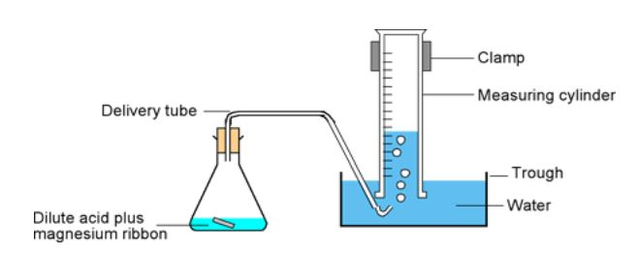
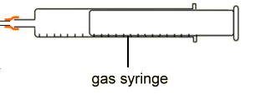




Chemistry Revision Mind Map Unit 1– Reaction Rate 1
List 4 factors which will increase the rate of a chemical reaction.
Draw a label 2 pieces of apparatus which could be used to collect a gas in this reaction:
1.
2.
The graph below shows the volume of hydrogen produced in the reaction of 1g of magnesium ribbon and 1 M hydrochloric acid.
Draw a green line on the graph to show using 1g of magnesium powder and 1 M hydrochloric acid.
Draw a blue line on the graph to show using 1g magnesium ribbon and 0.5M hydrochloric acid(if acid is excess).
Draw a line to show when the reaction finished and state the time.
Reaction stopped:
The average rate of reaction in the first 40 seconds is:
- INCREASED concentration
- INCREASED temperature
- DECREASED particle size
- catalyst
How do you calculate average rate of reaction?
Rate = $\frac{∆quantity}{∆time}$
Calculate the average rate of reaction between 10 and 40 seconds, using the appropriate units.
Rate = $\frac{∆quantity}{∆time}$ = $\frac{(95−85)}{(40−10)}$
What will happen to the mass of this apparatus over time? Explain why?
= 0.33 g / s
Decrease – losing gas bubbles and gas bubbles have mass
In a reaction the volume increased from 20cm³ to 80cm³ in 200 seconds. What was the average rate of reaction in cm³s⁻¹?
Rate = $\frac{∆quantity}{∆time}$ = $\frac{(60−0)}{(40−0)}$ = 1.5 cm³ / s
Rate = $\frac{∆quantity}{∆time}$ = $\frac{(80−20)}{200}$ = 0.3cm³ / s

Slide 17
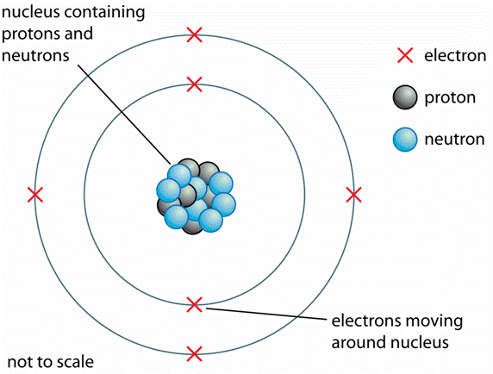
Chemistry Revision Mind Map Unit 1– Atomic structure 2
Draw and label the structure of the atom.
State how you could calculate the mass number of an element.
Complete the following:
What is an isotope:
Particles with the same atomic number but different mass numbers
(same protons different neutrons)
Protons and neutrons together
3
7
3
3
4
11
23
11
11
12
8
16
8
8
8
Complete the following:
State how you could calculate the number of neutrons in an element.
19
40
19
19
21
Mass number – atomic number = no of neutrons
How many electrons are able to go in the 1st, 2nd, 3rd shell.
1st:
2nd:
3rd:
Complete the table:
6
6
6
2
6
6
8
6
8
6
7
8
1
1+
nucleus
Below shows you nucleotide notation of an element. Label what each arrow is showing
none
1-
Energy levels
1
none
nucleus
Draw an electron shell diagram for sodium and for oxygen add write the electron arrangement:
Sodium:
Oxygen:
Hydrogen has 3 isotopes, it has a relative atomic mass of 1.0, which isotope do you think is most abundant ?
Mass No
State why an atom is neutral.
Equal numbers of protons and electrons
DO NOT WRITE protons cancel electrons as this also happens in ions which are NOT neutral
e
Symbol
e
e
Atomic No
e
e
e
2, 8, 1
e
e
e
RAM is closest to 1
e
e
What does the atomic number tell us
Write the nucleotide notation for Sodium which has a mass number of 23.
Bromine has two isotopes, shown. The relative atomic mass of bromine is 80. What does this suggest about the percentage of each isotope?
No of protons
e
e
23
e
e
e
2, 6
Na
e
What charge is the nucleus of an atom.
11
e
e
Positive ( protons are here)
Same amount of each.
RAM is in the middle of both masses

Slide 18
Chemistry Revision Mind Map Unit 1– Periodic Table 3
State the name of group 1 elements.
State the name of Group 7 elements.
Explain why the group 0/8 elements have similar chemical properties?
Labels the groups, high-light the metals and non-metals and identify the atomic number on the below Periodic table.
Noble gases
Alkali metals
halogens
halogens
Are group 1 elements reactive or unreactive? Why?
Explain why group 7 elements have similar chemical properties?
Same number of outer e⁻
Transition metals
Very reactive – have 1 outer e⁻
Atomic numbers
Same number of outer e⁻
Non-metals
Describe how the reactivity changes as you go down group 1.
Are group 8 elements reactive or unreactive? Why?
Explain why group 7 elements gain an electron?
Get more reactive
To achieve stable electron arrangements
Unreactive – already have achieved stable electron arrangements
Alkali metals
Explain why group 1 elements have similar chemical properties?
Same number of outer e⁻
Explain why group 1 metals lose an electron.
State the name of group 8/0 elements.
Define the following:
Element:
Atom:
Ion:
Substance in which all the atoms are the same type
To achieve stable electron arrangements
Proton and electron numbers are equal – neutral charge overall
Noble gases
Proton and electron numbers are unequal.
+ ions have more p than e. – ions have more e⁻ than p

Slide 19
Chemistry Revision Mind Map Unit 1– Bonding 4
What is a covalent bond
What holds the electrons together in a covalent bond
Draw a diagram showing outer electrons to show NH₃
Complete the table below:
e⁻
e⁻
Name for the attraction that two nuclei have for a shared pair of electrons
Attraction that two nuclei have for a shared pair of electrons
.
e⁻
.
e⁻
e⁻
e⁻
Draw a diagram showing outer electrons to show the bonding in HCl
low
never
s, l & g
e⁻
High
Never
(except graphite)
s
What group in the periodic table are monatomic? What does this mean.
e⁻
e⁻
.
e⁻
High
YES - aq or l
s
Group 0 - Atoms not bonded to anything.
No - s
e⁻
.
variable
Always
s (Hg=l)
e⁻
e⁻
e⁻
What is an ionic bond
e⁻
What elements are diatomic? What does this mean.
Attraction between positive and negative ions
e⁻
H₂ , N₂, O₂, F₂, Cl₂, I₂, Br₂
What is a compound
What name is given to describe the shapes of the following molecules.
Why can ionic solutions conduct electricity when in solution but not when solid?:
Two or more different types of atom(substance) chemically bonded together
Exist as pairs of two atom molecules
(aq) – ions free to move to electrodes
(s) – ions not free to move to electrodes
What is a metallic bond
Attraction between positive ions and a sea of delocalised electrons
linear
angular
Trigonal pyramidal
tetrahedral
Draw a diagram showing outer electrons to show N₂
Why do elements in an ionic bond transfer electrons?
Why can metallic substances conduct electricity.
e⁻
e⁻
e⁻
e⁻
To achieve stable electron arrangements
e⁻
What is a molecule
.
e⁻
e⁻
e⁻
Free moving electrons
e⁻
Small group of atoms covalently bonded together
e⁻

Slide 20
Chemistry Revision Mind Map Unit 1– Writing formula 5
Write the chemical formula for the following: (SVSDF)
Magnesium hydride
2) Carbon iodide
3) Silicon oxide
4) Beryllium sulphide
Write the chemical formula for the following:
(prefix method)
Carbon dioxide
2) Dinitrogen tetraoxide
3) Nitrogen trihydride
4) Dihydrogen dioxide
Write the chemical formula for the following:
(SVSDF using roman numerals method)
Copper(II) oxide
Nickel(II) chloride
Vanadium(V) oxide
Write the chemical formula for the following:
(SVSDF and using complex ions, p8 of data book)
Magnesium phosphate
2) Copper(II) nitrate
3) Ammonium carbonate
S
V
S
D
F
Mg H
2 1
S
V
S
D
F
Cu O
S
V
S
D
F
Mg (PO₄)
MgH₂
1 2
CO₂
x
2 2
2 3
MgH₂
CuO
2 2
Mg₃(PO₄)₂
3 2
S
V
S
D
F
C I
1 1
x
CuO
Mg₃(PO₄)₂
C I₄
4 1
1 4
N₂O₄
S
V
S
D
F
Ni Cl
S
V
S
D
F
Cu (NO₃)
x
2 1
2 1
C I₄
Cu(NO₃)₂
1 2
S
V
S
D
F
Si O
NiCl₂
1 2
x
x
Cu(NO₃)₂
SiO₂
4 2
NH₃
NiCl₂
2 4
1 2
S
V
S
D
F
(NH₄) (CO₃)
SiO₂
S
V
S
D
F
V O
1 2
S
V
S
D
F
Be S
5 2
(NH₄)₂ CO₃
BeS
2 2
H₂O₂
V₂O₅
2 5
2 1
2 2
x
x
2 2
V₂O₅
BeS
Write the formula with charges for the following: (remember metals have a positive charge, non-metals have a negative charge)
1) Aluminium Sulfide 2) Copper (II) Nitrate 3) Aluminium hydroxide
S
V
S
D
F
(Al³⁺) (S²⁻)
S
V
S
D
F
(Cu²⁺) (NO₃⁻)
S
V
S
D
F
(Al³⁺) (OH⁻)
3 2
2 1
3 1
2 3
1 2
1 3
x
x
x
(Al³⁺)₂(S²⁻)₃
Cu²⁺(NO₃⁻)₂
Al³⁺(OH⁻)₃
(Al³⁺)₂(S²⁻)₃
Cu²⁺(NO₃⁻)₂
Al³⁺(OH⁻)₃

Slide 21
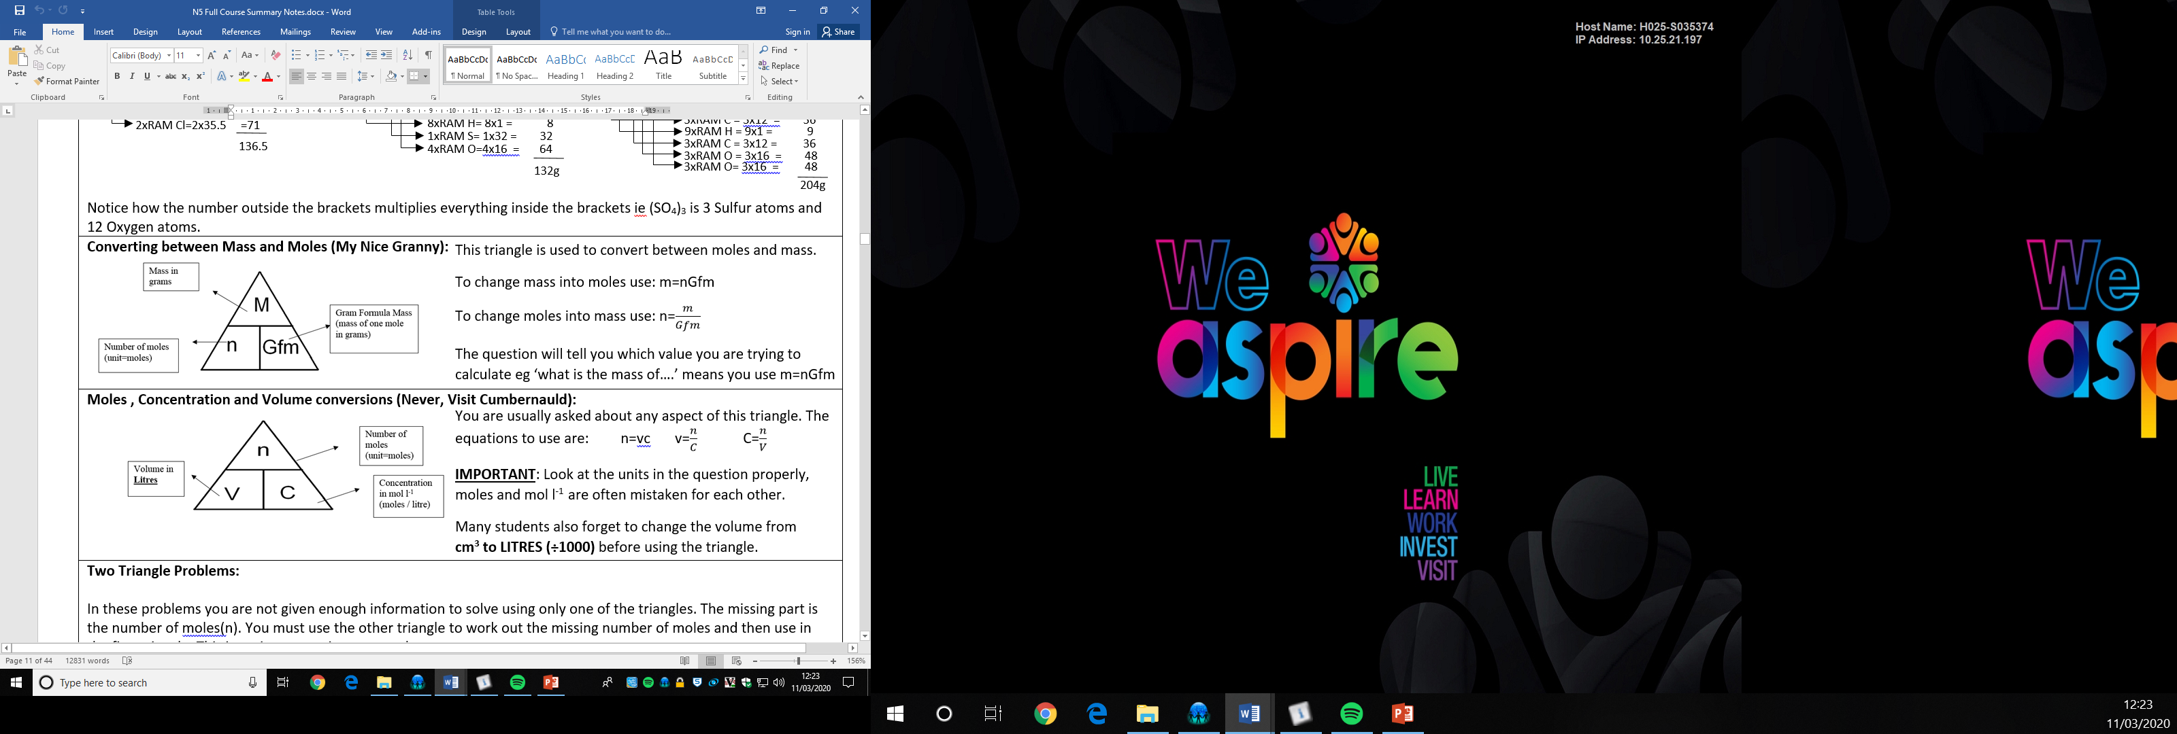




Chemistry Revision Mind Map Unit 1– Calculations 6
Draw the two calculations triangles you use in chemistry with the appropriate units
Calculate the mass of:
3 moles of K₂S0₄
0.025 moles of Mg(NO₃)₂
Calculate the concentration of 0.05 moles of 25cm³ HCl
Calculate the volume of 0.04moles of 0.1 mol l⁻¹ of H₂SO₄
2 x 39 = 78
n = 0.05 moles
1 x 32 = 32
V = 25cm³ = 0.025 l
4 x 16 = 64
+
c = $\frac{n}{v} =\frac{0.05}{0.025}$ = 2 moles / l
174g
m = nGfm = 3 x 174 = 522g
1 x 24.5 = 24.5
2 x 14 = 28
n = 0.04 moles
6 x 16 = 96
+
c = 0.1 mol l⁻¹
148.5g
V = $\frac{n}{c} =\frac{0.04}{0.1}$ = 0.4 l
m = nGfm = 0.025 x 148.5 = 3.71g
Calculate the gram formula mass for the following:
1) CO₂
2) K₂SO₄
3) Mg(NO₃)₂
Calculate the number of moles of:
15g of K₂S0₄
2) 0.04g of Mg(NO₃)₂
Calculate the mass of CO₂ produced from 5g of ethene (C₂H₄)
C₂H₄ + 3O₂ → 2CO₂ + 2H₂O
D
2 x 39 = 78
Q
1 x 12 = 12
1 x 32 = 32
D
Q
2 x 16 = 32
4 x 16 = 64
+
+
174g
44g
D:Q mole ratio: 1mole C₂H₄ → 2 moles CO₂
n = $\frac{m}{Gfm} =\frac{15}{174}$ = 0.086 moles
2x12=24
1x12=12
2 x 39 = 78
4x1 = 4
2x16=32
Fix units:
(question is in mass)
+
+
1 x 32 = 32
28g
44g
4 x 16 = 64
+
m = nGfm
= 1 x 28
= 28g
m = nGfm
= 2 x 44
= 44g
174g
1 x 24.5 = 24.5
2 x 14 = 28
1 x 24.5 = 24.5
6 x 16 = 96
+
2 x 14 = 28
148.5g
D:Q ratio in grams:
28g C₂H₄ → 88g CO₂
6 x 16 = 96
+
Scale ratio to question data (5g)
148.5g
n = $\frac{m}{Gfm} =\frac{0.04}{148.5}$ = 2.69x10⁻⁴ moles
28g C₂H₄ → 88g CO₂
5g C₂H₄ → $\frac{88}{28}$ x 5 → 15.7g CO₂

Slide 22



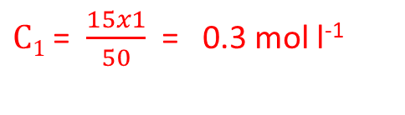




Chemistry Revision Mind Map Unit 1– Acids and Bases 7
Describe the concentration of H⁺ and OH⁻ ions in a neutral solution.
Complete the word equation for the following:
Metal oxide + acid →
Metal hydroxide + acid →
Metal carbonate + acid →
Sodium oxide + hydrochloric acid →
Potassium hydroxide + sulphuric acid →
Calcium carbonate + nitric acid →
The following titration was carried out:
Why is an indicator used?
Calculate the average volume of hydrochloric acid used in the titration.
Why is the rough titre not used?
What does concordant results mean?
What two pieces of equipment are used in titrations to measure accurate volumes?
Salt + water
[H⁺] = [OH⁻]
Salt + water
Salt + water + carbon dioxide
Describe the concentration of H⁺ and OH⁻ ions in an acidic solution.
Sodium chloride + water
Potassium sulfate+water
[H⁺] > [OH⁻]
Calcium nitrate
+ water +
Carbon dioxide
What are spectator ions?
Describe the concentration of H⁺ and OH⁻ ions in an alkali solution.
Ions that do not take part in the reaction – remain unchanged at the end of reaction
[H⁺] < [OH⁻]
30 cm³ of 1 mol l⁻¹ potassium hydroxide solution was neutralised by 50 cm³ of sulfuric acid. Calculate the concentration of the sulphuric acid.
H₂SO₄ + 2KOH → K₂SO₄ + 2H₂O
So that the end point is visible
Which type of oxides dissolve in water to form an acidic solution?
Non-metal oxides dissolve to make acids
$$Acid side$$
Only use concordant results and ignore rough titre
$$alkali side$$
$$\frac{(25.1+24.9)}{2}=25.0cm3$$
Which type of oxides dissolve in water to form an alkali solution?
$\frac{C1V1}{n1}$ = $\frac{C2V2}{n2}$
Metal oxides dissolve to make acids
$\frac{C1x50}{1}$ = $\frac{1x30}{2}$
It is done quickly / not as accurate
Which type of oxides dissolve in water to form a neutral solution?
$\frac{C1x50}{1}$ = $15$
none
Within 0.2cm³ of each other
Name three metal bases:
$C1x50$ = $15x1$
Metal oxides
Metal hydroxides
Metal carbonates
$C1$ = $\frac{15x1}{50}$ = 0.3 mol l⁻¹
Pipettes & burettes
(standard solutions are also used. These are solutions with very accurately known concentrations.)

Slide 23
Chemistry Revision Mind Map Unit 2– Homologous series 1
What is a homologous series?
What are the prefixes for carbon compounds?
1 Carbon- 2 Carbons-
3 Carbons- 4 Carbons-
5 Carbons- 6 Carbons-
7 Carbons- 8 Carbons-
Describe the steps required to name a carbon compound.
Group of chemicals that share similar chemical properties and the same general formula
meth
eth
1. Identify the longest chain (that contains the FG)
prop
but
2. Name the parent giving the FG the LOWEST number
3. Identify, name and number any branches
What is the trend in boiling and melting points within a homologous series as molecular size increases?
pent
hex
4. Group any like branches and add a prefix (eg dimethyl)
Increasing size, increases mp’s/bp’s
hept
Oct
5. Arrange branches in alphabetical order and then write name
Describe how to identify an alkane from
their structure
their name
What is the general formula of:
1. alkanes
2. alkenes
3. cycloalkanes
Explain the above trend.
Larger molecules have stronger intermolecular forces which need more energy to overcome
Chains of carbons, all single bonds, C_{n}H_{2n+2}
C_{n}H_{2n+2}
What are hydrocarbons?
End in ‘ane’
C_{n}H_{2n}
Molecules made of hydrogen and carbon only
C_{n}H_{2n}
Describe how to identify an alkene from
their structure
their name
Chains, have C=C, C_{n}H_{2n}
Draw 2-methylpentane
Draw 2-methylbut-2-ene
What are saturated hydrocarbons?
What are unsaturated hydrocarbons?
Describe the test to distinguish between unsaturated and saturated compounds.
H
H
H
H
H
Molecules with no C=C
H
End in ‘ene’
C
C
C
C
C
H
H
CH₃
H
H
H
Describe how to identify an cycloalkane from
their structure
their name
Molecules with C=C
Rings, all single bonds, C_{n}H_{2n}
H
H
H
H
C
C
C
C
Unsaturated molecules decolourise bromine water immediately
Start with ‘cyclo’ end in ‘ane’
H
CH₃
H
H

Slide 24
Chemistry Revision Mind Map Unit 2–Homologous series 2
What are isomers?
Draw hex-1-ene and one of its isomers
What is meant by hydration?
Molecules with the same molecular formula but different structural formula
H
H
H
H
H
H
Addition reaction with water
H
C
C
H
C
C
C
C
H
H
H
H
Draw butane and one of its isomers
H
H
H
H
H
H
H
H
H
H
Draw the product made when water reacts with propene
H
C
C
H
H
H
H
O
H
C
C
C
C
C
C
C
C
H
H
H
H
C
C
C
H
H
H
H
H
H
H
H
H
+
H
H
H
H
H
H
H
→
H
What is an addition reaction?
C
C
C
H
H
C
C
C
H
H
H
OH
H
CH₃
H
C=C breaks open and a molecule adds into the newly created spaces
What is meant by halogenation?
Draw propene and one of its isomers
What is meant by hydrogenation?
Addition reaction with a halogen
H
H
H
Addition reaction with hydrogen
H
C
C
C
H
H
H
H
C
Draw the product made when bromine reacts with but-1-ene.
H
C
C
H
Draw the product made when hydrogen reacts with ethene
H
H
H
H
H
H
H
H
H
C
C
C
C
H
Br
H
+
H
H
+
Br
C
C
H
H
H
H
H
H
H
→
H
H
H
C
→
C
C
C
H
H
H
C
C
Br
Br
H
H
H
H

Slide 25
Chemistry Revision Mind Map Unit 2– Everyday consumer products 3
Describe how to identify an alcohol from
their structure
their name
Describe how to identify an carboxylic acid from
their structure
their name
Draw the full structural formula of butan-2-ol
H
H
H
H
Have a hydroxyl functional group (-OH)
Have a carboxyl functional group (-COOH)
H
C
C
C
C
OH
H
H
H
H
Names end in ‘ol’
End in ‘oic acid’
Draw the shortened structural formula of hexan-3-ol
CH₃CH₂CH(OH)CH₂CH₂CH₃
What is name is given to the functional group of alcohols?
What is name is given to the functional group of carboxylic acids?
or
CH₃CH₂CH(OH)(CH₂)₂CH₃
carboxyl functional group (-COOH)
Draw the molecular formula of propan-1-ol
hydroxyl functional group (-OH)
O
C₃H₇OH
C
or
OH
C₃H₈O
What is the general formula of alcohols?
Which carboxylic acid is the main component of vinegar?
Draw the full structural formula of heptanoic acid.
H
H
H
H
H
H
O
C_{n}H_{2n+1}OH (or C_{n}H_{2n+2}O)
H
C
C
Ethanoic acid
C
C
C
C
C
H
H
H
H
H
H
OH
What happens to the solubility of as their size increases?
What happens to the solubility of carboxylic acid as their size increases?
Draw the shortened structural formula of pentanoic acid.
Increasing alcohol size decreases solubility
CH₃(CH₂)₃COOH
Increasing carboxylic acid size decreases solubility
Explain why as alcohols increase in size their melting and boiling points increase
Explain why as carboxylic acid increase in size their melting and boiling points increase
Draw the molecular formula of methanoic acid.
Larger molecules have stronger intermolecular forces which need more energy to overcome
Larger molecules have stronger intermolecular forces which need more energy to overcome
HCOOH
or
CH₂O₂

Slide 26





Chemistry Revision Mind Map Unit 2– Energy from fuels 4
What word is used to describe a reaction or process that releases heat energy?
Write a word equation, chemical equation and balanced chemical equation for when propane reacts completely oxygen.
Which formula allows the energy released when a fuel burns to be calculated?
Exothermic
E_{h} = cm∆T
Propane + oxygen → carbon dioxide + water
What word is used to describe a reaction or process that takes in heat energy?
C₃H₈ + 5O₂ → 3CO₂ + 4H₂O
What are the units for each term in the above equation?
E_{h} = energy in kJ
Endothermic
c = heat capacity for water kJ kg⁻¹ ºC⁻¹ (unit in databook)
m = mass of water in kg (1 litre = 1kg)
∆T = change in temperature (ºC)
What is a fuel?
Calculate the energy released when 50cm³ of water is heated from 10.3ºC to 28.4ºC. Include the correct units for your answer.
A substance that burns to release energy
Using this apparatus which measurements would need to be taken to allow the energy released to be calculated?
c = 4.18 (databook)
E_{h} = cm∆T
m = 50cm³ in kg = 0.05kg
What happens during a combustion reaction?
∆T = 28.4-10.3 = 18.1ºC
E_{h} = 4.18 x 0.05 x 18.1
= 3.78kJ
Fuel reacts with oxygen
-Starting and ending water temp
Calculate the temperature rise when 100g of water absorbs 26.7 kJ of energy. Include the correct units for your answer.
- Mass of water present
(or a volume that can be converted to mass)
What is produced when a hydrocarbon or alcohol burns in a plentiful supply of oxygen (complete combustion)?
∆T = $\frac{Eh}{cm}$
E_{h} = 26.7kJ
m=100g in kg = 0.1kg
C=4.18 (databook)
Carbon dioxide and water
Give examples of possible sources of error within this experiment. Include a way of preventing the error.
∆T = $\frac{26.7}{(4.18x0.1)}$ = 63.9ºC
Error source: Heat loss. FIX: heat shield / loose fitting lid
Calculate the specific heat capacity of the sodium chloride solution which requires 15.6kJ of energy to heat 100g of solution by 24ºC. Include the correct units for your answer
What is produced when a hydrocarbon or alcohol burns in a limited supply of oxygen (incomplete combustion)?
Error source: poor heat transfer. FIX: copper can used
Error source: measuring temp of can instead of water.
FIX: keep thermometer off can when taking measurement
Carbon monoxide + soot (carbon)
∆T = $\frac{Eh}{m\text{∆}\text{T}}$
= $\frac{15.6}{(\text{0.1}x24)}$
= $\frac{15.6}{(\text{0.1}x24)}$ = 6.5 kJ kg⁻¹ ºC⁻¹
Error source: Incomplete combustion. FIX: good O₂ supply

Slide 27
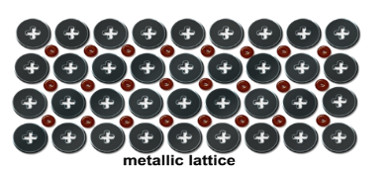
Chemistry Revision Mind Map Unit 3 – Metals 1
What is metallic bonding?
What are the three methods of extracting metals from ores and what metals would be extracted using each method?
1.
2.
3.
This is a simple cell:
What is the purpose of the electrolyte?
Why is the electrolyte an ionic solution?
Write the reduction, oxidation and redox reaction for the cell above:
Reduction:
Oxidation:
Redox:
Show on the diagram the path of electron flow.
Attraction between positive metal ions and a sea of delocalised electrons
Electrolysis (most reactive set – Al and up in the ECS)
Heating with C or CO (moderate reactivity eg Mg – Cu in ECS)
Complete the circuit
Draw the structure of a metallic lattice
Heat alone / no extraction needed ( low reactivity egAg/Au/Pt)
Must conduct electricity
Why is a D.C supply used in electrolysis?
Cu²⁺ + 2e⁻ → Cu
So that the products can be easily identified (ie the metals will ALWAYS form on the negative electrode and vice versa)
Zn → Zn²⁺ + 2e⁻
(use databook pg 10)
Why can metals conduct electricity?
Zn + Cu²⁺ → Zn²⁺ + Cu
They have free moving electrons
Complete the word equation for the following:
Metal + oxygen →
Metal + water →
Metal + dilute acid →
Zinc + oxygen →
Lithium + water →
Magnesium + hydrochloric acid →
Metal oxide
Metal hydroxide + hydrogen
If a metal is found uncombined in the Earths crust, what does this suggest about its reactivity?
Salt + hydrogen
This is a half cell:
What is the purpose of the ion bridge?
Show the path of electron flow.
Zinc oxide
Low reactivity
(as it hasn’t combined with oxygen)
Lithium hydroxide + hydrogen
Complete the circuit
Magnesium chloride + hydrogen
What is the name given to a naturally occurring rocks that contain metal compounds?
What is an oxidation reaction in terms of electrons?
What non-metal can be used as electrodes in half-cells?
Oxidation Is Loss of electrons (OILRIG)
Graphite (has delocalised electrons and is fairly unreactive)
higher
What is a reduction reaction in terms of electrons?
Electrons flow from the metal _______________ in the electrochemical series to the metal ________________ in the electrochemical series.
Reduction Is Gain of electrons (OILRIG)
lower
Metals can be extracted from their ore. Metal ions from metal atoms, what is this reaction called?
Write the ion-electron equation for iron (II) ions forming iron (III) ions. What is this reaction called?
The further apart metals are in an electrochemical series, the _______________ the voltage.
When copper is connected to copper in an electrochemical cell the voltage is ___________.
higher
Reduction
(metal ions gain electrons to become atoms again)
(use databook pg 10)
Fe²⁺ → Fe³⁺ + e⁻ (oxidation)
0

Slide 28
Chemistry Revision Mind Map Unit 3 – Plastics 2
Plastics are materials known as:
Is a monomer saturated or unsaturated? What does this mean?
From the following co-polymer, draw the two monomers used to make it.
polymers
Unsaturated – has a C=C
Draw a section of a polymer showing three of the following monomers joined together:
Draw the repeating unit for the above polymer you have drawn.
Polymers are long chain molecules formed by joining what together?
monomers
What is the name of the reaction called forming a polymer?
CH₃
H
CN
H
Polymerisation
(addition polymerisation)
C
C
C
C
H
CH₃
H
H
Name the monomers used to make the following:
Polystyrene
Polyethene
Polyvinylchlride
H
H
H
NC₁₂H₁₈
NC₁₂H₁₈
NC₁₂H₁₈
styrene
C
C
C
C
C
C
H
H
H
H
H
H
ethene
vinylchloride
A different answer is possible as they haven’t told you one of the monomers. This will not happen in your exam.
Name the polymer made from the following monomers:
Propene
Styrene
Tetraflouroethene
H
CH₃
polypropene
CN
H
H
NC₁₂H₁₈
C
C
C
C
polystyrene
C
C
CH₃
H
H
H
polytetrafluoroethene
H
H

Slide 29

Chemistry Revision Mind Map Unit 3 – Fertilisers 3
The three elements required for plant growth are:
What are the two reactants for the Haber process?
What is the catalyst used in this process?
NPK - nitrogen, phosphorous and potassium
N₂ + H₂
Platinum (O&P are together in the alphabet)
Write a balanced chemical equation to show the production of ammonia.
Complete the following equations:
Ammonia + Nitric acid →
Potassium hydroxide + Nitric acid →
Circle the salts produced above.
Give two reasons why these salts would be good fertilisers.
What is the name given to the reactions above?
What is the purpose of fertilisers?
Ammonium nitrate + water
Replace soil nutrients
N₂ + 3H₂ ⇌ 2NH₃
potassium nitrate + water
Why do fertilisers need to be soluble?
So that they can be absorbed with water in the roots of plants
The production of ammonia is a reversible reaction, draw the arrows used to represent this.
⇌
Have NP or K.
Are soluble
What is the formula for ammonia?
What catalyst is used in the Haber process?
NH₃
Iron (H&I are together in the alphabet)
Neutralisation
What is the purpose of adding a catalyst?
When ammonia dissolves in water, what colour would pH paper turn? Why?
Speed up reaction. Allow reaction to take place at a lower temperature therefore lowering fuel costs
Calculate the percentage of nitrogen in the fertiliser ammonium nitrate (NH₄NO₃)?
1 x 14 = 14
What is the name of the process used to make Nitric acid?
4 x 1 = 4
Blue/purple – ammonia solution is an alkali
1 x 14 = 14
Ostwald process
3 x 16 = 48
+
80g
What is the name of the process used to make ammonia?
What are the three starting materials in this process?
Ammonia, oxygen and water are needed to make nitroc acid.
% by mass = $\frac{m}{Gfm}$ x 100 = $\frac{28}{80}$ x 100 = 35%
Haber process
First the NH₃ and O₂ are converted to NO₂ , then water is added to dissolve the NO₂ into nitric acid (HNO₃)

Slide 30
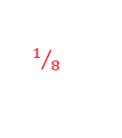
Chemistry Revision Mind Map Unit 3 – Nuclear Chemistry 4
Where does radioactive decay occur in an atom?
An alpha particle can be represented as:
What does the term half-life mean?
4
4
nucleus
α
or
He
2
2
Time taken for half of the nuclei to decay
A beta particle can be represented as:
Unstable nuclei become more stable by giving out which three forms of radiation?
1.
2.
3.
0
0
e
-1
β
or
-1
What affect would increasing the temperature have on the half-life of an isotope?
Alpha α
Beta β
A proton can be represented as:
None
1
Gamma γ
p
1
Alpha particles are stopped by:
Beta particles are stopped by:
Gamma particles are stopped by:
A neutron can be represented as:
16 g of a radioisotope has a half-life of 20 days. What mass of the original isotope will still be left after 60 days?
Few cm of air / paper
1
n
0
20days
20days
20days
Thin Al foil
Complete the following equations and decide whether the isotope is undergoing alpha or beta decay.
1.
2.
16g
8g
4g
2g
Thick concrete or Pb
238
92
U
A luminous watch dial containing a material with a half life of 2.5 years has only 1/8th of its original glow. How old is the watch?
Alpha particles are attracted to a _______________ plate
Beta particles are attracted to a ______________ plate.
Gamma particles are not deflected by an electric field.
234
Pa
negative
91
2.5 years
2.5 years
2.5 years
positive
3 x t½
= 3 x 2.5 years
=7.5 years
1
½
¼
$1/8$

