Slide 1
AH Chemistry – Unit 1
Transition Metals

Slide 2
Introduction
Aspects of the Transition Metals are studied with particular reference to their Electronic Configurations

Slide 3
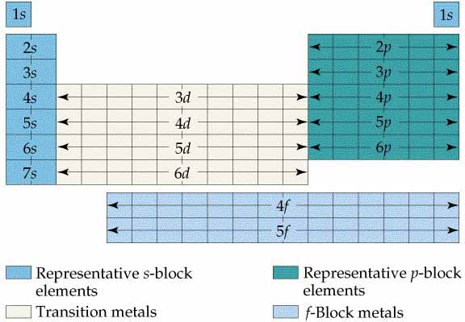
Transition Metals - Definition 1
The easiest, but least useful, definition of a Transition metal is that it is found in the d-block of the table.

Slide 4
Transition Metals - Definition 2
Another definition of a Transition metal is that it has an incomplete d subshell. This excludes Cu and Zn.
Atomic No. Symbol 4 s 3 d Configuration
NB 4s is of lower energy so fills before 3d. Cr and Cu are exceptions to Aufbau rule

Slide 5
Filling of d-orbitals - exceptions
Cu and Cr are exceptions to the Aufbau principle.
Cr should be:
Cr actually is:
There is a special stability associated with all the d-orbitals being half-filled.
Cu should be:
Cu actually is:
There is a special stability associated with all the d-orbitals being completely filled

Slide 6
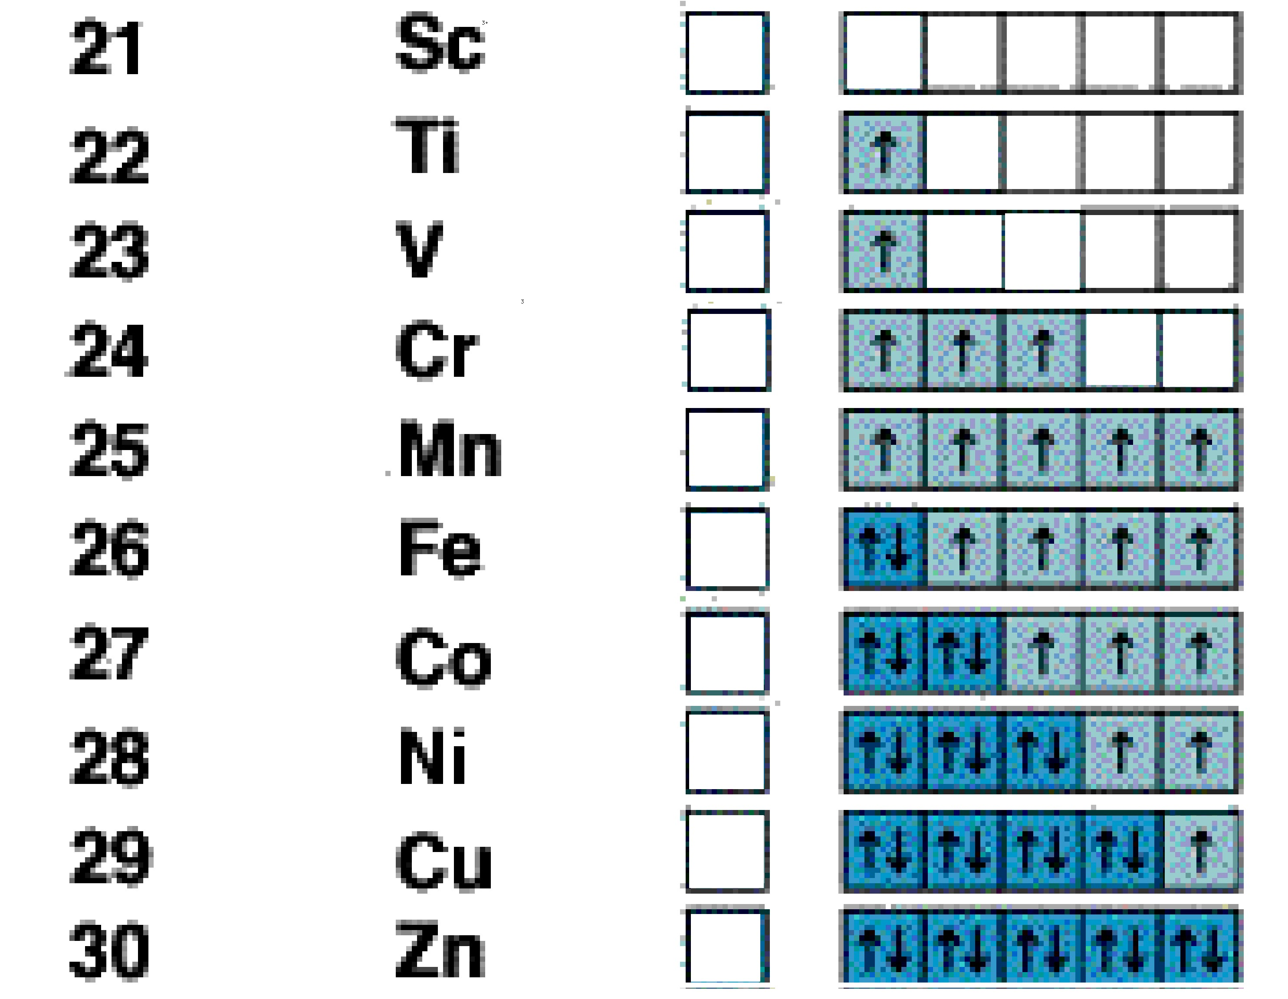
Transition Metals - Definition 3
Another definition of a Transition metal is that it has at least one ion with an incomplete d subshell.
NB 4s is now at higher energy so empties before 3d.
Atomic No. Symbol 4 s 3 d
3+
Sc only forms a Sc³⁺ ion so would be excluded by this definition.
3+
4+
3+
2+
2+
2+
2+
Zn only forms a Zn²⁺ ion so would be also be excluded by this definition.
2+
2+

Slide 7
Transition Metals - Best Definition
There are 3 main characteristics of a Transition metal
* they can produce ions with different valencies
Sc & Zn produce only one possible ion each
* they produce coloured compounds
Sc & Zn have no coloured compounds
* they can act as catalysts
Sc & Zn have no catalytic applications
Therefore, the best definition of a Transition metal is that it has at least one ion with an incomplete d subshell.

Slide 8
Coloured Transition Metal Complexes
The ligands surrounding metal ions in these complexes are responsible for the characteristic colours seen in so many of their compounds.
Interactions between the ligands and electrons occupying the d-orbitals create the circumstances that lead to the absorption of some light from the visible spectrum.

Slide 9
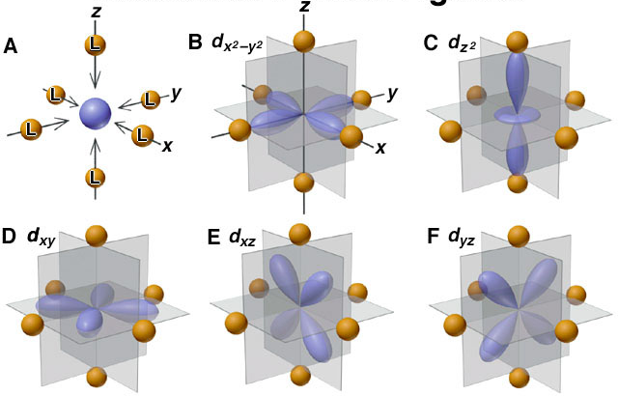
Repulsive Forces - octahedral

Slide 10
Splitting of d-orbitals

Slide 11
Colour of [ Ti(H₂O)₆ ]³⁺
Green-yellow light is absorbed as an electron is promoted from one set of d-orbitals to the other set of d-orbitals.
d → d transitions
The blue & red light transmitted makes the compound a purple colour

Slide 12
Tetrahedral & Square Planar
Details about splitting of d-orbitals do not need to be learnt.
Just need to know that d → d transitions are possible

Slide 13
Spectrochemical Series

Slide 14
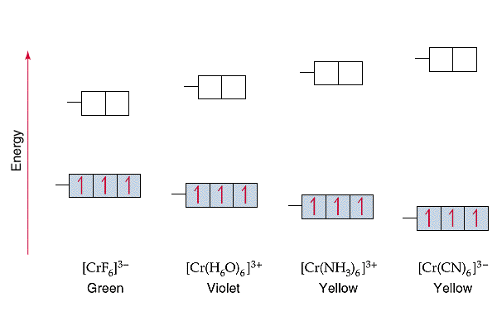
Effect of Ligand Field

Slide 15
Oxidation States
Transition metals exhibit variable oxidation states of differing stability.
Transition metals exhibit variable oxidation states because they can not only lose their 4s electrons but some or all of their 3d electrons.

Slide 16
Oxidation States - stability 1
Sometimes electron configurations can be used to explain why one oxidation state is more stable.
For example, during rusting Fe²⁺ ions are formed first, but they then change into Fe³⁺ ions.
2+
3+
The Fe³⁺ ion forms in preference to Fe²⁺ because of the extra stability associated with all the d-orbitals being half-filled.

Slide 17
Oxidation States - stability 2
Sometimes electron configurations cannot be used to explain why one oxidation state is more stable.
For example, copper forms two ions Cu⁺ and Cu²⁺. Most copper compounds contain the soluble Cu²⁺ ion.
1+
2+
The Cu⁺ ion should form in preference to Cu²⁺ because of the extra stability associated with all the d-orbitals being filled.
In fact the Cu²⁺ ion usually forms in preference to Cu⁺ because there is even more extra stability due to forming in solution.

Slide 18
Oxidation Numbers
Oxidation numbers are a way of keeping track of electrons. They do not necessarily represent the ‘true’ charge on a particle but they work!
Rule 1 Simple ions such as Na⁺, K⁺, Cl— etc continue to count as + 1 or - 1 .
Rule 2 Oxygen is always assumed to be - 2 .
Rule 3 Hydrogen is always assumed to be +1 .
Rule 4 Overall charge on a compound is always 0 .
Rule 5 In polyatomic ions, the sum of all the oxidation numbers is equal to the overall charge on the ion.

Slide 19
Oxidation Numbers - example 1
What is the oxidation number for Mn in KMnO₄ ?
Rule 1 We assume K counts as + 1
Rule 4 Overall the compound is 0, so MnO₄ must be -1.
Rule 2 We assume each oxygen is -2, so 4 x O = - 8
Rule 5 Overall charge on ion is -1, so Mn must be +7 .
When permanganate reacts to form Mn²⁺ ions we can calculate that 5e must be gained; Mn⁷⁺ + 5e → Mn²⁺
Alternatively,
MnO₄⁻ + 8H⁺ + 5e → Mn²⁺ + 4H₂O

Slide 20
Oxidation Numbers - example 2
What is the oxidation number for S in SO₄²⁻ ?
Rule 2. We assume each oxygen is -2, so 4 x O = - 8
Rule 5. Overall charge on ion is -2, so S must be +6 .
What is the oxidation number for S in SO₃²⁻ ?
Rule 2. We assume each oxygen is -2, so 3 x O = - 6
Rule 5. Overall charge on ion is -2, so S must be +4 .
When sulphite ions react to form sulphate ions we can calculate that 2e must be lost; S⁴⁺ → S⁶⁺ + 2e
Alternatively,
SO₃²⁻ + H₂O → SO₄²⁻ + 2H⁺ + 2e

Slide 21
Oxidation Numbers - example 3
What is the oxidation number for Cr in CrO₄²⁻ ?
Rule 2. We assume each oxygen is -2, so 4 x O = - 8
Rule 5. Overall charge on ion is -2, so Cr must be +6 .
What is the oxidation number for Cr in Cr₂O₇²⁻ ?
Rule 2. We assume each oxygen is -2, so 7 x O = - 14
Rule 5. Overall charge on ion is -2, so 2 x Cr must be +12 so Cr must be +6
When chromate ions react to form dichromate ions we can calculate that no electrons are gained or lost.
Alternatively,
2CrO₄²⁻ + 2H⁺ → Cr₂O₇²⁻ + H₂O

Slide 22
Oxidising & Reducing Agents
Compounds containing metals in a high oxidation state tend to be oxidising agents
e.g. MnO₄⁻ + 8H⁺ + 5e⁻ → Mn²⁺ + 4H₂O
Compounds containing metals in a low oxidation state tend to be reducing agents
e.g. Fe(OH)₂ + OH⁻ → Fe(OH)₃ + e⁻

Slide 23
Redox Titration

Slide 24
Transition Metal Complexes
Metal (atom or ion), surrounded by ligands, with the
ligands bound to the metal through coordinate covalent bonds.
Metal : makes use of empty hybrid orbitals, usually involving at least some d-orbitals.
Ligand : atom, molecule or ion that contain at least one lone pair.

Slide 25
Transition Metal Complexes
Octahedral Complex

Slide 26
Transition Metal Complexes
Square Planar Complex

Slide 27
Transition Metal Complexes
Tetrahedral Complex

Slide 28
Ligands - monodentate
Can only form one bond with the metal atom/ion
[Co(NH₃)₄Cl₂]⁺

Slide 29
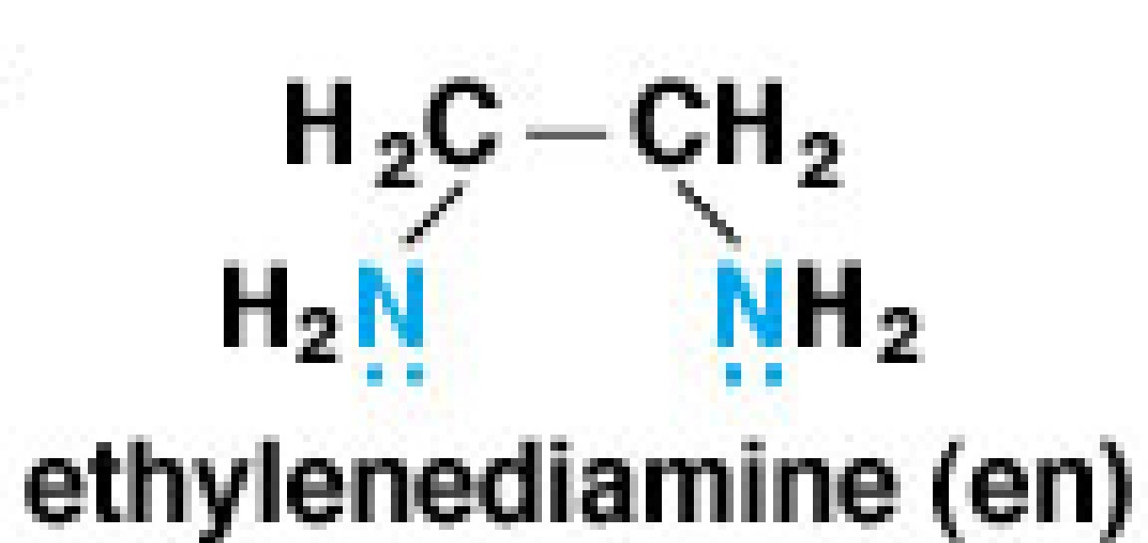
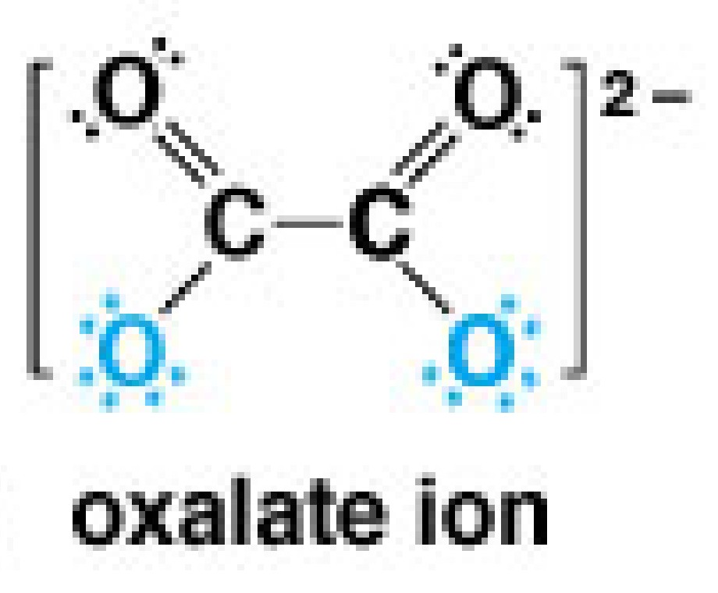
Ligands - bidentate
Can form two bonds with the metal atom/ion
[Co(en)₃]³⁺

Slide 30
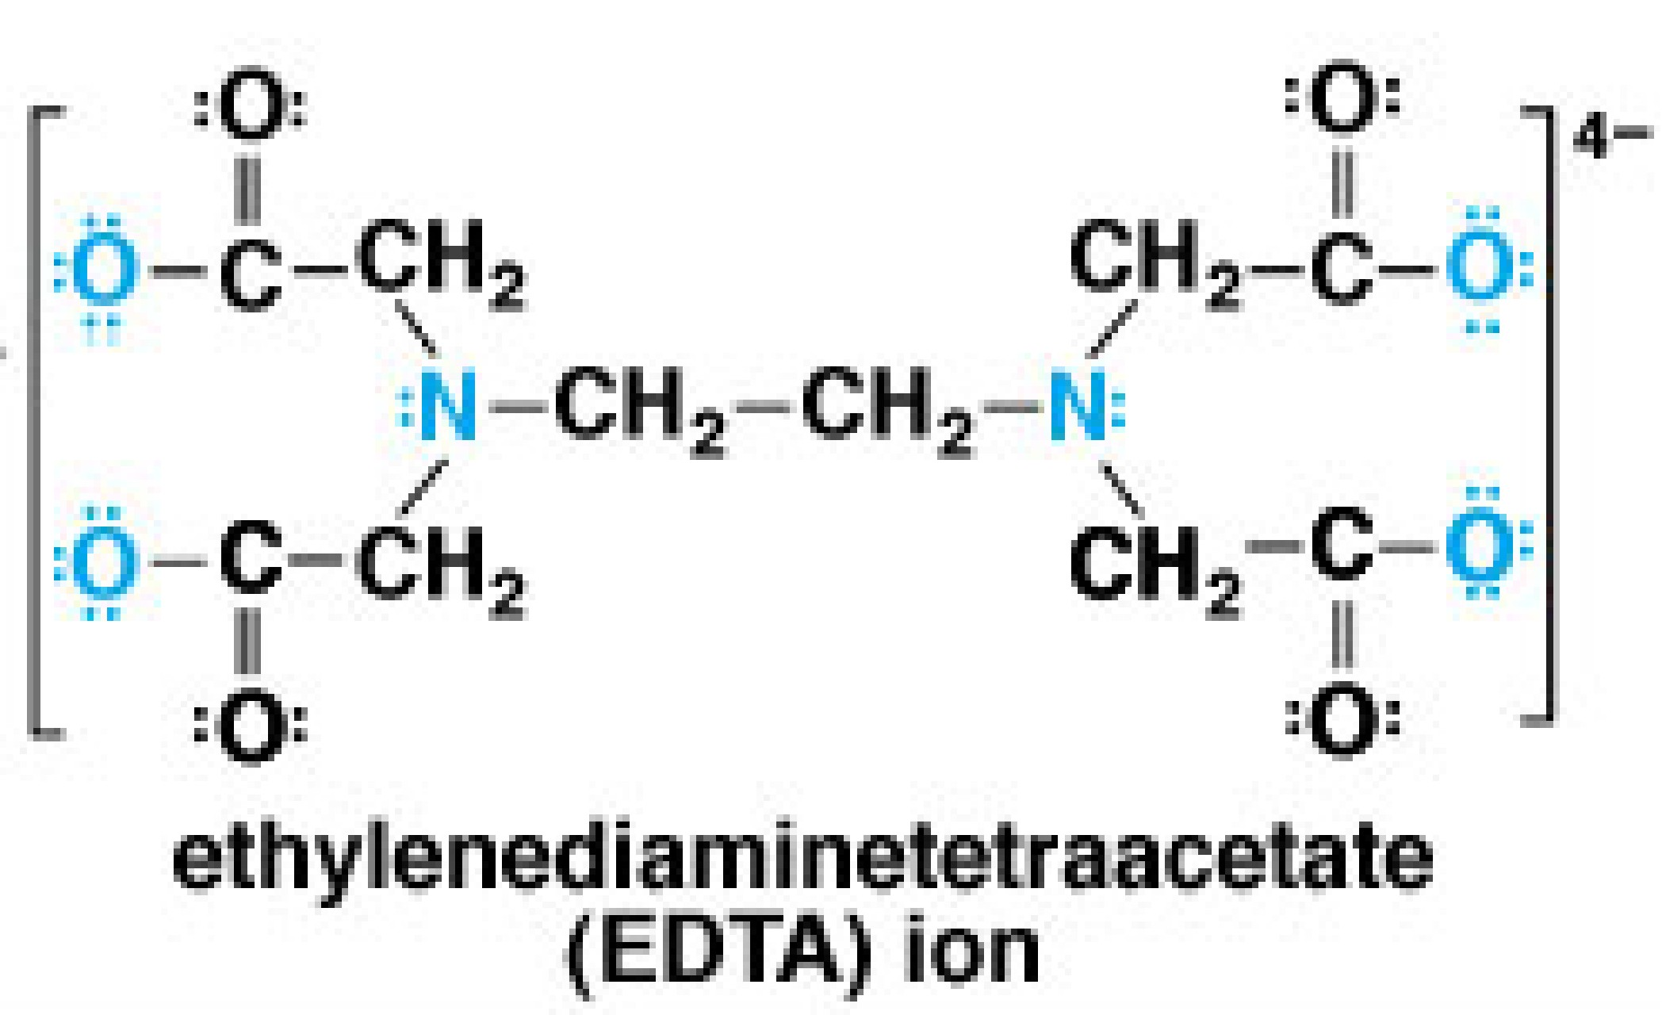
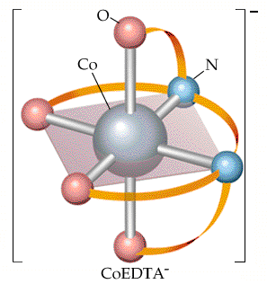
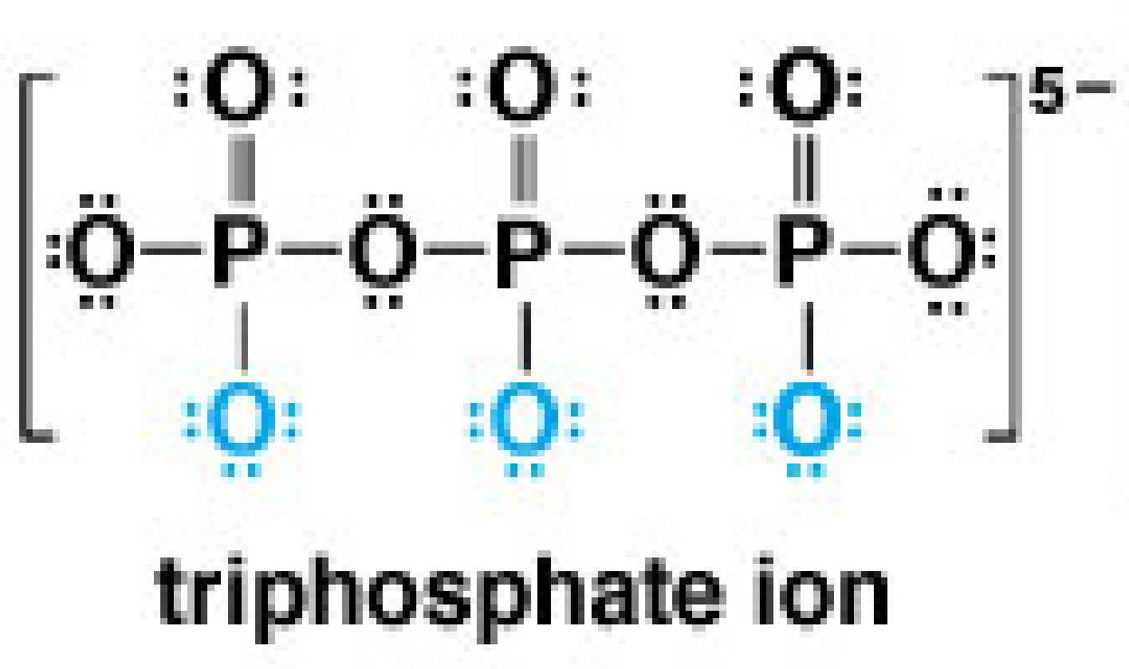
Ligands - polydentate
Can form many bonds with the metal atom/ion
[Co(EDTA)]⁻

Slide 31
Coordination Number
number of bonds formed between the metal ion and the ligands in the complex ion.
Varies from two to eight
Depends on the size, charge, and electron configuration of the transition metal
Most common coordination number is 6
Next is 4, then 2
Many metals show more than one coordination number
No way to predict which coordination number

Slide 32
Naming Complexes 1
Cation (+ve ion) is named before the anion (-ve ion)
Eg hexaquairon(III) sulphate
potassium hexacyanoferrate(III)

Slide 33
Naming Complexes 2
Ligands are named before the metal ion
Eg hexaquairon(III) sulphate
potassium hexacyanoferrate(III)
Naming ligands
Add an -o to the root name of an anion (fluoro, chloro, hydroxo, cyano, etc.)
Neutral ligand, use the name of the molecule except for the following:
H₂O = aqua
NH₃ = ammine

Slide 34
Naming Complexes 3
Use prefixes to indicate number of simple ligands (mono, di, tri, tetra, penta, hexa)
Eg hexaquairon(III) sulphate
potassium tetrachlorocuprate(II)
Oxidation state of central metal ion is designated by a Roman numeral in parentheses
Eg hexaquairon(III) sulphate
potassium tetrachlorocuprate(II)

Slide 35
Naming Complexes 4
When more than one type of ligand is present, they are named alphabetically, (prefixes do not affect the order).
Eg tetramminedichlorochromium (III) chloride
[Cr(NH₃)₄Cl₂]Cl

Slide 36
Naming Complexes 5
If the complex ion has a negative charge, add –ate to the latin name of the metal (eg. ferrate or cuprate)
Eg potassium hexacyanoferrate(III)
(K⁺)₃[Fe(CN)₆]³⁻
sodium hexafluorocobaltate(III)
(Na⁺)₃[Co(F)₆]³⁻

Slide 37
Complexes in Living Things 1
Mg²⁺ is in the center of the chlorophyll molecule.
The alternating double bonds give chlorophyll its green color (it absorbs red light).
Chlorophyll absorbs red light (655 nm) and blue light (430 nm).

Slide 38
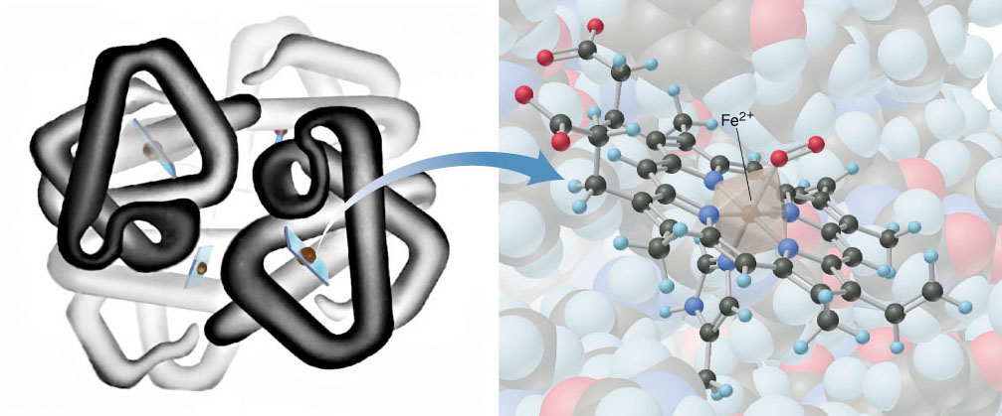
Complexes in Living Things 2
An octahedral complex of Fe²⁺ is in the center of the haemoglobin molecule.

Slide 39
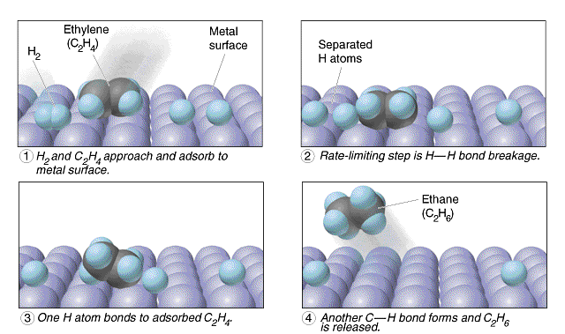
Catalysis 1
The presence of unpaired d-electrons or empty d-orbitals allow intermediate complexes to form, providing alternative reaction pathways of lower activation energy

Slide 40
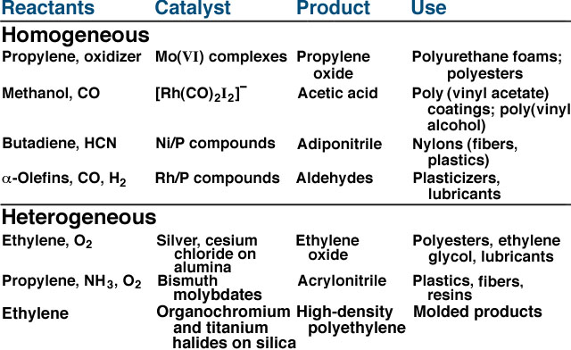
Catalysis 2

Slide 41
Catalysis 3

