Slide 1
AH Chemistry – Unit 1
Electromagnetic Radiation and Atomic Spectra

Slide 2
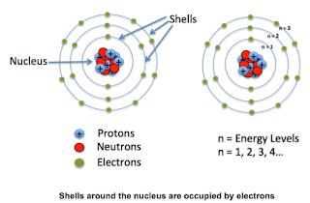

Slide 3
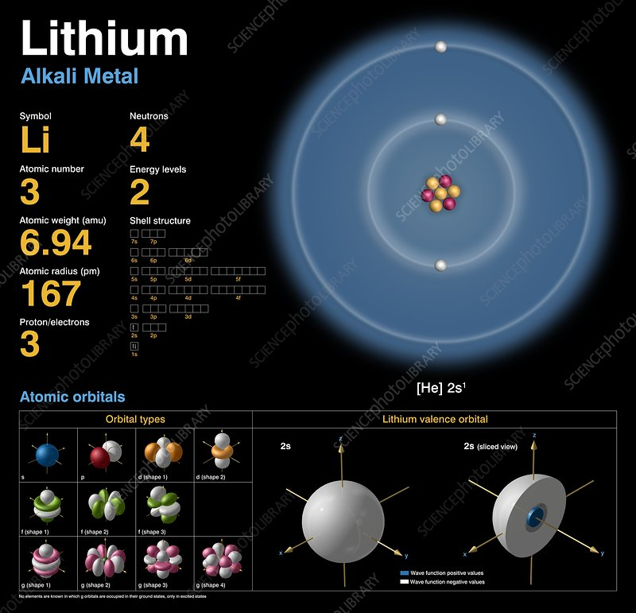

Slide 4
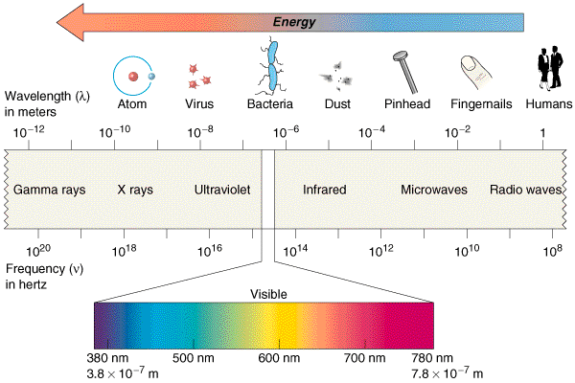
Introduction
This topic describes the Electromagnetic Spectrum and how it can interact with atoms, Spectroscopy.
Much information about Electronic Structure comes from spectroscopic evidence.

Slide 5
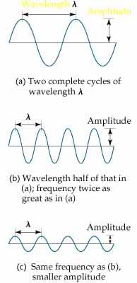
The Wave Nature of Light
Wavelength
Amplitude
All waves have a characteristic
wavelength, λ, measured in metres (m)
to nanometres (nm)
The frequency, ν, of a wave is the number of waves which pass a point in one second measured in Hertz (Hz) or per seconds (s⁻¹)
The speed of a wave, c, is given by its frequency multiplied by its wavelength:
c = νλ
For light, c = 3.00 x 10⁸ ms⁻¹
Another unit of ‘frequency’ used in spectroscopy is the wavenumber (1/λ),
nu , measured in m⁻¹ or cm⁻¹

Slide 6
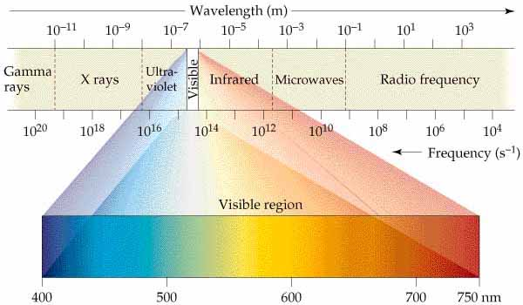
Electromagnetic Radiation

Slide 7
The Particle Nature of Light 1
Planck: energy can only be absorbed
or released from atoms in
certain amounts called quanta
To understand quantization, consider the notes produced by a violin (continuous) and a piano (quantized):
a violin can produce any note by placing the fingers at an appropriate spot on the fingerboard.
A piano can only produce certain notes corresponding to the keys on the keyboard.

Slide 8
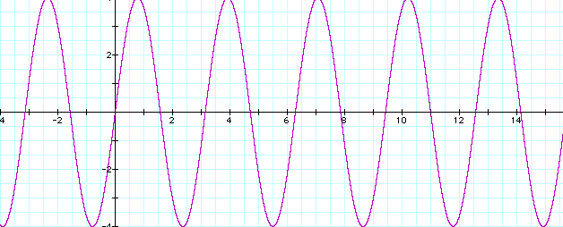
The Particle Nature of Light 2
Electromagnetic Radiation can also be
thought of as a stream of very small
particles known as photons
Electromagnetic Radiation exhibits wave-particle dual properties.
The energy (E) of a photon (particle) is related to the frequency (wave) of the radiation as follows:
E = hν
where h is Planck’s constant ( 6.63 × 10⁻³⁴ J s ).

Slide 9
Energy Calculations 1
E = hν or E = h c / λ
The energy calculated would be in Joules (J) and would be a very small quantity.
Normally, we would calculate the energy transferred by the emission or absorption of one mole of photons as follows:
E = Lhν or E = L h c / λ
Where L is the Avogadro Constant, 6 .02 x 10²³ and E would now be in J mol⁻¹ or kJ mol⁻¹.

Slide 10
Energy Calculations 2
For example, a neon strip light emitted light with a
wavelength of 640 nm.
640 nm = 640 x 10⁻⁹ m = 6.40 x 10⁻⁷ m.
For each photon:
E = h c / λ
= 6.63 x 10⁻³⁴ x 3.00 x 10⁸ / 6.40 x 10⁻⁷
= 3.11 x 10⁻¹⁹ J
For 1 mole of photons:
E = 3.11 x 10⁻¹⁹ x 6.02 x 10²³ J
= 1.87 x 10⁵ J mol⁻¹
= 187 k J mol⁻¹

Slide 11
Atomic Spectra
Atomic emission spectra provided significant
contributions to the modern picture of atomic structure
Radiation composed of only one wavelength is called monochromatic
Radiation that spans a whole array of different wavelengths is called continuous
White light can be separated into a continuous spectrum of colors.

Slide 12
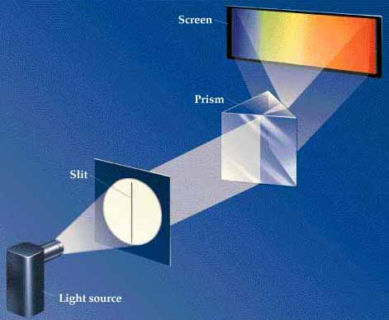
Atomic Spectra 2

Slide 13
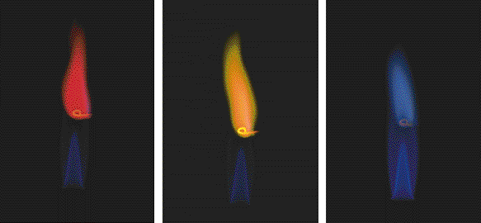
Emission Spectroscopy
Li line: 2p → 2s transition
Na line (589 nm): 3p → 3s transition
K line: 4p → 4s transition
In emission spectroscopy, light of certain wavelengths is emitted as ‘excited’ electrons drop down from higher energy levels.
The spectrum is examined to see the wavelengths emitted.

Slide 14
Absorption Spectroscopy
In absorption spectroscopy, light of certain wavelengths is absorbed and electrons are promoted to higher energy levels.
The spectrum is examined to see which wavelengths have been absorbed.
The intensity of the light absorbed is proportional to the quantity of the atoms/ions in the sample. Calibration samples can be prepared, intensities measured and unknown concentrations determined (PPA)

Slide 15
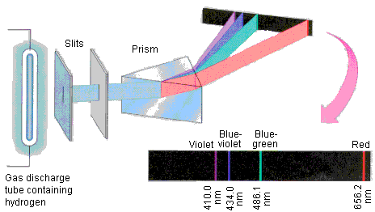
Hydrogen Emission Spectrum

Slide 16
Line Spectra
The spectrum obtained when hydrogen atoms are
excited shows four lines: red, blue-green, blue and indigo
Bohr deduced that the colours were due to the movement of electrons from a higher energy level back to the ‘ground state’.
The significance of a Line Spectrum is that it suggests that electrons can only occupy certain fixed energy levels

Slide 17
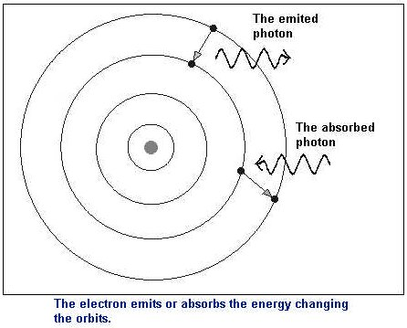
Bohr’s Model
These fixed energy levels are what we have always called our electron shells
A photon of light is emitted or absorbed when an electron changes from one energy level (shell) to another.

Slide 18
Emission Spectroscopy 2
Each element provides a characteristic spectrum which can be used to identify the element. Analysing light from stars etc, tell us a lot about the elements present.
The intensity of a particularly strong line in an element’s spectrum can be measured. The intensity of the light emitted is proportional to the quantity of the atoms/ions in the sample. Calibration samples can be prepared, intensities measured and unknown concentrations determined. Analytical tool.

Slide 19
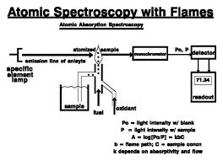
How much of an element?
If a blank or reference sample is introduced, it is possible to quantify how much of an element is present in a sample, as the intensity of light absorbed will be proportional to concentration.
A α C

