Slide 1
AH Chemistry – Unit 1
Atomic Orbitals, Electronic Configurations and the Periodic Table

Slide 2
Principal Quantum Number
Bohr described each shell by a number,
the principal quantum number, n
For the first shell, n = 1
For the second shell, n = 2 and so on.
After lots of math, Bohr showed that
  where n is the principal quantum number (i.e., n = 1, 2, 3, …), and R_{H} is the Rydberg constant = 2.18 × 10⁻¹⁸ J.

Slide 3
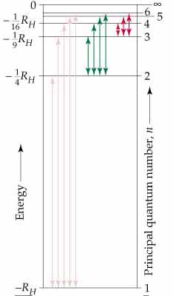
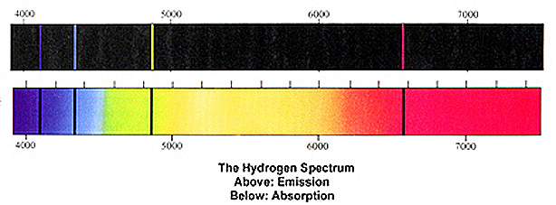
Hydrogen Spectra
The lines detected in the visible spectrum were due to electrons returning to the n=2 level and are called the Balmer Series
Another series of lines called the Lyman Series are due to electrons returning to the n=1 level. The ΔE values are higher and the lines appear in the ultra-violet region.

Slide 4
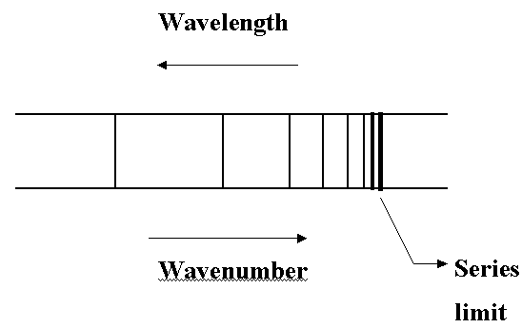
Ionisation Energy 1
When we examine spectra we notice that each series of lines converge, i.e the gaps between the lines get smaller and smaller until the lines seem to merge.
Frequency
The line of greatest energy (lowest wavelength, highest frequency), represents an electron returning from the outer limit of an atom to the ground state ( n=1 in the case of Hydrogen).
With slightly more energy the electron would have removed from the atom completely, i.e. the Ionisation Energy

Slide 5
Ionisation Energy 2
For example, the wavelength of the line at the convergence
Limit of the Lyman series in the Hydrogen spectrum is 91.2 nm.
91.2 nm = 91.2 x 10⁻⁹ m = 9.12 x 10⁻⁸ m.
For each photon:
E = h c / λ
= 6.63 x 10⁻³⁴ x 3.00 x 10⁸ / 9.12 x 10⁻⁸
= 2.18 x 10⁻¹⁸ J
For 1 mole of photons:
E = 2.18 x 10⁻¹⁸ x 6.02 x 10²³ J
= 1.31 x 10⁶ J mol⁻¹
= 1,310 k J mol⁻¹
Data Book Value
1,311 kJ mol⁻¹

Slide 6
Subshells - Orbitals
High resolution spectra of more complex atoms reveal that lines are often split into triplets, quintuplets etc.
This is evidence that Shells are further subdivided into Subshells
These Subshells are called Orbitals
Calculations using Quantum Mechanics have been able to determine the shapes of these Orbitals

Slide 7
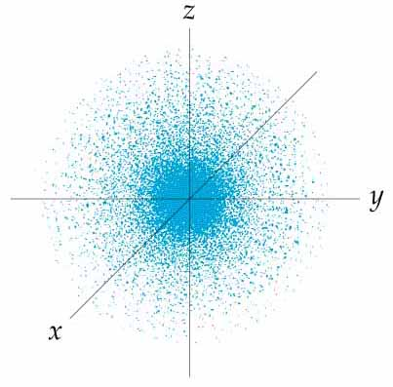
s-orbitals
Quantum mechanics has shown that s orbitals are spherical in shape
An orbital is a region in space where there is a greater than 90% probability of finding an electron.

Slide 8
Orbitals and Quantum Numbers
  Angular Quantum Number, l. This quantum number describes
  the shape of an orbital. l = 0, 1, 2, and 3 (4 shapes) but we use letters for l (s, p, d and f). Usually we refer to the s, p, d and f-orbitals
  Magnetic Quantum Number, m_{l}. This quantum number describes the orientation of orbitals of the same shape. The magnetic quantum number has integral values between -l and +l. However, we use p_{x} , p_{y} and p_{z} instead.
  There are 3 possible p -orbitals -1 0 +1
  There are 5 possible d-orbitals -2 -1 0 +1 +2
  There are 7 possible f-orbitals

Slide 9
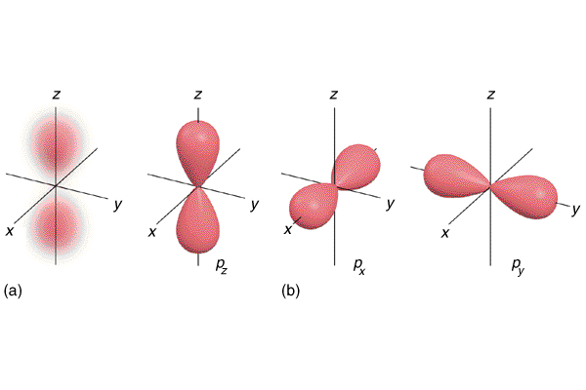
p-orbitals
The shape of a p-orbital is dumb-bell, (l = 1).
Each shell, from the second shell onwards, contains three of these p-orbitals, ( m_{l} = -1 0 +1 ).
We describe their orientation as ‘along the x-axis’, p_{x} ‘along the y-axis’, p_{y} and ‘along the z-axis’, p_{z}

Slide 10
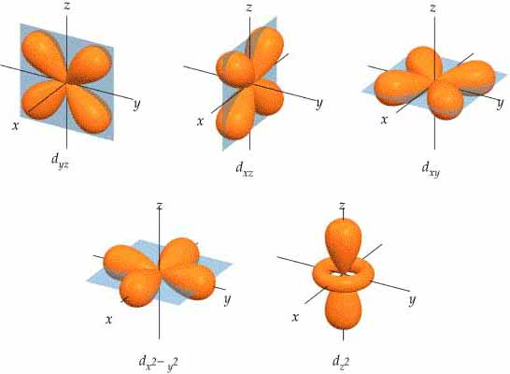
d-orbitals
The shape of d-orbitals (l = 2) are more complicated.
Each shell, from the third shell onwards, contains five of these d-orbitals, ( m_{l} = -2 -1 0 +1 +2 ).
We describe their orientation as
‘between the x-and y-axis’, d_{xy}, ‘between the x-and z-axis’, d_{xz}, ‘between the y-and z-axis’, d_{yz},
‘along the x- and y-axis’, d_{x}2 -_{y}2 and ‘along the z-axis’, d_{z}2

Slide 11
f-orbitals
The shape of f-orbitals (l = 3) are even more complicated.
Each shell, from the fourth shell onwards, contains seven of these f-orbitals, ( m_{l} = -3 -2 -1 0 +1 +2 +3 ).
f-orbitals are not included in Advanced Higher so we will not have to consider their shapes or orientations, thank goodness!

Slide 12
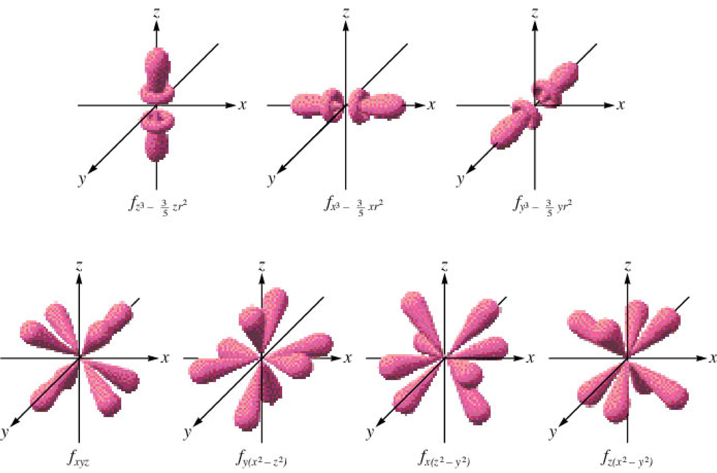
f-orbitals
Couldn’t resist it !

Slide 13
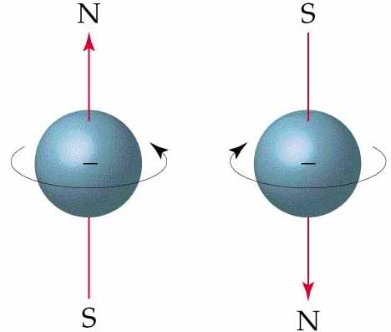
Spin Quantum Number
Each orbital can hold up to 2 electrons.
In 1920 it was realised that an electron behaves as if it has a spin
A fourth quantum number was needed.
The spin quantum number, m_{s} only has two values +¹/₂ and - ¹/₂
Therefore, up to four quantum numbers, n (shell), l (shape), m_{l} (orientation) and m_{s} (spin) are needed to uniquely describe every electron in an atom.

Slide 14
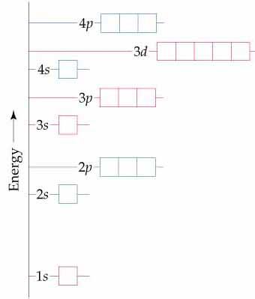
Energy Diagram
Orbitals can be ranked in terms of energy to yield an Aufbau diagram
As n increases, note that the spacing between energy levels becomes smaller.
Sets, such as the 2p-orbitals, are of equal energy, they are degenerate
Notice that the third and fourth shells overlap

Slide 15
Electron Configurations 1
There are 3 rules which determine in which orbitals the electrons of an element are located.
The Aufbau Principle states that electrons will fill orbitals starting with the orbital of lowest energy.
For degenerate orbitals, electrons fill each orbital singly before any orbital gets a second electron (Hund’s Rule of Maximum Multiplicity).
The Pauli Exclusion Principle states that the maximum number of electrons in any atomic orbital is two……..
and ….. if there are two electrons in an orbital they must have opposite spins (rather than parallel spins).

Slide 16
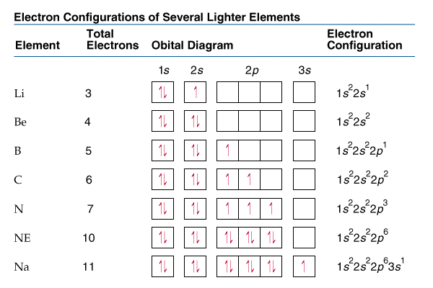
Electron Configurations 2
Ne

Slide 17
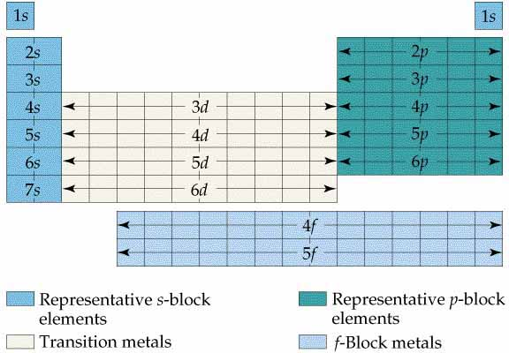
Periodic Table

Slide 18
Ionisation Energy
The first ionisation energy for an element E is the energy required to remove one mole of electrons from one mole of atoms in the gas state, as depicted in the equation
E(g) → E+(g) + e–

