Slide 1
Remodelling the Cytoskeleton
Unit 1: Cells and Proteins
Advanced Higher Biology
Miss Aitken

Slide 2
Structure and Function of the Cytoskeleton
The cytoskeleton is a network of fibres made from protein. It extends the whole way through the cytoplasm.
It’s attached to the cell membrane and gives structure and shape to the cell. It acts as scaffolding.
Organelles like the nucleus are attached to the cytoskeleton and when organelles or entire cells move, it is the cytoskeleton which is responsible.

Slide 3
Structure and Function of the Cytoskeleton
Microtubules:
Hollow straight rods
Polymer made from two globular proteins:
α-tubulin
β-tubulin
25nm thick
Length is controlled through the polymerisation (assembly) or depolymerisation (disassembly) of tubulin at the ends of the microtubule
Deal with location and movement of membrane-bound organelles and other cell components

Slide 4
Microtubules
Microtubules come from the microtubule-organising centre (MTOC) – also known as the centrosome
Centrioles form part of the centrosome and are involved in the organisation of spindle fibres during mitosis.

Slide 5
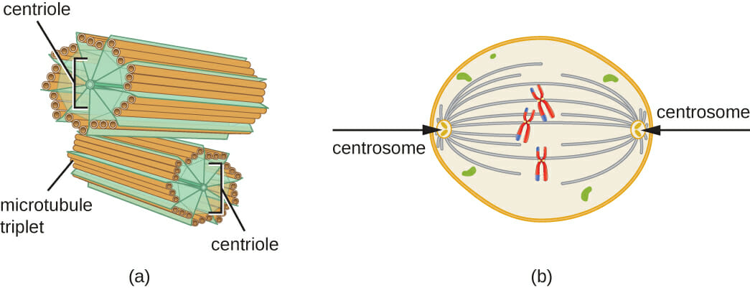

Slide 6
Microtubules and Mitosis
Cell division requires remodelling of the cells microtubules.
Spindle fibres are made of microtubules and control the movement of chromosomes during mitosis and meiosis.
The centrosome is the area of the cell where microtubules are formed. During mitosis, the centrosome is duplicated and they move to the poles of the cell.

Slide 7
Microtubules
During cell division, microtubules have 3 roles:
A star shaped tuft of microtubules (called an aster) arises from the centrosomes and ensures that cell division apparatus is correctly located.
Some microtubule spindle fibres are attached to kinetochore proteins at the centromere of each chromatid.
Some microtubules in the spindle do not attach to chromosomes but attach to other microtubules from the opposite centrosome.

Slide 8
Microtubules
Chromatids are then separated by the disassembly of microtubules, which has the effect of pulling the chromatids to the poles.
During cell division, assembly and disassembly of microtubules is at a far higher rate than any other time in the cell’s life.

