Slide 1
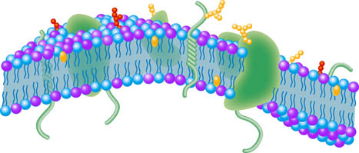
Key Area 1.3 Membrane Proteins
Unit 1 Cells and Proteins
Advanced Higher Biology
Miss Aitken

Slide 2
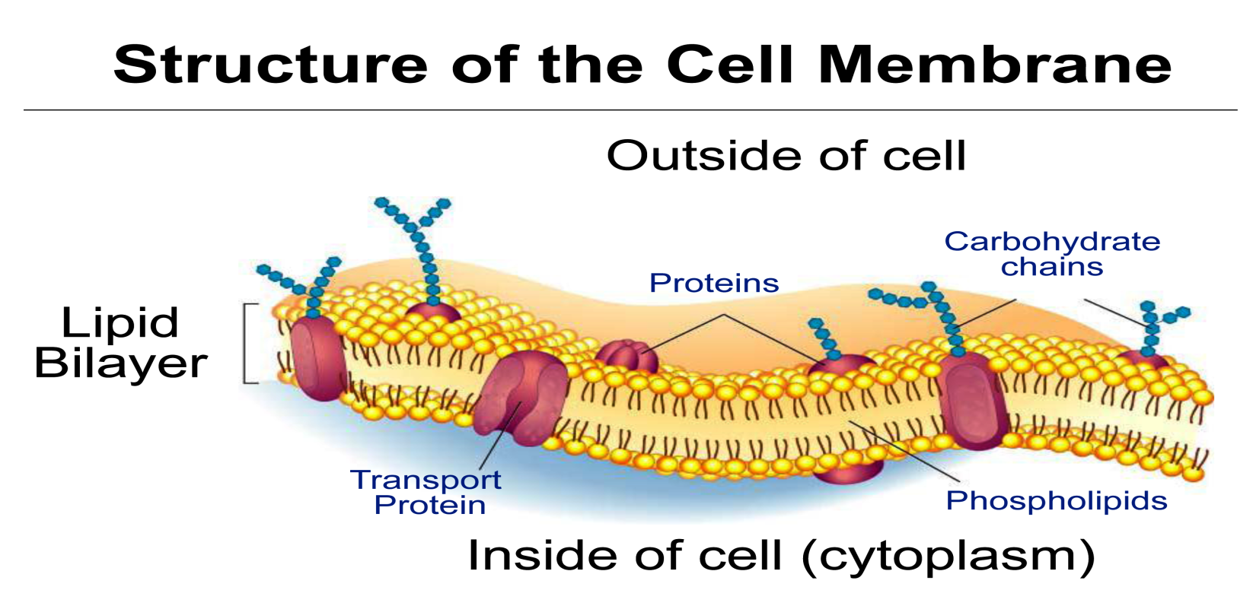
Recap on the Cell Membrane
In N5, we learned that the membrane of cells is made up of a bi-layer of phospholipids with proteins embedded in the layers.
A phospholipid molecule has a hydrophilic head and a hydrophobic tail.

Slide 3
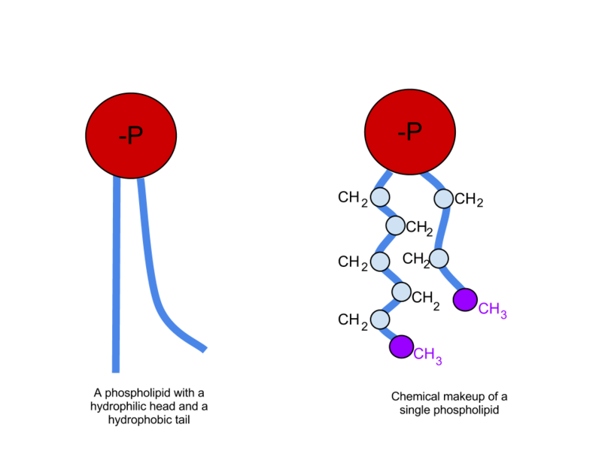

Slide 4
Membrane Proteins
There are two types of proteins found in the cell membrane:
Integral proteins
Peripheral proteins

Slide 5
Integral Proteins
Penetrate the hydrophobic interior and form strong hydrophobic interactions with regions of hydrophobic R groups.
Some only extend partly through the membrane and some are transmembrane proteins (span the width of the membrane).

Slide 6
Peripheral Proteins
Not embedded in the membrane – instead they form ionic and hydrogen bonds to the surface of the membrane.
Have hydrophillic R groups on their surface
Many peripheral proteins interact with the surfaces of integral proteins.

Slide 7
Membrane proteins
Reworded slightly to help you understand and remember:
“The main difference between integral and peripheral proteins is that integral proteins are embedded in the whole bilayer whereas peripheral proteins are located on the inner or outer surface of the phospholipid bilayer.”

Slide 8
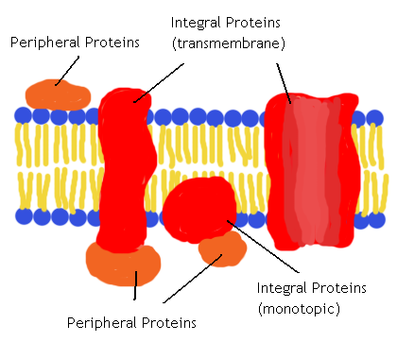

Slide 9
What can pass through the cell membrane directly?
Oxygen (by diffusion)
Carbon dioxide (by diffusion)
Hydrophobic signalling molecules
Thyroxine
Steroids
Only non-polar molecules can pass through the cell membrane directly.

Slide 10
What cannot pass through the cell membrane directly?
Charged ions
H⁺ and Na⁺
Hydrophilic amino acids
Polar molecules
Water
Glucose
These molecules require an alternative route

Slide 11
Facilitated Diffusion
DEFINITION: The passive transport of substances across the membrane through specific transmembrane proteins.

Slide 12
How do molecules cross the cell membrane?
To perform specialised functions, different types of cell have different types of proteins in their cell membrane to help move molecules across.

Slide 13
Channel Proteins
A type of integral protein
These proteins function by having a hydrophillic channel that certain molecules or ions can use as a tunnel through the membrane. Most channels are highly selective – they only let one type of molecule through.
For example, the channel protein aquaporin facilitates the passage of water molecules.

Slide 14
Channel Proteins
Some channel proteins can be opened or closed to allow/disallow diffusion of a molecule/ion. These are called gated channels – there are 2 types.
Ligand-gated: A signal molecule binds to the channel protein and changes its shape/opens or closes gate.
Voltage-gated: A change in ion concentration across the cell membrane causes a change in the channel protein and it opens or closes.

Slide 15
Transporter Proteins
Another type of integral protein
Sometimes called carrier proteins
Specific to one substance
These proteins hold onto their passengers and change their shape in a way that shuttles them across the membrane. Transporters alternate between two conformations so that the binding site is exposed to one side of the membrane, then the other.

Slide 16
Movement of Ions and Molecules Across Membranes
Ions/Polar molecules must go through a protein channel in order to pass through the cell membrane
There are specific transmembrane proteins which act as sodium channels etc.
Some transmembrane proteins control the concentration gradient across a membrane by controlling numbers of ions on either side.

Slide 17
Transporter Proteins
Also involved in facilitated diffusion
Also specific to one type of ion/molecule
Main difference: Transporter proteins bind to ions or molecules and this causes a conformational change in the protein.
Protein actually passes ions or molecules across the membrane rather than providing a route through.
Example: GLUT4 glucose transporter

Slide 18
The Sodium Potassium Pump
The sodium potassium pump is a vital transmembrane transporter protein.
It does active transport – moving sodium ions out of the cell whilst moving potassium ions into the cell. It uses ATP to do this as it is moving ions against their concentration gradient.
When thinking about the sodium potassium pump, it is vital to remember that Na⁺ ions and K⁺ ions are both POSITIVE.

Slide 19
The Sodium Potassium Pump
The sodium potassium pump moves 3 sodium ions out for every 2 potassium ions it moves into the cell.
The sodium potassium pump has two stable conformational states.
There are six steps in the movement of the sodium potassium pump.

Slide 20
The Sodium Potassium Pump
Step 1: The transporter protein has it’s ion binding sites exposed to the cytoplasm (inside of cell).
This conformation has an affinity for sodium ions and this means 3 sodium ions will bind.

Slide 21
The Sodium Potassium Pump
Step 2: When the ions attach to the pump, the pump is then able to hydrolyse ATP.
Breaking down ATP to ADP + Pi means that the phosphate can be used to phosphorylate the pump and this causes a conformational change.

Slide 22
The Sodium Potassium Pump
Step 3: This new shape has it’s ion binding sites exposed to the outside of the cell. The affinity for sodium ions is now low, so the pump releases them.

Slide 23
The Sodium Potassium Pump
Step 4: At the same time, the affinity for potassium ions is high so 2 potassium ions bind to the binding sites.
This triggers dephosphorylation, the removal of the phosphate group.

Slide 24
The Sodium Potassium Pump
Step 5: Dephosphorylation causes the protein to change it’s shape to the first conformation, thus exposing the binding sites to the cytoplasm again.

Slide 25
The Sodium Potassium Pump
Step 6: This conformation has a low affinity for potassium ions so the pump lets them go into the cytoplasm.
The pump then reverts back to stage 1 as it has a high affinity for sodium ions, and so on...

Slide 27
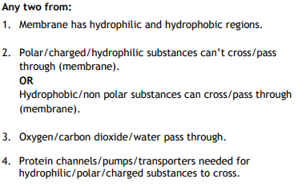
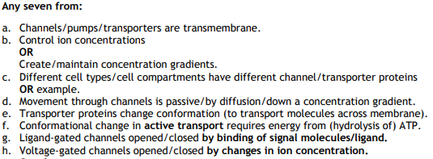

Slide 28
The Sodium Potassium Pump
Why is this so important? It’s found in most animal cells.
Reasons:
Maintains osmotic balance in cells
Allows sodium ion gradient in glucose symport
Generates a gradient in kidney tubules
Allows resting potential in neurons

Slide 29
Coupled Transport
The movement of one molecule ‘downhill’ along it’s concentration gradient powers the movement of another ‘uphill’ against it’s concentration gradient.
Example: glucose symport process

Slide 30
Specialisation
Different tissues in a multicellular organism have different types of channel and transporter proteins in their membrane to move different materials across their cell membranes.
e.g: glucose symporters are only found in the cells lining the small intestine and kidney nephron.

