Slide 1
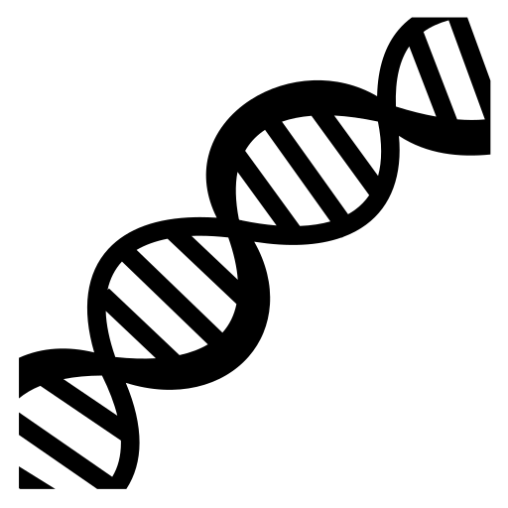
Key Area 1.2 Proteins
Cells and Proteins
Unit 1 Advanced Higher
Miss Aitken
Textbook
Pages 16-25

Slide 2
Proteomics
Genome:
complete set of DNA
Comprises of coding and non-coding areas
20-25000 genes in human genome
Proteome:
Entire set of proteins that can be expressed from a genome
250k – 1 Million proteins
Proteome is much larger than the genome

Slide 3
Why is the proteome larger than the genome?
Alternative RNA splicing. Depending on what parts of the RNA are treated as introns or exons, different mature transcripts are produced from strands of DNA
2. Not all genes are expressed as proteins in a particular cell type. There are some genes which are non-coding and include those which make tRNA, rRNA and RNA molecules that control the expression of other genes.
3. The set of proteins expressed by a given cell type can vary over time and under different conditions e.g. cellular stress, diseased cells.

Slide 4
Why is the proteome larger than the genome?
4. Post Translational Modification:
Polypeptide strands can be modified (changed) after they have gone through translation, and before they become the final protein shape. Modifications can include cutting and combining of chains, or the addition of a carbohydrate or phosphate group.

Slide 5
Intracellular Membranes
Eukaryotic cells have a system of internal membranes, which increases their total area of membrane.
This is a good thing because some eukaryotes are very small and their plasma (outside) cell membrane is too small an area to carry out all of the vital functions carried out by membranes.
Animals, plants, fungi and algae are all eukaryotes

Slide 6
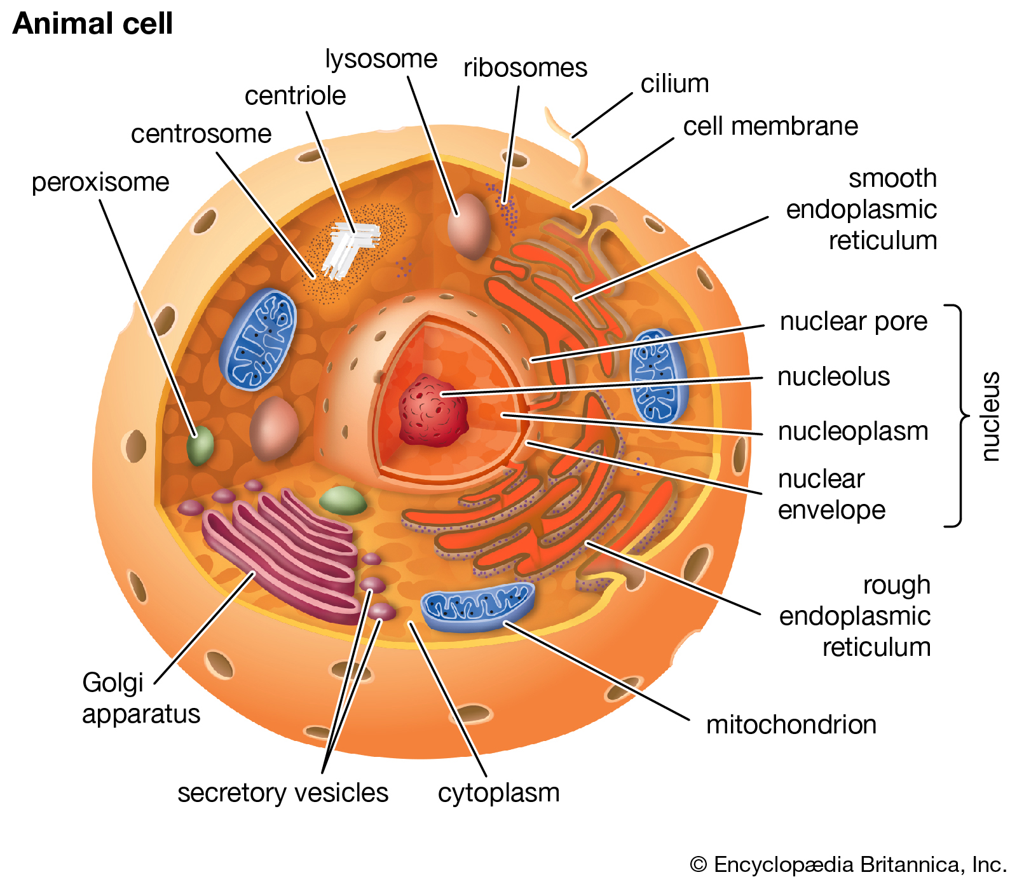

Slide 8
Endoplasmic Reticulum
Two kinds, rough (has ribosomes attached) and smooth (does not have ribosomes attached).
The job of the endoplasmic reticulum is to fold proteins and to transport completed proteins to the Golgi apparatus.
The endoplasmic reticulum forms a network of membrane tubules that branch off from the nuclear membrane.

Slide 10
Golgi Apparatus
The Golgi apparatus is a series of flattened membrane discs.
It’s job is to process and package proteins, to be used inside and outside of the cell.

Slide 12
Lysosomes
Lysosomes are membrane-bound organelles containing a variety of hydrolases. These are enzymes which digest protein, lipids, nucleic acids and carbohydrates.

Slide 14
Vesicles
Vesicles are fluid filled sacs which transport materials between different membrane compartments.

Slide 15
How are the parts of the cell membrane made?
REMEMBER: the cell membrane is made up of lipids and proteins.
Both lipids and proteins are synthesised in the endoplasmic reticulum.
There is a process to remember.

Slide 16
How are the parts of the cell membrane made?
Lipids are made in the smooth endoplasmic reticulum (SER). When they are made, they are inserted into the SER membrane.

Slide 17
How are the parts of the cell membrane made?
The process of making all protein begins in the cytosolic ribosomes. These are ribosomes which are floating around freely in the cytoplasm (cytosol).
The synthesis of cytosolic proteins is completed there, and these proteins remain in the cytosol.

Slide 18
How are the parts of the cell membrane made?
Some proteins are not cytosolic and have other jobs, either inside or outside of the cell.
At the end of translation, the ribosome synthesising the protein will move to the ER and dock on it, making RER. It does this because of a signal sequence in the protein, which is a short stretch of amino acids at one end of the polypeptide. It tells the ribosome where to go with the protein.

Slide 19
How do proteins move around the cell, and out to the cell membrane?
Once proteins are in the endoplasmic reticulum, they are transported around by vesicles.
These bud off from the ER and move across the cell to fuse with the Golgi apparatus.
As proteins move through the Golgi apparatus, they go through post-translational modification.

Slide 20
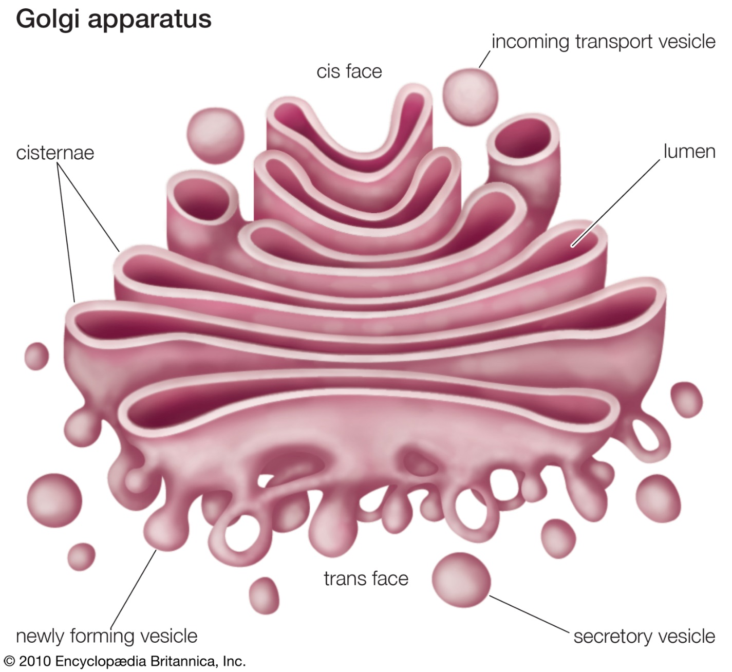
The Golgi Apparatus

Slide 21
The Golgi Apparatus
The Golgi apparatus is a series of flattened discs. Molecules move through the discs in vesicles that bud off from one disc and fuse to the next one in the stack.
The main modification to proteins is the addition of carbohydrates.
Enzymes catalyse the additions of various sugars in multiple steps, to form the carbohydrates.

Slide 22
The Golgi Apparatus
Vesicles leave the Golgi apparatus to take proteins to the main cell membrane, and sometimes to lysosomes. They do this by moving through the cell and fusing with them.

Slide 23
The Secretory Pathway
Some proteins are made inside of the cell that must be secreted (let out) of the cell. Examples are hormones and digestive enzymes.
Proteins that have to be secreted are translated in ribosomes on the RER. They then enter it’s lumen.
The proteins move through the Golgi apparatus as normal and are packaged into secretory vesicles.
These vesicles move to the membrane and fuse with it, releasing their contents out of the cell.
Many proteins are made as an inactive version of the final product. They require proteolytic cleavage to produce active proteins.

Slide 24
Proteolytic Cleavage
A type of post-translation modification.
This turns inactive proteins into active proteins by breaking the peptide bonds between some amino acids in a protein.
For example the inactive enzyme prothrombin is converted into the active enzyme thrombin by proteolytic cleavage. This process is started by the release of clotting factors (Higher Key Area 2.7)

Slide 25
Amino Acid Structure
Polypeptides are polymers of amino acid monomers. After post-translational modification, we can then call this polypeptide a protein.

Slide 26
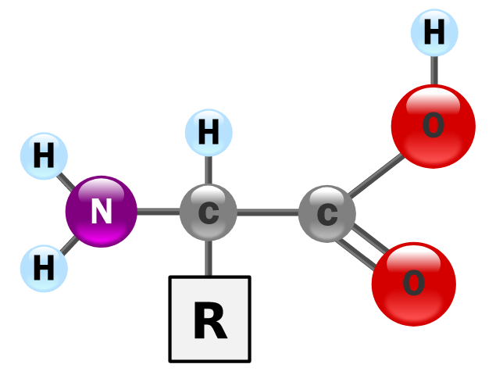
Amino Acid Structure
All amino acids have a central carbon which has 4 groups bonded to it:
An NH₂ (amine) group
A COOH (acid) group
A singular hydrogen atom
A variable R group

Slide 27
Amino Acid Structure
When in the aqueous solution of the cell, the NH₂ amine group will gain a hydrogen ion to form NH₃⁺, whilst the COOH acid group will lose a hydrogen ion to form COO⁻
That means it is upto the variable R group to decide the charge on the amino acid. This affects the way it behaves.

Slide 28
R Groups
R Groups vary in:
Size
Shape
Charge
Hydrogen bonding capacity
Chemical reactivity

Slide 29
Amino Acid Groups
There are four classes of amino acids:
Acidic (negatively charged) – R group with COOH
Basic (positively charged) – R group with NH2
Polar (slightly charged, hydrophillic) - R group with OH
Hydrophobic (no charge) – R group with hydrocarbon
At Advanced Higher level you do not need to know the structure of any specific amino acids but you should be able to identify which group each amino acid falls into.

Slide 30
Acidic Amino Acids (COO⁻)

Slide 31
Basic Amino Acids (NH₂ /NH₃⁺)

Slide 32
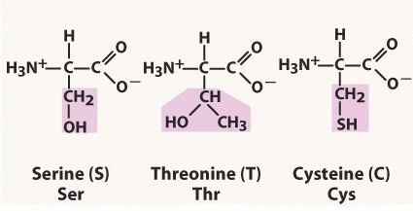
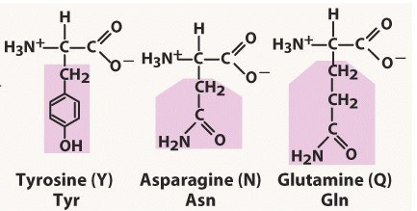
Polar Amino Acids (OH)

Slide 33
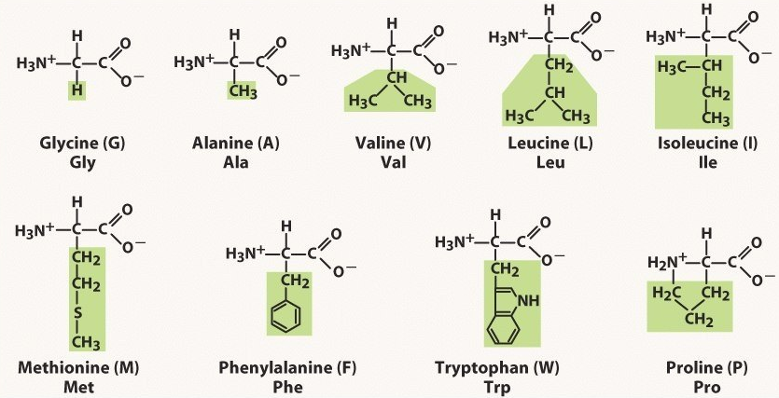
Hydrophobic Amino Acids (CH)

Slide 34
Joining Amino Acids
To join amino acids together, a condensation reaction must occur. This is controlled by an enzyme.
In this reaction, a water molecule is made by taking the OH from the COOH acid group of one amino acid and the H from the NH₂ group of the next amino acid.
The bond made (C-N) is called a peptide bond.

Slide 35
Protein Structure
After a polypeptide has gone through post-translational modification, it must be folded to make the final protein shape.
Polypeptides go through up to 4 levels of folding to become a protein.

Slide 36
Primary Structure
The sequence in which amino acids are arranged. This determines the function of the protein.

Slide 37
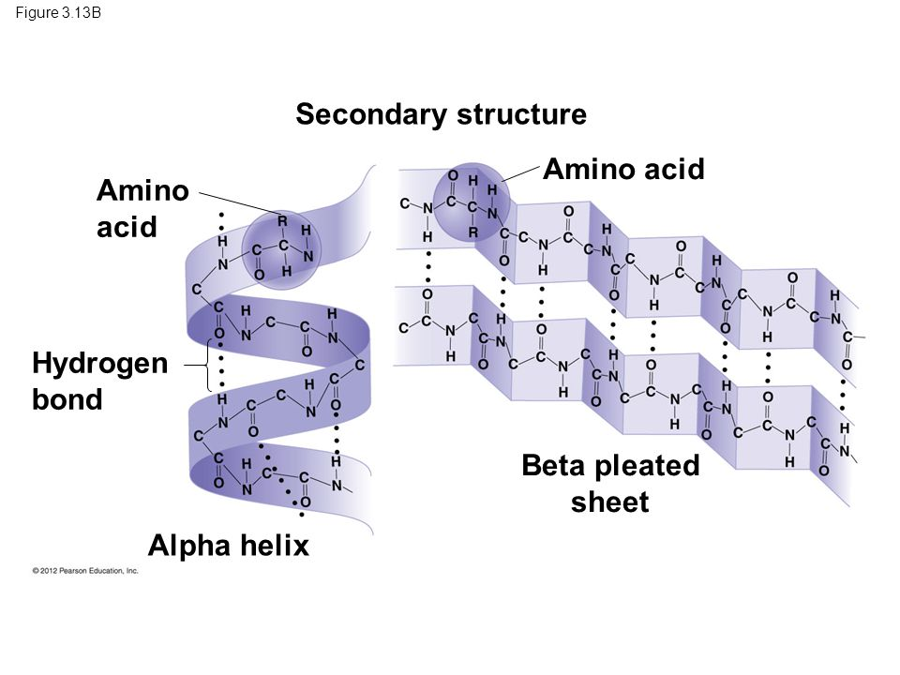
Secondary Structure
Once the primary structure is established, it can fold in two main different ways:

Slide 38
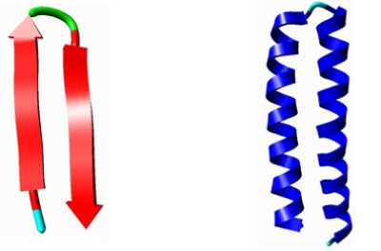
Secondary Structure
There is a third, less common, secondary structure called turns.

Slide 39
Tertiary Structure
For many proteins, the final folded shape is the tertiary structure. This is 3 dimensional and is caused by interactions between R groups of amino acids.
There are 5 types of interactions which will affect the tertiary structure:
Hydrophobic interactions
Ionic bonds
London dispersion forces
Hydrogen bonds
Disulphide bridges

Slide 40
Tertiary Structure
Tertiary structure is affected by changes in temperature and pH.
A higher temperature will cause the structure to become destablised as the chain “shakes” which breaks weak bonds.
A change in pH will affect the ionisation of the acidic and basic R groups and changes the charge they carry so they no longer bond correctly.

Slide 41
Quaternary Structure
This exists in proteins with two or more sub-units.
The polypeptide unit may join with other units.
Examples:
Collagen – made of 3 subunits
Haemoglobin – made of 4 subunits

Slide 42
Prosthetic Groups
A non-protein strongly bound to one or more poly peptide units within the protein.
Example:
Haemoglobin – made of 4 subunits of protein and one “haem” group – made of Iron.

Slide 43
Why are R groups important?
R groups of amino acids are very important for three reasons.
R groups determine the structure of the protein. R groups interact with each other while forming the primary, secondary and tertiary structure. In the quaternary structure, R groups from one chain may interact with R groups from another chain.

Slide 44
Why are R groups important?
R groups allow ligands to bind
A ligand is a molecule which binds to a protein.
R groups which are not involved in protein
folding will be on the outer surface of the
protein, so ligands could bind to them. Ligands
which bind may change the conformation
(shape) of a protein.

Slide 45
Why are R groups important?
R groups determine the location of the protein within a cell. The number of hydrophobic and hydrophillic R groups at the surface of a protein will determine the solubility of the protein in the cytoplasm, which is aqueous.
Remember: The cell membrane contains phospholipids which are hydrophobic.

Slide 46
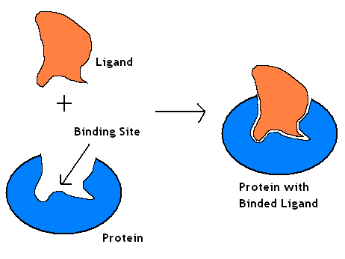
Ligand
In Biology, a ligand is the name given to any substance that can bind to a protein.
When a ligand binds to a protein, it very slightly changes the shape of the protein.
A ligand in biology is not
the same as a ligand
in chemistry

Slide 47
How does ligand binding happen?
When a protein folds into it’s tertiary structure, there may be some amino acids whose R groups are exposed to the outer surface of the protein.
These R groups may help in the binding of the protein to other molecules.
Areas where this occurs are called ligand-binding sites. They look like small clefts on the surface of the protein.

Slide 48
How does ligand binding happen?
The binding site matches the shape of the ligand and it’s chemistry is complementary.
For example, the binding site has charged, polar and non-polar R groups arranged which match the charged, polar and non-polar R groups on the ligand.

Slide 49
Why do ligands bind?
When a ligand binds to a protein, it causes a conformational change (change in shape).
The shape of a protein is crucial for it’s function. A change in shape normally means a change in function. This means proteins can be “switched on” or “switched off” when a ligand is present.

Slide 50
Enzymes and Ligands
The active site of an enzyme is a ligand binding site. When a substrate joins to an enzyme, there is a very slight conformational change.
This is called induced fit – it helps to increase the binding and interaction between the active site and the substrate.

Slide 51
Induced Fit
This new shape is temporary and because the enzyme is trying to revert back to its original shape, it places the substrate under tension.
When under tension, the substrate is more likely to change into the product and so the overall activation energy is reduced.
Once the reaction has taken place, the active site is less attracted to the products and so they are released, leaving the enzyme to move back into it’s original shape.

Slide 52
Enzyme Modulators
Remember metabolic pathways from Higher
The rate of product formation can be controlled by raising or lowering the activity of one enzyme within the pathway.
Enzymes which can be manipulated in this way are called allosteric enzymes

Slide 53
Allosteric Enzymes
Some enzymes are regulated by altering their shape.
The conformational change is caused by a modulator which joins at a different site from the active site. This is called the allosteric site. Most allosteric proteins consist of multiple subunits.
Modulators changing the shape of the enzyme affects the enzyme’s affinity for it’s substrate and the shape of the active site. Enzyme activity can be turned on or turned off in this way.

Slide 54
Allosteric Enzymes
There are two types of modulators:
Positive Modulators
Increase the enzymes affinity for the substrate
Negative Modulators
Decrease the enzymes affinity for the substrate

Slide 55
Cooperativity
Proteins which have a quaternary structure (subunits joined together) show cooperativity.
If a ligand binds at one subunit, the conformation of the subunit is altered.
This then alters the conformation of the neighbouring subunits, increasing the ligand affinity of the remaining subunit.
This means that for example, an enzyme molecule made of a number of subunits (e.g. catalase) shows an increase in activity in the presence of it’s substrate (ligand). The binding of one substrate to the active site of one unit causes conformation change in the other subunits so their active sites become active.

Slide 56
Cooperativity
The binding and release of oxygen by haemoglobin molecules shows cooperativity.
Changes in the binding of oxygen at one subunit alter the affinity of the remaining subunits for oxygen.
Two things can influence the binding of oxygen:
Temperature
Increasing the temperature lowers the affinity of haemoglobin for oxygen, so the binding of oxygen is reduced.
pH
Decreasing pH also lowers affinity of haemoglobin for oxygen

Slide 57
Adding or Removing Phosphate
The addition or removal of a phosphate causes reversible conformational (shape) changes in proteins.
Common form of post-translational modification
It is an important method of regulating the activity of many proteins like enzymes or receptor molecules. This systems acts as a molecular switch on the cell, turning activities on or off as required.

Slide 58
Adding Phosphate
Kinases catalyse phosphorylation (addition of a phosphate)
Approximately 500 different kinases in the proteome
Kinases transfer a phosphate from ATP to other proteins, activating them.
In more detail: Adding a phosphate adds negative charges to the molecule. Ionic interactions in the unphosphorylated protein can be disrupted and new ones are created.
SWITCH “ON”

Slide 59
Removing Phosphate
Phosphatases catalyse dephosphorylation (removal of a phosphate)
Approximately 150 different phosphatases in the proteome
Phosphotases rapidly remove phosphate groups from proteins, inactivating them.
SWITCH “OFF”

