Slide 1
Clinical Trials of Vaccines and Drugs
Neurobiology and Immunisation
Higher Human Biology for CfE
Miss Aitken

Slide 2
Clinical Trials
A clinical trial is a type of medical research.
It aims to find new and improved ways of
preventing
diagnosing
Treating
controlling illnesses.
People are involved in the trial in a controlled and carefully planned way.

Slide 3
Clinical Trials
Clinical trials are designed to answer questions - about a treatment or a procedure.
The main questions are usually:
Does it work?
Is it safe?
Does it cause side effects?
How does it affect quality of life?
Does it work better than existing treatments?
What is the best dose to use?

Slide 4
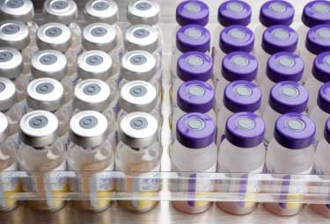
Clinical Trials
Vaccines are subjected to clinical trials just like any other pharmaceutical medicine
They must be shown to be safe and effective when used in humans

Slide 5
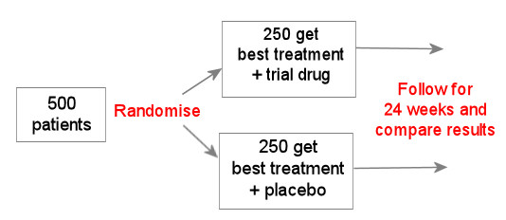
Placebo Controlled Trials
A placebo is a dummy treatment. E.g. a pill that looks the same as the drug being tested but just contains sugar.
People can sometimes feel better when they have a placebo because they think they are having a real treatment. This is known as the 'placebo effect'.
Comparing a group of people taking a new treatment with a group taking a placebo can show if the new treatment is really having an effect.
A truly effective drug will show better results than the placebo.
The use of a placebo allows for a valid comparison to be made

Slide 6
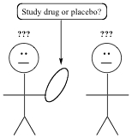
Double Blind Trials
In a blinded trial, you won't know whether you are getting the trial treatment, or the standard treatment or placebo. They will both look the same. Trials need to be 'blind' because just knowing that you are getting a new treatment can affect how you respond to, and make the results unreliable.
Often the health professionals on the trial who give you your treatment are also 'blinded', meaning they don't know which treatment you are getting either - so they can't be influenced by what they know. This is known as double blind.
A double blind trial eliminates bias

Slide 7
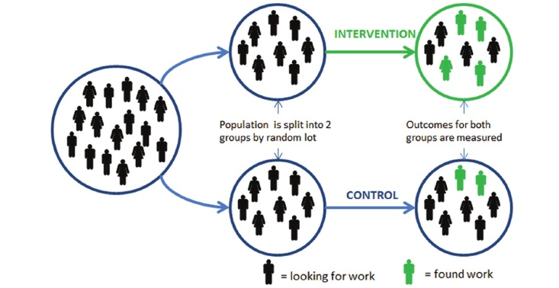
Types of Vaccine Trials Randomisation
Everyone taking part in a randomised trial is put into different groups at random. Usually decided by computer.
There are usually two groups in a randomised trial. Only one group has the new treatment. The other, called the control group, has the standard treatment or a placebo. The research team can then compare results from the two groups.
One reason that trials are randomised is so that the research team can't choose who goes into which group based on what they know about their patients. For example, they might put people who they thought were healthier or more unwell into a particular group. This precaution helps to increase the reliability of the results.
This procedure further eliminates bias

Slide 8
Experimental Error
At the end of the trial, results from the two groups, which must be of a suitable size to reduce the magnitude of experimental error are compared to determine whether there are any statistically significant differences between the groups

Slide 9
Essay Questions
Describe non-specific defences that the body uses to protect itself from pathogens. (8)
Describe how immunity is naturally acquired (7)
Give an account of immunisation under the following headings
Vaccination (5)
Difficulties achieving widespread vaccination (3)

