Slide 1
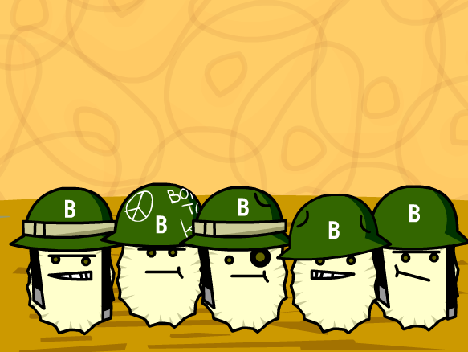
Specific Cellular Defences Against Pathogens
Neurobiology & Immunology - Unit 3
CfE Higher Human Biology

Slide 2
The Third Line of Defence
The third line of defence is a specific immune response.
This line of defence is brought about by lymphocytes, a type of white blood cell which comes from stem cells in the bone marrow.

Slide 3
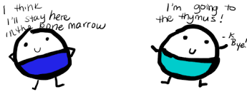
Types of Lymphocyte
Some lymphocytes pass to the thymus where they develop into T-Lymphocytes (T-Cells)
Some remain and mature in the bone marrow where they develop into B-Lymphocytes (B-Cells)

Slide 4
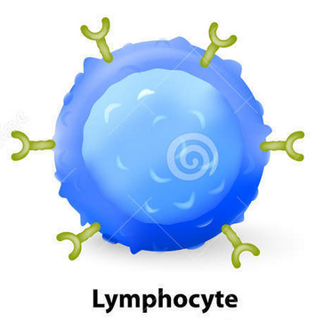
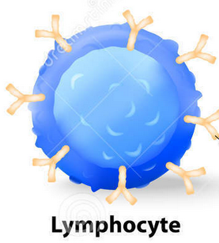
How Lymphocytes Work
All lymphocytes have a single type of membrane receptor on their surface which is specific to one antigen.
Each lymphocyte has several copies of one type of antigen receptor. These antigen receptors are specific to an antigen, and is different to any receptors on any other antigens. Therefore, each lymphocyte is only able to become attached to one type of antigen.
The body possesses a huge number of different lymphocytes.

Slide 5
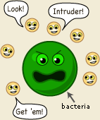
Antigens
A surface marker on any foreign molecule is called an antigen. Antigens trigger an immune response
Molecules on viruses, bacteria, toxins and on the surface of transplant cells can all act as antigens.

Slide 6
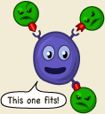
If a lymphocyte patrolling the body finds an antigen which fits it’s antigen receptor, it is said to have been “selected.”
The lymphocyte responds by dividing repeatedly to form a clonal population of identical lymphocytes.
This process is known as clonal selection.

Slide 7
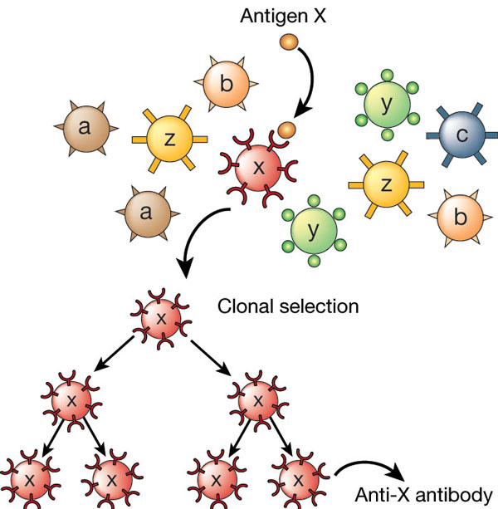

Slide 8
T Lymphocytes
T lymphocytes are able to tell the difference between self-antigens on the body’s own cells and non-self-antigens on pathogens or infected cells.
If a T lymphocyte comes across a pathogen with a non-self antigen, it can cause the pathogen to die by a process called apoptosis. Apoptosis is programmed cell death.

Slide 9
How do T Lymphocytes cause Apoptosis?
T lymphocytes attach on to infected cells and release proteins. These proteins diffuse into the infected cells causing production of self-destructive enzymes which cause cell death. The remains of the cell are then removed by phagocytosis.

Slide 10
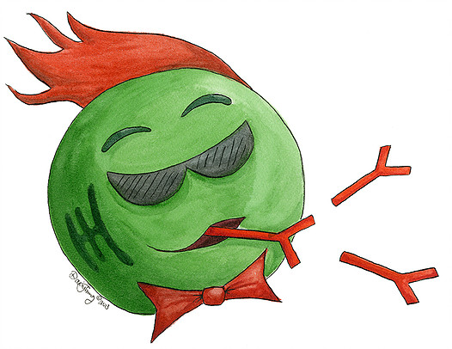
B Lymphocytes
B Lymphocytes produce and secrete molecules called antibodies.
Antibodies are Y-shaped proteins that have receptor binding sites specific to a particular antigen on a pathogen.
Antibodies become bound to antigens, inactivating the pathogen. The resulting antigen-antibody complex can then be destroyed by phagocytosis.

Slide 11
Autoimmunity
A failure in a regulation of the immune system means that sometimes, T-Lymphocytes will launch an attack on the body’s own cells.
This is called autoimmunity and is the cause of autoimmune diseases such as rheumatoid arthritis and type 1 diabetes.

Slide 12
Primary and Secondary Response
Some of the cloned B and T lymphocytes produced during an infection survive long-term as memory cells.
When a secondary exposure to the same antigen occurs, these memory cells rapidly give rise to a new clone of specific lymphocytes. These destroy the invading pathogens before the individual shows symptoms.
During the secondary response, antibody production is greater and more rapid than during the primary response.

Slide 13
Direct Attack on the Immune System
Some types of very successful pathogens have often found a way of mounting a direct attack on the immune system
The human immunodeficiency virus (HIV) attacks and destroys T lymphocytes. HIV causes depletion of T lymphocytes which leads to the development of AIDS (acquired immune deficiency syndrome).
Individuals with AIDS have a weakened immune system and so are more vulnerable to opportunistic infections.

Slide 14
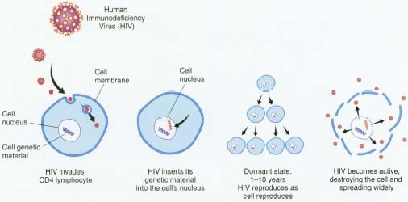
Direct Attack on the Immune System

Slide 15
Clonal Selection Theory
Antigens
Immunological Memory
Key Area 4.2:
Specific Defences
HIV/AIDS
T-Lymphocytes
Auto-immunity
B-Lymphocytes

