Slide 1
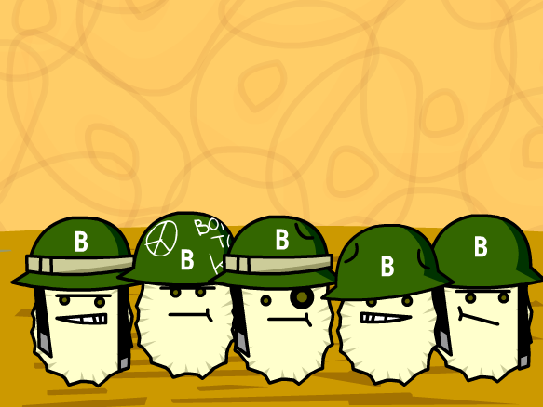
Key Area 3.5: Non-Specific Body Defences
Neurobiology and Immunology -Unit 3
CfE Higher Human Biology

Slide 2
What is Immunity?
Immunity is the ability of the body to resist
infection by a pathogen or to destroy the
organism if it succeeds in invading and infecting
the body.

Slide 3
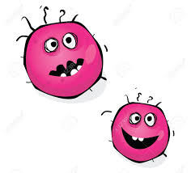
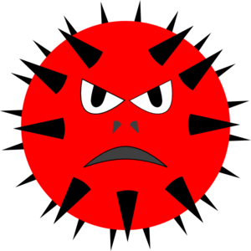
The Immune System
The body attempts to defend itself against:
Pathogens - disease-causing organisms
Toxins – poisons produced by living things
Cancer cells

Slide 4
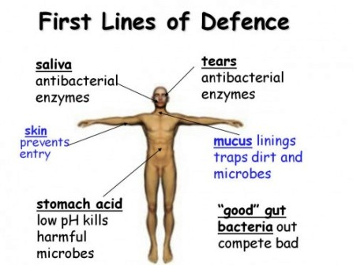
The first line of defence is non-specific.
It works against any type of disease-causing agent

Slide 5
The first line of defence is non-specific.
It works against any type of disease-causing agent

Slide 6
Examples of the First Line of Defence
Secretions from the skin’s sweat glands and sebaceous glands keep the pH of the skin too low for many organisms
The skin is composed of layers of epithelial cells which provide a physical barrier against bacteria and viruses
Secretions such as tears and saliva contain lysozyme which digests bacterial cell walls killing them
Acid secreted by the cells of the stomach lining kill off microbes that may have been swallowed
Mucous membranes that line the digestive and respiratory tracts are also composed of epithelial cells
Ciliated cells in the trachea sweep mucous and trapped microbes up and away from the lungs

Slide 7
The Second Line of Defence: The Inflammatory Response
The second line of defence is also known as the inflammatory response. The inflammatory response is a specialised defence which works at the affected site.

Slide 8
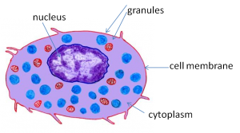
Mast Cells & Histamine
Mast cells are cells found in connective tissue around the body. They are closely related to white blood cells
Mast cells contain granules containing histamine. Histamine causes blood vessels to dilate and capillaries to become more permeable.

Slide 9
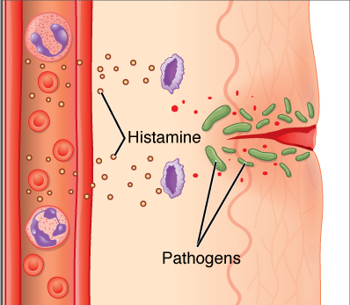
When injury occurs, mast cells become “activated” and release large quantities of histamine. This results in blood vessels in the area undergoing vasodilation, and capillaries become full of blood.
This extra blood flow makes the area red, swollen, inflamed and hot to touch.

Slide 10
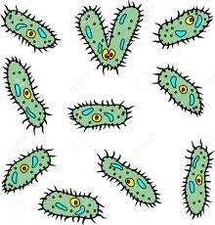
Cytokines
Cytokines are cell-signalling molecules that are secreted by white blood cells which have arrived at the site of infection.
Signals sent out by cytokines increase the number of:
Phagocytes – cells which engulf pathogens
Anti-microbial proteins – cells which amplify the immune response
Blood-clotting chemicals – which help to stop blood loss and prevent infection

Slide 11
White Blood Cells - Phagocytes
Phagocytes engulf (consume) pathogens by a process called phagocytosis
During phagocytosis, a foreign pathogen is broken down inside a phagocyte by powerful digestive enzymes called lysosomes.

Slide 12
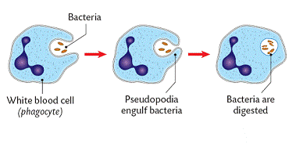
When a phagocyte has finished “digesting” a pathogen, the cell releases more cytokine molecules to attract other phagocytes to the infected area.
Dead bacteria and phagocytes may ‘clump’ together to form pus.

