Slide 1
Key Area 3.1 – Division of the Nervous System & Neural Pathways
Unit 3 Neurobiology and Immunology
Higher Human Biology for CfE
Miss Aitken

Slide 2
Structure of the Nervous System
The nervous system is made up of:
The Central Nervous System (CNS)
Includes brain and spinal cord
The Peripheral Nervous System (PNS)
Includes peripheral nerves which branch off from spinal cord and go to arms, legs, torso etc.

Slide 3
Function of CNS
Brain – Processing of information
Spinal Cord – Connects brain to PNS
Peripheral Nerves – Carries information to and from all parts of the body

Slide 4
Function of PNS
The PNS can be split into two parts:
The Somatic Nervous System (SNS)
Voluntary movements of the skeletal muscle
The Autonomic Nervous System (ANS)
Involuntary movements of the smooth muscle, cardiac muscle and glands. Controls heartbeat, breathing rate and intestinal secretions. Controls functions which bring about a steady internal state within the body.

Slide 5
Sympathetic and Parasympathetic Fibres
Sympathetic fibres within the nervous system speed things up – preparing the body for action.
Parasympathetic fibres within the nervous system slow things down – preparing the body for rest, digest and recovery.
Sympathetic and parasympathetic fibres are antagonistic, which means they exert opposing forces and work against each other.

Slide 6
Sympathetic and Parasympathetic Fibres
Sympathetic fibres within the nervous system speed things up – preparing the body for action.
Speeds up breathing and heart rate
Slows down peristalsis and production of intestinal secretions to focus on sending oxygen to places which need it.

Slide 7
Sympathetic and Parasympathetic Fibres
Parasympathetic fibres within the nervous system slow things down – preparing the body for rest, digest and recovery.
Slows down breathing and heart rate
Speeds up peristalsis and production of intestinal secretions – digestion can take place when the body is at rest

Slide 8
Neurons
Cells which make up the nervous system are called neurons. They transmit information through electrical impulses.

Slide 9
Neural Pathways
Neurons connected to each other through synapses form pathways through the nervous system.
A converging neural pathway is where several small neurons join to form a larger neuron e.g. Retina at back of eye
A diverging neural pathway is where one large neuron splits to form several small neurons e.g. Nerves in hand
A reverberating neural pathway is where neurons are cycled back through the pathway continuously.

Slide 10
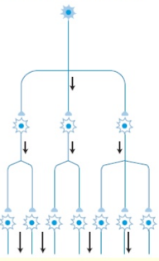
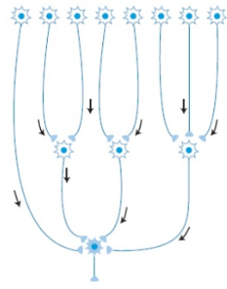
Diverging and Converging Neural Pathways

Slide 11
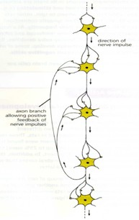
Reverberating Neural Pathways

Slide 12
3.1 - Past Paper Question
Taken from SQA Specimen Paper 2014:
“Describe the structure and function of the autonomic nervous system” (7)

Slide 13
3.1 Past Paper Question - Answers
ANS works automatically/it is not controlled/it is involuntary
It is made up of two branches: the sympathetic and the parasympathetic systems
These two systems are antagonistic which means they work against each other
The sympathetic nervous system prepares the body for fight or flight
The parasympathetic nervous system prepares the body for resting and digesting
ANS can control heart rate – the sympathetic nervous system speeds it up and parasympathetic system slows it down.
ANS can control breathing – the sympathetic nervous system speeds it up and parasympathetic system slows it down.
ANS can control digestive processes – the sympathetic nervous system slows it down and parasympathetic system speeds it up.

