Slide 1
Key Area 2.7 – Pathology of Cardiovascular Disease (CVD)
Unit 2 Physiology and Health
Higher Human Biology for CfE
Miss Aitken

Slide 2
Atherosclerosis
Atherosclerosis is the build up of substances under the endothelium of the artery wall.
The build up is called an atheroma and is made up of fatty material such as cholesterol, fibrous material and calcium salts.

Slide 3
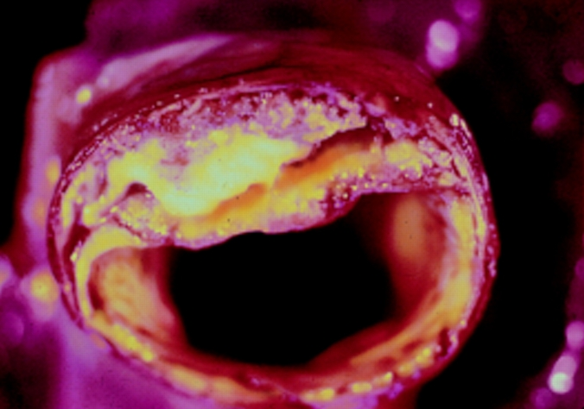
Atherosclerosis
Atheroma
Narrowed lumen of the artery

Slide 4
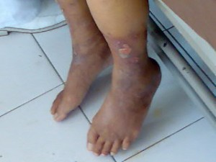
Atherosclerosis
Atherosclerosis is the root cause of diseases:
Angina
Heart attacks
Stroke
Peripheral vascular disease

Slide 5
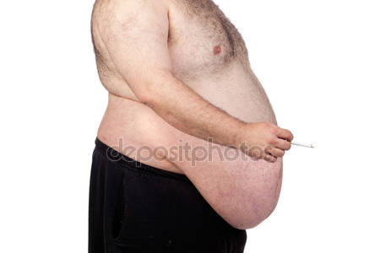
Atherosclerosis – Risk Factors
People at risk of atherosclerosis are those with diabetes, with a low HDL/LDL cholesterol ratio, high blood pressure, large body weight and smoking.

Slide 6
Thrombosis –
Formation of a blood clot
If an atheroma ruptures, the damage caused to the endothelium of the artery causes a series of reactions to happen.
Clotting factors are released
This changes the inactive enzyme prothrombin to the active enzyme thrombin
Thrombin changes soluble fibrinogen to insoluble fibrin
Platelets are then trapped within the fibrin mesh and form a thrombus (clot)

Slide 7
Thrombosis –
Formation of a blood clot
Release of clotting factors
Inactive Prothrombin
Active Thrombin
Fibrinogen (soluble)
Fibrin (insoluble)
Platelets are trapped within the fibrin and a clot forms

Slide 8
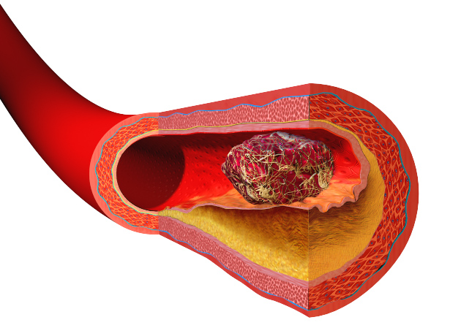
Thrombosis –
Formation of a blood clot
Atheroma which has ruptured
Blood clot blocking artery

Slide 9
Embolism
If a thrombus (blood clot) breaks loose, it forms an embolus.
An embolus can travel through the bloodstream and block a blood vessel, resulting in cells being deprived of oxygen. This leads to the death of tissues.

Slide 10
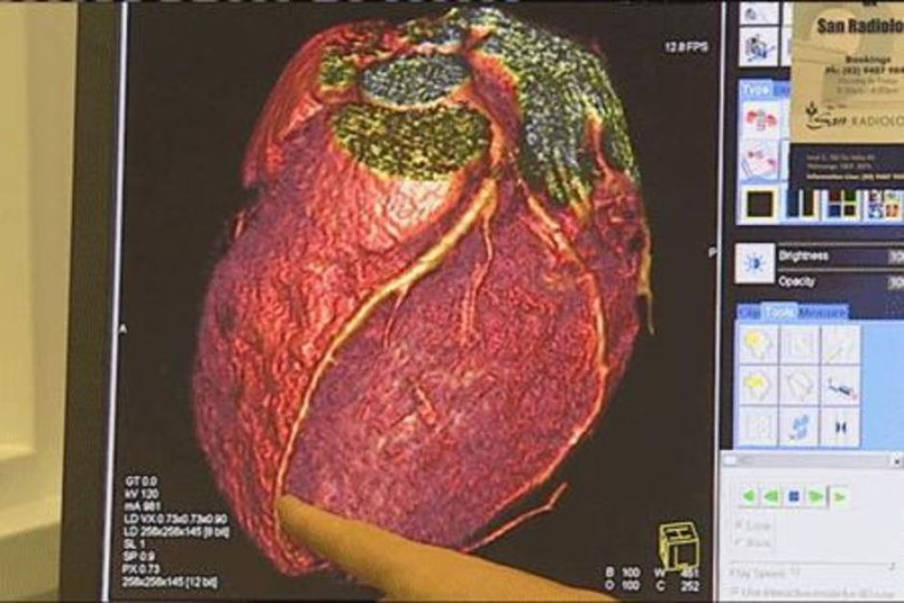
Embolism
A blocked coronary artery can lead to a myocardial infarction – a heart attack
Heart Attack Video
A blocked artery in the brain can lead to a stroke.

Slide 11
Peripheral Vascular Disease
A narrowing of arteries due to atherosclerosis – somewhere other than the heart or brain.
Deep vein thrombosis (DVT) is the formation of a blood clot in a deep vein, usually the leg.
Pain is experienced due to the lack of oxygen
If a thrombus breaks loose, it forms an embolus which could travel through the blood stream and block a blood vessel.

Slide 12
Peripheral Vascular Disease

Slide 13
Peripheral Vascular Disease
A pulmonary embolism is caused by part of the thrombus breaking free and travelling to the pulmonary artery, where it can cause a blockage, resulting in chest pain and breathing difficulties.

Slide 14
Cholesterol – What is it?
Cholesterol is a component of cell membranes
It is vital for making steroids such as sex hormones
Most cholesterol is made by the liver from saturated fats in the diet.

Slide 15
High Density Lipoprotein (HDL)
HDL transports excess cholesterol from the blood to the liver for elimination, and so stops cholesterol building up in the blood.
GOOD

Slide 16
Low Density Lipoprotein (LDL)
LDL transports cholesterol to body cells. Most cells have LDL receptors that take LDL into the cell, but once a cell has enough cholesterol, negative feedback happens and stops LDL from entering the cell. This means LDL continues to circulate in the blood and may deposit cholesterol in the arteries, forming atheromas.
BAD

Slide 17
Lifestyle Choices and Cholesterol Level
A high ratio of HDL to LDL results in lower blood cholesterol with a reduced chance of atherosclerosis.
Regular exercise increases the levels of HDL as does reduced levels of total fat in the diet, and replacing saturated fats with unsaturated fats.

Slide 18
Past Paper Question
Discuss the causes, development and associated health problems of atherosclerosis (8)

Slide 19
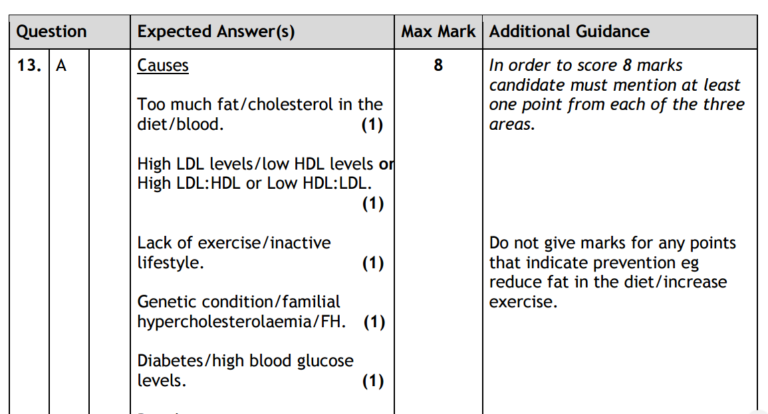
Past Paper Question

Slide 20
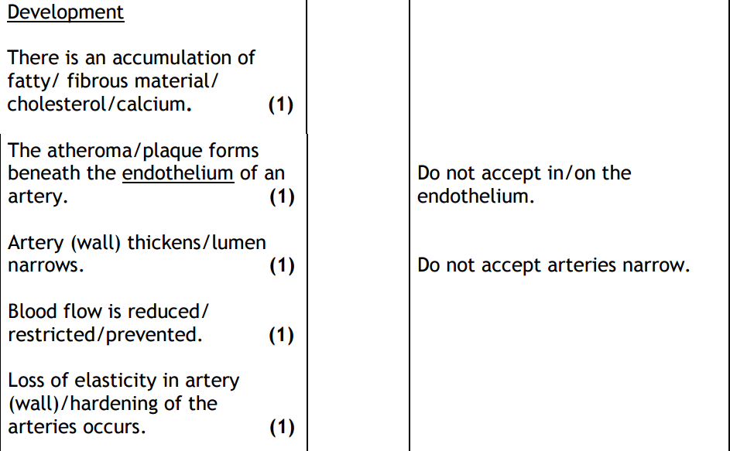
Past Paper Question

Slide 21
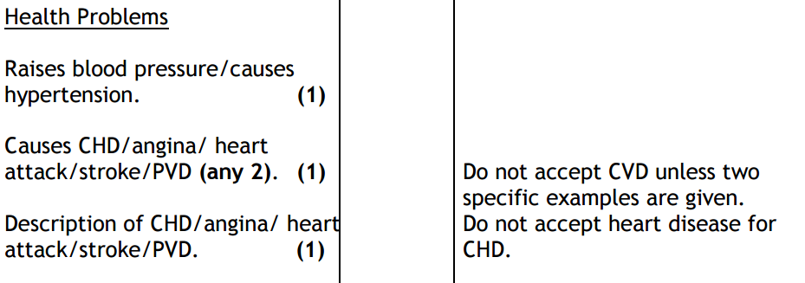
Past Paper Question

