Slide 1
Key Area 2.6 – The Structure and Function of the Heart
Unit 2 Physiology and Health
Higher Human Biology for CfE
Miss Aitken

Slide 2
The Structure of the Heart
The heart is a muscular pump with 4 chambers.
Right atrium
Left atrium
Right ventricle
Left ventricle

Slide 3
Circulation through the Heart
The vena cava returns deoxygenated blood to the heart. The right atrium receives this blood, which is then pumped to the right ventricle.
From the right ventricle, blood travels through the pulmonary artery to the lungs, absorbs oxygen, and travels back to the heart through the pulmonary vein.
Oxygenated blood is received by the left atrium, which is then pumped to the left ventricle, where it travels to the rest of the body.

Slide 4
Circulation through the Heart
The heart is separated into two halves by the septum, which ensures that deoxygenated blood in the right hand side is kept separate from the oxygenated blood in the left hand side.

Slide 5
Heart Valves
Valves prevent the backflow of blood
The Atrio-Ventricular (AV) valves are found between the atrium and ventricle in each side of the heart.
The aortic semi-lunar valve is found between the left ventricle and aorta leaving the heart
The pulmonary semi-lunar valve is found between the right ventricle and the pulmonary artery leaving the heart.

Slide 6
Cardiac Output
The cardiac output (CO) is the total volume of blood pumped out by a ventricle each minute.
The heart rate (HR) is the number of heartbeats in one minute
The stroke volume (SV) is the volume of blood pumped out by the left ventricle during each contraction.

Slide 7
Cardiac Output
The cardiac output is determined by multiplying the heart rate by the stroke volume.
CO = HR X SV

Slide 8
Cardiac Cycle
The cardiac cycle is the pattern of contraction (systole) and relaxation (diastole) in one complete heartbeat.

Slide 9
Cardiac Cycle - Diastole
During diastole heart muscle relaxes and the higher pressure in the arteries closes valves.
The atria fill with blood.

Slide 10
Cardiac Cycle - Systole
Atrial systole is when both atria contract and squeeze the blood through the AV valves to the ventricles
Ventricular systole closes the AV valves and pumps the blood out through the other two valves to the aorta and pulmonary artery.

Slide 11
Cardiac Cycle
The average length of one cardiac cycle is 0.8 seconds – based on a rate of 75 beats per minute.

Slide 12
Heart Sounds
The reason you can hear sounds from the heart when you listen with a stethoscope is due to the opening and closing of valves.
‘Lubb’ is caused by the AV valves closing
‘Dup’ is caused by the SL valves closing
Heart murmurs are caused by valves which do not open or close fully.

Slide 13
The Cardiac Conducting System
Heart muscles are self-contractile. This means they can contract and produce an electrochemical signal, which it passes to other cardiac muscle cells.
The Sino Atrial Node (SAN) or pacemaker in the wall of the right atrium sets the rate at which the cardiac muscle cells contract.

Slide 14
The Cardiac Conducting System
The electrical impulse that is generated by the cells in the SAN is passed through to the atria and to the atrio-ventricular node (AVN).
From the AVN, the electrical impulse travels down the heart via conducting fibres down the septum between the atria and ventricles. This results in the simultaneous contraction of the ventricles.

Slide 15
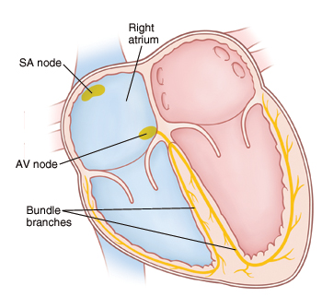
Sino- Atrial Node (SAN)
Atrio- Ventricular Node (AVN)
Conducting Fibres

Slide 16
Electrocardiograms (ECGs)
An electrocardiogram (ECG) is a trace of the electrical impulses of the heart’s conducting system.
This can be shown on a screen by placing electrodes on the skin
The tracings can be used to diagnose problems with the heart, for example heart attacks.

Slide 17
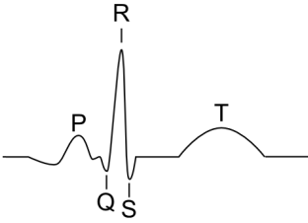
Electrocardiograms (ECGs)
ECGs are labelled with the letters PQRST.

Slide 18
T Wave:
Electrical recovery of the ventricles at the end of ventricular systole
P Wave:
Impulses spreading over the atria from the SAN
QRS Complex:
Impulse spreading through the ventricles

Slide 19
Role of the Medulla
The medulla regulates the rate of the impulses which come from the SAN.
It does this using the autonomic nervous system.
The autonomic nervous system has two ‘branches’ – the sympathetic nerves and the parasympathetic nerves.

Slide 20
Role of the Medulla
Sympathetic nerves accelerate the heart and strength of the contractions.
This releases nor-adrenaline.
These fibres can be activated by stress or fear.

Slide 21
Role of the Medulla
Parasympathetic nerves slow down the heart and strength of the contractions.
This releases acetylcholine.
These fibres can be activated by periods of calm or rest.

Slide 22
Blood Pressure
Blood pressure is done using a sphygmomanometer.
The cuff is attached to the arm and two readings are taken, the systolic pressure(top number) and the diastolic pressure (bottom number).

Slide 23
Blood Pressure
The cuff inflates to stop blood flow down the arm. It deflates gradually until blood starts to flow. This is the systolic pressure.
The cuff deflates until blood flows through the arm freely. This is called the diastolic pressure.
A normal reading is around 120/80mmHg

Slide 24
Blood Pressure
Hypertension (high blood pressure) is a major risk factor for a number of different diseases and conditions, so it is important to control blood pressure.
If hypertension is ignored it can lead to coronary heart disease, heart attacks, and strokes.

