Slide 1
Key Area 2.4 – Ante- and Post-natal Screening
Unit 2 Physiology and Health
Higher Human Biology for CfE
Miss Aitken

Slide 2
Ante-natal Screening
Ante-natal screening involves assessing the general health and wellbeing of the mother, and testing for diseases or genetic disorders before the foetus is born.
Can be used to detect disorders such as Downs syndrome, spina bifida, cystic fibrosis and muscular dystrophy. Sex can also be determined.

Slide 3
Ante-Natal Tests
Ultrasound imaging
Amniocentesis
Chorionic Villus sampling (CVS)

Slide 4
Ultrasound Imaging
Dating scans are used for working out pregnancy stage and delivery due date.
The first scan is carried out at around 8-14 weeks and is used to determine the age of the foetus. It can also identify multiple births or anything unusual.
Another scan is offered at 18-20 weeks, when the foetus is much larger. This is known as an anomaly scan and is used to identify any physical aspects of the developing baby that are unusual.

Slide 5
Biochemical Tests
Health of mother and baby are routinely checked by biochemical blood tests which detect levels of ‘marker’ chemicals during the pregnancy.

Slide 6
Diagnostic Testing
Further tests may be offered for high-risk individuals or where an anomaly has been detected.
There is an element of risk associated with diagnostic testing and decisions regarding pregnancy may be required if the outcome of the test is positive.

Slide 7
Diagnostic Testing - Amniocentesis
A needle is inserted into the amniotic sac at 15-18 weeks and some amniotic fluid is withdrawn into a syringe. The fluid contains cells belonging to the developing baby.
Defects in the developing baby can be detected but there is a small risk of miscarriage, and results are not immediately available.

Slide 8
Diagnostic Testing – Chorionic Villus Sampling
A suction tube is used to sample cells from the chorion (early placenta) at around 11-14 weeks. The foetal cells are then cultured and studied. Results are available in early pregnancy.
Defects in the developing baby can be detected but there is a small risk of miscarriage, and neural tube defects are not detected. Fingers and toes can also be harmed.

Slide 9
Karyotypes
Cells from diagnostic testing can be used to produce karyotypes. A karyotype is an image of an individuals chromosomes, arranged in homologous pairs.
A karyotype can be used to identify anomalies in the number or structure of chromosomes.

Slide 10
Post-Natal Screening
Post-natal screening is the name given to health checks carried out after the birth of a baby.

Slide 11
Phenylketonuria (PKU)
PKU is an inborn error of metabolism caused by a gene disorder. The gene encoding the enzyme that converts phenylalanine to tyrosine is faulty.
As a result, individuals with PKU cannot metabolise/process phenylalanine. Instead, it’s turned into a harmful substance called phenylpyruvate.

Slide 12
Phenylketonuria (PKU)
Gene
Enzyme
Phenylalanine
Tyrosine
Normal Individuals

Slide 13
Phenylketonuria (PKU)
Gene
Enzyme
Phenylalanine
Tyrosine
Phenylpyruvate
Individuals with PKU

Slide 14
Phenylketonuria (PKU)
All babies are tested for PKU routinely once they are born, by taking some blood from their heel.
Individuals who test positive for PKU must avoid all foods with phenylalanine in them.
Sources of phenylalanine include beef, lamb, chicken, pork, eggs, fish, cheese, milk and some nuts and seeds.

Slide 15
Pedigree Charts
Patterns of inheritance can be revealed by collecting information and using it to construct a pedigree chart.
Construction of a family tree may be carried out by a genetic counsellor and can help predict the likelihood of future children inheriting a condition from their parents.

Slide 16
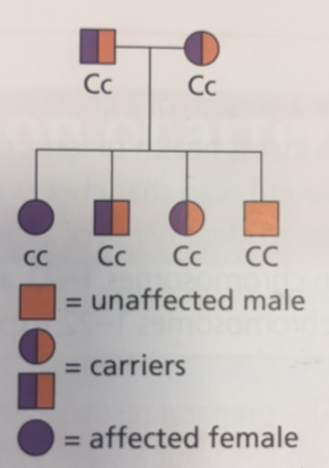
Inheritance Type – Autosomal Recessive
An autosomal recessive disorder is expressed rarely in offspring. It affects males and females equally and may skip generations.
Carriers of the condition do not show it, but can pass it on to their offspring.
Cystic Fibrosis is an example

Slide 17
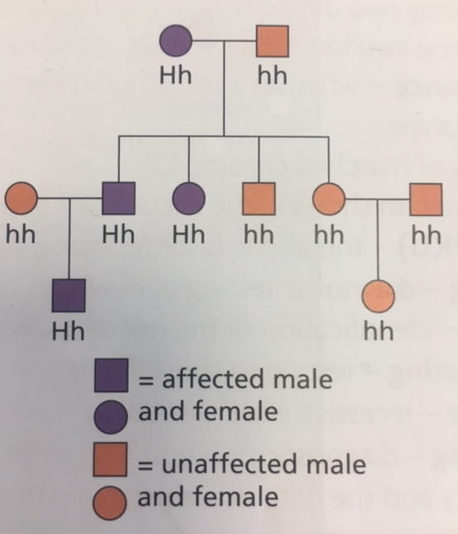
Inheritance Type – Autosomal Dominant
An autosomal dominant disorder is expressed commonly. It affects males and females equally.
You cannot carry it without showing it.
Huntington’s disease is an example

Slide 18
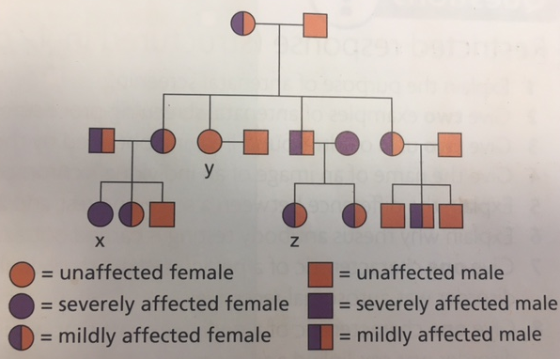
Inheritance Type – Autosomal Incomplete Dominance
In this type of inheritance, the full-blown condition is rare, and the partly expressed condition is more common. Carriers have a less severe version of the trait.

Slide 19
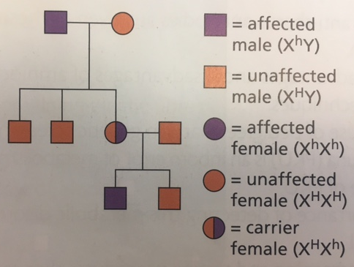
Inheritance Type – Sex Linked Recessive
Males are more commonly affected than females.
The disease is carried on the X chromosome and so males can inherit this from their mothers. Fathers do not pass on the condition to their sons.
Females can only be affected by the condition if their father has it and their mother is at least a carrier/has the condition.

