Slide 1
Key Area 2.3 – The Biology of Controlling Fertility
Unit 2 Physiology and Health
Higher Human Biology for CfE
Miss Aitken

Slide 2
Fertile Period
A fertile period is the time when a male is capable of fathering a child, or when a female is capable of conceiving and becoming pregnant.

Slide 3
Male Fertility
Males are continuously fertile
They produce sperm from puberty onwards. Negative feedback control ensures that ICSH and FSH are maintained at a relatively constant level which means testosterone and sperm are produced.

Slide 4
Female Fertility
Female fertility is cyclical – they are only fertile for a few days every month.
Females are most likely to conceive in a fertile period, which lasts around 5 days at the time of ovulation.
Ovulation can be estimated by:
Counting the number of days after menstruation
A slight rise in body temperature
Thinning of cervical mucus.

Slide 5
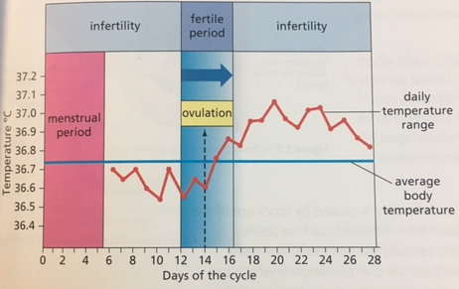
Figure 2.8 – Menstrual Cycle

Slide 6
Infertility
Infertility is when an individual is unable to father / conceive a child.
Factors such as age, genetics, disease, anorexia, smoking, obesity, drug misuse, stress and poor diet can all lead to infertility.

Slide 7
Treatments for Infertility – Stimulating Ovulation
Female infertility could be due to failure to ovulate.
This can be treated with drugs that mimic FSH and LH, or by drugs which block negative feedback control.
These drugs can cause super ovulation which can lead to multiple births. They can also be used to collect eggs for IVF purposes.

Slide 8
Treatments for Infertility – Artificial Insemination
This is a treatment where sperm is collected and inserted into the female reproductive tract without intercourse having taken place.
Useful if male has a low sperm count as more than one sperm sample can be collected and inserted at the same time.
If male is infertile, donor sperm can be used. This is donor insemination.

Slide 9
Treatments for Infertility – In Vitro Fertilisation (IVF)
Used when infertility is caused by a blockage in the oviduct – this could be due to:
Pelvic Inflammatory Disease
STDs like Chlamydia
Abortion
Miscarriage
Caesarean Section

Slide 10
Treatments for Infertility – In Vitro Fertilisation (IVF)
The steps used in IVF are:
1: Ovary is stimulated by drugs to produce a number of eggs, which are then collected
2: Eggs are mixed with sperm cells in a culture dish and fertilisation occurs
3: Zygotes are allowed to divide to produce very early embryos
4: Pre-implantation genetic diagnosis (PGD) is done to identify disorders or abnormalities
5: Eggs which are suitable are transferred into the uterus where implantation takes place. Any additional eggs are frozen.

Slide 11
Treatments for Infertility – Intracytoplasmic Sperm Injection (ICSI)
Successful fertilisation in IVF procedures depends on the presence of a very high number of active sperm. If this is not the case, ICSI can be used.
In ICSI, only one sperm per egg is needed and can be used if mature sperm are defective or low in number. In ICSI, sperm are directly injected into the egg using a needle.

Slide 12
Treatments for Infertility
Now copy down the tables on page 78 of the HTP textbook.

Slide 13
Contraception
Contraception is the intentional prevention of pregnancy by natural or artificial methods.
These can be physical or chemical.

Slide 14
Physical Methods of Contraception
Barrier methods: Condom, diaphragm/cervical cap, Intra-uterine device (IUD)
An IUD is a small structure that is usually T-shaped with metallic copper parts. It is fitted into the uterus to prevent implantation of an embryo into the endometrium.

Slide 15
Physical Methods of Contraception
Sterilisation: This is called a vasectomy in males and tubal ligation in females
This procedure is usually irreversible. Sterilisation in males involves cutting and closing the sperm tube (vas deferens) in each of the testes. In females, sterilisation involves cutting and closing each oviduct.

Slide 16
Chemical Methods of Contraception
Chemical contraceptives can
suppress ovulation (‘the pill’)
prevent ovulation/implantation of an embryo (‘morning-after pill’)
cause thickening of the cervical mucus to stop sperm reaching the egg (‘the mini-pill’)
Morning after pills are emergency contraceptives (ECPs) and contain high levels of oestrogen and progesterone.

