Slide 1
Key Area 2.2 – Hormonal Control of Reproduction
Unit 2 Physiology and Health
Higher Human Biology for CfE
Miss Aitken

Slide 2
Puberty
Puberty is the sequence of changes in which an individuals body develops from a child into an adult.
Puberty can happen at any age between 8-16 but typically tends to be around 11-13 in females and 12-14 in males

Slide 3
Hormonal Onset of Puberty
At puberty, the hypothalamus in the brain secretes a releaser hormone which targets the pituitary gland.
The pituitary gland then begins to secrete Follicle Stimulating Hormone (FSH) and Luteinising Hormone (LH) in females, and FSH and Interstitial Cell Stimulating Hormone (ICSH) in males.
This starts off the menstrual cycle in females and sperm production in males.

Slide 4
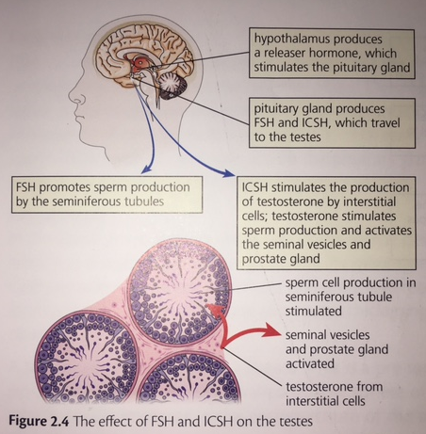
Figure 2.4 – The Effect of FSH and ICSH

Slide 5
Hormonal Control of Sperm Production
ICSH stimulates interstitial cells to produce testosterone
In turn, this stimulates the seminiferous tubules, so sperm is now made inside the seminiferous tubules.
If testosterone levels in the blood increase above a certain level, testosterone molecules inhibit the production of ICSH and FSH from the pituitary gland.
This decreases the level of testosterone released from the interstitial cells.

Slide 6
Menstrual Cycle in Females
In females, FSH stimulates the development of one Graafian follicle at a time. The Graafian follicle then begins to produce oestrogen (previous lesson).
LH triggers ovulation, where the egg is released from the graafian follicle into the oviduct.
After ovulation, LH stimulates the corpus luteum to release progesterone.

Slide 7
Ovulation
Each egg cell is surrounded by a Graafian follicle which protects the maturing egg and produces oestrogen.
Ovulation is the release of a mature egg into the oviduct, where it may be fertilised by a sperm cell to become a zygote.
The zygote will divide by mitosis to form an early embryo as it continues along the oviduct and enters the uterus, where it implants in the womb lining to continue it’s development.
Following ovulation, the Graafian follicle develops into a corpus luteum, which secretes progesterone.

Slide 8
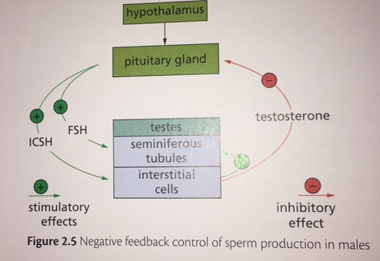
Figure 2.6 – FSH and LH on the Ovaries

Slide 9
Hormonal Control of the Menstrual Cycle
Each menstrual cycle lasts approximately 28 days in the majority of women.
This is divided into two 14-day phases:
Phase 1 – Follicular phase
Phase 2 – Luteal phase

Slide 10
Follicular Phase
FSH stimulates one follicle to mature and secrete oestrogen.
It continues to grow and develop until approximately day 14. During this time, oestrogen stimulates the endometrium to repair itself and prepare for implantation. Cervical mucus also becomes thinner, allowing it to be easily penetrated by sperm cells.
Around day 14, LH stimulates the follicle to break open and release an egg into the oviduct.

Slide 11
Luteal Phase
The remaining cells of the follicle develop into the corpus luteum.
Progesterone acts on the endometrium and vascularisation begins, which means it grows thicker and more blood vessels appear. This is to prepare it for implantation of an early embryo. Cervical mucus begins to thicken.
An embryo develops from a zygote. This implants in the lining of the endometrium 8-13 days after fertilisation.

Slide 12
Negative Feedback in Females
High progesterone levels have a negative feedback effect on the pituitary gland, which inhibits the production of FSH and LH.
Lack of FSH stops follicles developing. Lack of LH leads to a breakdown of the corpus luteum, which drops progesterone levels, leading to menstruation (a period), allowing the cycle to start again.

Slide 13
Hormones in the Menstrual Cycle
Copy the table from the middle of HTP textbook page 72. This table gives a summary of the hormones associated with the menstrual cycle, their site of production, and their function.

Slide 14
No fertilisation
If fertilisation does not take place, the corpus luteum breaks down. Progesterone and oestrogen levels decrease.
A low level of progesterone and oestrogen result in the inner layer of the endometrium breaking away, and menstruation occurs.
Fertilisation can be unsuccessful for a number of reasons.

Slide 15
Fertilisation and Pregnancy
If fertilisation does occur, the corpus luteum continues to produce progesterone, maintaining the lining of the endometrium and preventing miscarriage.
The placenta takes over the production of progesterone a few weeks into pregnancy.
The high levels of progesterone carry out negative feedback inhibition on the pituitary gland so no more FSH and LH are produced.

Slide 16
Past Paper Question
Explain the menstrual cycle under the following headings:
Follicular Phase (5)
Luteal Phase if fertilisation does not occur (5)

Slide 17
Past Paper Question
Follicular Phase:
FSH stimulates development of a follicle (1)
Follicle releases the hormone oestrogen (1)
Oestrogen stimulates the repair of the endometrium, preparing it for implantation (1)
Cervical mucus becomes thinner/temp rise (1)
Follicle grows and develops over approximately 14 days, after which a surge in LH causes ovulation to occur (1)

Slide 18
Past Paper Question
Luteal Phase:
Remaining cells of follicle develop into corpus luteum(1)
Corpus luteum secretes progesterone(1)
Progesterone vascularises the endometrium and prepares it for implantation(1)
Cervical mucus becomes thicker/temp fall (1)
Corpus luteum breaks down, progesterone and oestrogen fall and menstruation occurs(1)

Slide 19
Past Paper Question
Give an account of the role of female hormones under the following headings:
Pituitary hormones (FSH & LH) – (4)
Ovarian hormones (Oestrogen and Progesterone) – (4)

Slide 20
Past Paper Question
Pituitary gland:
FSH stimulates the development of one Graafian follicle at a time. (1)
The Graafian follicle then begins to produce oestrogen (1)
LH triggers ovulation, where the egg is released from the graafian follicle into the oviduct. (1)
After ovulation, LH stimulates the corpus luteum to release progesterone. (1)

Slide 21
Past Paper Question
Ovarian hormones:
oestrogen stimulates the endometrium to repair itself and prepare for implantation. (1)
Oestrogen makes cervical mucus become thinner, allowing it to be easily penetrated by sperm cells. (1)
Progesterone acts on the endometrium and vascularisation begins, which means it grows thicker and more blood vessels appear. (1)
Progesterone also causes cervical mucus to thicken (1)
High progesterone levels have a negative feedback effect on the pituitary gland, which inhibits the production of FSH and LH. (1)

Slide 22
Now do the questions on page 73 of the How to Pass textbook

Slide 23
How is puberty started?
What happens if fertilisation DOES NOT take place?
Role of Hormones:
FSH (males)
ICSH
Testosterone
FSH (females)
LH
Oestrogen
Progesterone
What happens if fertilisation DOES take place?
Key Area 2.2
Hormonal Control of Reproduction
Negative feedback:
Testosterone
Progesterone
Stages of the menstrual cycle

