Slide 1
Key Area 2.1 – The Structure and Function of Reproductive Organs and Gametes
Unit 2 Physiology and Health
Higher Human Biology for CfE
Miss Aitken

Slide 2
Gametes
Gametes are produced from germline cells found in the reproductive organs
Diploid germline cells divide by mitosis to form more diploid germline cells
Diploid germline cells divide by meiosis to form haploid gametes

Slide 3
Male Reproductive Organs
The male reproductive organs are called the testes
Inside the testes there are seminiferous tubules which produce sperm cells
Seminiferous tubules are lined with germline cells.
Interstitial cells, which are found between the seminiferous tubules, produce the male hormone testosterone.

Slide 4
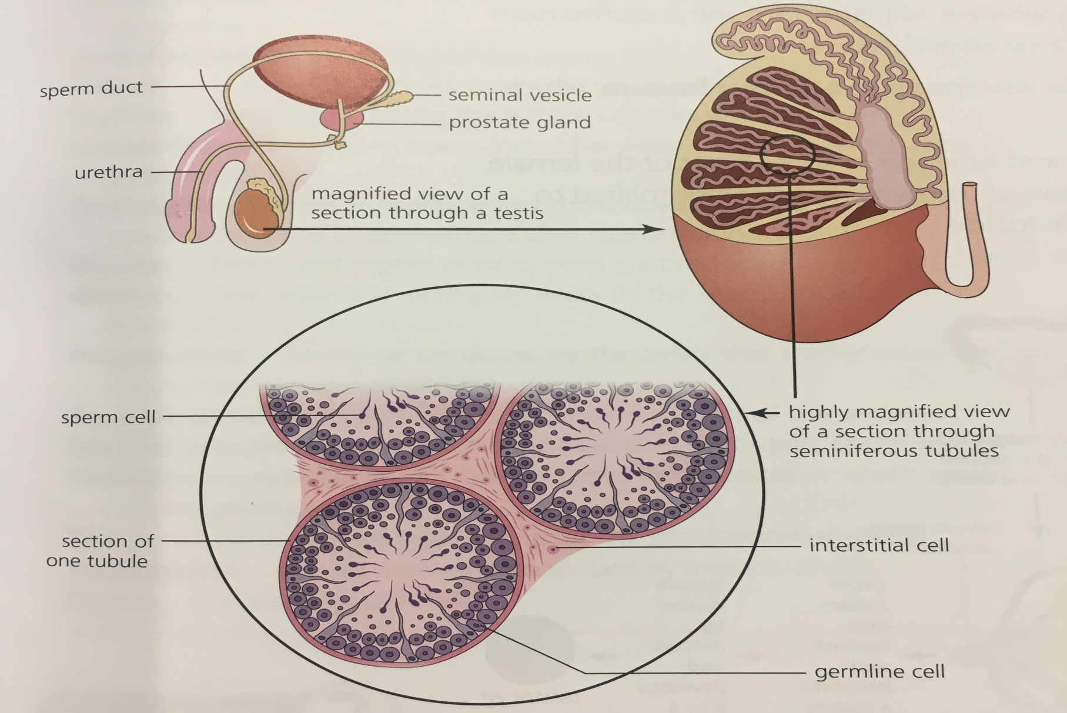
Male Reproductive Organs

Slide 5
Prostate Gland and Seminal Vesicles
The hormone testosterone activates two other parts of the male reproductive system:
The prostate – when activated it produces enzymes to keep seminal fluid at the correct consistency
Seminal vesicles – when activated they produce fructose to give sperm energy to swim, and prostaglandins, which cause the female reproductive tract to contract, pulling sperm upwards.

Slide 6
Female Reproductive Organs
The female reproductive organs are called the ovaries
Ovaries produce ova (egg cells) and the hormones oestrogen and progesterone
Ovaries are lined with germline cells.

Slide 7
Ovulation
Each egg cell is surrounded by a Graafian follicle which protects the maturing egg and produces oestrogen.
Ovulation is the release of a mature egg into the oviduct, where it may be fertilised by a sperm cell to become a zygote.
The zygote will divide by mitosis to form a blastocyst as it continues along the oviduct and enters the uterus, where it implants in the womb lining to continue it’s development.
Following ovulation, the Graafian follicle develops into a corpus luteum, which secretes progesterone.

Slide 8
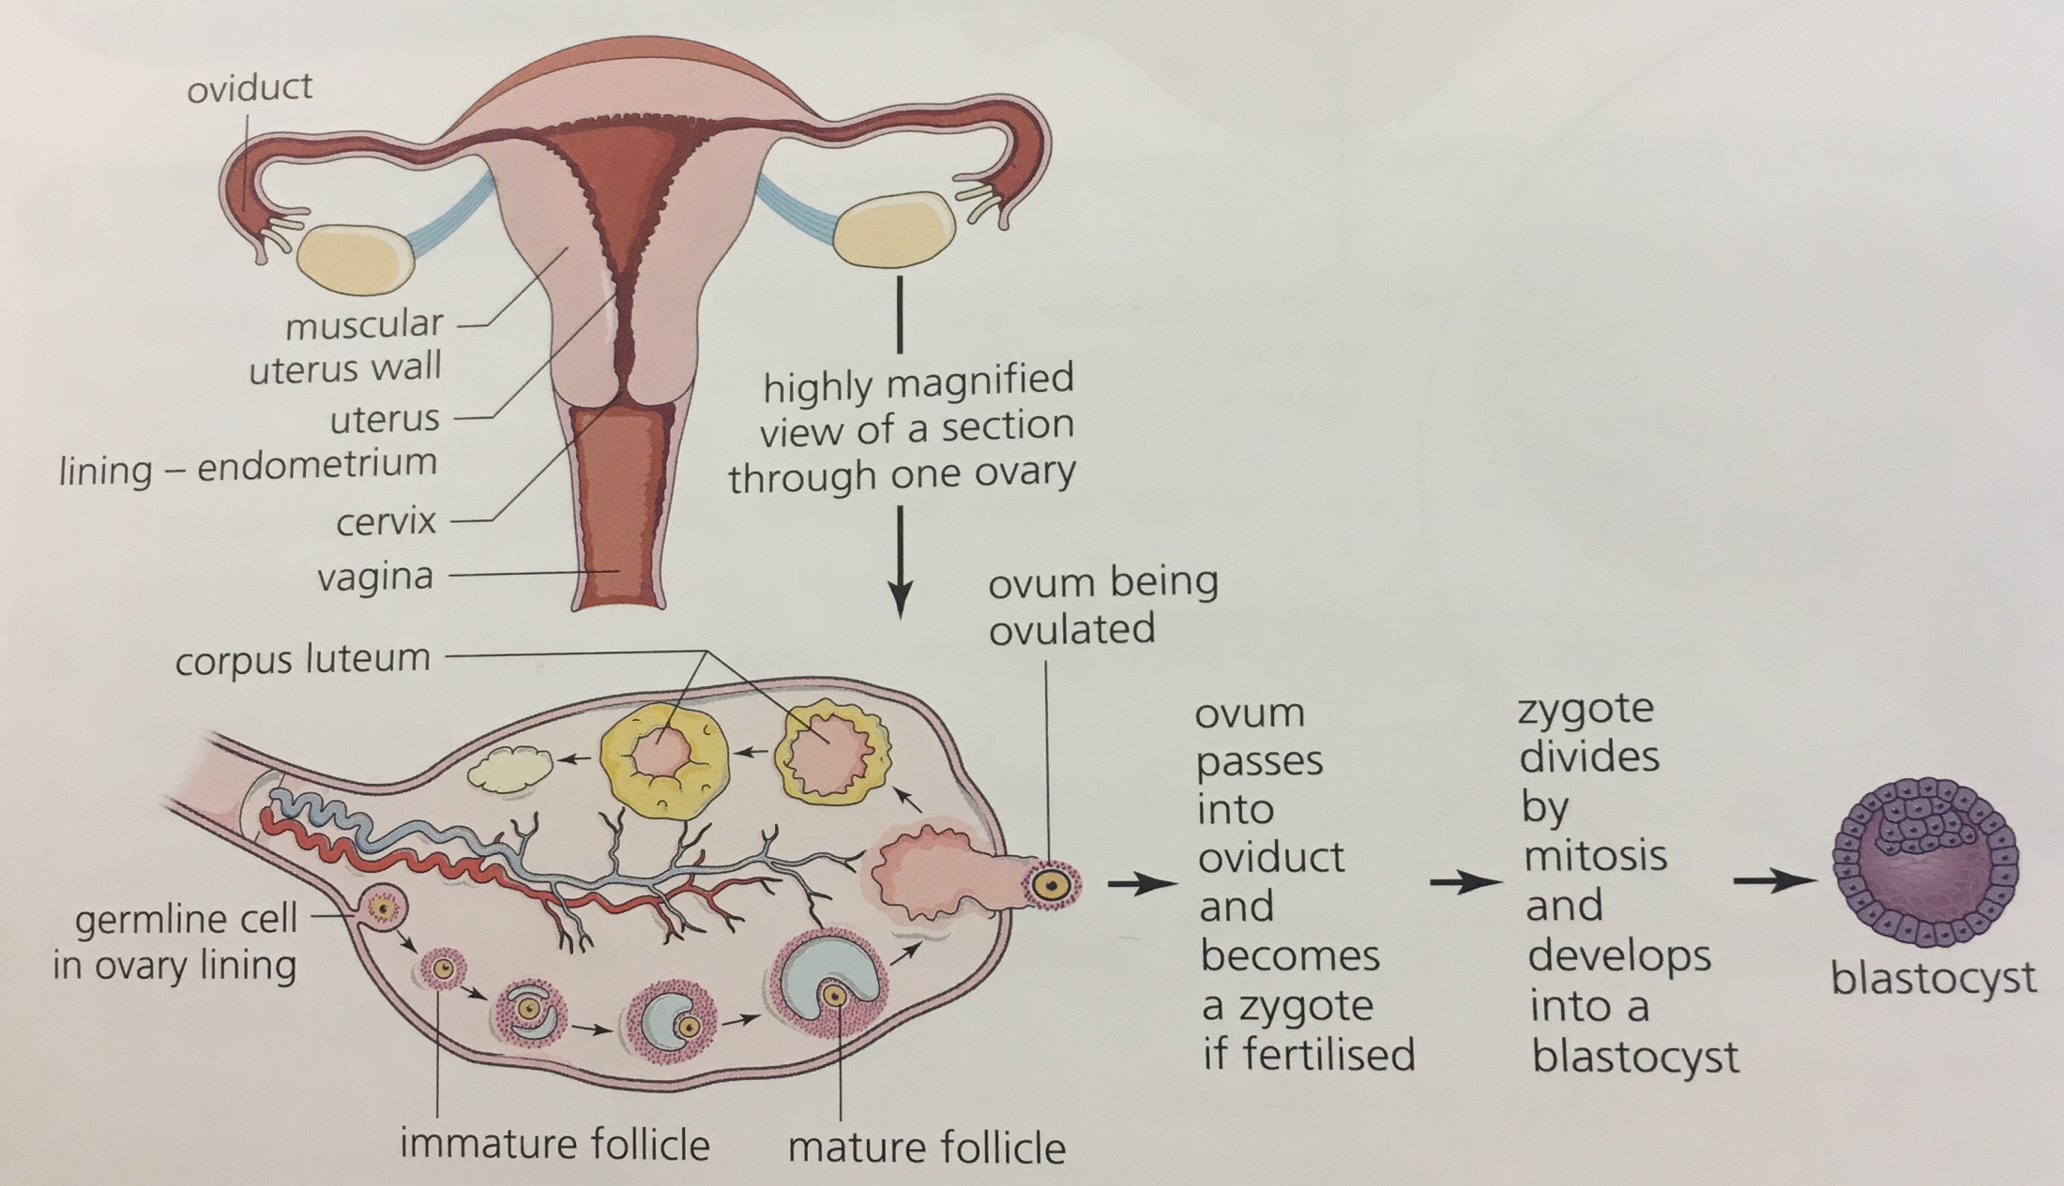
Female Reproductive Organs

Slide 9
End of Key Area 2.1
Now do the questions on page 67 in the HTP textbook.

