Slide 1
Key Area 1.8 – Energy Systems in Muscle Cells
Unit 1 Human Cells
Higher Human Biology for CfE
Miss Aitken

Slide 2
Lactate Metabolism
After a short period of intense exercise, the demand for oxygen in the muscles becomes too high.
When oxygen is in a limited supply, muscle cells must convert pyruvate to lactate (lactic acid) instead of carbon dioxide. This is called fermentation (anaerobic respiration).

Slide 3
Lactate Metabolism
Under these anaerobic conditions the conversion of pyruvate to lactate involved the transfer of hydrogen from NADH produced during glycolysis to pyruvate in order to produce lactate
This is beneficial because the process produces NAD, which is required for glycolysis and allows exercise to continue.

Slide 4
Lactate Metabolism
Lactate builds up if it is produced faster than it can be removed during extended periods of intense exercise.
Lactate build up is painful, because the pH of muscle cells decreases and causes acidosis. This is what causes “the burn”, causing muscle cells to become fatigued.
During the recovery period following exercise, muscle cells become well oxygenated and this allows the Lactate to be converted back to pyruvate, which can then pass to the Citric Acid Cycle.

Slide 5
Skeletal Muscle
Skeletal muscle is muscle that is connected to the skeleton. It is connected by tendons.
Skeletal muscle contracts to cause movement during exercise. There are two types of skeletal muscle fibres:
Slow twitch muscle fibres (type 1)
Fast twitch muscle fibres (type 2)
Most muscles contain both types but the percentage of each varies depending on the muscle
Look at page 50 How to pass brain book; take a note of differing % of each fibre relating to activity

Slide 6
Skeletal Muscle
Myoglobin – protein in muscle tissue that can bind with oxygen

Slide 7
Different fibres for different events
Slow twitch fibres – endurance events e.g. rowing, cycling, cross country skiing & long distance running
Fast twitch fibres- power events e.g. weight lifting & sprinting

Slide 8
Slow Twitch Muscle Fibres
SLOW twitch muscle fibres are for activities which require STAMINA. They are for endurance activities like marathon running or long distance cycling.
They can SUSTAIN contractions over a long period of time.
The fibres are dense with capillaries, rich in mitochondria and have lots of myoglobin, the oxygen carrying protein, which makes the fibres dark red in colour.
They take up more oxygen and can sustain activity for longer.
Their energy comes from glycolysis, citric acid cycle and the electron transport chain.

Slide 9
Fast Twitch Muscle Fibres
FAST twitch muscle fibres are for activities which require FAST action. They are for short term activities like sprinting and high jumping.
They can FATIGUE very quickly and can only sustain a quick burst of energy.
The fibres have fewer capillaries and mitochondria.
They make up most of the muscle
strength and have the greatest
potential for increase in mass.
Their energy comes from glycolysis only.

Slide 10
Characteristic | Fast-twitch fibres | Slow-twitch fibres
Type of activities | Strength & speed, fast bursts (weight lifting, high jump, sprint) | Stamina (Rowing, distance & cycling)
Blood supply | Fewer blood vessels | Many blood vessels
Energy release | Small amounts quickly | Large amounts slowly
Mitochondria | Few | Many
Myoglobin | Few | Many
Respiratory Pathway | Glycolysis | Glycolysis, Citric Acid Cycle, ETC
Respiratory Substrate | Glycogen (stored glucose) | Fats

Slide 11
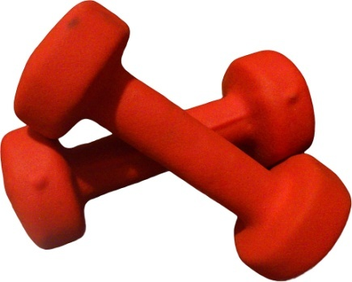
Muscle Fibres
Most human muscles have a mix of both fast and slow twitch muscle fibres.
Back muscles contain mostly slow twitch fibres
Eye muscles contain mostly fast twitch fibres
Different types of training can affect the proportion of these fibres in the body
Athletes show distinct patterns of muscle fibres that reflect their sporting activities

