Slide 1
Key Area 1.7 – Cellular Respiration
Unit 1 Human Cells
Higher Human Biology for CfE
Miss Aitken

Slide 2
Stages of Respiration
There are three stages of respiration which take place in different parts of the cell:
1. Glycolysis
2. Citric Acid Cycle/Krebs Cycle
3. Electron Transport Chain

Slide 3
Stage1: Glycolysis
Glycolysis means “splitting of glucose”
Glycolysis is a series of enzyme-controlled reactions which take place in the cell cytoplasm.
During glycolysis, glucose is broken down into pyruvate.
Oxygen is not required in this step.

Slide 4
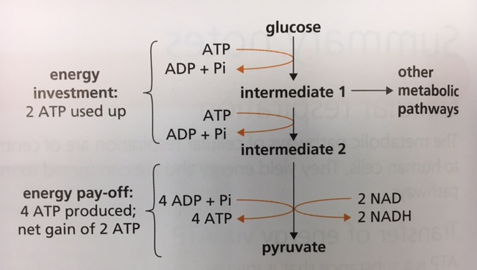
The first part of glycolysis is called the “energy investment” phase. This is because two ATP molecules must be “invested” in order for the second half of the reaction to proceed.
This is referred to as phosphorylation of intermediates as the 2 ATP molecules are broken down to 2 ADP + 2 Pi to allow the reaction to proceed.

Slide 5
The second part of glycolysis is called the “energy payoff” phase. This is because 4 ATP molecules are made – a net gain of 2 ATP. During this part of the reaction, dehydrogenase enzymes remove Hydrogen ions, which combine with a hydrogen carrier NAD to form NADH. This hydrogen carrier transports hydrogen to stage 3 of respiration where more ATP is made.

Slide 7
Stage2. Citric Acid Cycle/Krebs Cycle
Takes place in the central matrix of the mitochondria and requires oxygen.
Pyruvate formed during glycolysis enters from the cytoplasm.
Pyruvate is broken down to an acetyl group and CO₂.
Acetyl group combines with coenzyme A to form Acetyl coenzyme A.

Slide 8
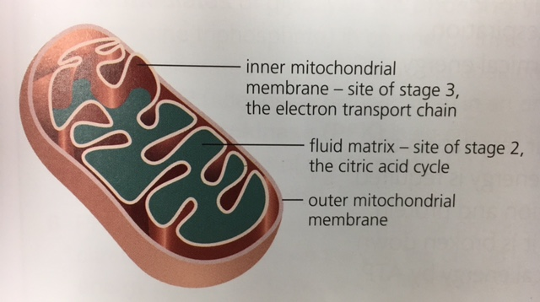
Mitochondrion

Slide 9
Citric acid cycle (continued)
Acetyl coenzyme A combines with oxaloacetate to form citrate.
Citrate undergoes a series of enzyme steps resulting in one ATP molecule being made.
CO₂ is also released and oxaloacetate is regenerated.
Dehydrogenase enzymes remove hydrogen ions and electrons during the citric acid cycle.
These are carried to stage 3 by coenzyme hydrogen carrier NAD

Slide 10
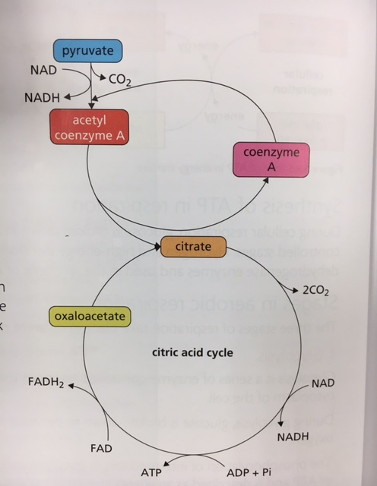
Citric acid cycle
NAD is a hydrogen carrier which takes hydrogen and electrons to stage 3 of respiration where they are used to make ATP

Slide 12
Stage 3: Electron transport chain
Takes place on inner membranes of mitochondria.
Requires oxygen.
Hydrogen and electrons are carried here by NAD from glycolysis and citric acid cycle.
These are then used to form a lot of ATP molecules.

Slide 13
Stage 3: Electron transport chain
Made up of a chain of electron acceptor proteins attached to inner membranes of mitochondria.
High energy electrons from NAD and FAD are passed along chain.
Their energy is used to pump hydrogen ions across inner mitochondrial membranes.
Return flow of hydrogen ions drives the enzyme ATP synthase which results in the synthesis of ATP from ADP and Pi.
Oxygen is the final hydrogen acceptor forming water.

Slide 14
Stage 1
Name of stage
Process
ATP made and used
Enzymes involved
Carriers involved
Stage 2
Name of stage
Process
ATP made
Enzymes involved
Carriers involved
Key Area 1.7
Cellular Respiration
Stage 3
Name of stage
Process
How is ATP made?
Enzymes involved

Slide 15
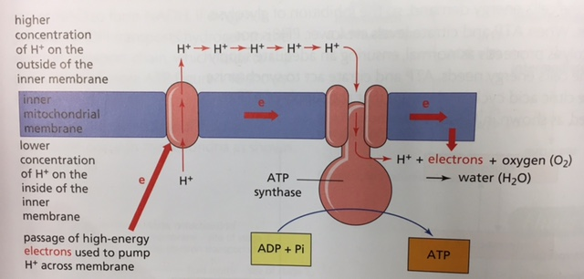
The electron transport chain

