Slide 1
Key Area 1.6 – Metabolic pathways
Unit 1 Human Cells
Higher Human Biology for CfE
Miss Aitken

Slide 2
Metabolic pathways
Metabolic pathways are controlled by enzymes.
Anabolic pathways are pathways which synthesize (build-up) complex molecules from simpler ones and need energy.
Catabolic pathways break down complex molecules into simpler ones and release energy.

Slide 3
Control of metabolic pathways
Each step in a metabolic pathway is controlled by a specific enzyme.
Enzymes are coded for by genes.
A ‘metabolic block’ can occur on a pathway because of a gene mutation.
This results in the enzyme being absent or not functioning correctly.

Slide 4
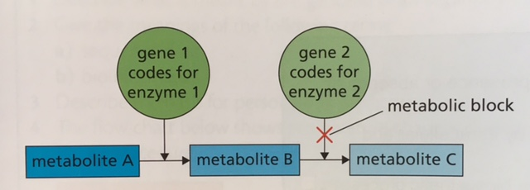
Metabolite A is converted to metabolite B. A metabolic block prevents the formation of metabolite C.
Most metabolic pathways are reversible but some have irreversible steps and alternative routes.

Slide 5
Enzyme action
Enzymes are Biological catalysts.
Enzymes speed up the rates of chemical reactions by lowering the activation energy required for the reaction to proceed.
Before a substrate can change into a product, it must overcome this activation energy barrier.
Enzymes lower the activation energy need for the reaction to occur.

Slide 6
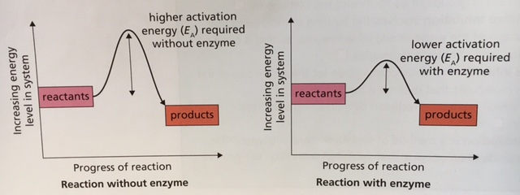

Slide 7
Induced fit hypothesis
Enzymes are specific because only one substrate is complementary to the shape of the active site.
Substrates have a high affinity for the active site and are chemically attracted to it.
Enzymes are flexible and as the substrate binds (attaches), the active site changes shape to fit around the substrate more closely.
This is called the Induced fit hypothesis.

Slide 8
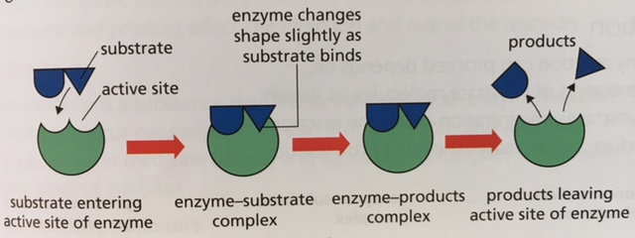
Induced fit hypothesis
The active site can also orientate the substrate molecule so that they fit more closely (see p37 of HTP textbook).
The product has a low affinity for the active site so leaves and the active site returns to it’s original shape.

Slide 9
Effect of substrate concentration on the rate of an enzyme controlled reaction
An increase in the substrate concentration drives the reaction in the direction of the end product and increases the rate of the reaction.

Slide 10
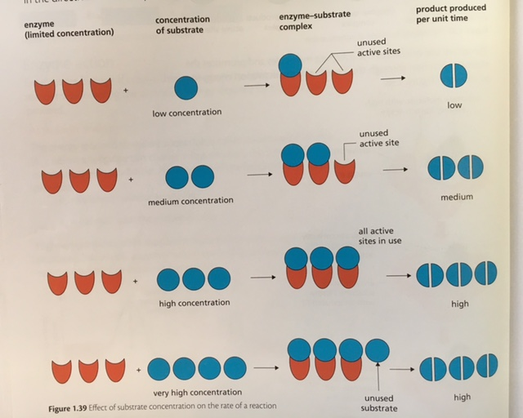
Increasing substrate conc increases the rate of reaction up to a certain point as more active sites become occupied.
Beyond that point, the conc of enzyme becomes limiting.

Slide 11
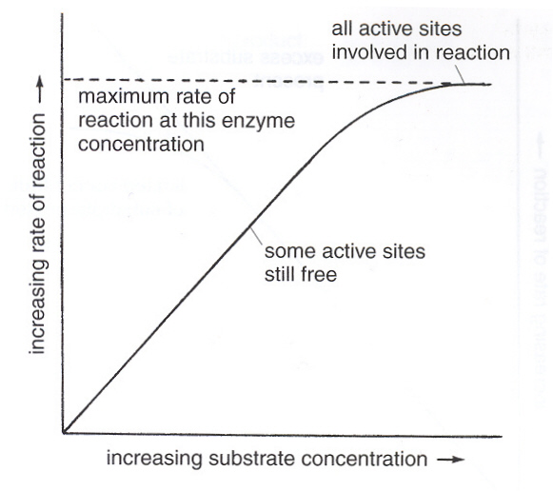
INCREASING SUBSTRATE CONCENTRATION
From the diagram, you can see that increasing the substrate concentration, increases the rate of reaction, until the graph levels off-this is because the enzyme concentration is now a limiting factor

Slide 12
Inhibitors
An inhibitor is a substance that reduces the rate of an enzyme reaction.
Inhibitors can control metabolic pathways by regulating enzyme action.
There are two types of inhibitor:-
Competitive inhibitors.
Non-competitive inhibitors.

Slide 13
Competitive inhibitors
These are similar in shape to the substrate and compete for the active site thereby reducing reaction rate.
Competitive inhibitors are affected by the concentration of the substrate present.

Slide 14
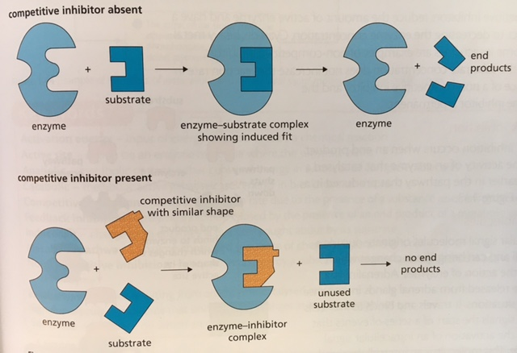
Competitive inhibitors

Slide 15
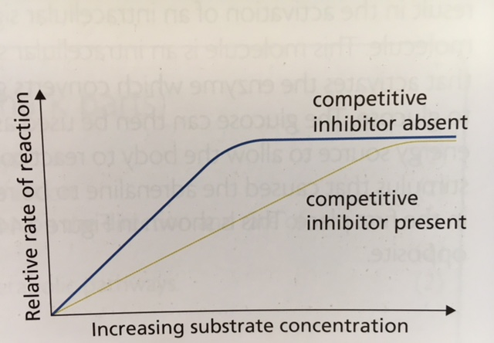
The effect of increasing substrate concentration on competitive inhibition
Competitive inhibition can be reduced by increasing substrate concentration. More substrate will bind to active sites so the reaction rate will increase.

Slide 16
Non-competitive inhibitors.
Non-competitive inhibitors are not similar in shape to the substrate and attach to another part of the enzyme.
When they do this, they affect the shape of the active site so that the substrate no longer fits.
This reduces the rate of the reaction.

Slide 17
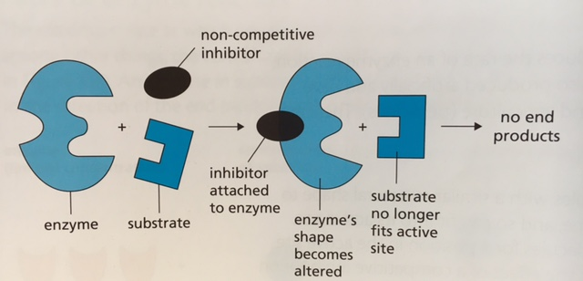
Non-competitive inhibitors

Slide 18
Non-competitive inhibitors
Non-competitive inhibitors reduce the amount of active enzyme and have a similar effect to decreasing enzyme concentration.
Cyanide, heavy metal ions and some insecticides act as non-competitive inhibitors.
Non-competitive inhibitors are not affected by substrate concentration (unlike competitive inhibitors).

Slide 19
Feedback inhibition
This is when the build up of the end product in a metabolic pathway inhibits an enzyme earlier in the pathway.

Slide 20
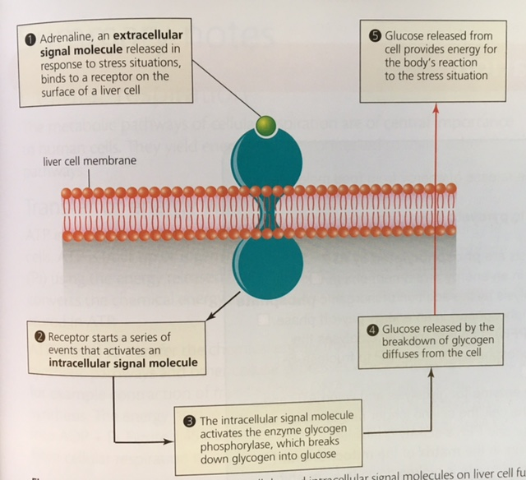

Slide 21
Anabolic and Catabolic Pathways
Induced fit
Enzyme Inhibition
Key Area 1.6
Metabolic Pathways
Activation Energy
Feedback Inhibition
Effect of substrate and enzyme concentration

