Slide 1
Key Area 1.5 – Human Genomics
Unit 1 Human Cells
Higher Human Biology for CfE
Miss Aitken

Slide 2
The Human genome
The genome is the total genetic information encoded in the base sequence of DNA.
Some base sequences code for proteins while others are non-coding and regulate transcription or have no function.
DNA can be sequenced to determine the order of bases along chromosomes and genes.
The ‘Human Genome Project’ began in the 1990’s and sequenced all human chromosomes.

Slide 3
Videos
The race to sequence the genome (5 mins)
Brief description of techniques and the public vs private race
Human Genome TEDtalk (16mins)
Visual representation of genome, what can we tell from the genome
Lessons from the Human Genome (8mins)
Reflections of the genome project by scientists who were involved

Slide 4
Pharmacogenetics and Personalised medicine
Pharmacogenetics is the use of genome information in the choice of drugs.
This can enable doctors to ‘tailor’ medicines to a person’s genome since some diseases have a genetic risk component and so certain medicines will be more effective with people of a particular genotype.
Some medicines might be effective for some genotypes but harmful to others.

Slide 5
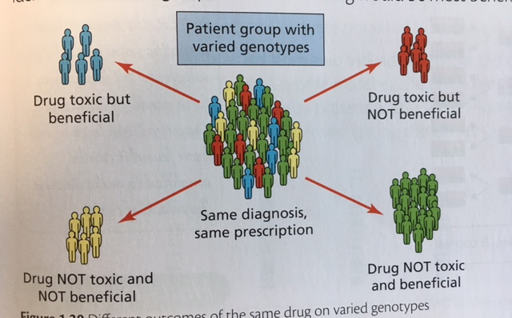
Effects of medicines on different genotypes

