Slide 1
Key Area 1.3 – Gene Expression

Slide 2
The Genetic Code
DNA is found in all forms of life on earth. DNA forms the genetic code by which all life can exist.
A gene is a portion of DNA. Genes are passed on to offspring.
Genes are expressed to produce proteins.
Proteins form the structure of the organism, and control many of it’s functions.
Proteins are required for growth & repair

Slide 3
The Genetic Code
Genes are expressed to produce proteins. Only a small number of the genes in any cell are expressed.
For example the pancreas makes the protein insulin (this regulates/controls; blood sugar (glucose) concentration) therefore the gene to make insulin is expressed in the pancreas.
Genotype: The genes an individual has (Ss/TT)
Phenotype: How an individual looks – physical appearance

Slide 4
The Genetic Code
DNA base sequences in the genes make up the genotype
Proteins produced by gene expression
Proteins determine the phenotype

Slide 5
Stages of Gene Expression
2 main stages – transcription and translation
Transcription – to copy something
Translation – to change the information into another language
In transcription, the gene is copied by a molecule called mRNA
In translation, the mRNA is changed into a sequence of amino acids. Amino acids join together to make proteins.

Slide 6
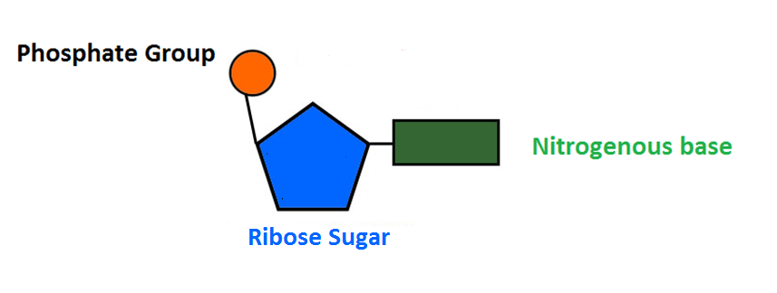
Structure of RNA
RNA nucleotides look similar to DNA.
5
4
1
3
2

Slide 7
Differences between DNA and RNA
DNA | RNA
Double stranded | Single stranded
Deoxyribose sugar | Ribose sugar
Bases are A, C, T and G | Bases are A, C, U and G
In RNA, the base Thymine is replaced by a base called URACIL.

Slide 8
Types of RNA
Name | Job
Messenger RNA (mRNA) | Carries a complimentary copy of DNA from the nucleus to the ribosome The bases on the mRNA molecule are grouped in triplets called Codons.
Transfer RNA (tRNA) | Carries specific amino acids to the ribosome to form proteins It carries an amino acid at one end and a triplet of bases called an anticodon at the other.
Ribosomal RNA (rRNA) | rRNA & proteins make up the structure of a ribosome

Slide 9
Steps in Transcription
RNA polymerase (enzyme) unwinds and unzips gene.
Free RNA nucleotides are then added to the exposed bases on the DNA strand by complementary base pairing.
RNA nucleotides are then joined to form a strand of mRNA called a primary transcript.
This is made up of groups of three bases called codons.

Slide 10
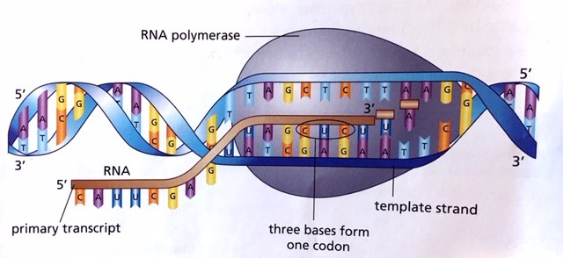
Formation of a primary transcript

Slide 11
Introns and Exons
Each primary mRNA transcript is made up of regions called introns and exons.
Introns are non-coding regions while exons are coding regions.
Introns are removed and the exons are then spliced together to form a mature RNA transcript.
This is called RNA splicing.

Slide 12
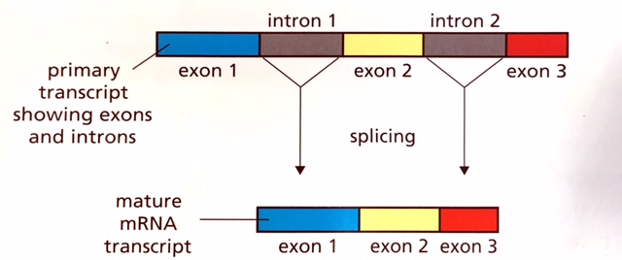
RNA splicing to make a mature transcript
The mature transcript then moves to the ribosome to be translated.

Slide 13
Alternative RNA splicing
Alternative RNA splicing allows a primary transcript to form different mature mRNA transcripts depending on which sequences are treated as introns and which as exons.

Slide 14
Ribosomes
Ribosomes are found free in the cytoplasm or attached to the endoplasmic reticulum (ER).
They are made of rRNA and protein.
A mature mRNA transcript attaches to a ribosome and then translation occurs.

Slide 15
Translation (steps)
Mature mRNA binds to ribosome.
tRNA molecules carry a specific amino acid to the mRNA transcript.
Anticodons on the tRNA attach to the complementary codons on the mRNA.
Peptide bonds form between amino acids to form a polypeptide (a small protein).
Start and stop codons on the mRNA cause translation to start and finish to make the complete polypeptide.
The polypeptide then folds to form a protein held together by hydrogen bonds.

Slide 16
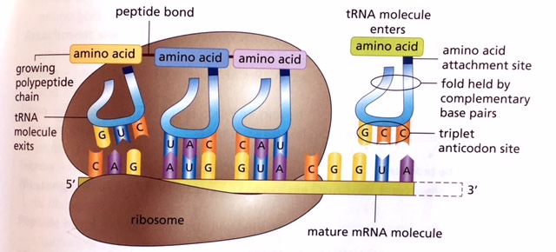
Translation

Slide 17
DNA Transcript:
ACT-ATC-ACC-GGG-ACT-TCA-AAC-AGA-GCG-GCC-ATA-AAA-TGA
mRNA codons:
UGA-UAG-UGG-CCC-UGA-AGU-UUG-UCU-CGC-CGG-UAU-UUU-ACU
tRNA anti-codons:
ACU-AUC-ACC-GGG-ACU-UCA-AAC-AGA-GCG-GCC-AUA-AAA-UGA
Amino Acid sequence:

Slide 18
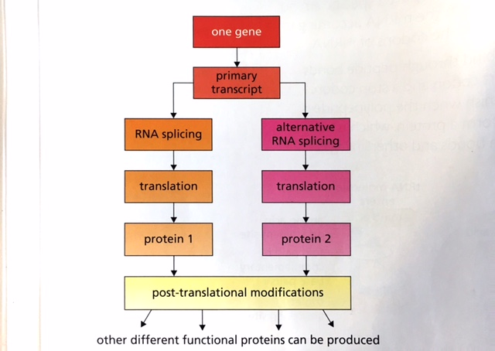
One gene, many proteins
A variety of proteins can be made from the same gene due to alternative RNA splicing and post-translational modification.

Slide 19
Regulation of gene expression
Some proteins are needed continuously in the life of the cell e.g enzymes, so their genes remain switched on. Other proteins are only made when needed so their genes can be switched on and off.
This regulation is important because it conserves cell resources and energy by making proteins only when they are needed.

Slide 20
Structure and function of proteins
Proteins are made up from chains of polypeptides.
A polypeptide is a chain of amino acids linked by peptide bonds.
In proteins, different polypeptide chains are held together by hydrogen bonds and other molecular interactions.
This gives the protein a 3D shape.

Slide 21
Different functions of proteins
The shape of a protein is linked to it’s function.
e.g an enzyme has a part called an active site which is complementary to the shape of it’s substrate.
Protein functions include acting as structural components of cells, enzymes, hormones and antibodies.

Slide 22
Genotype and Phenotype
Process of Transcription
Structure and function of proteins
Differences between RNA and DNA
Process of Translation
1.3 Gene Expression
Types of RNA and their function
Process of Splicing

