Slide 1
Key Area 1.2 – Structure and Replication of DNA
Unit 1 Human Cells
Higher Human Biology for CfE
Miss Aitken

Slide 2
Deoxyribonucleic Acid
Genetic information is coded into the chemical language of DNA which makes up chromosomes.
This information allows the cell to make specific proteins which determine the cell’s structure and control it’s metabolism.
DNA is copied by the parent cell when it divides and passed to the daughter cells.

Slide 3
Structure of DNA
DNA is very long, double stranded and is coiled into the shape of a double helix.
DNA is copied by the parent cell and is inherited by the daughter cell when the parent cell divides.
Each strand of the double helix is made up of nucleotides.

Slide 4
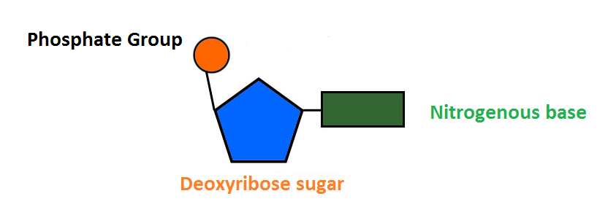
Structure of DNA
Each strand of the double helix is made up of nucleotides.
The carbon atoms are labelled 1-5 as shown.
5
4
1
3
2

Slide 5
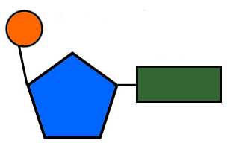
Structure of DNA
Nucleotides are linked together by their deoxyribose sugars and phosphates to form a sugar-phosphate backbone.
5’
3’
5’
3’
5’
3’
5’

Slide 6
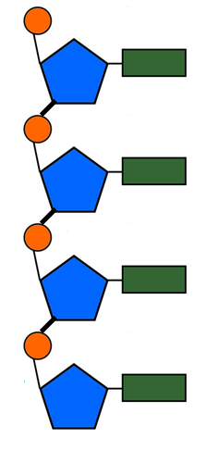
Structure of DNA
3’
Two strands of DNA are connected by hydrogen bonding between complimentary bases.
Adenine (A) pairs with Thymine (T)
Cytosine (C) pairs with Guanine (G)
The strands run in opposite directions to one another and are said to be anti-parallel.
One strand has deoxyribose (3’) at one end and the other has the phosphate group (5’) at same end of the molecule.
5’
A
T
5’
3’
3’
5’
G
C
5’
3’
3’
5’
T
A
5’
3’
3’
5’
C
G
5’
3’
Hydrogen bond

Slide 7
Replication of DNA
DNA is the hereditary material which is passed on when the cell divides and copies itself by mitosis.
DNA makes a precise copy of itself through a process called replication. This happens before mitosis so the DNA can be passed on to the daughter cell.
There are several stages to this replication.

Slide 8
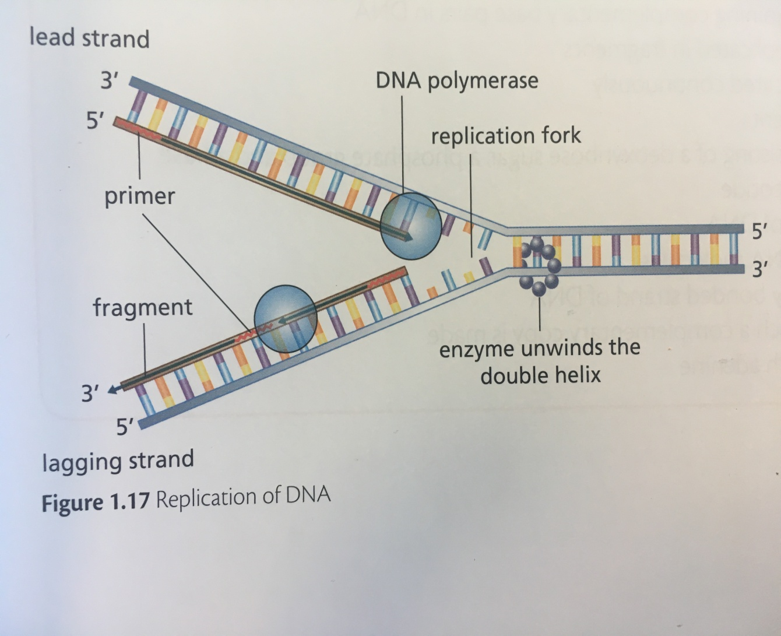
Stages in Replication of DNA
The double helix of DNA is unwound by an enzyme.
Hydrogen bonds are broken. The unwinding and breaking of bonds opens a replication fork.

Slide 9
Stages in Replication of DNA
Primers are short complimentary sequences of nucleotides which allow the enzyme DNA polymerase to bind.
2. A primer joins the end of the 3’-5’ leading template strand and DNA polymerase adds free nucleotides to synthesise a complimentary strand continuously.

Slide 10
Stages in Replication of DNA
3. On the lagging strand, primers are added one by one into the replication fork as it widens. DNA nucleotides are added to form fragments.
4. These fragments must be joined together by an enzyme called DNA Ligase. The process requires energy, supplied by ATP.

Slide 11
Requirements for DNA replication
DNA (to act as a template for copying).
Free DNA nucleotides.
Primers.
The enzymes DNA polymerase and DNA ligase.
ATP.

Slide 12
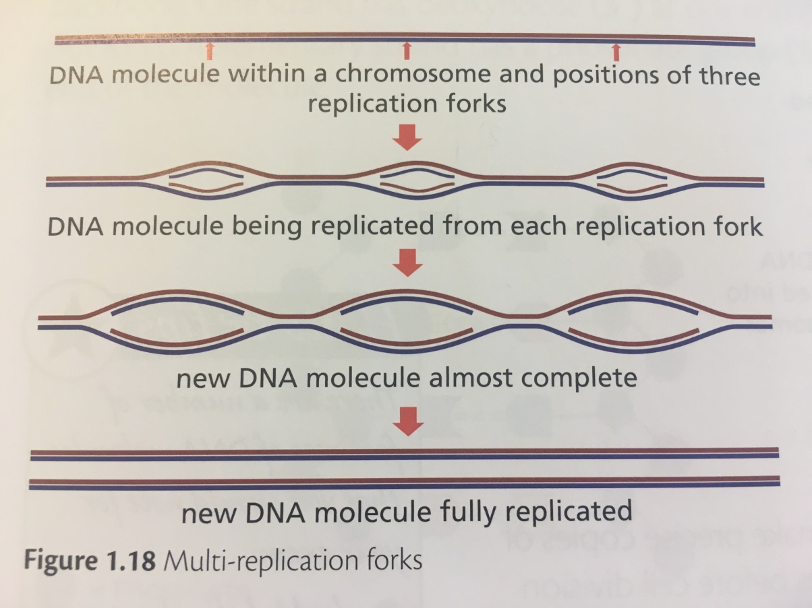
Importance of DNA Replication
When DNA in a chromosome is being copied, many replication forks are formed at the same time. This means DNA of whole chromosomes can be copied quickly and precisely.

Slide 13
Importance of DNA Replication
This is important because it ensures that precise copies of the genetic material are available for cells undergoing mitosis and meiosis. The information is passed on from cell to cell, and from generation to generation.

Slide 14
Polymerase Chain Reaction (PCR)
PCR is a technique used in laboratories to produce millions of copies of a sequence of DNA.
This occurs in vitro which means it happens outside of the body inside lab equipment
PCR involves exposing DNA to a series of changes in temperature. This is called thermal cycling

Slide 15
Steps in PCR
DNA is denatured at 90ºC, which separates the strands
DNA is cooled to 60ºC and primers are added which bind to the target DNA sequence
The temperature is then raised to over 70ºC, where heat-tolerant DNA polymerase is used to make new strands of DNA from free DNA nucleotides
The cycle is repeated many times in a thermal cycling machine to allow millions of copies of DNA to be produced.

Slide 16
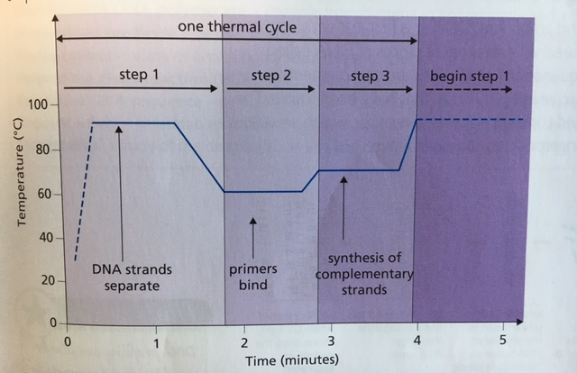

Slide 17
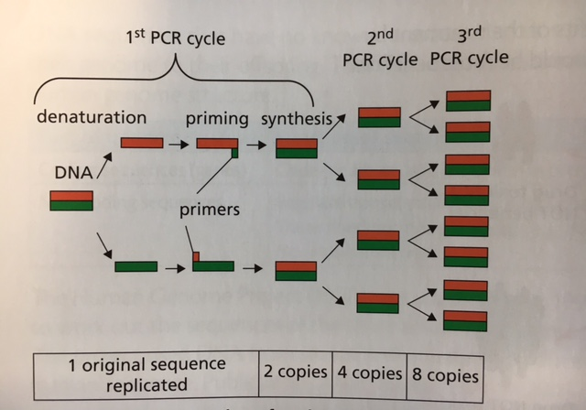
Number of copies
The number of copies of the DNA sequence made doubles in every cycle.

Slide 18
Applications of PCR – Why is it used?
PCR is used to amplify tiny quantities of DNA from human sources such as blood or semen.
This means DNA profiling can be carried out.

Slide 19
DNA profiling
Humans share 99.9% of their DNA but the remaining 0.1% is unique to an individual.
DNA profiling is used to solve crimes and in paternity disputes.

Slide 20
Essay Question
Describe the structure and replication of a molecule of DNA (9)

Slide 21
Essay Question Answer
Any SIX MARKS from:
DNA is made up of strands of nucleotides
Nucleotides are made of a deoxyribose sugar, a phosphate and a base
Structure is a double helix
Backbone of DNA double helix is a sugar-phosphate backbone
Adenine pairs with thymine and cytosine pairs with guanine
Bases are linked with hydrogen bonds
Strands run anti-parallel to one another
3’ end has a phosphate and 5’ end has a sugar
ANY THREE MARKS from:
DNA unwinds and unzips/ H bonds break
Primers attach
DNA polymerase adds complementary nucelotides to the DNA
Lead strand is made continuously
Lagging strand is made in fragments
DNA ligase joins fragments

Slide 22
Features and structure of DNA
Stages of replication
Important molecules involved in replication
Key Area 1.2
Structure and Replication of DNA
Complimentary base pairing
Importance of replication to organisms.
Structure of a nucleotide
PCR and it’s uses

