Slide 1
Key Area 1.1 – Division and Differentiation of Human Cells
Unit 1 Human Cells
Higher Human Biology for CfE
Miss Aitken

Slide 2
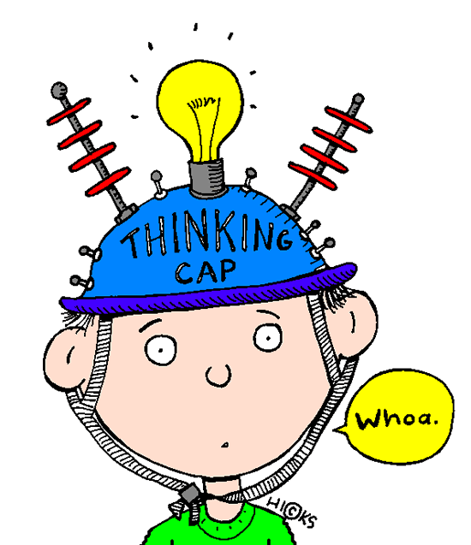
RECAP from National 5
This key area deals with:
Gametes
Haploid and diploid
Mitosis
Stem cells
Cells, tissues and organs
What do we already know about these areas?

Slide 3
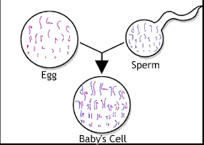
The Human Life Cycle
All humans produce gametes – sperm cells and egg cells.
Gametes are haploid – this means they contain one set of human chromosomes
Gametes fuse together to form a zygote
Zygotes are diploid – this means they contain two sets of human chromosomes

Slide 4
The Human Life Cycle
The zygote grows and develops in the womb, and once the baby is born it continues to develop to produce an adult body, made up of many diploid body cells called Somatic cells.
Other diploid cells are found in the ovaries and testes and are called germline cells.
Germline cells undergo cell division called meiosis to produce haploid gametes.
Haploid gametes (sperm and egg cells) join together to make a zygote...... and so on!

Slide 5
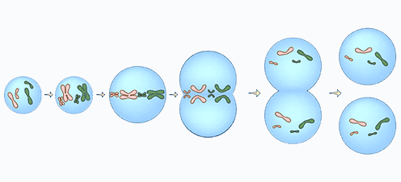
Mitosis and Cell Division
Humans grow by producing new cells. New cells are produced when the nuclei of a somatic diploid cell divides by mitosis and their cytoplasm is split into two. This happens in growth and repair.

Slide 6
Germline Cells and Meiosis
Germline cells are found in the ovaries of females and the testes of males.
Germline cells undergo a process called meiosis to produce gametes - egg and sperm cells. They also renew themselves by Mitosis.
Gametes produced by meiosis are genetically different from each other – this is why we see variation in the population.

Slide 7
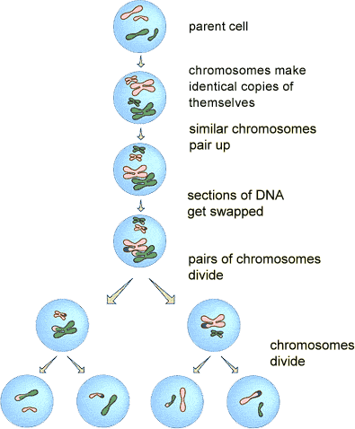

Slide 8
Somatic Cells - Summary
Body cells ( All diploid-46 chromosomes).
Divide by mitosis only (for growth and repair).
One parent cell produces two identical diploid daughter cells.

Slide 9
Germline Cells - Summary
Found in ovaries and testes. (diploid).
Divide by mitosis to renew themselves.
Also divide by meiosis to produce sperm & egg cells (4 daughter haploid cells are made all genetically different).

Slide 10
Comparing Mitosis and Meiosis
Both processes happen in germline cells (in the testes and ovaries) but somatic cells only divide by mitosis.
Mitosis produces two diploid daughter cells identical to the parent cell.
Meiosis produces four haploid daughter cells (gametes) which all show variation.

Slide 11
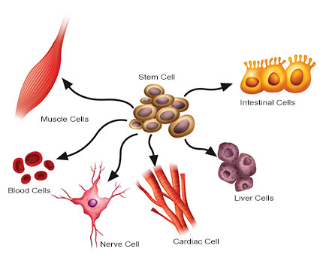
Cellular Differentiation
The cell is the basic unit of life. Humans are made of many different types of cell.
In order to become specialised, cells must go through a process called gene expression.

Slide 12
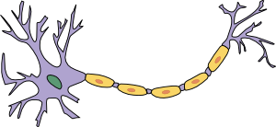
Gene Expression
Gene expression is the process by which an unspecialised cell “switches on” some of its genes.
Genes which are switched on are expressed.
Genes which remain switched off are not expressed.
Gene to carry electrical impulses switched on
Gene for long cell length switched on
Gene for releasing neurotransmitter turned on

Slide 13
Stem Cells and their Therapeutic Use
Human stem cells are unspecialised somatic cells. They can divide to produce cells that can differentiate into different cell types.
e.g Liver, blood, muscle and nerve cells.
Two types of stem cell exist;
1) Embryonic stem cells and 2) Adult (or tissue) stem cells.
Embryonic stem cells are pluripotent – this means they can differentiate into all cell types that make up the adult organism.

Slide 14
Stem Cells and their Therapeutic Use
Adult (Tissue) stem cells are multipotent, which means they can differentiate to replace damaged cells of the type found only in that particular tissue.
For example, adult tissue stem cells in bone marrow differentiate into blood cells. They can only make blood cells, nothing else.

Slide 15
Essay Question
Compare the processes of mitosis and meiosis (8)

Slide 16
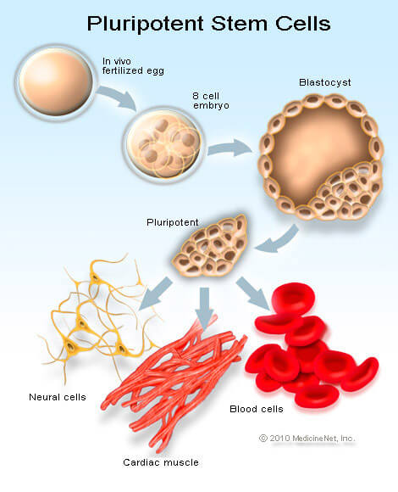
The inner cells of a blastocyst are pluripotent.
Pluripotent stem cells have the potential to make almost every type of differentiated cell.

Slide 17
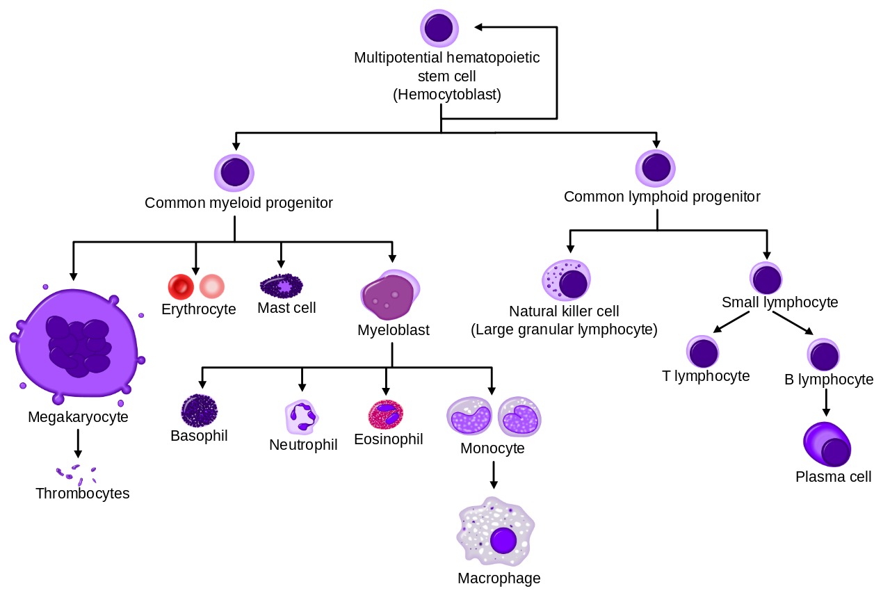
For example:
Inside the bone marrow
Blood is made up of all of these things!

Slide 18
Stem Cell Research
Research is constantly being done into the use of stem cells.
Stem cells can be used therapeutically to repair damaged or diseased organs and tissue.
There are many ethical issues surrounding the use of stem cells. These can be found in the HTP textbook on page 7.

Slide 19
Cancer Cells
Cancer cells are abnormal cells that do not respond to the regulatory signals of the body.
They are not destroyed by the immune system.
They divide rapidly and excessively to form a mass of abnormal cells called a tumour.
Cancer cells can fail to attach to the main tumour and travel through the bloodstream to form a secondary tumour elsewhere in the body.

Slide 20
Mutations
A mutation is a change in genetic information.
Mutations that occur in a somatic cell are passed on to cells that are produced when the parent cell divides. It is not passed to offspring.
For example, a woman develops a mutation in her skin cells which leads to skin cancer. The somatic cells divide and this mutation is passed on, leading to a tumour. The skin cancer is not passed on to that woman’s children.

Slide 21
Describe the human life cycle
Meiosis
Gene Expression
Key Area 1.1
Division and Differentiation of Human Cells
Mitosis
Tissues and Organs
Stem Cells
Mutations
Cancer cells

Slide 23
Definition of mutation
Types of gene mutations
Point or frameshift
1.4 Mutations
Nonsense or missense
Types of chromosome mutations

