Slide 1
Investigative Biology Scientific Method and Ethics
Turnbull High School
Advanced Higher Biology
Unit 3
P90-91

Slide 2
The Scientific Research Cycle
The scientific research process consists of several different steps including:
What do I want to find out?
How will I carry out my research?
How will I gather, record and analysis results?
What did I find out from my research?
Did I find out what I set out to achieve?

Slide 4
Karl Popper’s Concept of Falsifiability
Philosopher of Science Karl Popper’s concept of falsifiability is considered by many to be the basis of scientific thinking.
Scientist A has a theory topic and carries out an experiment, proving his theory to be true. His colleague Scientist B may carry out an experiment which proves that it is not true. Scientist B has falsified Scientist A’s claim. It is therefore an unscientific theory.
Karl Popper states that “only an unfalsifiable theory can be considered true and scientific.”

Slide 5
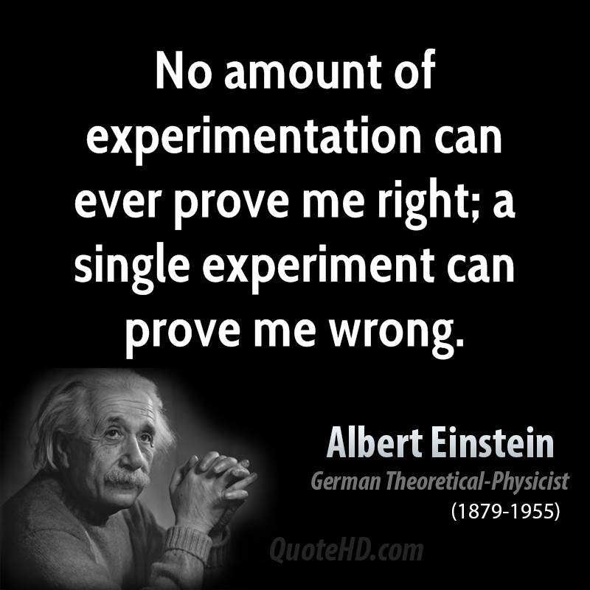
A theory takes shape...
In science, the refinement of ideas is key.
Scientific knowledge can be thought of as the current best explanation, which may be updated later after a thorough evaluation of further experimental evidence.

Slide 6
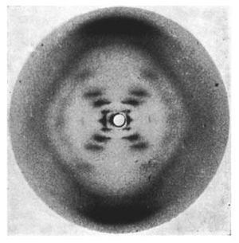
The Discovery of DNA – a progressive idea
Francis Watson and James Crick were unlikely to have made their groundbreaking discovery had it not been for the scientists before them.
1951 – Pauling discovers an important structure inside a protein molecule.
1951 – Wilkins takes pictures of a structure inside the nucleus with an X-Ray and proposes that DNA is a triple-helix structure
1953 – Franklin takes pictures of an ‘X’ structure in the middle of DNA proving that Wilkins’ theory of a triple-stranded molecule is untrue
1953 – Watson and Crick develop on Franklin’s theory that DNA is double-stranded and develop a double-helix model which is published later in the year in the Nature journal.

Slide 7
Negative Results
In scientific research, even failure to find an effect is a valid finding.
“Drug A does not affect the symptoms of Disease B”
This result is both negative and valid.

Slide 8
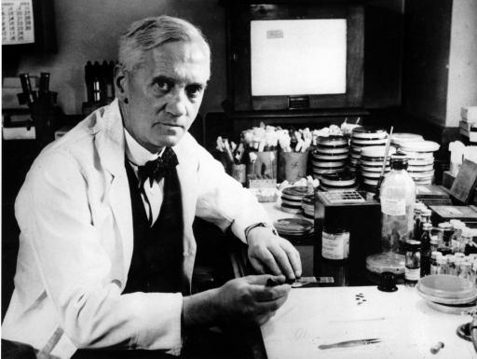
Accidental Results
In some cases, scientific breakthroughs have happened purely by accident, giving unexpected results.
Penicillin
The Microwave Oven
Coca-Cola!

Slide 9
Scientific Ethics
Ethics are the rules for distinguishing between right and wrong.
All of the scientific experiments done in the classroom, in the lab, in the world (!) should be carried out with a highly ethical basis.
Different scientists will have different opinions on what is right or wrong and so government/law must provide what they deem to be “ethical rules”.

Slide 10
Personal Ethics
An ethical scientist will:
Present their data in an unbiased way
Acknowledge the contribution of others through citations
Use references
Avoid plagiarism

Slide 11
Ethics of Animal Studies
Using animals in experiments is a hotly debated issue. If scientists are considering the use of animals in an experiment, the following ethical rules apply:
Replacement: Could you use something else instead of an animal (e.g. bacteria?)
Reduction: Use the smallest number of animals possible
Refinement: Make adjustments to your experiment so that the least amount of harm happens to animals

Slide 12
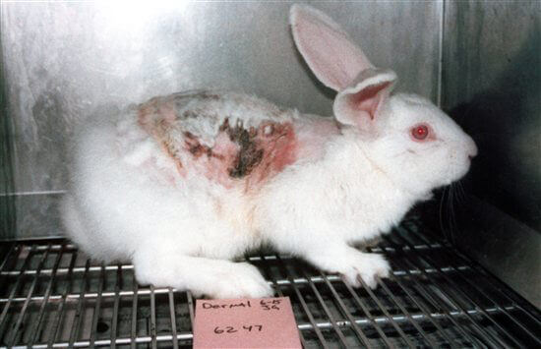
Many companies, particularly cosmetic and skin care brands, still use animal testing widely.

Slide 13
Ethics of Human Studies
Often easier to consider than animal studies, because humans can communicate their suffering.
4 Key Principles:
Informed consent
Right to Withdraw
Confidentiality
Aim to cause no harm

Slide 14
Laws to be aware of:
The Human Rights Act
The Animal Welfare Act (1966)

Slide 15
Abiding by the Law
Scientists are not allowed to just investigate whatever they want. They must justify their research and make sure that they do not cause any harm.
Some regulatory bodies oversee certain areas of scientific research such as the Human Fertilisation and Embryology Authority

