Slide 1
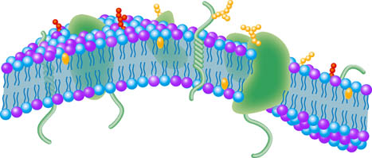
Binding and Conformational Change
Cells and Proteins
Unit 1 Advanced Higher
Miss Aitken

Slide 2
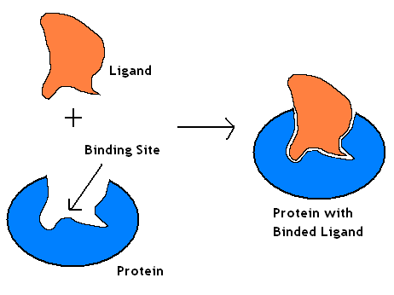
Ligand
In Biology, a ligand is the name given to any substance that can bind to a protein.
When a ligand binds to a protein, it very slightly changes the shape of the protein.
A ligand in biology is not
the same as a ligand
in chemistry

Slide 3
How does ligand binding happen?
When a protein folds into it’s tertiary structure, there many be some amino acids whose R groups are exposed to the outer surface of the protein.
These R groups may help in the binding of the protein to other molecules.
Areas where this occurs are called ligand-binding sites. They look like small clefts on the surface of the protein.

Slide 4
How does ligand binding happen?
The binding site matches the shape of the ligand and it’s chemistry is complementary.
For example, the binding site has charged, polar and non-polar R groups arranged which match the charged, polar and non-polar R groups on the ligand.

Slide 5
Why do ligands bind?
When a ligand binds to a protein, it causes a conformational change (change in shape).
The shape of a protein is crucial for it’s function. A change in shape normally means a change in function. This means proteins can be “switched on” or “switched off” when a ligand is present.

Slide 6
DNA as a ligand
Some proteins within the cell have binding sites for parts of the DNA molecules. DNA can bind to a number of different proteins and these proteins have important roles.

Slide 7
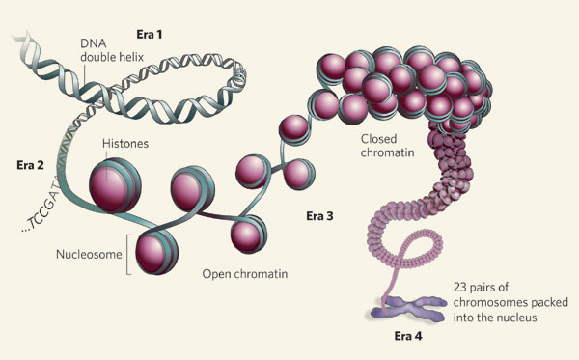
Histone Proteins
DNA is arranged into chromosomes by tightly coiling around histone proteins (accessory proteins) to form nucleosomes.

Slide 8
Histone Proteins
The outside of the histone proteins have positively charged R groups which interact with the negatively charged phosphates of the sugar-phosphate backbone. This allows the DNA to bind to the histone and wrap around it, forming a nucleosome.

Slide 9
Other Proteins
Some proteins control gene expression by regulating the transcription of genes.
When one of these proteins is bound to the DNA, it can either stimulate the initiation of transcription or inhibit it. Steroid hormones and thyroxine activate genes in cells by binding to these proteins.

Slide 10
Binding and Conformational Change 2
Read pages 24 – 25 of the Bright Red Textbook
Make notes on Enzymes as Ligands and Enzyme Modulators

Slide 11
Enzymes and Ligands
The active site of an enzyme is a ligand binding site. When a substrate joins to an enzyme, there is a very slight conformational change.
This is called induced fit – it helps to increase the binding and interaction between the active site and the substrate.

Slide 12
Induced Fit
This new shape is temporary and because the enzyme is trying to revert back to its original shape, it places the substrate under tension.
When under tension, the substrate is more likely to change into the product and so the overall activation energy is reduced.
Once the reaction has taken place, the active site is less attracted to the products and so they are released, leaving the enzyme to move back into it’s original shape.

Slide 13
Enzyme Modulators
Remember metabolic pathways from Higher
The rate of product formation can be controlled by raising or lowering the activity of one enzyme within the pathway.
Enzymes which can be manipulated in this way are called allosteric enzymes

Slide 14
Allosteric Enzymes
Allosteric enzymes are regulated by altering their shape.
The conformational change is caused by a modulator which joins at a different site from the active site. This is called the allosteric site.
Modulators changing the shape of the enzyme affects the enzyme’s affinity for it’s substrate and the shape of the active site. Enzyme activity can be turned on or turned off in this way.

Slide 15
Cooperativity
Proteins which have a quaternary structure (subunits joined together) show cooperativity.
If a ligand binds at one subunit, the conformation of the subunit is altered.
This then alters the conformation of the neighbouring subunits, increasing the ligand affinity of the remaining subunit.
This means that for example, an enzyme molecule made of a number of subunits (e.g. catalase) shows an increase in activity in the presence of it’s substrate (ligand). The binding of one substrate to the active site of one unit causes conformation change in the other subunits so their active sites become active.

Slide 16
Essay Questions
Give details of the structure of proteins including primary, secondary, tertiary and quaternary levels. (10 marks)
Give an account of enzyme activity under the following headings:
induced fit; (4 marks)
enzyme activation. (5 marks)

Slide 17
Primary structure of a protein is the sequence of amino acids in the polypeptide chain.
Amino acids are joined together by peptide bonds.
Secondary structure of a protein is stabilised by hydrogen bonds.
α-helix and β-sheet are two types of secondary structure.
α-helix is a spiral with the R groups sticking outwards.
β-sheet has parts of the chain running alongside each other forming a sheet.
The R groups sit above and below the sheet.
β-sheet can be anti-parallel or parallel.
Turns are a third type of secondary structure (not required)
Tertiary structure refers to the final 3D structure of the protein.
Folding at this level is stabilised by many different interactions between the R groups of the amino acids.
Any two from: hydrophobic regions, ionic bonds, hydrogen bonds, van der Waals interactions, disulfide bridges.
Tertiary structure of a protein may include prosthetic (non-protein) parts.
For example, haem in haemoglobin.
Quaternary structure exists in proteins with several connected polypeptide subunits.

Slide 18
Induced fit (maximum of 4 marks):
The active site is where a substrate binds to an enzyme.
The shape of the active site is specific/complementary to the substrate
When the correct substrate starts to bind, a temporary change in shape of the active site occurs.
The change in shape increases the binding and interaction with the substrate.
The chemical environment that is produced lowers the activation energy required for the reaction.
Once catalysis takes place, the original enzyme conformation is resumed.
Enzyme activation (maximum of 5 marks):
Modulators change the rate of reaction/activity.
Modulators bind at secondary binding sites.
Causes a conformation/shape change in the enzyme.
Alters the affinity of the active site for the substrate.
Positive modulators increase the enzyme affinity for the substrate.
Negative modulators reduce the enzyme's affinity for the substrate.
Phosphorylation/addition of a phosphate can alter enzyme activity.
Kinase enzymes carry out phosphorylation/adds phosphate.

