Slide 1
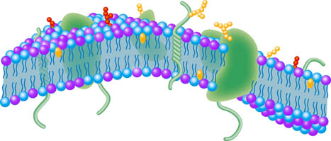
Cell Proteins and Membrane Structure
Cells and Proteins
Unit 1 Advanced Higher
Miss Aitken

Slide 2
Why are R groups important?
R groups of amino acids are very important for three reasons.
R groups determine the structure of the protein. R groups interact with each other while forming the primary, secondary and tertiary structure. In the quaternary structure, R groups from one chain may interact with R groups from another chain.

Slide 3
Why are R groups important?
R groups allow ligands to bind
A ligand is a molecule which binds to a protein.
R groups which are not involved in protein
folding will be on the outer surface of the
protein, so ligands could bind to them. Ligands
which bind may change the conformation
(shape) of a protein.

Slide 4
Why are R groups important?
R groups determine the location of the protein within a cell. The number of hydrophobic and hydrophillic R groups at the surface of a protein will determine the solubility of the protein in the cytoplasm, which is aqueous.
Remember: The cell membrane contains phospholipids which are hydrophobic.

Slide 5
Cytoplasmic Proteins
The cytoplasm is a watery (aqueous) jelly and so proteins which are found there must be soluble. This includes enzymes and G-proteins (more later).
The surface of a protein which exists in the cytoplasm should have a high proportion of hydrophillic R groups.
This is because the charges on acidic, basic and polar groups form weak interactions with the polar water groups and make them soluble.

Slide 6
Cytoplasmic Proteins
Sometimes during post-translational modification, some molecules are added (like sugar) to the outside of the protein to make it more soluble.
Hydrophobic R groups cluster at the core of the protein.

Slide 7
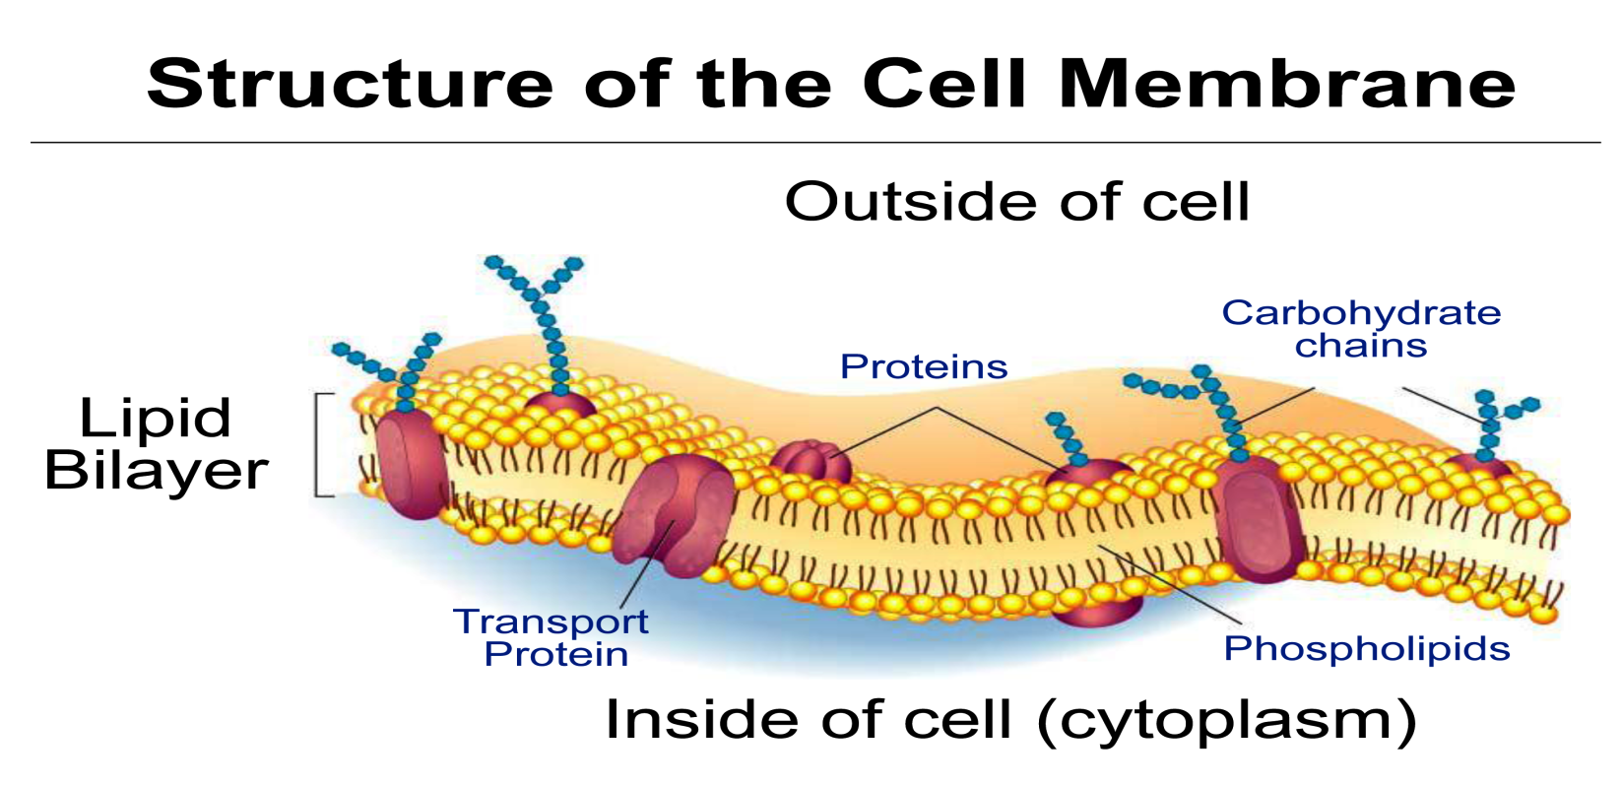
Cell Membrane
In N5, we learned that the membrane of cells is made up of a bi-layer of phospholipids with proteins embedded in the layers.
A phospholipid molecule has a hydrophilic head and a hydrophobic tail.

Slide 8
What can pass through the cell membrane?
Oxygen
Carbon dioxide
Hydrophobic signalling molecules
Thyroxine
Steroids
Only non-polar molecules can pass through the cell membrane directly.

Slide 9
What cannot pass through the cell membrane?
Charged ions
H⁺ and Na⁺
Hydrophilic amino acids
Polar molecules
Water
Glucose
These molecules can only pass through channel-forming proteins in the cell membrane.

Slide 10
Membrane Proteins
There are two types of proteins found in the cell membrane:
Integral proteins
Penetrate the hydrophobic interior and form strong hydrophobic interactions. Some only extend partly through the membrane and some are transmembrane proteins (span the width of the membrane –more later).
Peripheral proteins
Not embedded in the membrane – instead they form weak bonds to the surface of the membrane. Some peripheral proteins are attached to the cytoskeleton to give the cell shape and structure.

