Slide 1
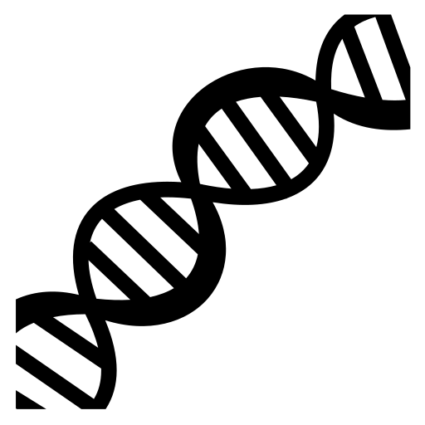
Protein Structure
Cells and Proteins
Unit 1 Advanced Higher
Miss Aitken
Textbook
P18-19

Slide 2
Protein Structure
After a polypeptide has gone through post-translational modification, it must be folded to make the final protein shape.
Polypeptides go through up to 4 levels of folding to become a protein.

Slide 3
Primary Structure
The sequence in which amino acids are arranged. This determines the function of the protein.

Slide 4
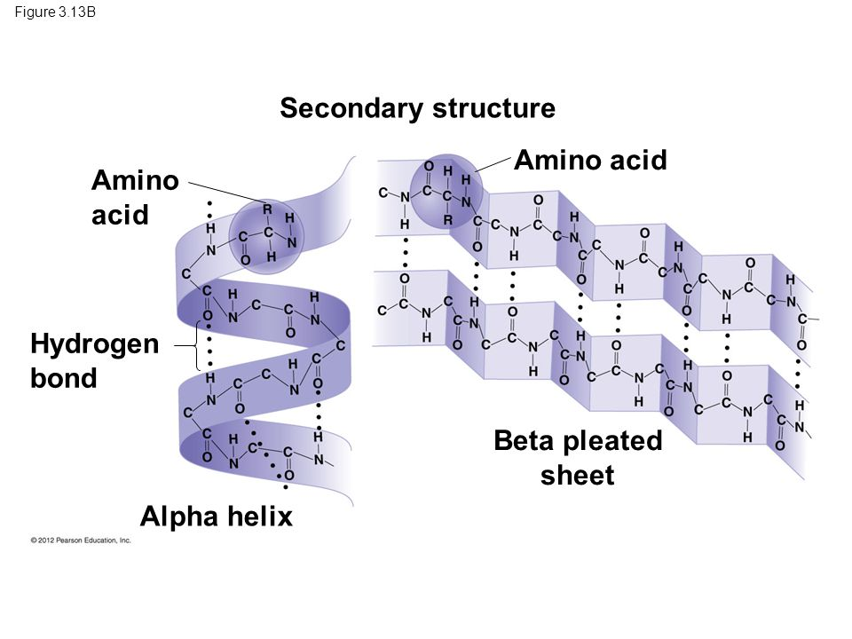
Secondary Structure
Once the primary structure is established, it can fold in two main different ways:

Slide 5
Tertiary Structure
For many proteins, the final folded shape is the tertiary structure. This is 3 dimensional and is caused by interactions between R groups of amino acids.
There are 4 types of interactions which will affect the tertiary structure:
Hydrophobic interactions
Ionic bonds
Van der Waals interactions
Disulphide bridges

Slide 6
Tertiary Structure
Tertiary structure is affected by changes in temperature and pH.
A higher temperature will cause the structure to become destablised as the chain “shakes” which breaks weak bonds.
A change in pH will affect the ionisation of the acidic and basic R groups and changes the charge they carry so they no longer bond correctly.

Slide 7
Quaternary Structure
This is where the polypeptide unit may join with other units.
Examples:
Collagen – made of 3 subunits
Haemoglobin – made of 4 subunits

Slide 8
Prosthetic Groups
A non-protein strongly bound to one or more poly peptide units within the protein.
Example:
Haemoglobin – made of 4 subunits of protein and one “haem” group – made of Iron.

