Slide 1
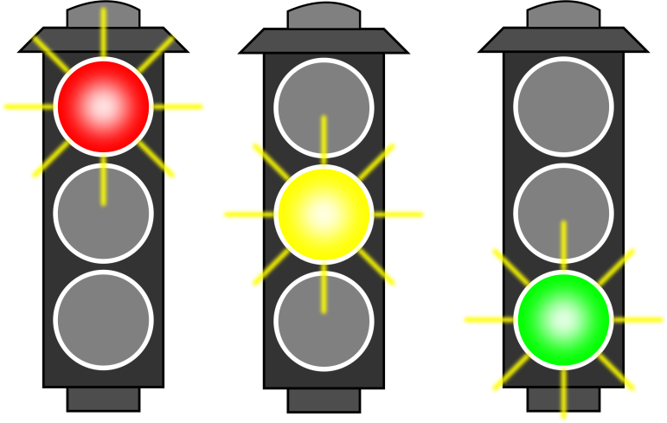
Control of the Cell Cycle
Unit 1 – Cells and Proteins
Advanced Higher Biology
Miss Aitken

Slide 2
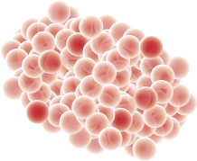
Why is controlling the cycle important?
Complex events must work perfectly to produce new daughter cells. Mutations can occur if events do not go to plan
A reduction in the rate of cell division can cause diseases like Parkinsons.
An increase in the rate of cell division may result in tumour formation which can be cancerous.

Slide 3
Cell Cycle Checkpoints
Checkpoints occur at G1, G2 and Metaphase.
G1 Checkpoint – Near the end of G1. Cell size is checked. If the cell is not the correct mass to divide into two daughter cells, it is put into a resting phase called G0.
G2 Checkpoint – Near the end of G2. DNA replication is checked. If DNA has not replicated successfully, cell will not be allowed to undergo mitosis
M checkpoint – During metaphase. Monitors chromosome alignment to check each daughter cell is receiving one chromatid from each chromosome. This controls entry to anaphase and cell will be destroyed if it doesn’t meet the criteria.

Slide 4
Cyclin-dependent Kinases
As the cell gets larger during G1, it accumulates more proteins called cyclins. These cyclin proteins combine with regulatory proteins called cyclin-dependent kinases (CDKs).
The binding of these two proteins activates the CDK, which causes phosphorylation of target proteins which stimulate the cell cycle.

Slide 5
Cyclin-dependent Kinases
The more target proteins that are phosphorylated, the more likely the cell is to meet it’s target threshold.
It must meet a certain threshold before the cell will be allowed through a checkpoint. If it does not meet the threshold, it will be held in G0 state – except in cancer cells.

Slide 6
Retinoblastoma (Rb) Proteins
Important part of the G1 checkpoint
Transcription-factor inhibitor
Required for DNA replication in S Phase
Low CDK levels = Rb binds to transcription factor E2F, stopping transcription
Result – STOP

Slide 7
Retinoblastoma (Rb) Proteins
High CDK levels – phosphorylated 14 times
No longer binds to transcription factor E2F
Transcription of genes required for S phase
Result - GO

Slide 8
p53 Proteins
Important part of the G1 checkpoint
Transcription factor which can stimulate DNA repair, trigger cell death or stop the cell cycle
If DNA damage has occurred, it can stop the cell cycle and repair the damage.
If damage is significant, it can tell cell to commit cell suicide
Result – STOP
Missing in 50% of cancer sufferers

