Slide 1
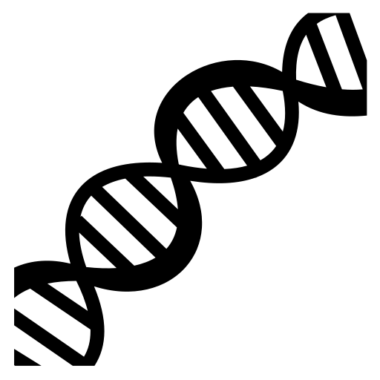
Proteomics and Amino Acids
Cells and Proteins
Unit 1 Advanced Higher
Miss Aitken
Textbook
P16-17

Slide 2
Proteomics
Genome:
complete set of DNA
Comprises of coding and non-coding areas
20-25000 genes in human genome
Proteome:
Entire set of proteins that can be expressed from a genome
250k – 1 Million proteins
Proteome is much larger than the genome

Slide 3
Why is the proteome larger than the genome?
Alternative RNA splicing:
Depending on what parts of the RNA are treated as introns or exons, different mature transcripts are produced from strands of DNA
2. Post-translational modification:
The protein made at the end of transcription and translation can be cut or combined with different molecules in different ways

Slide 4
Amino Acid Structure
Polypeptides are polymers of amino acid monomers. After post-translational modification, we can then call this polypeptide a protein.

Slide 5
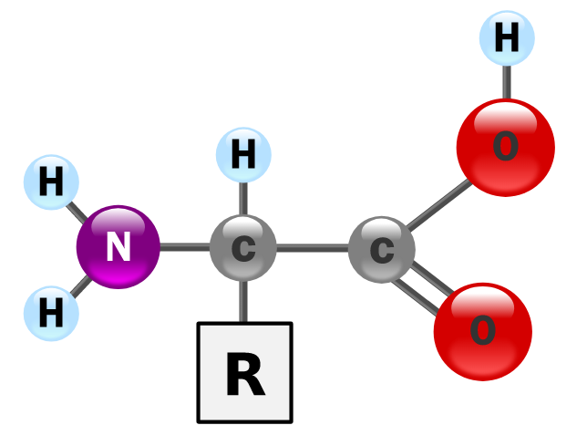
Amino Acid Structure
All amino acids have a central carbon which has 4 groups bonded to it:
An NH₂ (amine) group
A COOH (acid) group
A singular hydrogen atom
A variable R group

Slide 6
Amino Acid Structure
When in the aqueous solution of the cell, the NH₂ amine group will gain a hydrogen ion to form NH₃⁺, whilst the COOH acid group will lose a hydrogen ion to form COO⁻
That means it is upto the variable R group to decide the charge on the amino acid. This affects the way it behaves.

Slide 7
Amino Acid Groups
There are four classes of amino acids:
Acidic (negatively charged) – R group with COOH
Basic (positively charged) – R group with NH2
Polar (slightly charged, hydrophillic) - R group with OH
Hydrophobic (no charge) – R group with hydrocarbon
At Advanced Higher level you do not need to know the structure of any specific amino acids but you should be able to identify which group each amino acid falls into.

Slide 8
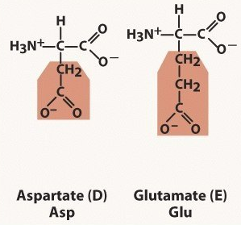
Acidic Amino Acids (COO⁻)

Slide 9
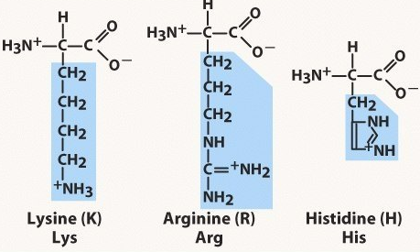
Basic Amino Acids (NH₂ /NH₃⁺)

Slide 10
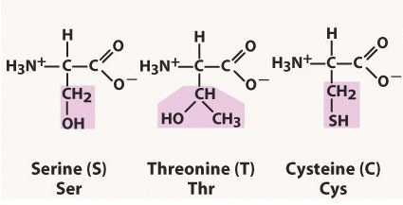
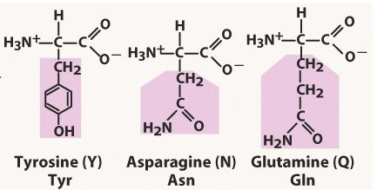
Polar Amino Acids (OH)

Slide 11
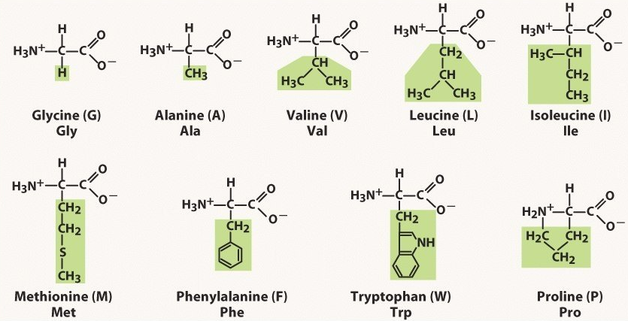
Hydrophobic Amino Acids (CH)

Slide 12
Joining Amino Acids
To join amino acids together, a condensation reaction must occur. This is controlled by an enzyme.
In this reaction, a water molecule is made by taking the OH from the COOH acid group of one amino acid and the H from the NH₂ group of the next amino acid.
The bond made (C-N) is called a peptide bond.

