Slide 1
Courtship
Unit 2: Organisms and Evolution
Advanced Higher Biology
Miss A Aitken

Slide 2
Courtship and Fixed Action Patterns
Courtship is the process of using behaviours and characteristics to attract a mate.
An increased chance of sexual reproduction can increase evolutionary fitness.
Many species show elaborate courtship displays in which a specific sign stimulus from one individual produces a fixed-action pattern response in another. This is instinctive and varies between species.

Slide 3
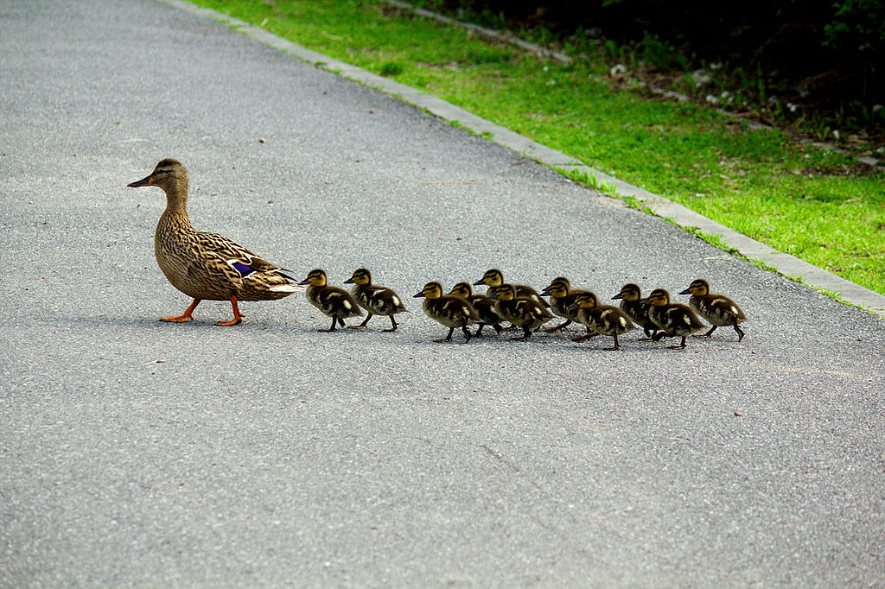
Imprinting
Imprinting is an irreversible development process that occurs during a critical time period in young animals.
This is where an animal fixates on another – often seen in newly-hatched birds who will follow their mother wherever she leads them.

Slide 4
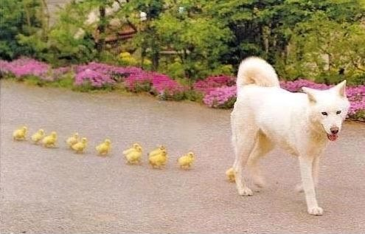
Imprinting
Imprinting forms a bond between parent and offspring, increasing their survival chances.

Slide 5
Imprinting
Imprinting can also influence mate choice later in life, as offspring may choose to breed with mates that resemble their parents.

Slide 6
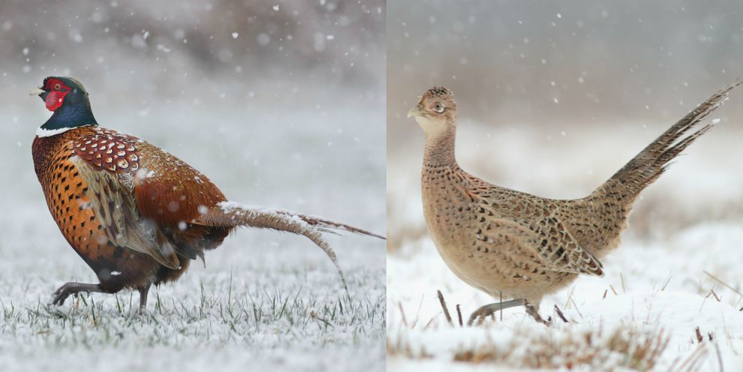
Sexual Dimorphism
Sexual dimorphism is the name given to differences in characteristics between two genders in the same species.

Slide 7
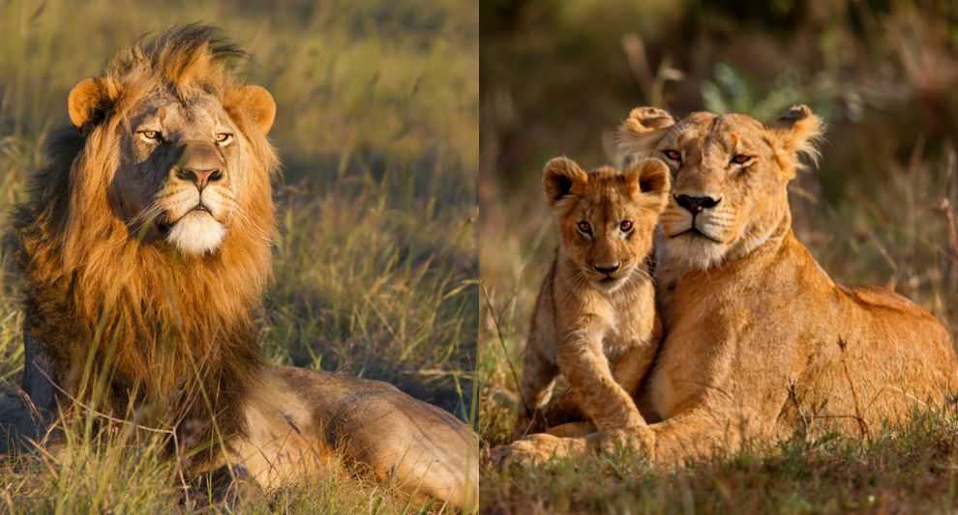

Slide 8
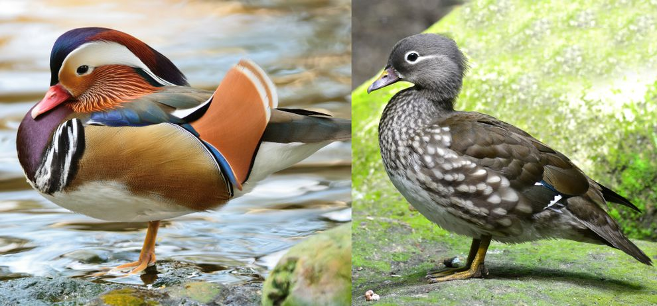

Slide 9
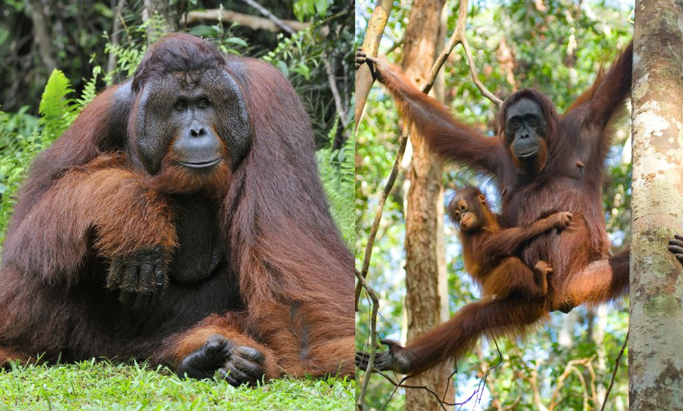

Slide 10
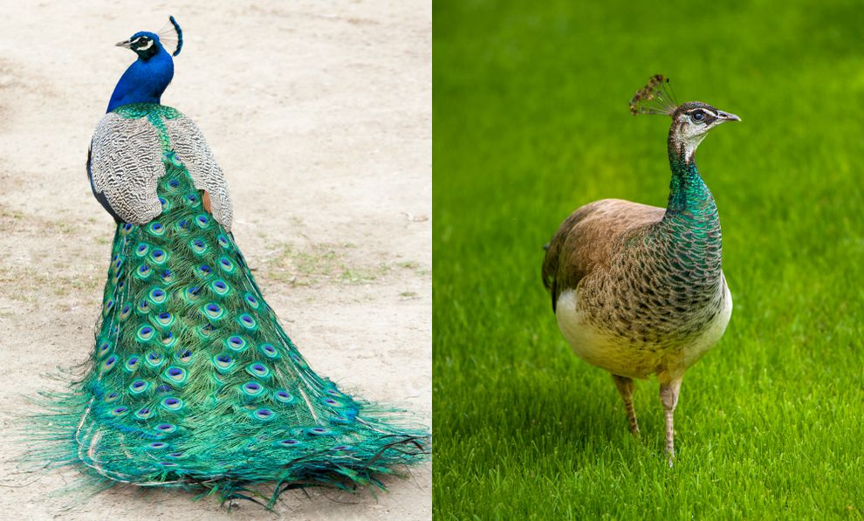

Slide 11
Sexual Dimorphism
In most cases of sexual dimorphism, the male is either larger, more heavily armoured or is more “conspicuous” – he has something extra, such as brightly coloured feathers or extra hair.
Males generally have more “outrageous” behaviours.

Slide 12
Reversed Sexual Dimorphism
Some species of birds have reversed sexual dimorphism, where the females are larger or more brightly coloured.
Males tend to be smaller and are better adapted to hunt small prey that are suitable for feeding his young chicks during breeding seasons.
Females are larger to incubate large clutches of eggs.

Slide 13
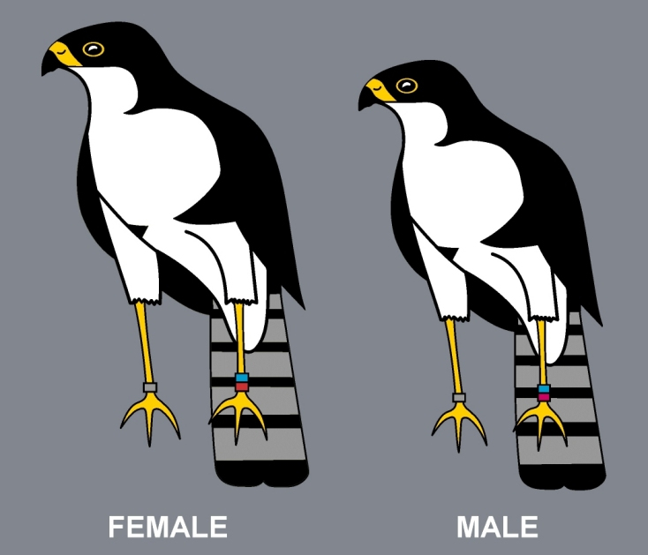

Slide 14
Male-Male Rivalry
In many species, success in competitive male-male rivalry can increase the access of males to females.
Successful males have the best weaponry. They are generally stronger and this is passed to their offspring.
Alternatively, some males are successful by acting as a sneaker. Sneakers look very similar to the female, so they can infiltrate the female group without having to fight another male.

Slide 15
Female Choice
In other species, female choice drives the evolution of different markings, structures or behaviours.
Male mating displays tend to show “honest signals”
An honest signal is a characteristic that will allow the female to assess the fitness of the male.
For example, a peahen will “assess” a peacock during his mating display – large, bright feathers will indicate that he is fit and healthy.

Slide 16
Lekking
Lekking is a communal display by groups of males.
Males will gather together in an area (the lek) and put on a display. The alpha male will be found at the centre of the lek, with satellite males around the periphery.
Females will visit the lek to assess the honest signals from the males, and will choose a mate based on the display.

