Slide 1
Sex Determination
Unit 2: Organisms and Evolution
Advanced Higher Biology
Miss A Aitken

Slide 2
How do we become male or female?
Genes (most common)
Sex can be determined by genetic factors
Environment (less common)
Sex can be determined by things going on in the environment
Temperature
Size
Competition
Parasitic Infection

Slide 3
Sex determined by genetics:
Sex Chromosomes:
In all mammals and some insects, there are chromosomes which determine the sex of the individual.
There are 23 pairs of chromosomes: 22 pairs of autosomal chromosomes and one pair of sex chromosomes.

Slide 4
Sex determined by genetics:
Sex Chromosomes in Mammals (and some others):
Females have a homologous pair of X chromosomes (XX) - homogametic
Males have one X and one much smaller Y chromosome (XY) - heterogametic
All gametes from a female are X – producing females.
50% of gametes from a male are X – producing females, and 50% are Y – producing males.
Males determine sex in mammals and some other animals.

Slide 5
Sex determined by genetics:
Sex Chromosomes in birds and reptiles:
Males have a homologous pair of Z chromosomes (ZZ) - homogametic
Females have one Z and one W chromosome (ZW) - heterogametic
All gametes from a male are Z – producing males.
50% of gametes from a female are Z – producing males, and 50% are W – producing females.
Females determine sex in birds and reptiles

Slide 6
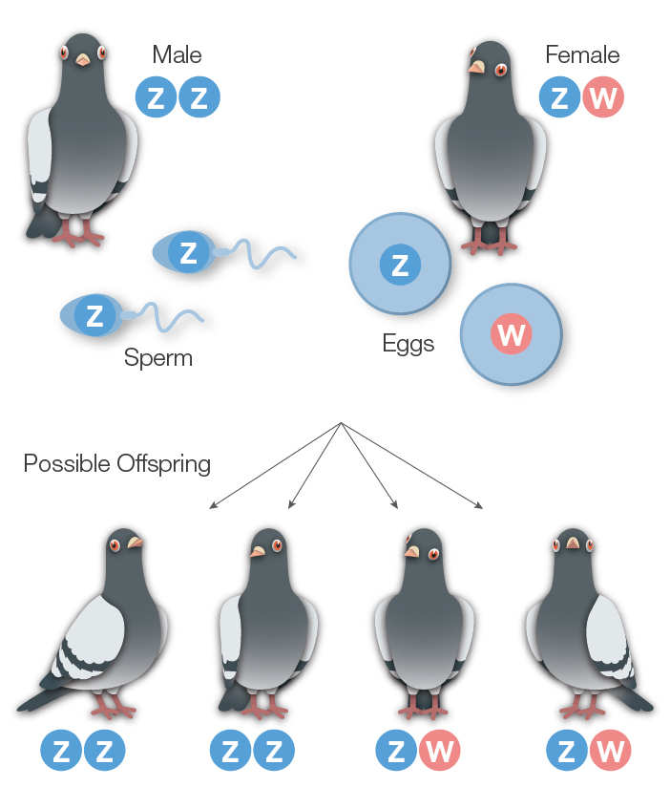

Slide 7
“Male-ness”
How do mammals become male?
All embryos start out life in a similar way.
Y chromosomes are very small and do not carry much information. A single gene on the Y chromosome called the SRY gene causes embryos to be male.
Without this, embryos are female.

Slide 8
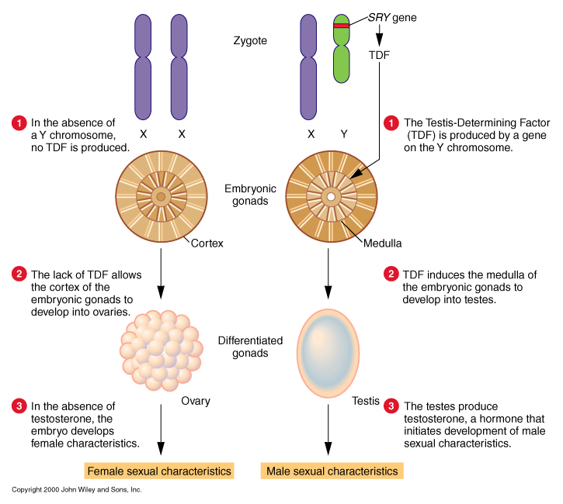
“Male-ness” – the SRY Gene
The SRY gene provides instructions for making a transcription factor called the Testis-Determining Factor (TDF).
A transcription factor is a protein that binds to specific regions of DNA and helps control the activity of particular genes.

Slide 9
Sex Linkage
As the X chromosome is much larger than the Y chromosome, it carries many more genes.
Many genes on the X chromosome do not have a homologous partner on the Y chromosome.
This leads to sex-linked patterns of inheritance, where females can either pass on a condition/trait or be a carrier for the condition/trait.

Slide 10
Sex Linkage
As the X chromosome is much larger than the Y chromosome, it carries many more genes.
Many genes on the X chromosome do not have a homologous partner on the Y chromosome.
This leads to sex-linked patterns of inheritance, where females can either pass on a condition/trait or be a carrier for the condition/trait if a dominant allele masks a recessive allele.
Males do not have the ability to be carriers – they either have the trait, or they do not.

Slide 11
X Inactivation
Male cells only have one X and female cells have two.
This initially led scientists to think that females developed a double dose of all the genes on the X chromosome. They do not.
In early female embryonic development, most of the genes on one X chromosome in each cell are inactivated, supercoiling into a structure called a Barr Body – to prevent females from getting a double dose of gene products as this could be harmful to cells.

Slide 12
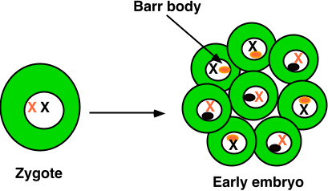
X Inactivation
X inactivation is random in each cell: there's no way to predict which of the two X chromosomes will become inactivated.

Slide 13
X Inactivation and Carriers
Carriers remain unaffected by any deleterious mutations on these X chromosomes as the X-chromosome inactivation is random, half of the cells in any tissues will have a working copy of the gene in question.

Slide 14
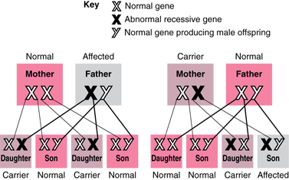

Slide 15
Tortoiseshell Cats
In cats, one of several genes controlling fur colour is located on the X chromosome.
The gene has two versions, or alleles. One form of the gene codes for orange fur (X^{B}), and the other form codes for black fur (X^{b}).
In any given cell of a heterozygous female could end up as either of the following:

Slide 16
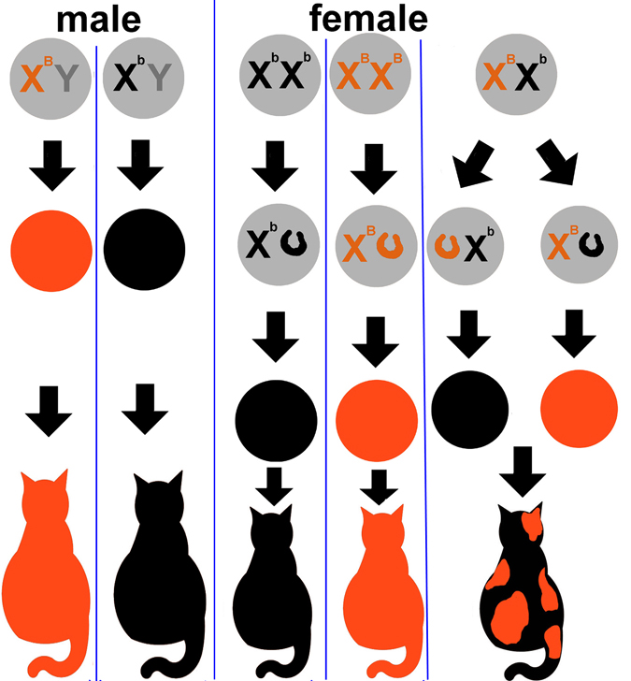

Slide 17
Environmental Factors
Temperature
Size
Competition
Parasitic Infection
Copy the table from your textbook

