Slide 1
Meiosis
Unit 2: Organisms and Evolution
Advanced Higher Biology
Miss A Aitken

Slide 2
National 5 Re-Cap
Haploid: One set of chromosomes – 23
All gametes (sex cells – sperm and egg) are haploid
Diploid: Two sets of chromosomes – 46 (or 23 pairs)
All other body cells are diploid (e.g. skin cell, muscle cell)

Slide 3
Homologous Chromosomes
The chromosomes in each “set” are homologous.
This means they are matching/the same
Same size
Same genes in the same loci (latin: place/location)
Same centromere position
Although they have the same genes in the same loci, the alleles (forms of gene) may be different.

Slide 4
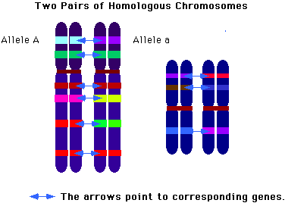

Slide 5
Sexual Reproduction
Fertilisation is the combining of two haploid nuclei of two gametes, which forms a diploid nucleus.
This combining of two haploid genomes produces a new combination of alleles and increases variation.

Slide 6
Gamete Production
Gametes are produced by meiosis in a gamete mother cell.
Meiosis happens in the interphase of the cell cycle.
During S phase, the homologous chromosomes duplicate.
Gamete mother cells are diploid cells – so after replication, there will be two sets of two chromosomes (92). Meiosis can then occur to make 4 haploid gametes with 23 chromosomes each.

Slide 7
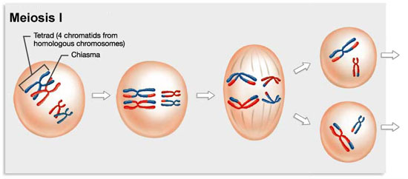
Meiosis 1
Similar pattern to mitosis
Includes crossing over and independent assortment

Slide 8
Process of Meiosis 1
Before meiosis 1, in S phase, chromosomes duplicate.
During meiosis 1, each duplicated pair lines up with their homologous partner, so that they are aligned.
Chiasmata (crossing points) form at random positions between the homologous pairs, allowing the crossing over of sections of DNA between homologous chromosomes. (more later)

Slide 9
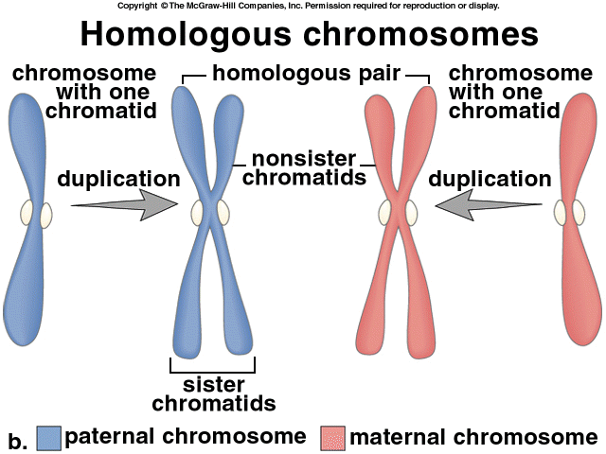

Slide 10
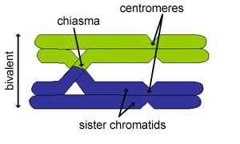
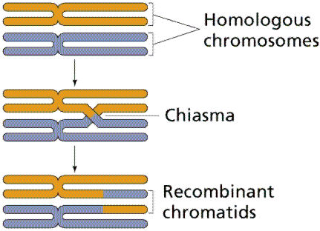

Slide 11
Process of Meiosis 1 (cont.)
Nuclear membrane then breaks down so that microtubules from the centrosomes can connect with the centromeres of the chromosomes.
The microtubules form spindle fibres linking across the cell and this aligns homologous chromosomes along the cell’s equator.
Chromosomes position themselves randomly along the equator, regardless of which parent they came from. This is called independent assortment. (more later)

Slide 12
Process of Meiosis 1 (cont.)
Microtubules of spindle fibres shorten and pull on the centromeres so the homologous chromosomes separate to opposite ends of the cell.
A nuclear membrane then forms around the chromosomes, and cytokinesis (division of cytoplasm) forms two new cells. At this point, cells are still referred to as haploid even though they have two sets of genetic information.
This is because they only have one copy of each homologous chromosome.

Slide 13
Meiosis 2
The nuclear membrane breaks down again
Microtubules are sent out from centrosomes and bind to the centromeres of each chromatid.
Spindle fibres align the chromosomes across the equator of the cell.

Slide 14
Meiosis 2 (cont.)
Microtubules shorten and pull on the chromatids, separating them to opposite ends of the cell.
Immediately after being separated, chromatids are referred to as chromosomes. This is because they can be seen separately through a microscope.
The new chromosomes group together and a nuclear membrane reforms, and cytokinesis occurs.
4 genetically different haploid cells have been produced.

Slide 15
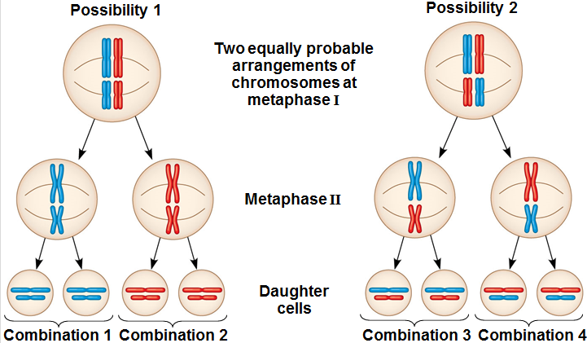
independent assortment
During meiosis I homologous chromosomes pair up along the equator of the cells in a random and independent manner.
Independent assortment results in the production of gametes with varying combinations of maternal and paternal chromosomes.

Slide 16
independent assortment
The number of different combinations produced by independent assortment can be calculated using the formula 2^{n} - where n is the haploid number.
2³ = 2x2x2 = 8

Slide 17
independent assortment
Independent assortment results in new combinations of alleles and increased variation.

Slide 18
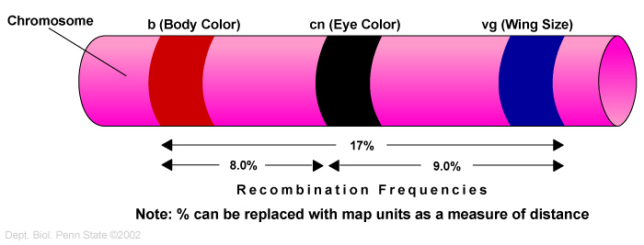
recombination frequency
The recombination frequency indicates the distance between the linked genes.

Slide 19
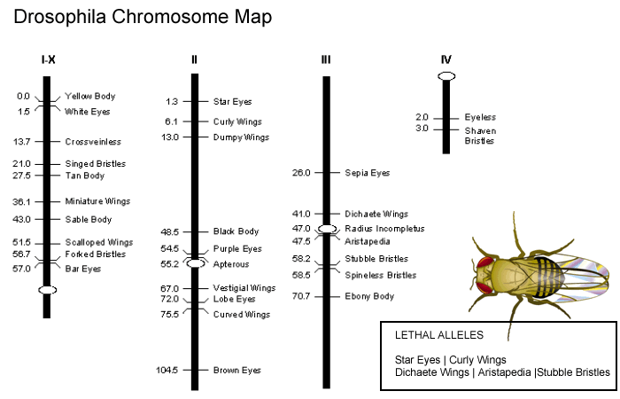
gene mapping
The recombination frequencies can be used to map the position of linked genes on a chromosome.
Bozeman – gene mapping

Slide 20
gene mapping
linked genes | % RF
BZ | 12
RZ | 7
BS | 5
BR | 5
SZ | 17
plot two genes that are furthest apart
S
Z
17
S
B
Z
5
12
S
B
R
Z
5
7

Slide 21
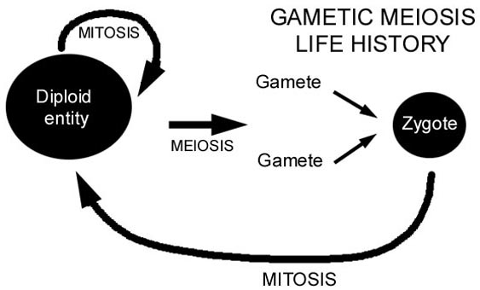
gametic meiosis
In many organisms, gametes are formed directly from the cells produced by meiosis – gametic meiosis.

Slide 22
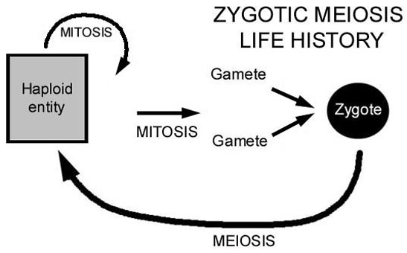
zygotic meiosis
In other groups, mitosis may occur after meiosis to form a haploid organism; gametes form later by differentiation – zygotic meiosis.

