Slide 1
Microbial Parasites
Unit 2: Organisms and Evolution
Advanced Higher Biology
Miss Aitken

Slide 2
Microbial Parasites
Most microbes are transmitted by direct contact
Only have one host species in their lifecycle
One exception: the bacteria that causes Lyme disease cannot be directly transmitted to a new host, so is transmitted by bites from a vector (tick).

Slide 3
Examples of Microbial Parasites
Tuberculosis – mycobacterium tuberculosis
Influenza
Human Immunodeficiency virus (HIV)
More details can be found on page 84 – but the mechanism of these microbial parasites was studied in Higher.

Slide 4
The “Life” of a Virus
Viruses can only replicate inside a host cell.
They are not quite “living” – they cannot carry out the basic functions of any other living organism except for reproduction, and even then, they need a host for that.

Slide 5
Virus Structure
Viruses contain DNA or RNA inside a protective coat called a capsid.
Some viruses also have an outer envelope made from part of the host-cell membrane.
The outer surface of a viral cell has proteins on it. These proteins are foreign antigens to the host.

Slide 6
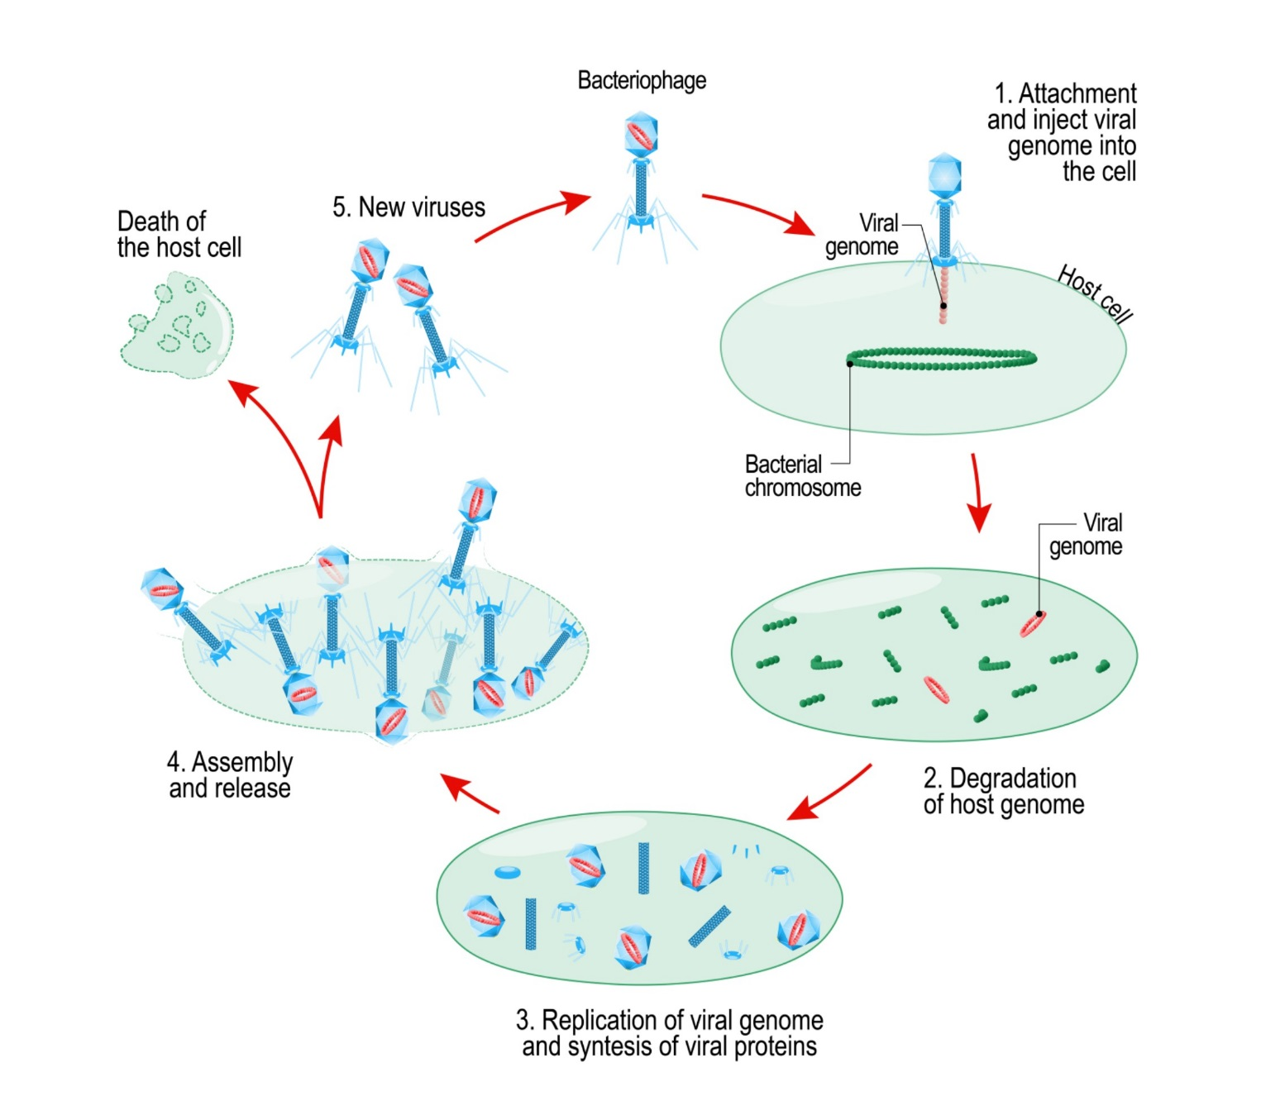
Virus Reproduction

Slide 7
Virus Reproduction
Virus antigens attach to host cell surface
Viral DNA injected into the host
Viral DNA is replicated by host enzymes
Viral genes are transcribes to RNA which is translated to make viral protein coats
New virus particles are assembled and burst out of host cell when ready.

Slide 8
Virus Reproduction
Examples of viruses with DNA:
Smallpox, herpes and chicken pox
Examples of viruses with RNA:
influenza, Ebola, hepatitis C, polio, rabies, measles
Same steps as before except in step 3, viral RNA is replicated directly using an enzyme from the virus. Viral DNA is never made.

Slide 9
RNA Retroviruses
Example: HIV
More complex process
These viruses use the enzyme reverse transcriptase to form a DNA copy of the virus genome. This DNA is then integrated into the genome of the host cell, and is replicated as part of normal cell production. That way, the virus is always going to be in host cells.
When the virus is reproducing, the DNA copy of the virus genome will be transcribed to RNA, which is then translated to make new viral proteins. These proteins and the RNA form new virus particles and these burst out of the host cell.

Slide 10
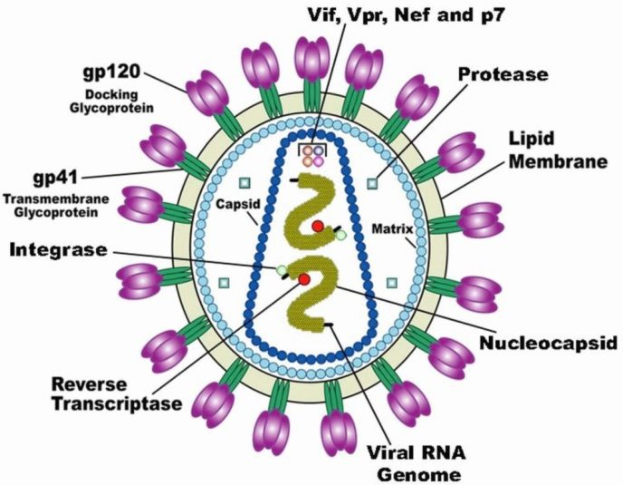

Slide 11
