Slide 1
Parasitic Lifecycles
Unit 2: Organisms and Evolution
Advanced Higher Biology
Miss Aitken

Slide 2
Types of Parasites
There are 6 main types of parasite:
Protists (e.g. Plasmodium – causes malaria)
Arthropods (ticks, lice)
Platyhelminths (e.g. tapeworm)
Nematodes (e.g. threadworm)
Viruses (e.g. HIV, Influenza)
Bacteria (e.g. tuberculosis)

Slide 3
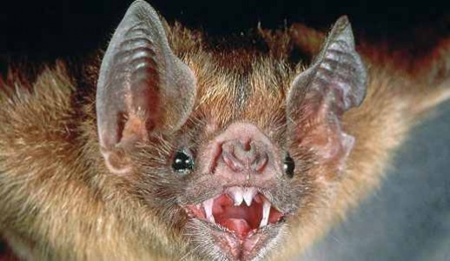
Types of Parasites
Being a parasite is such a good strategy for survival that many other groups of organisms have members that are parasites.
For example, some mammals like the vampire bat, and some fish, like the lamprey, are considered to be parasitic in their behaviour.

Slide 4
Parasites with one host
Some parasites that are in direct contact with the host can complete their lifecycle within one host species.
Human head lice go from egg through to full maturity on one host
Parasitic amoebas go from the start of their lifecycle to the finish in the large intestine of their host. Cysts are released in faeces and are found in contaminated food or water
Bacteria and viruses complete many lifecycles inside a host. When the host breathes out, the parasites are transmitted in droplets to the next host.

Slide 5
Many parasites need more than one host
Some parasites have to spend part of their lifecycle in an intermediate host to complete the next stage of their development. This improves transmission and virulence.
The eggs of the pork tapeworm are passed out from a person in the faeces and are eaten by pigs. The pig is the intermediate host. The eggs hatch and develop as cysts in the muscle tissue before being consumed by a human as pork.

Slide 6
Important Parasitic Lifecycles
The lifecycle of Plasmodium parasites
The lifecycle of Schistosoma parasites

