Slide 1
Field Techniques for Biologists
Advanced Higher Biology
Unit 2
Miss Aitken

Slide 2
Health and Safety Risks in Fieldwork
Wider range of hazards than being in a lab
Terrain (ground) – hazards associated with uneven ground must be considered
Weather conditions – even a relatively safe area can become hazardous in bad weather
Isolation – people can become isolated and injured, separated from others etc.

Slide 3
Health and Safety Risk Assessments
Risk assessments required when outside
Identify foreseeable hazards
How likely is there to be an event?
How harmful could an event be?
How can the risk be lowered?
How will this be recorded?

Slide 4
Sampling Wild Organisms
Minimise impact on animals and plants
Leave places as you find them
Rare species and vulnerable habitats must be protected and are covered by legislation (Wildlife and Countryside Act 1981)
It may be illegal to sample in some areas where animals and plants are protected by law.

Slide 5
Sampling Techniques
Point Count:
A point count is carried out from a stationary location. Gather observational data - Often used in sampling bird numbers in a population.

Slide 6
Sampling Techniques
Transect:
Used for determining changes in community across an environmental gradient.
Either a line transect or a band transect
For example, extending a line down a hill and measuring the moisture or pH level every meter, and recording changes.

Slide 7
Sampling Techniques
Remote Detection:
Carried out using satellite
Mostly used in plant sampling
Counts and measurements done from the air (sometimes from space)

Slide 8
Sampling Techniques
Quadrats:
Useful for monitoring plant population
Also useful for sessile organisms like barnacles

Slide 9
Sampling Techniques
Mobile species
Sampling a moving species is more difficult
Traps required
Nets may also be used
Animals must be released unharmed

Slide 10
Sampling Techniques
Elusive species
Some animals are very difficult to sample through normal observations
Camera traps
Scat (droppings/faeces) sampling
This provides indirect evidence

Slide 11
Life on Earth
1.5 million species have been named and described
10 million species may be living on Earth that have not yet been named
Another 1 billion species of unnamed species are extinct

Slide 12
Life on Earth
All life on Earth is related and our last common ancestor existed around 3.5 million years ago.
Scientists try to prove relations between animals by studying their DNA and comparing it.

Slide 13
Life on Earth
Identification: The ability to put a species name to a sample.
Can be done using:
classification guides,
biological keys,
by analysis of DNA or
by analysis of proteins made.

Slide 14
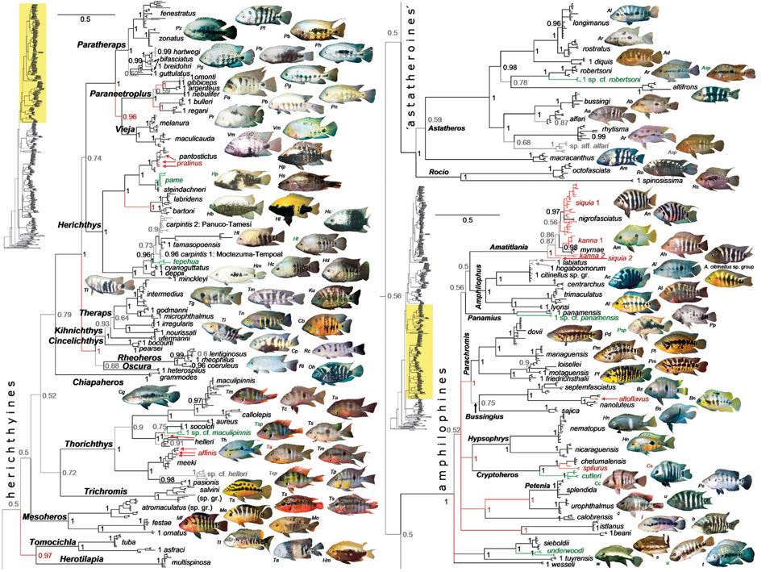
Life on Earth
Classification guides: Tend to focus on one ‘class’ of organisms from one part of the world e.g. Types of cichlid native to Africa.

Slide 15
Life on Earth
Biological Key: A series of questions posed, usually in the form of paired statements, which focus only on the features by which the organisms can be separated.

Slide 16
Life on Earth
DNA Analysis: This is a powerful technique for separating organisms that only have subtle differences.
In addition, it allows identification of organisms where only some evidence remains, for example, in fossils.

Slide 17
Taxonomy
Taxonomy is the organisation of life into a hierarchy of groups of increasingly related species. These groups are known as domains, kingdoms, phyla, classes, orders, families, genera and species.
If the taxonomic groupings are known for a particular animal, scientists can make assumptions about an organism based on its relations.

Slide 18
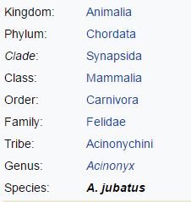
Taxonomy Example: Cheetah
Multicellular, motile
Possesses a spinal cord
Opening in the skull behind eye
Mammary glands, 3 ear bones
Meat-eating organism
Protracted claws and other characteristics which separate the family from other carnivores.
Sub-family of cats that purr
Species name

Slide 19
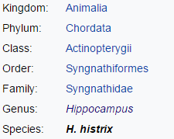
Taxonomy Example: Spiny Seahorse
Multicellular, motile
Possesses a spinal cord
Ray-finned
Narrow body, tubular mouth
Fused jaws
Upright posture, prehensile tail
Covered in thorns

Slide 20
Model Organisms
Organisms which have their entire genomes sequenced, and so can be studied in different ways:
Escherichia coli
Arabidopsis thaliana
Caenorhabditis elegans
Drosophilia melanogaster

Slide 21
Patterns of Evolution
Thousands of genetic studies have been carried out to give a more definitive picture of the ‘tree of life’.
The comparison of DNA sequences reveals that life has diverged into three domains:
Archaea
Bacteria
Eukaryota

Slide 22
Patterns of Evolution
Thousands of genetic studies have been carried out to give a more definitive picture of the ‘tree of life’.
The comparison of DNA sequences reveals that life has diverged into three domains:
Archaea
Bacteria
Eukaryota

Slide 23
Types of Evolution
Evolution can produce closely related species which look very different to one another, and distantly related species which look very similar.
Write a note on Divergent Evolution and Convergent Evolution from page 54 and 55 of the textbook.

Slide 24
Family Trees
There is overwhelming evidence to support the theory that all life is related and has evolved into the diversity we see today.
Write a note on each of the three domains from page 55 of the textbook:
Bacteria
Eukaryota
Archaea

Slide 25
The Kingdom of Eukaryota
This is the most well-known kingdom.
It can be split into 3:
Plants
Animals
Fungi

Slide 26
Divisions of Plants
The kingdom of plants can be split further into 5 main divisions. They are called:
Moss
Liverworts
Ferns
Conifers
Flowering plants
That’s all you need to know about that.

Slide 27
Divisions of Animals
The kingdom of animals can be split further into 5 main divisions called phyla. They are called:
Chordata – animals with a spinal cord
Arthropoda – animals with leg joints and segmented bodies – mostly insects and crabs
Nematoda – Round worms, mostly parasites
Platyhelminthes – Flat worms, mostly parasites
Mollusa – animals with shells

Slide 28
Indicator Species
A species which tells us about the environmental conditions in an area by it’s presence or absence, or in some cases, it’s abundance.
E.g. mayfly nymphs are only found in clean water with low pollution. Their abundance is important – if there are MANY of the insects, the water is extremely clean.

Slide 29
Methods of Marking
When monitoring populations it is helpful to identify individual organisms.
Banding - birds
Tagging – cows/whales
Surgical implant - dogs
Painting - sheep
Hair clipping – small mammals

Slide 30
Mark and Recapture
A method for estimating population size (N).
A sample of the population are captured and marked (M) and then released.
After an interval of time, a second sample is captured (C).
Some of the animals are captured twice/recaptured (R)
N = (MC)/R
Assuming all individuals have an equal chance of capture, and that no immigration or emigration has occurred.

Slide 31
Measuring and Recording Animal Behaviour
Behaviour is complex and scientists studying behaviour have to be aware of this. Most scientific studies use a reductionist approach, and break behaviour down into categories e.g.
Latency – the time between a stimulus and a response
Frequency – how often a behaviour occurs
Duration – the length of time behaviour occurs

Slide 32
Anthropomorphism
Anthropomorphism is the attribution of human motivation, characteristics or behaviour to non-human animals.
For example, saying that a fish carrying out a zig-zag dance is “confused” or “excited”.

Slide 33
Ethograms
An ethogram describes all the behaviours shown by a species in a wild context, allowing observation and recording of time spent carrying out each type of behaviour.
Behaviour | Description
Foraging | Searching for food
Feeding | Grabbing food
Cannabalism | Feeding on eggs
Escaping | Rapid swimming ahead of other fish
Courtship | Swimming slowly close to female, holding body at angle, entering nest etc
Reproduction | Laying eggs, fertilising eggs etc
Parental Care | Fanning nest with fins

