Slide 1
Creating Reports

Slide 2
Learning intentions
We are learning:
How to print database tables and queries in a report

Slide 3
Success criteria
You will understand the mechanics of creating a report
You will successfully be able to print out tables and queries
Grouping Levels, Sorting, Summary Options, Using Design View

Slide 4
When you create a query you can PRINT THIS in 2 different ways: copy and Paste onto a word document Create a REPORT You may also be asked to paste into an existing word document/powerpoint.

Slide 5
In your exam it is most likely that you will be asked to print a report and/or paste to Word/Powerpoint in the database task.

Slide 6
If the task asks for a Report specifically, then you must create a Report.

Slide 7
It is very likely that you will complete a query to use as a basis for a Report.

Slide 8
If the task does not state how this should be printed, either way is acceptable.

Slide 9
CREATING REPORTS
Use the Create tab and look out for the option for Report Wizard

Slide 10
CREATING REPORTS
Select the appropriate Table or Query you wish to make a report of…
Select from this drop down list
Add the relevant fields to the report
Click on Next

Slide 11
CREATING REPORTS
You will be asked if you want to add Grouping Levels.
Data can be Grouped using specific fields.
To do this, simply click on the field you wish to Group by.
Data can be Grouped on one or more levels (usually no more than two)

Slide 12
CREATING REPORTS
Sorts should be done in queries, but can also be done here in Reports

Slide 13
IF THE REPORT HAS BEEN GROUPED …
This Option only appears in a Grouped Report

Slide 14
Simple Calculations can be done to summarise information for a group
Select the calculations required

Slide 15
Layout of report
Good (but not essential) to choose landscape as this means that there is less formatting to be done later

Slide 16
Add a heading - block caps is good as it avoids errors with capitalisation!
INSERT HEADING IN BLOCK CAPS HERE
Click on Finish

Slide 17
YOUR REPORT IS NOW ON DISPLAY
Careful Checks now have to be conducted:
All information (Field Headings and Contents) should be visible and not clipped – adjustments should be made to ensure this is well displayed
Graphics/Logo may have to be added in and we have to ensure the image is not clipped
Delete =Now() and Page 1 of 1 information
Report Footer will have to be added in with standard footer information (Name, School and Task Name)

Slide 18
Design View
Use this option select a graphic (usually a Logo) to put in the header to the report. Clicking on this will take you to your File Management System and the correct image can be selected.

Slide 19
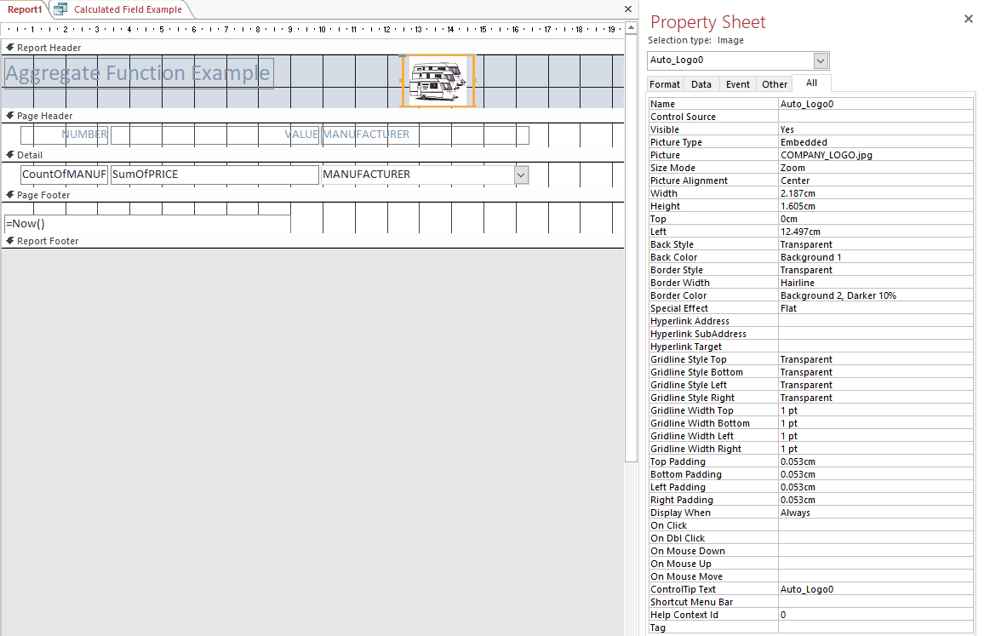
Right Click on Logo to access Properties.
Ensure Size Mode is set to Stretch or Zoom, not Clip.
Clip will clip the image and would therefore lose marks.

Slide 20
Design View
Use this option to draw a label box for your footer

Slide 21
Printing results of queries
Results of queries can be printed by copy and pasting the results to a Word document
Its better if you print them in a database report, demonstrating your knowledge of reports.
You may have to include your query results in a Word Document or in a Powerpoint presentation, so in this case your would simply open the document and paste the query results in the relevant place.

