Slide 1
Calculations in Queries

Slide 2
Learning intentions
We are learning:
How to perform a calculation using an Aggregate Function
How to perform a calculation by creating a Calculated Field

Slide 3
Success criteria
You will successfully be able to perform Aggregate Functions - SUM, AVERAGE, MAX and MIN functions
You will know how to create a new field within a query, and use existing fields to perform a variety of calculations

Slide 4
When you create a query you can perform calculations in 2 different ways: use Aggregate functions Create a calculated field

Slide 5
In your Higher exam it is most likely that you will be asked to carry out one or both of these in the database task.

Slide 6
Aggregate functions
You could be asked to use the Aggregate Function which can be recognised if you look for this icon:

Slide 7
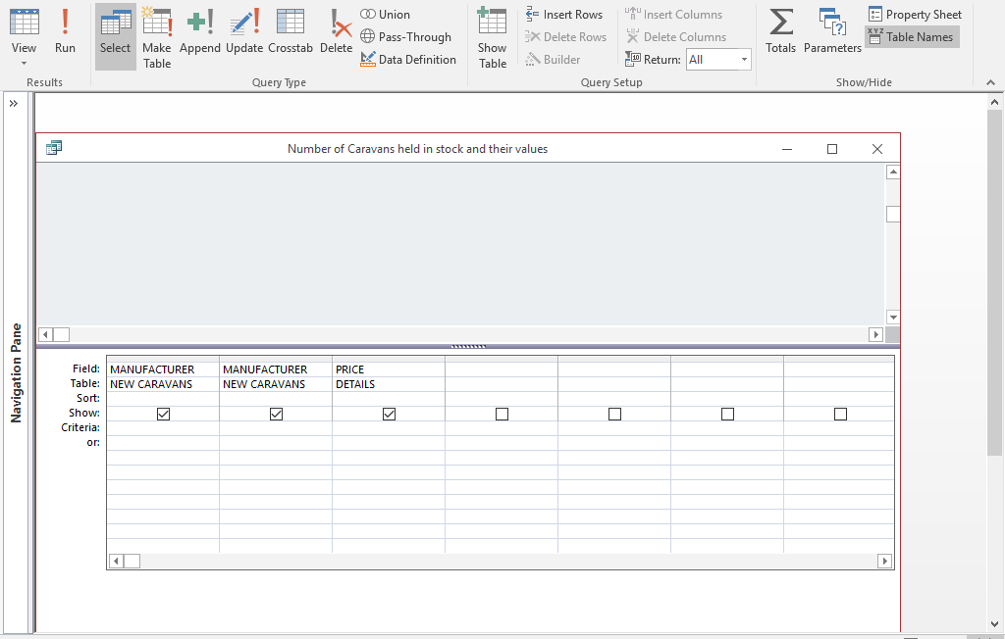
This is positioned at top right of the screen

Slide 8
AGGREGATE FUNCTIONS
When you click on this icon, this will add an extra row to your query.

Slide 9
Aggregate functions
This enables you to select the most appropriate function for the scenario you are working with. The terminology here is reminiscent of when we were working on Spreadsheets!
If you are looking for: | Aggregate Function selected
Total | SUM
Number of … | COUNT
Biggest number | MAX
Smallest number | MIN
Average | AVERAGE

Slide 10
Worked examples – TAYFORTH CARAVANS

Slide 11
Aggregate functions
We are going to have a look at the Caravan Database to see if we can:
Calculate the number of caravans held in stock from each Manufacturer
Calculate the total value of caravans held in stock from each Manufacturer
Remember to look carefully at the database tables before you start!

Slide 12
AGGREGATE FUNCTIONS

Slide 13
AGGREGATE FUNCTIONS
Steps | What you need to do:
1 | Look carefully at the table information, and look carefully at what is being asked you in the task.
2 | Add the relevant fields to the Query.
3 | Click on the
4 | See how there is an additional line added to your query which enables you to Group By:
5 | Choose the correct function from SUM, AVERAGE, COUNT, MAX or MIN.
6 | Run the Query in the usual way to check that this works

Slide 14
AGGREGATE FUNCTIONS
UNACCEPTABLE HEADING
UNACCEPTABLE HEADING
Results will look something like this!
MANUFACTURER | CountOfMANUFACTURER | SumOfPRICE
Ariada | 7 | £85,957.00
Barclay | 10 | £123,153.00
Church | 11 | £178,498.00
Kirkwood | 7 | £73,177.00
Meridian | 7 | £68,570.00
Stellar | 11 | £137,954.00
These headings can be renamed in the Properties. Keep all headings consistent!

Slide 15
AGGREGATE FUNCTIONS
You need to go back to design view of the Query and right click under the MANUFACTURER Field Heading. This will bring up the Properties box.
Click on this!

Slide 16
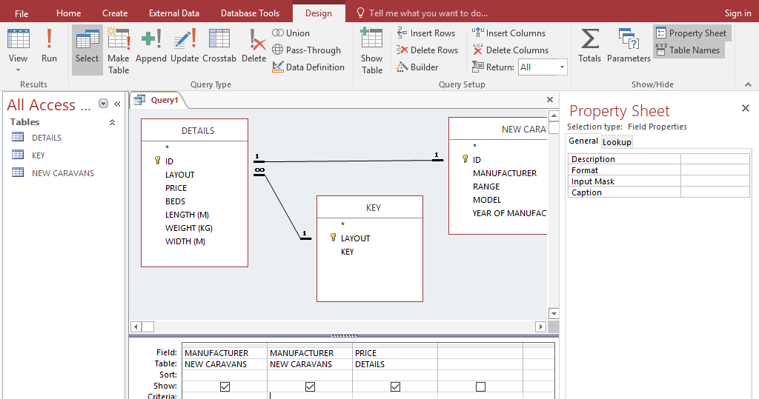
The Property Sheet appears at the right hand side, and you will see a blank Caption Box.
THIS IS WHERE YOU SHOULD ADD YOUR HEADING.
Run the query to check that it works!

Slide 17
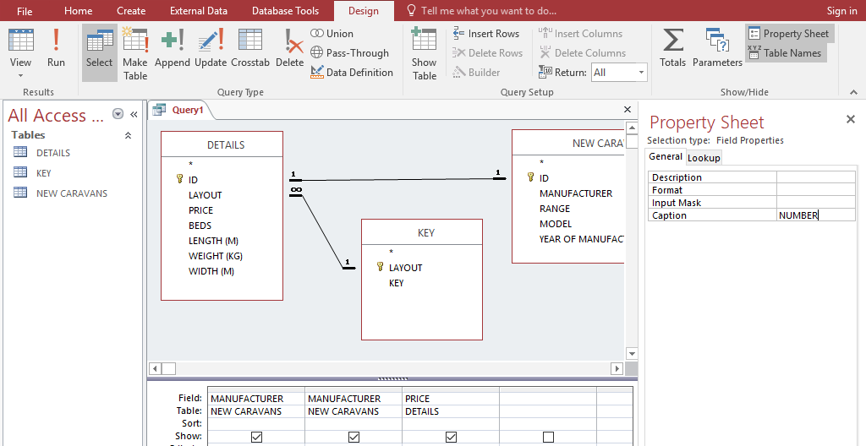

Slide 18
We now need to repeat the process for this field to add in a name that makes sense.

Slide 19
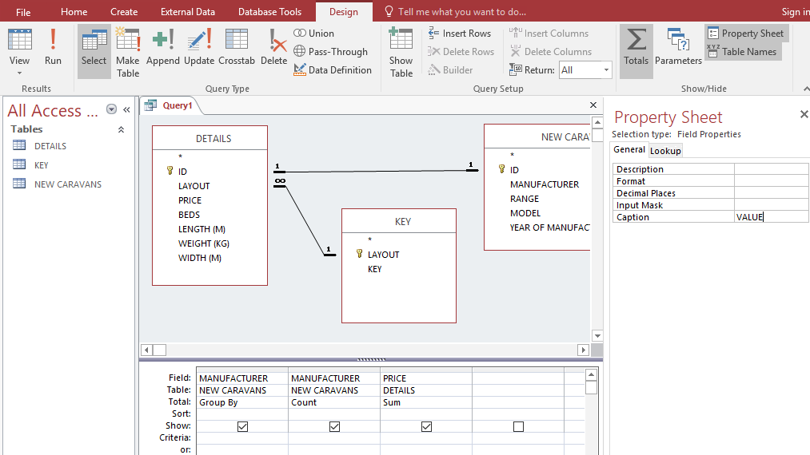

Slide 20
This is what you would would print, preferably as a report. (You could also be asked to paste into a Word Document or a Powerpoint, depending on the task).

Slide 21
Creating a calculated field
This is where you use information in existing fields to create and perform a calculation in a new field. This could be:
An increase in price using a percentage
A decrease in price using a percentage
Addition or subtraction
Multiplication or division

Slide 22
Mathematical operators for calculated fields
+
-
*
/

Slide 23
CALCULATED FIELDS

Slide 24
Calculated fields
You are going to work out a 10% discount on all 2007 Caravans in stock.
You should print this query showing Manufacturer, Model, Price, Discount Amount and Reduced Price.

Slide 25
Worked examples – TAYFORTH CARAVANS

Slide 26
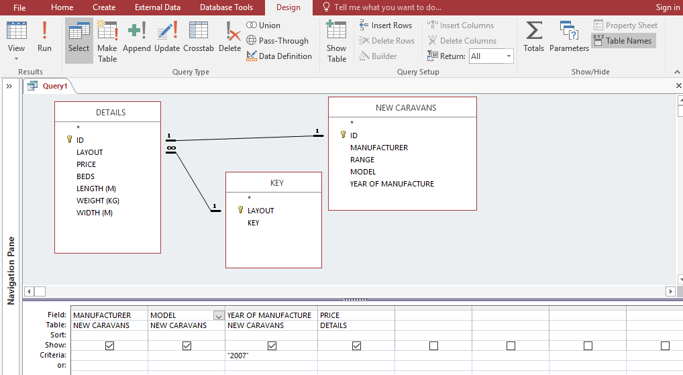

Slide 27
Calculated queries
Its now time to add in 2 Calculated Fields:
Discount Amount
Reduced Price

Slide 28
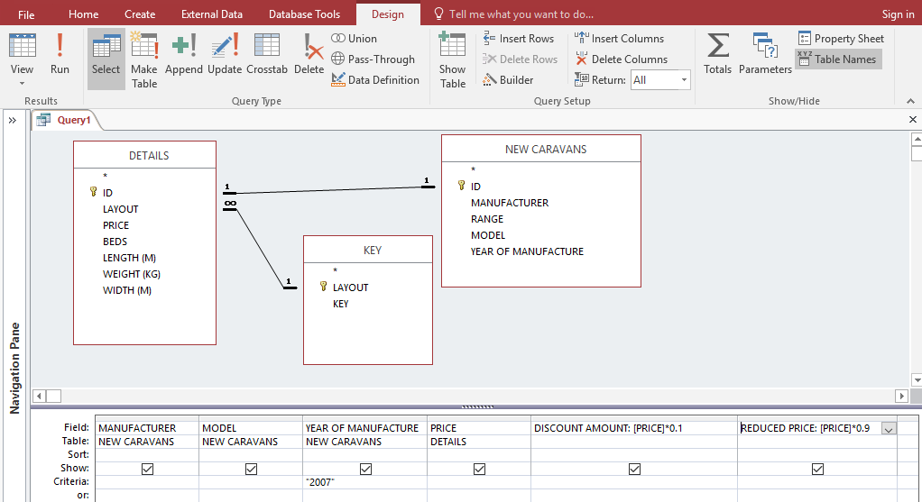

Slide 30
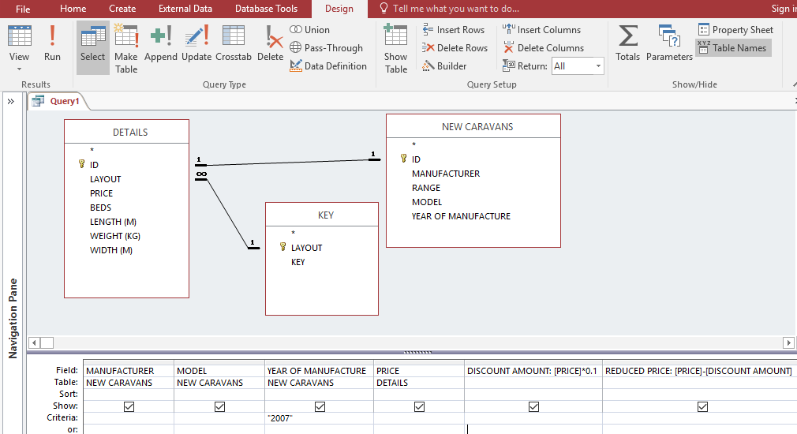

Slide 31
Run the query …
Price and Discount Amount Fields not properly formatted – all prices should be consistently formatted!

Slide 32
Calculated fields
You need to go back to design view of the Query and right click under the PRICE Field Heading. This will bring up the Properties box.
Click on this!

Slide 33
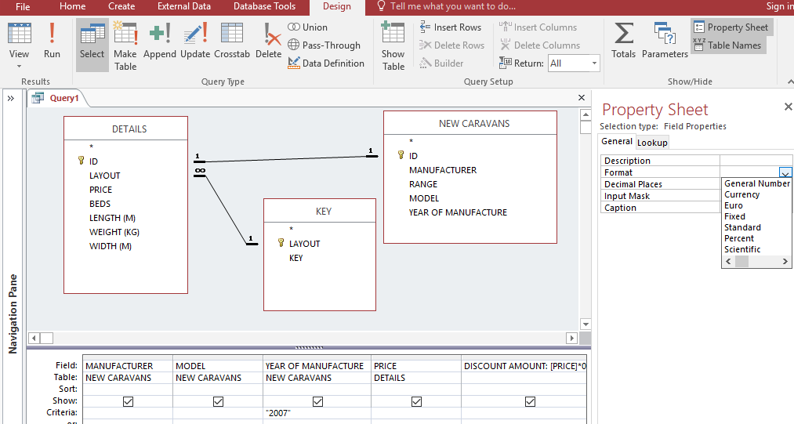
Calculated fields
Format this Field appropriately, and ensure all others are formatted appropriately

Slide 34
A NOTE ON THE Use of square brackets
These are used to tell the computer that you are doing a calculation working with an existing field.
You must remember to add [ at the start and ] at the end of the field name.
For example:
DISCOUNT AMOUNT:[PRICE]*0.1
REDUCED PRICE:[PRICE]-[DISCOUNT AMOUNT]
The Labels are here in pink – if you miss these out in the query the computer will put in a heading Expr1. You can fix this by including the label - you can also change this in the Caption if you prefer. Either way, all headings must be meaningful.

Slide 35
CALCULATED FIELDS
Steps | What you need to do:
1 | Look carefully at the table information, and look carefully at what is being asked of you in the task.
2 | Add the relevant fields to the Query.
3 | Add in a New Field on the right hand side of the query.
4 | Add a label for your field, followed by a colon!
5 | Use existing fields to make the calculation – all existing fields must be displayed within square brackets. You can only make a calculated field from existing fields.
6 | Ensure your calculation is correct using your Numeracy Skills.
6 | Run the Query in the usual way to check that this works and Caption the heading if necessary.

Slide 36
Printing results of queries
Results of queries can be printed by copy and pasting the results to a Word document
Its better if you print them in a database report, demonstrating your knowledge of reports.
You may have to include your query results in a business letter or in a Powerpoint presentation, so in this case your would simply open the document and paste the query results in the relevant place.

