Slide 1
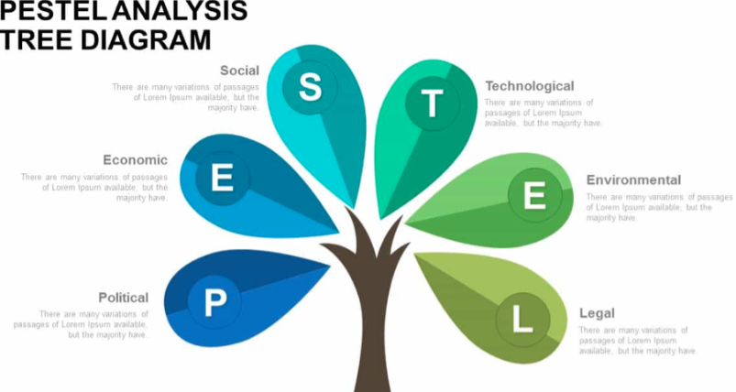
EXTERNAL FACTORS (PESTEL)

Slide 2
Learning Intentions:
In this unit you will look at the different factors and issues that can affect a business when decisions are being made

Slide 3
Success Criteria:
By the end of this unit, I will be able to:
Identify the external factors (PESTEC) that impact and influence decision-making
Explain the external factors (PESTEC) that impact and influence decision-making
List the contents of a specific Mission Statement

Slide 4
What is decision-making?
Decision-making
Takes place at all levels of an organisation
Involves choosing one option from a range of options

Slide 5
Why is decision-making important?
It helps move the business in the right direction
It determines what will happen in the future
Some examples include:
What to product to make, what price to charge, where to sell the product, who to employ, how much to pay staff, which supplier to use and so on
Making the wrong decision can have serious consequences for the business

Slide 6
Types of decisions
Strategic (Senior Manager)
Tactical (Middle Manager)
Operational (Manager)

Slide 7
Definitions
Type of Decision | Definition
Strategic | Long-term decisions that affect the overall direction of the company. They are made by managers at the highest level in the company
Tactical | Medium-term decisions that are the stepping stones to achieving strategic decisions. They are made by middle managers
Operational | Short-term decisions that impact upon an organisation on a daily basis. They are made by low level managers

Slide 8
EXTERNAL FACTORS
When decisions are being made management have to consider a range of internal and external factors
External factors are those factors ‘out-with’ an organisation that the business has NO control over and cannot influence
Note: Internal Factors will be taught at a later date

Slide 9
External factors
FACTOR | DESCRIPTION
P olitical | Actions the government takes and how this impacts on business eg, changing laws and regulations
E conomic | What is happening in the business world that impacts on how much the business can buy and sell eg, changing demand, changing taxes, changing interest rates and the impact of a recession on business (and society)
S ocial | The changing tastes and preferences of consumers eg, the changing demands of consumers with respect to fashion
T echnological | Introduction and availability of new technology. More advanced and sophisticated technology can enable the business to do new things and to change the way it operates eg, new ways to pay for what we buy

Slide 10
External factors (cont’d)
FACTOR | DESCRIPTION
E nvironmental (see case study – William Tracey Group) | Issues to do with the environment must be considered. Businesses today are required to act and behave in a much more socially responsible way. They need to be seen to promote ‘green issues’ and participate in recycling, reduce carbon emissions and other environmental practices
C ompetitive | The actions of other similar businesses in the marketplace. The decisions that are being made by competitors have an impact upon the decisions made by a company. If a competitor changes its price or product, this needs to be considered in the decision-making process

Slide 11
ACTIVITY:
In pairs, find out about PESTEL factors. Make notes in your jotter.
Then in groups of 4, choose 2 factors from the list below and investigate how these factors could impact upon a specific business
Political | Social | Environmental
Economic | Technological | Competitive

Slide 12
Case Study
The William Tracey Group, based in
Linwood (Paisley), is now the leading recycling company in the UK. However, it began his life as a skip hire company and has changed the way that it operates to meet customer demand and keep up with the changing external business environment.

Slide 13
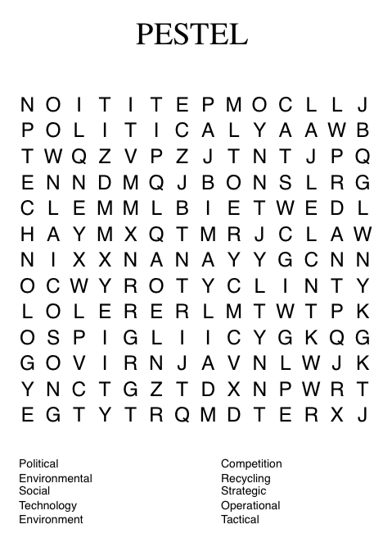
Activities
Access www.williamtraceygroup.com and make a list of all the different activities it is now involved in.
Design a poster to represent these activities.
Now write a paragraph to include as many of these words as possible!

Slide 14
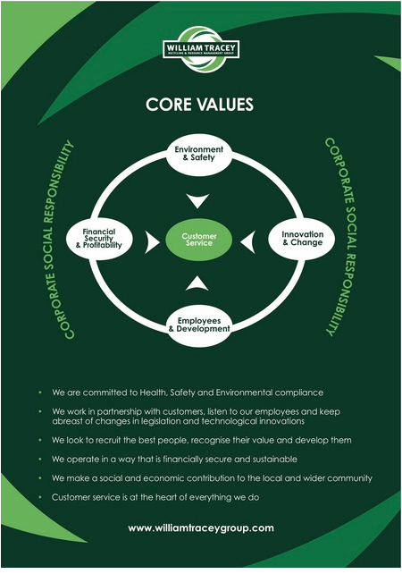
On a Mission …
Find out about the William Tracey Group’s Mission Statement and produce a report to be emailed to all STAKEHOLDERS with brief details of the content of this statement.

Slide 15
PESTEL recap questions: Produce a Report that answers the following questions:
Identify the external factors (PESTEC) that impact and influence decision-making
Explain the external factors (PESTEC) that impact and influence decision-making
You can choose a software of your choice or produce a Mind Map or Poster.
NOTE: It must cover the questions listed.

