Slide 1
Emerging Technologies
Administration & IT

Slide 2
Learning Intentions:
You learning intentions are:
Understand why organisations need to communicate with employees/customers and suppliers.
Understand the factors taken into consideration when choosing a method of communication.
Understand what emerging technologies mean.
Identify the different types of emerging technologies and when to use them.

Slide 3
Success Criteria:
You success criteria are to:
Be able to explain why organisations need to communicate with employees/customers and suppliers.
Be able to describe the factors taken into consideration when choosing a method of communication.
Be able to explain what emerging technologies mean.
Be able to identify the different types of emerging technologies and when to use them.

Slide 4
Communication
An organisations ability to communicate information to the right people at the right time is vital for an organisation to succeed.
Effective communication will allow an organisation to meet its targets and send the correct message it wants.
An Administrative Assistant will also need to decide what technology to use to communicate effectively with fellow employees, suppliers and customers; examples of effective communication include giving the correct phone messages to employees, sending out the correct price lists or directions to customers or suppliers.

Slide 5
How do we communicate?
Face to Face
Telephone
Meetings – with PowerPoint
Electronically

Slide 6
What factors decide how we communicate?
Who we are communicating with
Time available
Technology available
The number of people we are communicating with

Slide 7
What are modern forms of communication?

Slide 8
Emerging Technologies
The emerging technologies that can be used by organisations and what we will be learning about are:
Emails
E-diary
Websites
Texting
Blogs
Discussion groups and forums

Slide 9
Communication
The technology that is decided upon will depend on what is being communicated and why.
The choice of technology that can be used is wide varying, with established technology already in use (like the Internet and websites)and emerging technologies which are technologies that are new, creative and allows you to communicate in different ways.

Slide 10
Emerging Technologies
The emerging technologies that can be used by organisations and what we will be learning about are:
Instant messaging
Podcasts/Vodcasts
Twitter
Facebook
LinkedIn
Virtual Learning Environments (VLEs)

Slide 11
Choosing a Method of Communication:
When communicating with customers, clients and employees it is important that the correct method of communication is used:
Is it appropriate? Will all intended recipients receive the information?
Is it the most cost effective
How quickly is the information required?

Slide 12
Choosing a Method of Communication:
As you learn about the different emerging technologies, you have to decide:
Why each one is being used and what the benefits are of using that particular technology.

Slide 13
Task 1:
Complete task 1 in your jotters.

Slide 14
Emails:
Emails are commonplace and they can be sent and received while at your desk or if you are on the move via your laptop and smartphone. The advantages of using email is that you can:
You can get instant replies to your email.
You can send attachments for people to view.
You can send group emails, allowing for more than one person to view your email – good for making decisions.

Slide 15
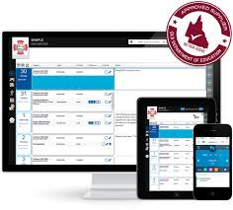
E-diary
E-diaries are used by organisations to check on employee’s availability so that they are able to participate in meetings and events for the organisation.
E-diary will allow the Administrative Assistant to book times and alert the employees when the meeting will take place and how long it will be.
It also helps to cut down on double booking employees for meetings/events.

Slide 16
Website:
Many organisations will have their own website.
They will use this to communicate with customers – promoting their products with pictures, product details (size, colour etc) and customer reviews – to encourage people to buy the product or use the service.
Many organisations have an e-commerce facility on their website, which allows customers to purchase products online.
Organisations will also use their website to keep (potential) customers informed of special offers etc.
There will also be a feedback page, where customers can have their say on the organisation and its product or service.

Slide 17
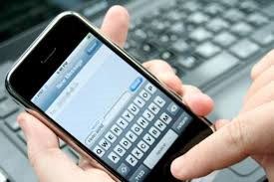
Texting:
One of the easiest ways of staying in touch with employees and customers/clients is to text them messages. This is easily done because everyone uses a mobile phone.
It is also good to get instant replies to a question or decision that is needed.
Other advantages of texting are:
You can send a question to more than one person.
It is cheap and easy to use.
A person can access the question anywhere and at any time.
It is available 24 hours a day.

Slide 18
Task 2:
Complete task 2 in your jotters.

Slide 19
Social Media
Social media is a way of communicating to other people via your computer, allowing you to exchange pictures, information, ideas, opinions etc.
Social media is becoming more popular with businesses as a way to communicate with customers and potential customers.
This will include blogs, forums, podcasts, the use of Facebook, Twitter and instant messaging.

Slide 20
Social Media
The advantages of a business using social media are:
It allows a person/business to get in touch with people quickly.
Customers/visitors/suppliers and staff can stay in touch with business.
Files can be sent to clients, suppliers for them to view
Businesses can monitor competition and see what they are doing
Businesses can keep up with what’s going on in the world, in case it affects them.

Slide 21
Blogs
Blogs are setup on the Internet by individuals who wish to communicate their thoughts and opinions on a particular topic; there are blogs on virtually anything you can think of – photography, business education, recipes, personal diaries, hobbies etc.
Blogs can bring people from around the world who share similar interests together to share ideas make friends and even do business together.
Businesses will monitor blogs, if they are set up for their products/services, to see what people are thinking.

Slide 22
Discussion Groups and Forums:
A discussion group is an online forum for individuals to discuss topics of interest.
Posters add their comment, which others can read and then respond to.
It is an informal and voluntary way to exchange ideas and information and keeps people up-to-date on topics of interest.
Businesses will monitor discussion groups/forums, if they are set up for their products/services, to see what people are thinking.

Slide 23
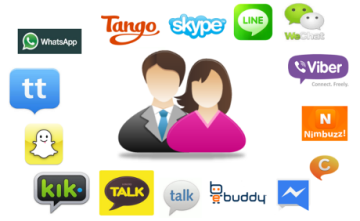
Instant Messaging:
Instant Messaging (IM) is a way of communicating in real time (instantly).
You can send IMs to anyone who is online at the same time, and you can reply immediately to messages sent to you, and so on.
Two or more people can join in a ‘conversation’ at the same time.
IMs can be used to have a quick conversation between colleagues working on the same project in different areas of the office.
Instant messaging is not a secure method of communication.

Slide 24
Podcasts and Vodcasts:
Podcasting/vodcasting is an audio/visual file which can be downloaded to a computer or mobile device (such as a smartphone or tablet).
It means that people can listen or watch at a time that is convenient to them.
Businesses can send videos on demonstrations or speeches to employees, clients and customers.

Slide 25
Twitter:
An information network that connects people to the latest stories, ideas, opinions and news.
Individuals choose to ‘follow’ whoever interests them, whether this is an individual, business, news outlet etc.
Businesses can use Twitter to quickly share information about their products and services.
It also allows a ‘conversation’ between the follower and the business about a product/service, which can then be ‘re-tweeted’ to many more potential customers.

Slide 26
Facebook:
A social networking site that lets you connect with friends, co-workers, and others who share similar interests or who have common backgrounds.
Businesses use these services as it gives them direct access to customers and potential customers.
They will be able to use Facebook to monitor what customers think about their products/services and look for new customers to sell to.
They can also use Facebook to monitor what customers think about their products/services and look for new customers to sell to.

Slide 27
LinkedIn:
Is a business version of Facebook – it connects individuals with people they know on a professional basis.
It allows the user to see other people’s business contacts and to ask for introductions in order to do business with them.

Slide 28
Virtual Learning Environments (VLEs):
Use the Internet to allow remote access to learning materials, for example notes, tasks, homework, tests etc.
Students can either work through the materials at their own pace before submitting to the ‘teacher’ for checking and tracking, or they can participate while a teacher conducts a live class – communicating through a microphone, chat rights, or by writing on the ‘board’.
Edmodo is a VLE that you may have used in school.

Slide 29
Virtual Learning Environments (VLEs):
It may also be used to:
advertise products and job vacancies (perhaps using social media)
e-commerce – selling online 24/7 (or buying from suppliers)
contacting customers/suppliers via email
web conferencing – face to face discussions eg using software such as Skype

Slide 30
Task 3:
Complete task 3 in your jotters.

