Slide 1
Prelim Prep
National 5

Slide 2
General advice:
Read the question: decide whether it’s a type 1 or type 2 question.
This helps you work out whether you need to give evidence (quote) or not
Look at the number of marks available to decide how much to write.
Always use bullet points.
Remember, when it says ‘use of language’ it is normally looking for a quotation and you should be thinking WISTS
Also, if the question says ‘HOW’ it normally needs a quote too

Slide 3

Summary

Slide 4
Summary Questions
These type of questions require you to summarise sections of the passage or to summarise the writer’s points.
To summarise is to select the main points from the passage which show the writer’s main ideas.
Again, you will probably be prompted to use your own words for this type of question.

Slide 5
How to Answer
Use bullet points
Do not repeat the question
No need to write in full sentences
The number of points you make should equal the number of marks the question is worth
A tip is to underline or highlight the main parts of the passage
Use your own words if prompted

Slide 6
Example Question
Dynamo grew up moving around some of Bradford's most deprived housing estates. He has three half-siblings, but they are much younger, so he spent much of his childhood as an only child, or a ‘lonely child’ as he puts it. He moved in with his grandparents (actually his great-grandparents) when he was sixteen.
His great-grandfather Ken was a Second World War veteran who had learned tricks in the navy. He died earlier this year, but lived long enough to see his great-grandson well on his way to becoming a magic superstar. ‘The First thing he ever showed me was how to take away the bullies’ strength,’ he says. The trick he learned- he still uses it today, once to baffle the heavyweight boxer David Haye- makes him impossible to physically pick up.
Rumour spread around the school that he has superpowers. ‘At the beginning, people thought I was weird, but slowly it got to the point where people wanted to see me do things. Magic,’ he says, ‘gave me the power to bring people to me. It gave me an edge, something to make me unique. The only reason I stood out before was being the smallest kid in school. This made me different, but in that way it was positive.
Using your own words, sum up the main points about Dynamo’s childhood in England. (4 marks)

Slide 7
Example Answer
He lived in a poor area
He lived with his grandparents
His grandfather taught him magic tricks
He used magic to stop being bullied and to help him attract friends

Slide 8
Word choice
Word choice questions will ask you about the words a writer has chosen.
A writer will always think carefully about the words they use and will use words which carry with them certain associations or suggestions to get you to feel a certain way and to agree with their point of view.
They will use powerful/ emotive/ descriptive words to suggest something to you.

Slide 9
Word Choice
You must quote the effective word that the writer has chosen. Look for an emotive/ descriptive word.
You then must list the connotations of the word (all the other words which you associate with the word). List as many as you can.
Look carefully at the number of marks the question is worth for an idea of how many words to pick out.
Take each word at a time to explore its connotations.

Slide 10
Formula
“QUOTE WORD” has connotations of ___________
This suggests.... (answer the question)
(Repeat this for every word you choose)

Slide 11

Link
Link question

Slide 12
Link Questions
These types of questions may ask you:
How one paragraph links to another OR
How one sentence acts as a link OR
How effective the writer has been in structuring his/her points.

Slide 13
How to Answer
Writers think carefully about how they structure their ideas and points and they aim for their writing to flow smoothly from one point to the next.
To link their points together they often use linking sentences or paragraphs to refer back to what they have previously written and to also refer forward to what they go on to write about.
To answer this type of question we have to follow 4 steps:
Quote the part of the linking phrase which refers back
Explain what topic/ idea/ argument it refers back to
Quote the part of the linking phrase which refers forward
Explain what topic/ idea/ argument it refers forward to

Slide 14
Example Question
Like its predecessors, One Direction has been compared to the Beatles, mostly owing to its remarkable chart success. But the comparison is misleading. In a way that was not possible fifteen years ago, let alone 50, tweens had access, via the internet, to the fresh faces of Harry Styles, Louis Tomlinson, Niall Horan, Zayn Malik and Liam Payne for months before their band’s album release. “We have to laugh it off because the Beatles were iconic,” Payne demurred once, slightly too accurately, when asked by Australia’s Sunday Telegraph about the resemblance.
The internet isn’t the only change. The nineties cohort of boy bands performed in music that was rooted in American R&B. In contrast, One Direction and other chart topping bands are evenly split between guitar-heavy pop rock and club beats. This makes for a dramatic stylistic shift. ‘We’re five lads in a band,’ Payne said. ‘Boy bands aren’t all about dancing and being structured and wearing the same clothes.’
Look at the sentence highlighted in bold. Explain as fully as you can, any TWO ways this works well as a link. (2)

Slide 15
Sentence Structure and Punctuation

Slide 16

Sentence Structure/ Punctuation
Sentence Structure questions ask you to comment on the way a sentence has been put together. Writers will use a variety of sentence structures or punctuation for effect. It’s up to you to work out what the effect is.
Writers may use:
Long/ short sentences
Lists
Repetition
Punctuation

Slide 17
Long/ Short Sentences
Writers will vary the length of the sentences for a variety of reasons.
Long Sentences: can show the length of something, that something can go on and on or that the writer has much to say on the issue.
Short Sentences: think BAD!
Blunt
Abrupt
Dismissive
Writers will use short sentences to be blunt and direct about an issue or to be abrupt and straight to the point or to be dismissive of all other opinions or arguments surrounding the topic.

Slide 18
Lists
Writers will use lists to emphasise the number or range of something.
For example:
“Smoking is the main cause of many serious illnesses: cancer, heart disease, stoke, respiratory disease and blood clots.”

Slide 19
Repetition
Repetition is when a writer repeats a word or a phrase to reinforce their point.
Example:
“We must educate our youth to the dangers of smoking. We must increase cigarette prices to deter people from smoking. We must put pressure on our government to ban smoking altogether.”

Slide 20
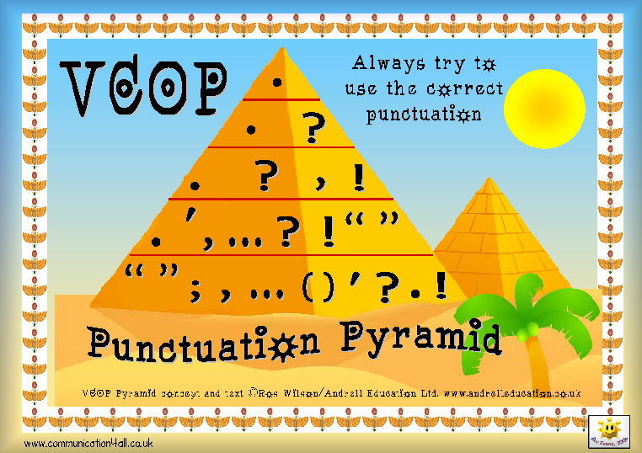
Punctuation
Semi-colon
Colon
Ellipsis
Exclamation mark
Question mark
Dash
Parenthesis
Inverted commas

Slide 21
Semi-Colon ;
Semi-colons are used to connect two sentences that are very close in content
or to divide up a list of phrases rather than single words.
E.g. Susan enjoys football; Caroline does not.
E.g. Being a teenager ain’t no fun at all: hormones going crazy; pimples and sweaty palms at all the wrong times; the guy you fancy is stuck on the girl in the short skirt; and, to top it all off, working in the chippy for the minimum wage still isn’t going to get you to Ibiza with all your mates next summer.

Slide 22
Colon:
Colons are used to introduce. They can introduce one of the following:
an elaboration
an explanation of the words that go before it
a list
a quotation
National 5 English requires many skills: dedication, commitment, perseverance and – if all that fails - a lot of dosh to bribe the examiner!

Slide 23
Ellipsis …
Ellipsis shows that something is unfinished.
The writer may choose to leave something unfinished to:
Allow the reader to think for themselves what could happen next
Show that they could go on and on but won’t
That there are other options that could be considered

Slide 24
Exclamation Mark !
Exclamation marks are used to show emotion.
This could be: anger, excitement, outrage, shock.

Slide 25
Question Mark ?
Question marks are used to ask a question- obviously!
However, writers use questions for a variety of reasons.
Rhetorical questions: to allow the reader to contemplate an issue
Series of Questions: to show confusion/ different alternatives/ different ways of thinking

Slide 26
Dash -
A writer may use a dash to:
Add to a sentence
Expand on an idea
Explain a previous point

Slide 27
Parenthesis ( ) - - , ,
This is when a writer uses a pair brackets, dashes or commas to add something to the sentence.
Sometimes we are being given additional information but often we are being told the writer’s attitude.
Parenthesis can often change or contribute to TONE.
Example:
I have heard Romantics claim that love is ‘a many splendid thing’ (yeah, right – only in the movies after a liposuction and mucho airbrushing), so who am I to disagree?

Slide 28
Inverted Commas “ ”
Inverted commas (Note: now we are ‘grown up’, we do not call them ‘speech marks’)
These are used to show:
speech
title of something
Quotations
as a way for the writer to show his or her disapproval or, need to distance himself from, a particular word or phrase.
For instance, an opponent of the BNP may refer to them as a “political party” – the inverted commas to leave the reader in no doubt of his opinion that they should not be afforded that status at all.

Slide 29
How to Answer
Name the feature as specifically as possible (for example: by quoting the word repeated or by mentioning the line where the semi-colon is)
Explain the job of the feature in the passage
ADVICE: always try and explain thoroughly WHY the writer has used the feature (what they are trying to achieve by using the feature)

Slide 30
Formulae for Common Answers
List
The writer uses a list of (what?) to show the number/ range of (what?). This suggests that (what is the writer trying to achieve by showing the number/range?)
Parenthesis
The writer uses parenthesis to add extra information about (what?). The writer adds this to (what is the writer trying to achieve by adding this extra information?)
Repetition
The writer repeats the word (quote word) to reinforce his point that (what point is he trying to reinforce and why?)

Slide 31
Example Question
The fitness culture is everywhere. Think about how often we run into sweaty bodies in lycra- some decidedly unappealing in this most unforgiving of materials- when trying to negotiate our way home from work. Think of the number of times fit young men and women look out at us from media advertising exhorting us to buy such-and-such a health-giving product. Think of the times we look sadly at our expanding waistlines and begin to wonder if perhaps it is not too late to do something about it. In an unhappy mood, such reflections are depressing; in a hopeful mood they are downright dangerous.
Explain two ways the writer uses sentence structure to emphasise our obsession with fitness (4)

Slide 32
Answer
The writer uses parenthesis to convey his own opinion that people look stupid wearing lycra.
This suggests that those people who are not fit and do not have perfect bodies are attempting to fit in to the fitness culture even if they look ridiculous.
The writer repeats the phrase “think about” to reinforce his point that if we took the time to properly think about it we could easily see that the fitness culture is everywhere.

Slide 33
One to Try
We were in Dracula's castle - sited on the remote Tihuta mountain pass where the Victorian Gothic novelist Bram Stoker based the home of his fictitious vampire - two days' carriage ride from Bistrita in northern Transylvania. It wasn't the real Dracula's castle but Hotel Castel Dracula, a three-star hotel built in the mountains to service some of the nearby, ski slopes. The architecture (1980s mock castle) reflected the Dracula movies but the setting amid the dramatic scenery of the Tihuta pass is stunning. The 'castle' is circled by bats every night and the surrounding forests have more wild bears and wolves than anywhere else in Europe.
How does the writer use sentence structure/ punctuation to show that the castle is not authentic? (4)

Slide 34
Answer
The writer uses parenthesis to add extra information about where the hotel is situated.
This shows that it is located somewhere that has been chosen based on a fiction novel suggesting that it is a hotel to attract fans of Dracula instead of a being a real historical castle.
The word ‘castle’ is in inverted commas to suggest that the writer doesn’t think it affords the status of a real castle as it is only a hotel.

Slide 35

Imagery

Slide 36
Imagery
Writer’s will often use imagery to persuade you.
Imagery is when a writer uses either a simile, personification or a metaphor (usually a metaphor) to put an image/picture of something in your mind.
Imagery questions will ask you about an image the writer has used and why the writer has used this image.

Slide 37
Literal/ Metaphorical
When answering an imagery question you must state what the image actually is (literal meaning).
You then must explain how the writer is using this image to make a point (metaphorical meaning)

Slide 38
How to Answer
Quote the image (unless the question has already identified the image for you)
Explain the literal meaning of the image
Explain how the writer uses this image metaphorically to make a point.

Slide 39
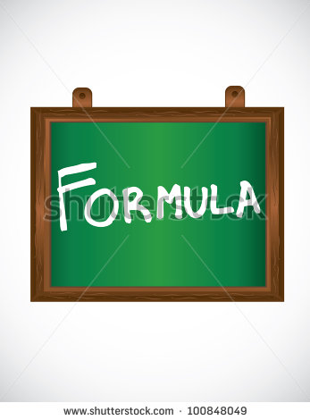
Formula
Just as a “QUOTE IMAGE” is a _____________ (literal)
So the writer suggests_________ (metaphorical)

Slide 40
Example Question
I understand parents who worry that a tidal wave of media is washing over their children if they are using an iPad and a variety of apps every night instead of reading a book at bedtime.
How effective do you find the words ‘tidal wave’ as an image to illustrate parents’ fear of the media? (3)

Slide 41
Example Answer
Just as a ‘tidal wave’ is a large powerful and destructive wave which is uncontrollable, so the writer argues that parents can feel that the media influence can be overwhelming and destructive to children.

Slide 42
Two to Try!
I have been thinking about this because I recently moved flat which for me meant boxing and heaving several Everests of books, accumulated obsessively since I was a kid. Ask me to throw away a book and I begin shaking and insist that I just couldn’t bear to part company with it, no matter how unlikely it is I will ever read (say) a 1000 page biography of little known Portuguese dictator Antonio Salazar. As I stack my books high and watch my friends get buried in landslides of novels, it stuck me that this scene might be incomprehensible a generation from now. The book- the physical paper book- is being circled by a shoal of sharks, with sales down 9% this year alone. It’s being chewed by the e-book. It’s being gored by the death of the book shop and the library.
Question 1:
Choose one of the images the writer uses to make clear the number of books that he has and explain why this is effective (2)
Question 2:
Choose one of the images the writer uses to make clear the threat to the paper book and explain why this is effective (2)

Slide 43
Answer
Q1:
Just as ‘Everest’ is a large mountain, so the writer argues that his books could pile very high if stacked as he has an enormous number of books.
Q2
Just as a ‘shoal of sharks’ is a group of predatory fish who would be looking for prey to kill and eat, so the writer argues that paper books are being destroyed and becoming fewer because of the E book.

