Slide 1
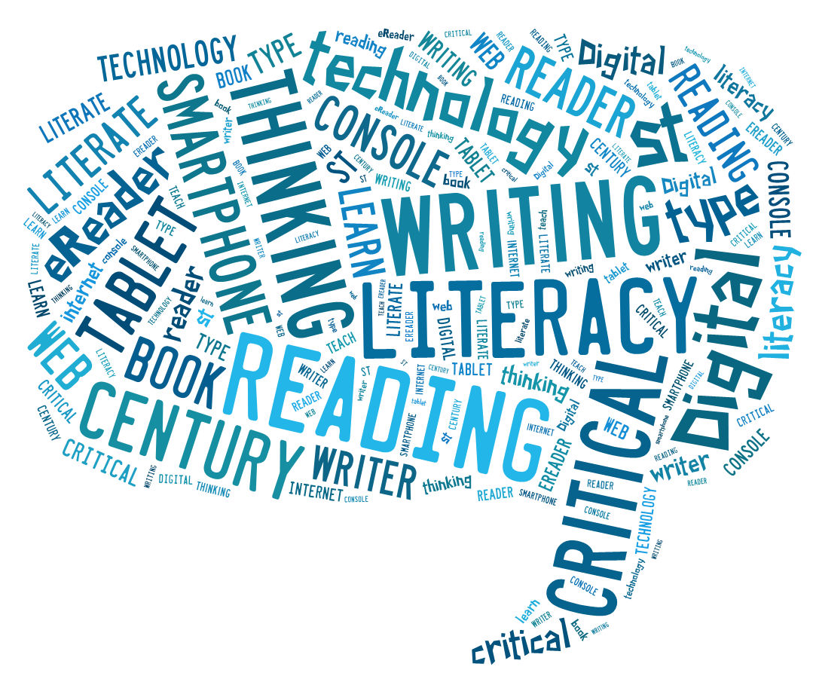
Boclair Academy

Slide 2
Literacy - Reading
- Writing
Speaking and Listening

Slide 3
Reading for pleasure is the single most important indicator of a child’s future success.
– OECD research

Slide 4
Reading for pleasure
Important to make the distinction between work and fun!
Day trips - Aye Write! Festival/ Edinburgh BF/ Mitchell Library / Book Week Scotland/ Glasgow Women’s Library/ Scottish Storytelling Centre
Environment – making reading special!
Modeling
Libraries
Practical – link books to activities you do
Technology – ipad/ phone/ audiobooks/ online resources
Variety of texts – newspapers/ graphic novels/ travel brochures/ websites

Slide 5
Children who write for pleasure achieve significantly better results in the classroom… Those who like writing outside of class are 7 times more likely to write above the expected level for their age
– National Literacy Trust

Slide 6
Writing
Chris Evans BBC 500 word Short Story Comp
Book week Scotland/ Scottish Book Trust
Blogging – hobbies and interests
Diary - health and well being
IntoFilm – Review films
Shopping lists/ Thanks you/ Christmas cards
Home language - Scots and dialect

Slide 7
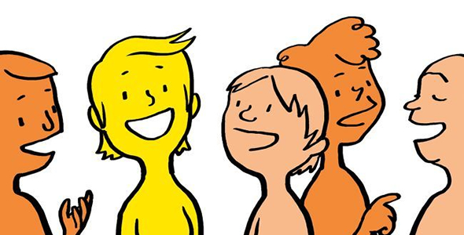
Communication is fundamental to children’s development; children need to be able to understand and be understood. Communication is the foundation of relationships and is essential for learning, play and social interaction.
– Communication Trust

Slide 8
Speaking and Listening
At home – debate/predictions
Board games night– Taboo/ Negotiation/ Team games
Day trips - Escape Rooms/ Cinema Theatre
Down time from the internet!

Slide 9
Websites http://scottishbooktrust.com https://literacytrust.org.uk http://www.scottishstorytellingcentre.co.uk www.ayewrite.com https://www.edbookfest.co.uk https://www.intofilm.org Literacy Blog https://blogs.glowscotland.org.uk/ed/boclairlearningblog/ “Once you learn to read you will forever be free” U.S. anti slavery campaigner Frederick Douglass

